Slide 1
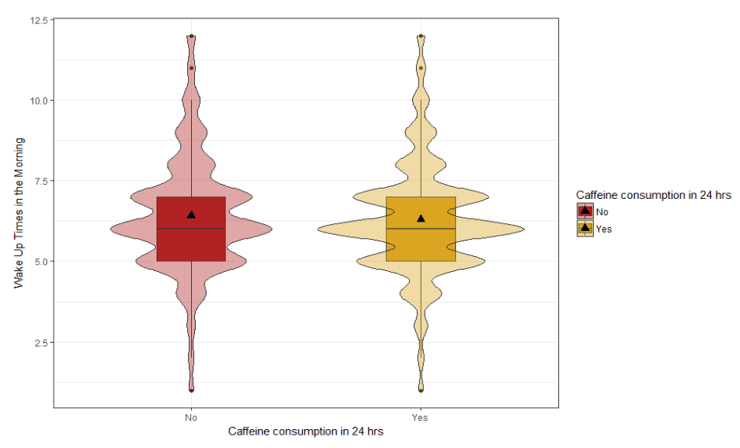
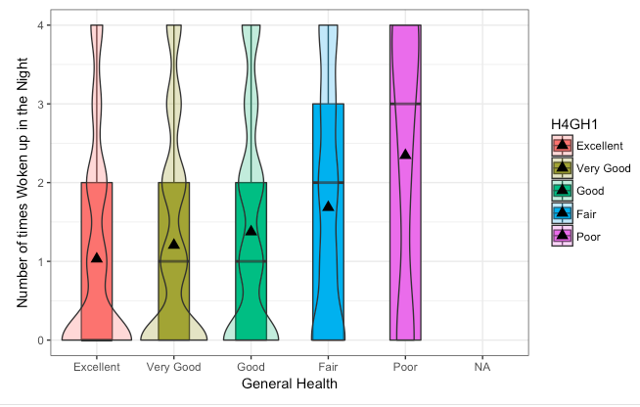


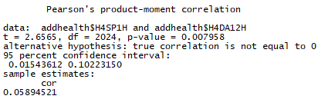
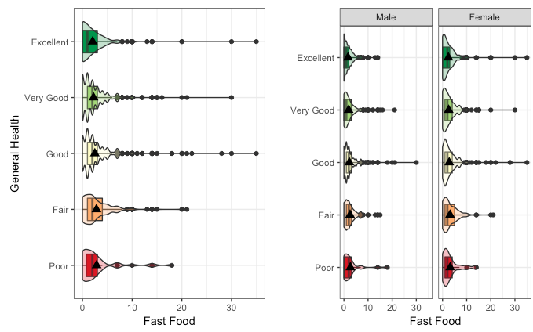
Observing and Analyzing the Correlation Between an individual’s General Health and Sleep Patterns
Linda Rodriguez and Tara McColm
California State University Chico – Math 315
Abstract
Results
Results
Conclusion
Is there a relationship between an individual’s general health and overall sleep quality? Sleep is an essential part of an individual’ life, in order to ensure a higher quality of overall health. Lack of sleep is known to have effects on an individual’s ability to perform daily functions. The team hypothesized that individuals categorized as “Healthy” would ultimately show greater sleep quality than compared to individuals categorized as “Unhealthy”. This research will be providing possible factors that may contribute to sleep patterns. Specifically, the purpose of this research is to identify correlations between general health and sleep patterns/quality. This project includes the analyzation of several variables, within the sections of General Health and Sleeping Patterns, provided by the Add Health Wave 4 in the Home Interview Code Book. To achieve this, the team conducted multiple analyses of different variables and observed the significance of certain variables in relation to the team’s hypothesis.
Figure 1: The graph above shows the relationship between caffeine consumption and times woken up in the morning.
The team observed the relationship between caffeine consumption and times woken up in the morning. As shown in the Figure 1, there is a relationship between the two variables. What is shown is that the individuals whom said they had consumed caffeine in the last 24 hours woke up more often earlier in the morning than those who said they did not. The densities of the graph are different in that individuals who did not drink caffeine during the day had the hours individuals woke up more spread out than those who did. Individuals who drank caffeine in the past 24 hours have a higher density around times ranging from am to 7:30am.
Our findings with this graphs suggests that caffeine consumption does relate to specific sleep patterns. More individuals wake up early in the morning when consumed caffeine during the day past 24 hours.
Figure 2. The graph above displays a conducted analyses of a moderator variable. This involved running an ANOVA test on three variables collected from Add Health Wave 4 Code Book.
The team observed if the relationship between two variables could potentially be dependent on a third(the moderator). The selected variables included: General Health as the Categorical explanatory variable, Fast Food as the Quantitative response variable, and Gender as the Categorical Potential Moderator. Ultimately the team examined if gender influenced the relationship between fast food consumption per week and an individual's personal view of health.
Does the distribution of fast food consumption compared to general health differ among males and females? The team found significant evidence between the original ANOVA and the stratified ANOVA. Specifically, females were found to have a higher fast food consumption mean for each general health category when compared to males.
Figure 3. The graph above displays the distribution of responses between the number of times an individual wakes up within each general health category.
The variables chosen for this graph were General Health as the categorical explanatory variable and Times Woken Up as the quantitative response variable. Based on the graph, the team observed that the individuals with "Fair" and "Poor" health rates tend to show slightly higher frequencies of waking up in the night compared to individuals with "Good" to "Excellent". This supports our claims that individuals considered “Unhealthy” tend to have lower quality of sleep when compared to those considered “Healthy”.
Table 1: The table above shows a correlation between the last hour participating in vigorous physical activity (H4DA12H) and the time of wake up in the morning (H4SP1H).
The team was interested in observing if there was a correlation between the last hours participating in vigorous physical activity in the last 24 hours and sleep quality. A correlation test was made and the results did show a slight correlation between the two variables. The results showed a p-value of 0.0079 and a correlation value of approximately 0.0589 therefore showing a slight correlation between the two. Participating in vigorous physical activity in the last 24 hours does have an affect on sleep quality.
After conducting a series of analysis, several relationships were observed between an individual's general health habits and quality of sleep. Certain factors like caffeine consumption and fast food consumption have shown to have an affect towards an individual’s sleep quality. Other factors such as how much physical activity is performed during the day and an individual's general health can also contribute to sleep patterns and sleep quality.
People can often disregard and overlook just how general health can relate to their quality of sleep. Lack of sleep and poor health have shown to have a direct relationship with each. Based on the team’s results, there was significant evidence to support the claim that there is a correlation between general health and an individual’s sleep quality. The team was successful in finding significant evidence for supporting the main hypothesis, that “Healthy” respondents have a higher quality of sleep than those considered “Unhealthy”. Our collected results could potentially serve researchers information on how to monitor and/or analyze the correlation between an individual’s general health and their overall quality of sleep.
Methods
The data that was used in this research was obtained and provided by the Add Health Wave 4 in the Home Interview Code Book. This data was collected through a survey in which individuals were asked several questions about general health and sleeping patterns. The team conducted research in order to observe whether or not there is a significant correlation between the two.
Several variables were examined from the survey in order to support the team’s hypothesis. Some of these variables included caffeine consumption, the amount of times woken up, and view of general health. The team tested and analyzed such variables, using different graphics and conducting specific tests, with the intention of observing any relationships/correlations between the selected variables. These variables were analyzed by using bar charts, histograms, and other graphics in order to describe the relationships of the chosen sample data sets.
References
St-Onge, M., Mikic, A., & Pietrolungo, C. (2016). Effects of Diet on Sleep Quality. Europe PMC.
Chaput, J. (2014). Sleep patterns, diet quality and energy balance. Physiology & Behavior, 134, 86-91.
Crispim, C. A., Zimberg, I. Z., Reis, B. G., Diniz, R. M., Tufik, S., & Mello, M. T. (2011). Relationship between Food Intake and Sleep Pattern in Healthy Individuals. Journal of Clinical Sleep Medicine.

