Slide 1
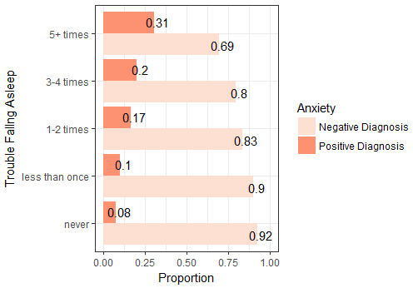
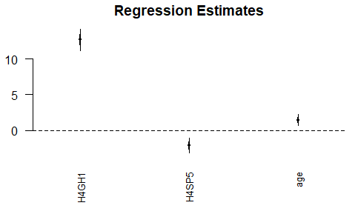
The Association Between Quality of Sleep and General Health
Rudy, R., Coia, V.
California State University, Chico
Fall 2017 Math 315-02
Introduction
Results
Sample Characteristics
Implications
Sleep is a vital process our bodies need in order to maintain well being. Not only does a lack of sleep cause us to feel exhausted and unable to properly function throughout the day, it affects our mood as well. Everyone has experienced being in a bad mood after not sleeping enough, the amount of sleep one gets has been proven to affect their mood often times negatively until they get more sleep. Sleep however may be affecting us even greater than just a bad mood, a lack of sleep specifically could be detrimental to our actual health.
Sleep allows the brain to function properly by regaining all the energy to process normally. This is specifically important for students who spend all day at school, all night doing homework, then sleeping very little and doing it all over again. It has been proven that students who sleep the recommended 8+ hours do better on tests, have an easier time focusing in class, and get overall better grades. Sleep deprivation has been linked to substantially deteriorated performance as opposed to enough sleep (Chua, 2017).
The research hypothesis for this experiment is there is an association between quality of sleep and general health.
Characteristic | Mean | Standard Deviation | N (%)
Female |  |  | 51.6% Female
Age | 29 years | 2 years
Weight | 182.8 lbs. | +/- 46.1 lbs.
General Health |  | 19.1% Excellent Health 1.1% Poor Health
Trouble Falling Asleep |  |  | 34.5% Trouble Falling Asleep 65.5% No Trouble Falling Asleep
Anxiety Diagnosis |  |  | 17.2% Positive Diagnosis 82.8 % Negative Diagnosis
If this research question proves a significant relationship between quality of sleep and general health, this furthers the relationship and can help us understand why one who has trouble falling asleep may be struggling with other everyday health aspects. This can be used to help those with general health issues improve their quality of sleep as a response to these specific issues.
One may want to further research what specific general health issues sleep quality affects, rather than general health overall. The possibilities range from disease, to weight, to attitudes and personality behaviors.
Figure 1.
We can conclude there is an association between anxiety diagnosis and trouble falling asleep (X2=218.8, df=4, p-value<.0001). The test statistics(Chi-Square) are significant and the proportion of anxiety diagnosis does significantly differ between pairs of anxiety diagnosis and trouble falling asleep.
References
Ashrafioun, L., Bonar, E., & Conner, K. R. (2016). Health attitudes and suicidal ideation among university students. Journal Of American College Health, 64(3), 256-260. doi:10.1080/07448481.2015.1081911
Chua, E. C., Fang, E., & Gooley, J. J. (2017). Effects of total sleep deprivation on divided attention performance. Plos ONE, 12(11), 1-11. doi:10.1371/journal.pone.0187098
Culnan, E., Holliday, S. B., Daly, B. P., Aggarwal, R., & Kloss, J. D. (2013). Insufficient Sleep and Weight Status in High School Students: Should We Be Focusing on the Extremes?. Children's Health Care, 42(2), 99-115. doi:10.1080/02739615.2013.786551
WINTER, W. C. (2017). The Sleep-Weight Connection. Better Nutrition, 79(10), 56.
Methods
Table 1. Depicts statistics of sample characteristics used within this research. Means and standard deviations provided where necessary.
The data set used for this research was the National Longitudinal Study of Adolescent to Adult Health (Add Health) data set, specifically wave IV.
The specific variables chosen for this experiment were trouble falling asleep, which was made into a binary variable, and general health. Each numerical value was labeled for both variables.
Variables within similar categories were also used including anxiety which was made into a binary, as well as missing variables removed.
Chi- Square test using two binary categorical variables
Potential moderators tested were trouble staying asleep, high blood pressure, and health limitations
Potential Confounders tested were HBP, high cholesterol, and general health.
No potential moderators nor confounders were found to be significant after running ANOVAs and multiple linear regressions.
Conclusion
Based on our bivariate graphical results we are able to conclude that there is a relationship between trouble falling asleep and anxiety diagnosis. For Sleep and Anxiety X-squared = 218.78, df = 4, p-value < .0001. The test statistics were significant and the proportion of each diagnosis did significantly differ between pairs of diagnosis and trouble falling asleep. Our research hypothesis, stating that there is an association between quality of sleep and general health was supported here.
Figure 1.
Multivariate plot observing the effects of age and trouble falling asleep along with the relationship between weight and general health. (H4GH1 corresponds to general health, HH4SP5 corresponds to weight).
Acknowledgements
rrudy1@mail.csuchico.edu
vcoia@mail.csuchico.edu

