Slide 1
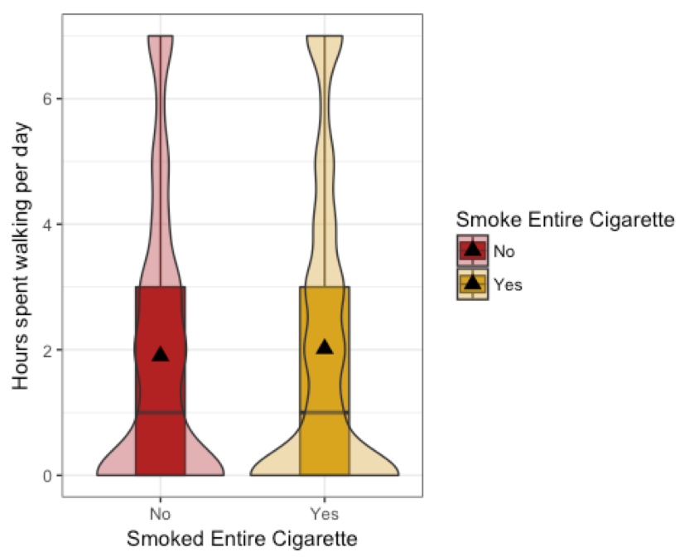
Smoking, Exercise and Perceived Health
TMAC and RYNO
Research Question
Introduction
Although smoking rates have declined, 16.8 percent of U.S. still citizens smoke on a daily basis (source).Smoking has already been linked to many health complications such as bronchitis and cancer. However, little research has been conducted on how it affects ones health perception and exercise habits. It is also unclear what role gender play into moderating these variables. We will analyze how smoking effects exercise habits and if they both effect ones perceived health . Looking at the correlation between smoking and perceived health is key in helping an individual get proper treatment.
Question: Is there a relationship between the amount an adult walks for exercise throughout the week and their smoking habits and does their perceived general health or gender change/modify (alter) the relationship
According to our and mulitple linear and our multiple linear regression test, there is slightly no significance(P-value = .089>.05) in the simple model thus there was no relationship between walking for exercise and smoking habits. When we tested to see if their perceived general health altered this relationship, we got insignificant numbers that were similar to the simple model, proving that perceived health does not change this relationship. Females had a significant p value (9.96e-17) thus females alter and signify the relationship between walking for exercise and smoking habits.
Model Type | Variable Tested | P-Value
Simple Model | -Frequency of walking for exercise per week -Smoked an entire cigarette (Y/N) | .089
Multivariate | -Frequency of walking for exercise per week -Smoked an entire cigarette (Y/N) -General Health Perception | Very Good: .15 Good: .26 Fair: .75 Poor: .087
Multivariate | -Frequency of walking for exercise per week -Smoked an entire cigarette (Y/N) Gender | Female:9.9e-16
Research Question
Methods
All data was derived from the “Add Health Wave IV” data set
We condensed and cleaned data using data management
The original data set had 976 total variable
We cleaned data and focused on 4 variables relating to our question
We Conducted a multiple linear regression test
Variable Descriptions:
1)Ho, S. Y., Lam, T. H., Fielding, R., & Janus, E. D. (2003). Smoking and perceived health in Hong Kong Chinese. Social Science & Medicine, 57(9), 1761-1770. doi:10.1016/s0277-9536(03)00021-2
2)Leyk, D., Rüther, T., Witzki, A., Sievert, A., Moedl, A., Blettner, M., … Löllgen, H. (2012). Physical Fitness, Weight, Smoking, and Exercise Patterns in Young Adults. Deutsches Ärzteblatt International, 109(44), 737–745. http://doi.org/10.3238/arztebl.2012.0737
3)Conway, K. S., & Niles, D. P. (2016). Cigarette Taxes, Smoking-and Exercise? Health Economics, 26(8), 1019-1036. doi:10.1002/hec.3381
4)Odonovan, G., Hamer, M., & Stamatakis, E. (2017). Relationships between exercise, smoking habit and mortality in more than 100,000 adults. International Journal of Cancer, 140(8), 1819-1827. doi:10.1002/ijc.30611
Sample Characteristics
Gender | Binary Categorical
Male: 3147 | Female: 3356
Smoked an entire Cigarette | Binary Catigerical
Yes(smoker): 3324 | No(non-smoker): 1407
How many hours an individual walks a week for exercise | Quantitative Continuous
Range: 0-8days | Mean: 1.95
General Health Perception | Categorical
Excellent: 979
Very Good: 1963
Good: 1683
Fair: 434
Poor: 55

