Slide 1
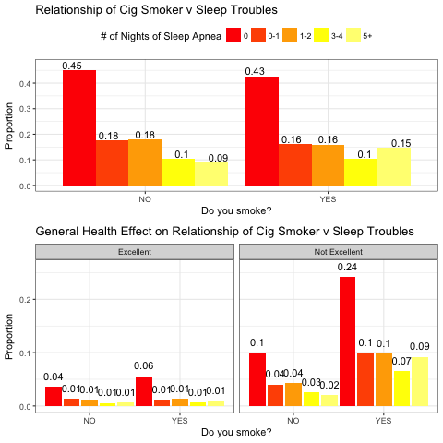
The Relationship Between Smoking Cigarettes and Sleep Apnea
Shippen, J., Klemm, M.
Fall 2017, Statistics 315, Section 1
Introduction and Background
Variables
Results
Logistic Regression Analysis
Recently California State University, Chico enacted a campus-wide tobacco ban, causing many students, staff, and faculty to have to refrain from smoking until they have left campus.
This study aims to see if this ban has the potential to help students maintain healthier sleeping habits. Previous research has been done to study this topic. A study conducted in 2014 found that smokers exhibited higher rates of sleep apnea compared to non-smokers. This study proposes that smoking can cause alternative pattern in sleep architecture, upper and lower airway inflammation, and increase in arousal due to nicotine affects (Krishnan, V., Dixon-Williams, S., & Thornton, J. D. , 2014).
The results of another study, this one conducted in 2008 on smokers who experience sleep apnea, found that the disruption to getting a full night sleep was reported to be caused by an “inner drive” where the patients had no control over their urges to smoke in the middle of the night (Provini F., Vetrugno R., Montagna P., 2008).
The data that was collected by the Add Health IV in-home survey, this survey had given us access to 5114 male and female respondents ranging age group of 24-32.
Before we added the potential moderator "general health", the relationship between sleep and cigarette smoker proved significant results with a chi-squared test (x² =20.812, df=4, p-value=0.0035).
After the moderator was added and the chi-squared test was performed, the "excellent" category of general health became non-significant with a p-value > 0.05.
The moderator of general health is significant only in participants who reported non-excellent general health, with a p-value < 0.05. Therefore, general health acts as a moderator.
After controlling for general health using Logistic Regression a statistical significance of participants that have a very good to very poor general health when compared to excellent (p<.05).
Participants that had poor health were the most statistically significant when comparing to the excellent group(p=4.63e-08).
Sleep Apnea | Cigarette Smoker | General Health
Number of times in the past week participants reported having troubles sleeping through the night. | Out of those who have ever smoked, has the participant smoked at least 1 cigarette/day in the last 30 days? | Does the participant report excellent or less than excellent general health (on a 5 point scale)?
Conclusion & Implications
The study is a valuable contribution to the understanding the importance of smoking habits, sleep habits and how it can be related to general health. Chico State is moving towards a healthier student community by offering free gym access and now a campus wide smoking ban. Our research indicates that these efforts could be favorable for the entire student body and faculty. Analysis of the Addhealth dataset we established that smoking habits and sleep apnea are modified by a person's general health. Previous research by Fackelmann (1989) has shown that healthy people who sleep a full night are more wakeful during the day and perform better on tests measuring comprehension and vigilance. With Chico State offering free gym access and non-smoking campus it could potentially raise the proficiency of the entire student body and faculty.
Objectives
The goals of the analysis will include:
1) establishing a relationship between smoking and sleep apnea; and
2) determining whether or not the relationship between smoking and sleep apnea is dependent on the participants overall general health
Methods
After assumptions were met, the variables of interest were examined and summarized.
Missing answers and legitimist skips were coded out.
General health, which was rated on a 5 point scale, was combined into two categories: “excellent” and “not excellent”
For analysis, a chi-square test of association was used to determine if there was an association between smoking and suffering from sleep apnea.
A chi-square test of equal proportions was used to see if the participants’ general health acted as a moderator.
The coefficient table was conducted using a multivariable linear model.
Graph 1. This graph shows that those who are in “Not excellent” health have a much higher proportion of participants that have problems sleeping throughout the night.
Logistic Regression
References
Research Questions
Variables | Odds Ratio | C.I. 2.5% 97.5% | P-value
Excellent | 0.854 | (0.71, 1.03) | 0.099
Very Good | 1.394 | (1.14, 1.71) | 0.001
Good | 1.817 | (1.48, 2.23) | 1.20E-08
Poor | 2.289 | (1.71, 3.09) | 4.63E-08
Very Poor | 3.062 | (1.54, 6.52) | 0.002
Cigarette Smoker | 1.009 | (0.86, 1.17) | 0.912
Krishnan, V., Dixon-Williams, S., & Thornton, J. D. (2014). Where There Is Smoke…There Is Sleep Apnea: Exploring the Relationship Between Smoking and Sleep Apnea. Chest, 146(6), 1673–1680. http://doi.org/10.1378/chest.14-0772
Provini F., Vetrugno R., Montagna P. (2008). Sleep-related smoking syndrome. Sleep Medicine, 9(8), 903-905. doi.org/10.1016/j.sleep.2007.10.021
Is there a relationship between smoking and sleep apnea?
Does that relationship depend on the participants general health?
Table 1. This table includes odds ratio, confidence interval, and p-value of each group compared to those who had excellent health.
Contact Jessica Shippen: jshippen1@mail.csuchico.edu

