Slide 1
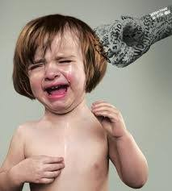
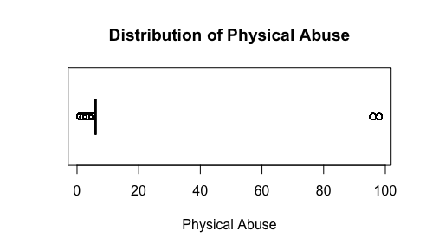
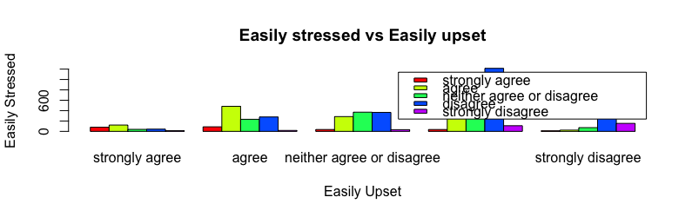
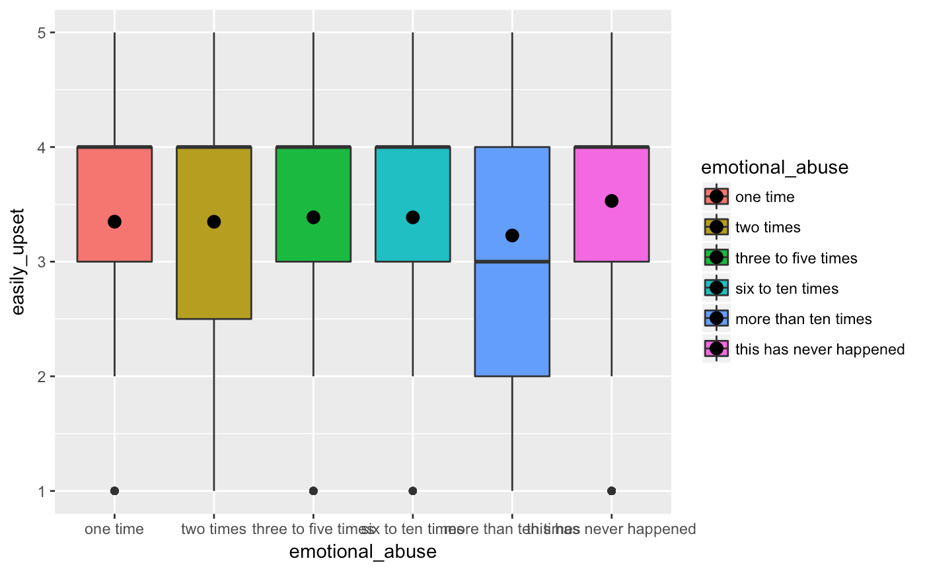
The Association Between Mistreatment by Adults and Personality Behaviors
Sigala, K. and Podhajny, V.
Donatello, RA, D.Ph. Department of Math and Statistics, California State University Chico
INTRODUCTION
SAMPLE CHARACTERISTICS
IMPLICATIONS
A child abuse report is made every ten seconds in the United States. In one study done by the Childhelp agency, 80% of 21-year-olds who reported childhood abuse met the criteria for at least one psychological disorder. We believe there is a correlation between child abuse and developing psychological disorders. We will be testing out how emotions, physical, and sexual abuse affects a person's personality.
Is there an association between mistreatment by adults and personality behaviors?
The goal of this research is to see if there is evidence supporting that mistreatment by adults could lead to psychological disorders in the future, and make a person more susceptible to committing crimes, being arrested, and getting involved in dating violence.
Neurobiological and psychiatric consequences of child abuse and neglect, states that In the US alone, there are about 3 million child maltreatment reports every year. The clinical consequences discovered because of maltreatment are mood and anxiety disorder, bipolarism, anxiety, panic disorder, phobias, and posttraumatic stress, all which affect their personalities. Personal and social difficulties that follow abuse that have been identified include insecure attachment, avoidance in social relationships, and deficits in social-interpersonal processing.
We used data given from 6 variables; 3 from mistreatment by adults codebook and 3 from personality behaviors codebook.
Of the variables we chose to study from Sections 24 & 26, there were 6,504 participants
48% were male and 52% female, aged 24 to 32.
Some implications we can conclude from our results are that out of the 6,504 respondents 20% of them admitted to have being mistreated by an adult before they turned 18, the other 80% either refused to answer or denied having been mistreated by an adult before the age of 18.
This research is important because, “In the US alone, there are about 3 million child maltreatment reports every year. The clinical consequences discovered because of maltreatment are mood and anxiety disorder, bipolarism, anxiety, panic disorder, phobias, and posttraumatic stress, all which affect their personalities. Personal and social difficulties that follow abuse that have been identified include insecure attachment, avoidance in social relationships, and deficits in social-interpersonal processing.” (Heim, C., 2010)
RESULTS
This graph demonstrates the frequency of how much physical abuse a participant has suffered before the age of 18. From 0 times up to 100.
80% of the people surveyed said this had never happened to them.
The highest bar shown ( 1215 individuals) represents disagreeing that they are easily upset and disagreeing that they are easily stressed
We were hoping to find a correlation between strongly agreeing/agreeing to being easily stressed and strongly agreeing/ agreeing to being easily upset, however, we did not find that in this sample.
This is a regression analysis after controlling for emotional abuse, physical abuse is signiﬁcantly associated with being easily upset.
Emotional abuse is not signiﬁcantly associated with being easily upset, the average amount of times someone is easily upset stays relatively the same as emotional abuse increases
CONCLUSIONS
•The effects of mistreatment by adults and its consequences for personality behaviors are reviewed. The prevalence and clinical sequelae of early emotional and physical abuse, and personality behaviors such as being easily upset, stressed, and having mood swings, are described.
•Moderating factors such as felony were reviewed. Felony meant that the individual had been to prison at least once.
•Our research hypothesis was not supported. This is likely due to having a small amount (>20%) of individuals who have claimed that they have been abused as a child, therefore we didn’t get an accurate representation of individuals who have been abused since in the US alone, there are approximately 3 million child maltreatment reports annually, of which nearly 1 million are substantiated; among the substantiated cases, about 60% are classified as neglect, 20% as physical abuse, and 10% as sexual abuse (Heim, Shugart, Craighead, & Nemeroff, 2010).
• For our univariate analysis we tested easily stressed, for bivariate we looked at easily stressed vs. easily upset, and for multivariate we tested gender, mood-swings and felony. Our results for the univariate, multivariate, and bivariate analysis all showed no connection.
METHODS
To understand and analyze mistreatment by adults and personality behaviors, we used the Add Health Wave IV data set. Data was collected from 2008-2009 via 90 minute in-home interviews. The codebook file contains data on 6,504 respondents, aged 24 to 32.
We first tested being a felon as a moderator for a person who had been physically abused and based on their gender. We then tested for gender being a potential confounder.
REFERENCES
Heim, C., Shugart, M., Craighead, W. E., & Nemeroff, C. B. (2010, September 29). Neurobiological and psychiatric consequences of child abuse and neglect.
Teicher, M. H., Samson, J. A., Polcari, A., & Mcgreenery, C. E. (2006). Sticks, Stones, and Hurtful Words: Relative Effects of Various Forms of Childhood Maltreatment. American Journal of Psychiatry, 163(6), 993-1000.
Child Abuse Statistics. (n.d.). from https://www.childhelp.org/child-abuse-statistics/#emotional
Abajobir, A. A., Kisley, S., Williams, G., & Clavarino, A. (2017, April 1). Gender-based differences in injecting drug use by young adults who experienced maltreatment in childhood: Findings from an Australian birth cohort study.
Notes:
‹#›
Ok how does that look?
We just need a pic in the corner
Can it be of a real kid? Im not sure lol. Is that too sad?
Lol
Eh lets do it
Catch the eye

