Slide 1
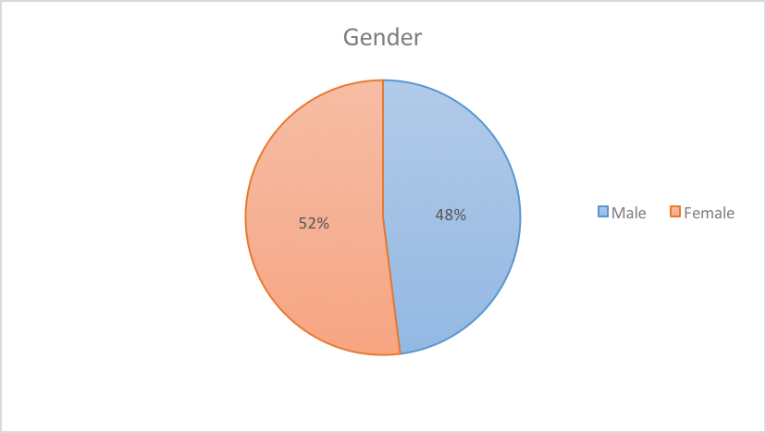
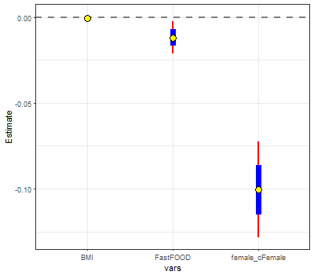
Correspondence between Depression and BMI
Michael A. Siva and Peter Angelonides
Math 315-01-4666
Introduction and Research Hypothesis
Data
Conclusion
Acknowledgement
Depression is a commonly secretive issue that isn't discussed in society, Weight gain caused by Depression is another problem in our culture that may be linked to depression. Many people do not consider the importance of having a sense of personal control to establish a better self-esteem. In this specific section, we chose to see the relationship between social psychology and mental health and how often a participant felt a particular emotion (happy, sad, depressed, guilty, etc.). According to the Anxiety and Depression Association of America, the significant age range of depression is 15 to 44 years of age, depression can affect anyone within that age group, but more commonly depression can affect women in their mid-30s. Depression also persists in men, and this leads to feeling tiredness, irritability, and anger; perhaps we will see an increase in our dataset in BMI due to always feeling tired. Anyone who has depression can show signs of missing work, school, and miss social gatherings altogether. We hypothesize that there is a is there a correspondence between BMI and having or not having symptoms of depression? We also too into consideration depression and the effects it has on Gender and BMI.
We wanted to understand the correlations between BMI and Depression, in addition to this, we also wanted to take into consideration of Gender and Fast Food consumption due to the known possibility of Excessive eating when a person feels depressed. While there is a correlation between BMI and Depression the addition of the two other variables changed our results. Therefore the results show that there isn't a link between depression and gender and if they are eating fast-food too if it would increase the likelihoods of increasing BMI.
This research uses data from Add Health, a program project directed by Kathleen Mullan Harris and designed by J. Richard Udry, Peter S. Bearman, and Kathleen Mullan Harris at the University of North Carolina at Chapel Hill, and funded by grant P01-HD31921 from the Eunice Kennedy Shriver National Institute of Child Health and Human Development, with cooperative funding from 23 other federal agencies and foundations. Special acknowledgment is due Ronald R. Rindfuss and Barbara Entwisle for assistance in the original design. Information on how to obtain the Add Health data files is available on the Add Health website (http://www.cpc.unc.edu/addhealth). No direct support was received from grant P01-HD31921 for this analysis.
Implications
These results matter to those who would like to add more data research into Add Health and show a correlation of BMI, Fast Food, Consumption, and Depression. There may not be a significant link between Depression and Food consumption due to missing Add Heath data, but other research like Anxiety and Depression of America see’s a linking between the two.
Methods
References
For our categorical tests used were a series of questions the participants were asked; they had to mark the following if they were true (Rarely, sometimes, a lot of the time, most of the time, I don’t know).
The variables we are using are BMI, Gender, and Fast Food consumption. We are using these variables to hopefully prove that Depression and BMI are linked due to fast food consumption.
BMI was the only variable we changed; the values above 97.4 as NA because that’s not possible. Depression was constructed by combining two other variables ‘depression in the past seven days’ and ‘health care providers’
Results
American Psychiatric Association. (2013). Diagnostic and statistical manual of mental disorders (5th ed.). Arlington, VA: American Psychiatric Publishing
Harris, K.M., C.T. Halpern, E. Whitsel, J. Hussey, J. Tabor, P. Entzel, and J.R. Udry. 2009. The National Longitudinal Study of Adolescent to Adult Health: Research Design [WWW document]. URL: http://www.cpc.unc.edu/projects/addhealth/design
Facts & Statistics. (n.d.). Retrieved November 29, 2017, from https://adaa.org/about-adaa/press-room/facts-statistics
Add Heath contractual data:
Harris, Kathleen Mullan. 2009. The National Longitudinal Study of Adolescent to Adult Health (Add Health), Waves I & II, 1994–1996; Wave III, 2001–2002; Wave IV, 2007-2009 [machine-readable data file and documentation]. Chapel Hill, NC: Carolina Population Center, University of North Carolina at Chapel Hill. DOI: 10.3886/ICPSR27021.v9.
Pie chart graph was used to show the readers a proportion of the demographic information we are using in the histogram graph for females and depression.
We used a histogram graph to show the analyzing of BMI, Fast Food, and Gender as the X values and Depression as our Y-axis. The results of this model show that Gender (female) are statistically associated depression (p-value <.0001). BMI and Fast food Consumption (in the past seven days) is not significant because of the p-values > .0001. Therefore the results show that there isn't link between depression and gender and if they are eating fast-food to if it would increase the likelihoods of increasing BMI.
Variable Characteristics
Variables | Estimate | Std. Error | T-Statistic | P-Value
BMI | -0.000632 | 0.000941 | -0.671 | 0.502
Gender | -0.101 | 0.0143 | -7.05 | 2.03E-12
Fast Food Consump. | -0.0118 | 0.0048 | -2.46 | 0.0141
Adjusted R^2 | 0.011
Variables | Mean | Median | St. Dev | Range
BMI | 29.14 | 27.7 | 7.48813 | [ 14.40 -70.30]
Fast Food Consump. | 1.664 | 1 | 1.47651 | [0.000-5.000]
Male | 48%
Female | 52%

