Slide 1


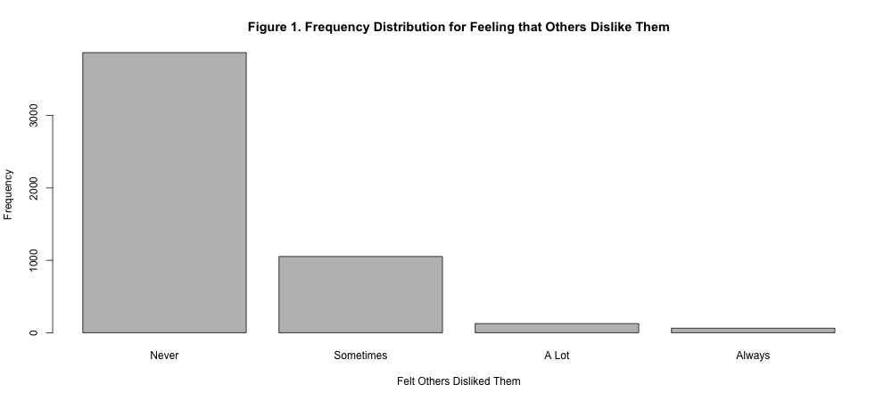
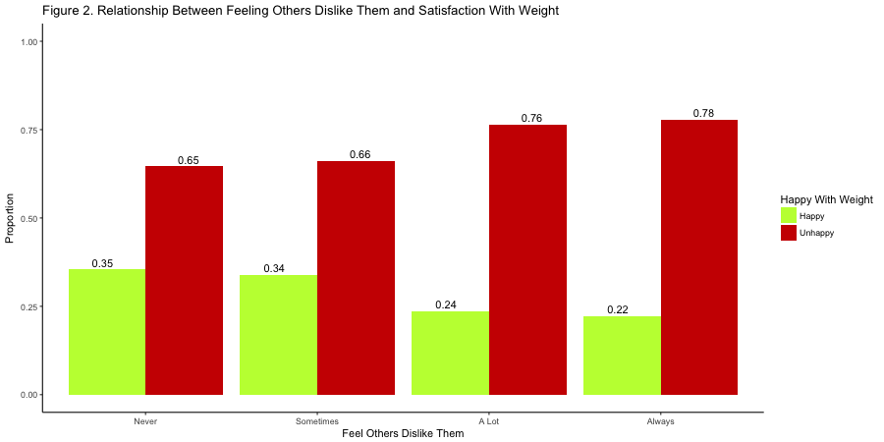
The Relationship Between One’s Self-Image and Feeling That They are Liked by Their Peers
Emma Stainton, Brittany Simpson
California State University, Chico
Introduction
Materials and Methods
Discussion
Does having a lot of close friends and feeling that they are generally accepted by their peers boost one’s self confidence and how they view themselves? This project aims to see if there is a relationship between these variables and whether popularity makes one feel good about themselves, or if it is still possible to have poor self-image even though one might have multiple close friends. This project also aims to see that if the two are indeed related, how so? Does popularity have an effect on self-image, or does self-image appear to hinder one’s ability to make many close friendships?
When studying factors like self-image and how one feels it is hard to know whether the information being collected is accurate. Studies like this operate on the assumptions that the respondent is being truthful in their answers and that the answers are not temporary due to other circumstances (i.e. one’s responses may be more negative if in a bad mood or unusually positive if in a good mood). Although difficult to know the validity of responses, it is still important to examine these things because it could help with issues in mental health and human development.
The data was taken from The National Longitudinal Study of Adolescent to Adult Health (addhealth) Wave IV. The addhealth data was collected through in-home interview via an interviewer and a computer system for the questions about sensitive matters. The researchers also obtained measurements for height, weight, and BMI. There were 5,114 male and female subjects that were surveyed. The subjects ranged from 24-32 years old and were from various ethnicities. From this data sets certain variables were chosen.
The variables that were used:
How many close friends do you have?
How do you think of yourself in terms of weight?
How often do you feel isolated from others?
Have you felt disliked by others in the past seven days?
BMI
Gender
The variables were loaded into R Studio and compared to see if their relationship is significant.
According to our research the number of close friends does not affect a person's view of their self image within the age range of 24-32. Also there was no relationship when compared with gender. The average number of friends the subjects reported having were 3-5.
Our research hypothesis was not supported. A reason that it was not supported is because the age range is to high (old). If the subjects were young (teenagers) our hypothesis would be supported according to the literature.
Bivariate
Figure 2 shows the relationship between feeling that others dislike them and whether they are happy or unhappy with their weight. Proportions are displayed above each bar.
References
Tobia,V.,Riva,P.,Caprin,C.(2016)Who are the Children Most Vulnerable to Social Exclusion?The Moderating Role of Self-Esteem, Popularity, and Nonverbal Intelligence on Cognitive PerformanceFollowing Social Exclusion. Journal of Abnormal Child Psychology 45(4) 789-801
Thomaes, S. et al.(2010) I Like Me If You Like Me:On the Interpersonal Modulation and Regulation ofPreadolescents’ State Self-Esteem. Child Development 81(3) 811-825.
Anthony, D. et al. (2007) Social Acceptance and self-esteem: Tuning the sociometer to interpersonal value.Journal of Personality and Social Psychology 92(6) 1024-1039.
Mares, S. et al.(2010) Facial Attractiveness and Self-Esteem in Adolescence.Journal of Clinical Child& Adolescent Psychology 39(5) 627-637.
Add Health. (2017, June 16). Retrieved November 17, 2017, from http://www.cpc.unc.edu/projects/addhealth
Multivariate
Receiving counseling seems to be a better predictor of whether one feels isolated (OR 2.51, CI 2.03-3.13) as opposed to if they are unhappy with their weight (OR 1.13, CI 1.01-1.27). This can be seen in Table 1 as it shows the odds ratios of variables associated with feeling isolated.
Research Questions
Results
Dose the number of close friends one has affect the way that they view themselves?
Does poor self image inhibit ones desire to seek friendship?
Is ones self image affected by what their peers say or think about them?
Univariate
As shown in Figure 1, the frequency distribution for feeling that others dislike them is skewed right with most of the responses being “Never”.
Table 1. Odds ratios of variables associated with feeling isolated
Variable | Odds Ratio | Lower Confidence Level | Upper Confidence Interval
Unhappy With Weight | 1.13 | 1.01 | 1.27
Receives Counseling | 2.51 | 2.03 | 3.13

