Slide 1
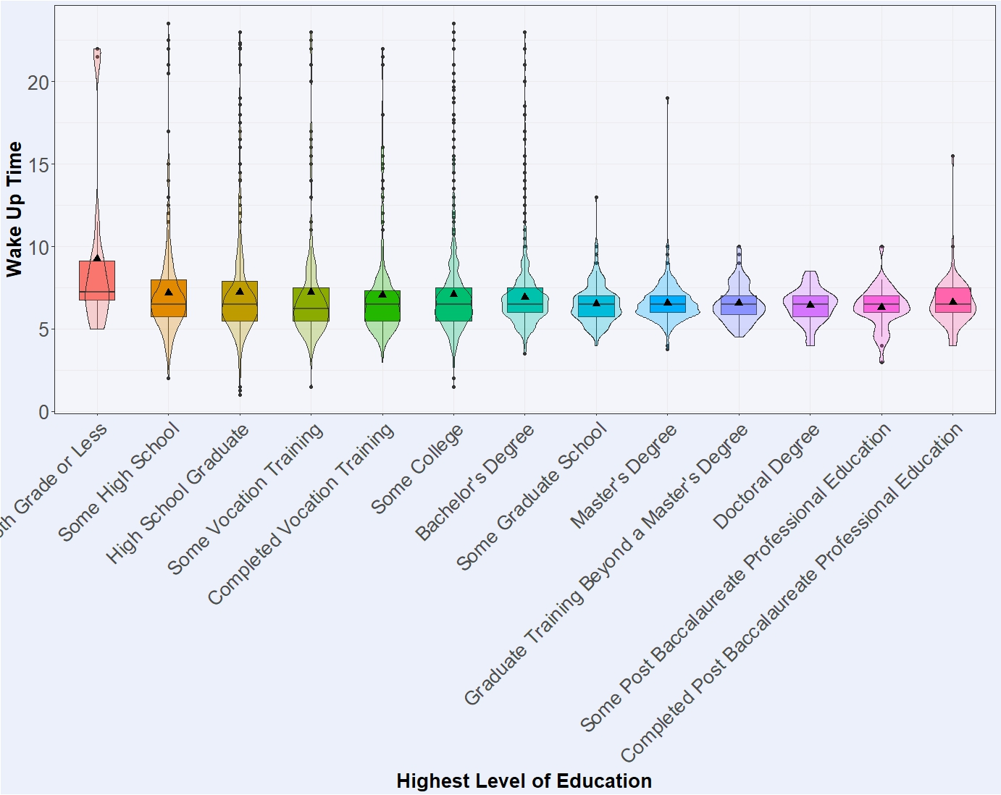
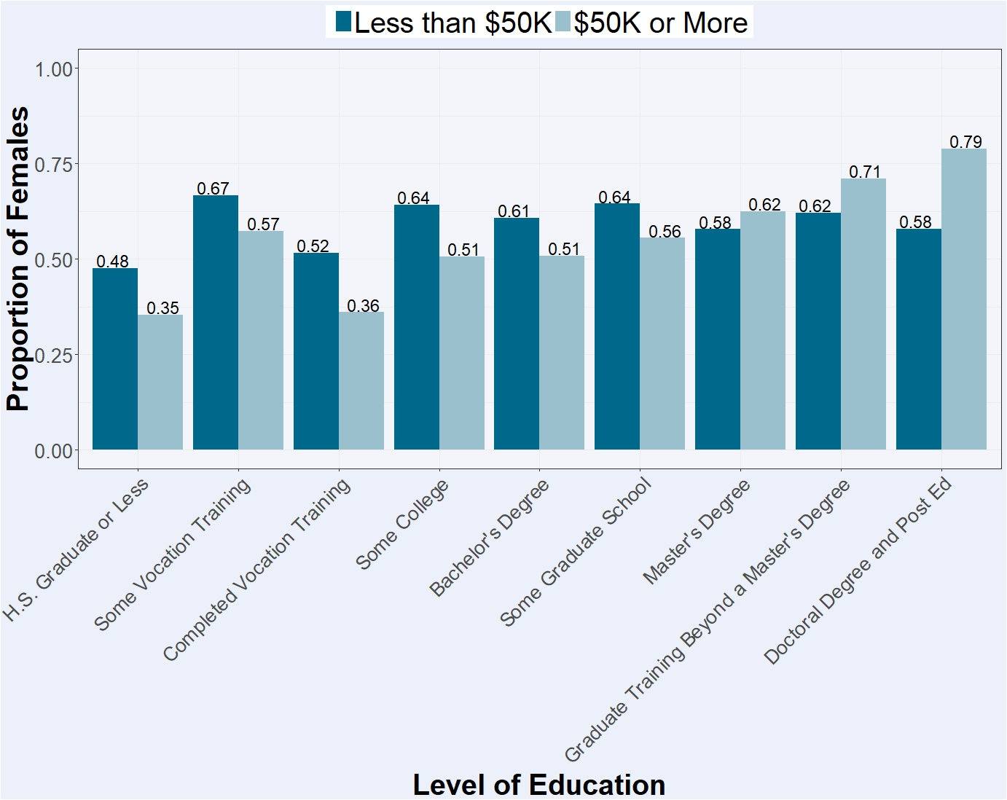
Education, Income and Sleep
Lucas Biggo, Jacob Mendez, Ian Schneider
Vindicators
Abstract
Study Demographics
Discussion
The relationship between good health and sleep duration has been clearly established by various meta-analyses and epidemiological studies, although exactly which variables and how much they influence sleep duration has yet to be statistically examined. In this research project, we wanted to focus on the specific differences in sleep among various levels of reported income and education. Although the association between enhanced cognitive performance and sleep duration is clearly evident, a quantification of sleep time among different socioeconomic and education levels was performed to better understand the discrepancies among our levels of treatment. We hypothesized seeing a negative association between sleep duration and higher levels of education and income. From this information, we hope to raise a greater understanding about sleep health in profession and academic cultures.
•Study began with the public use of ADDHEALTH data WAVE IV
•ADDHEALTH is a survey based study aimed to start with adolescence
•WAVE IV was 1995
•WAVE IV was conducted in 2008
•After accounting for missing data we were left with 5114 respondents
•54% were female 46% were male
•Birth years range from 1974-1973, with 1979 being the average
•All data analysis was performed using RStudio v3.4.1
Analysis of our data reveals a large difference in sleep duration between educated and non-educated groups.
Income and total asset worth increase when sleep decreases.
This data reveals the overall theme of our research: There truly isn’t any rest for the wicked.
Our hypothesis of a decrease in total levels of sleep versus levels of education and income was confirmed.
Compared to current epidemiological studies performed by Edward Bixler*, our results are congruent with the primary findings in the literature.
Moderation
Implications
Introduction
Major Variables
The explanatory variable is gender and the response is highest level of education achieved. The moderator being tested is household income. Specifically those people that make less than $50K or $50K or more per year.
A Chi Square analysis revealed that the relationship between gender and highest level of education achieved is significant in both the original and stratified model (p-value in original model is <0.0001 and p-values on both income categories in the stratified model is <0.0001).
The distribution of females across levels of education differs significantly between people with a household income of less than 50,000 dollars and an income of 50,000 dollars or more. The effect of gender on levels of education is therefore modified by the amount of money the person has made (see graph).
The implications that ours and other research suggests a lack of sleep is a serious health problem within professional and academic communities that needs to be addressed.
Sleep deprivation is a dangerously overlooked epidemic within these cultures and should be addressed on various fronts.
A smarter, more sleep-aware working culture is important for creating healthier and more sustainable lifestyles that will promote greater efficiency and productivity and ultimately a brighter future.
Adequate sleep optimally impacts mental functioning and therefore impacts students’ performance on examinations and ultimately grades received (Zeek, et al. 2015).
In youth, more sleep is consistently associated with better grades in school, and sleep quality and quantity are closely related to student learning and academic performance (Asarnow, et al. 2014).
Suboptimal sleep duration has a strong association with mortality and morbidity; hence there is a need to more clearly understand the mechanisms involved in regulating sleep duration and patterns and to identify high-risk individuals who are in greatest need of preventive strategies (Bixler, 2009).
The socioeconomic environment has a potentially important influence on sleep duration. For instance, based on data collected over a 34-year period from residents of Alameda County in California, a low socioeconomic status was shown to be a strong predictor of short sleep duration (Bixler, 2009).
H4ED1-Highschool graduation status-combined GED, certificates of completion and diploma into a single “graduated” category
H4SP1T,H4SP1M,H4SP1H-these coded for hour, minute , and AM/PM respectively, they were combined into a single variable indication what time a person will get out of bed on a workday
H4ED-Highest Education level-combined 8th grade graduate(or less), some high school, and high school graduate into a single (High School or less) variable, also combined doctoral degrees and post baccalaureate vocational training(i.e. nurse/lawschool) into a single category
Literature Review
Asarnow, Lauren D., et al. “The Effects of Bedtime and Sleep Duration on Academic and Emotional Outcomes in a Nationally Representative Sample of Adolescents.” Journal of Adolescent Health, vol. 54, no. 3, 2014, pp. 350–356., doi:10.1016/j.jadohealth.2013.09.004.
This article was primarily focused on examining the relationship between sleep and academia and was helpful in providing a guideline into our main research questions
Bixler, Edward. “Sleep and society: An epidemiological perspective” Sleep
Medicine , Volume 10 , S3 - S6
Bixler’s study was the most broad sleep study that we examined and was essential in answering the majority of our sleep questions as well as producing new questions for study.
Zeek, M. L., Savoie, M. J., Song, M., Kennemur, L. M., Qian, J., Jungnickel, P. W., &
Westrick, S. C. (2015). Sleep Duration and Academic Performance Among Student
Pharmacists. American Journal of Pharmaceutical Education, 79(5), 63.
http://doi.org/10.5688/ajpe79563
This was an interesting look into the correlation between academic performance and sleep, and helped us to reach our conclusions and to contribute to discussion
Results
Bivariate
The explanatory variable is highest education level that one has received and the response variable is the time a person wakes up on week days or work days.
An ANOVA test was conducted between these variables and found a statistically significant correlation (p-value <0.0001). We can reject the fact that there's not a relationship between the time people wake up during work days and the level of education they have received.
Looking at the violin plot, there’s a slight difference in the highest average wake up time versus those who have received a lower education degree than those who have received higher education degrees.
Research Questions
Is there an association between the time someone wakes up and the maximum level of education received?
Does the addition of income moderate the relationship between gender and highest level of education achieved?

