Slide 1

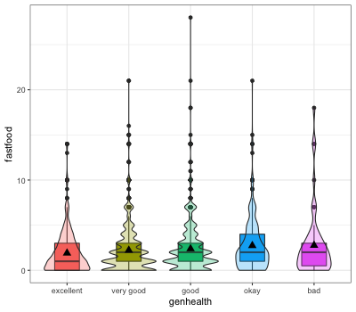
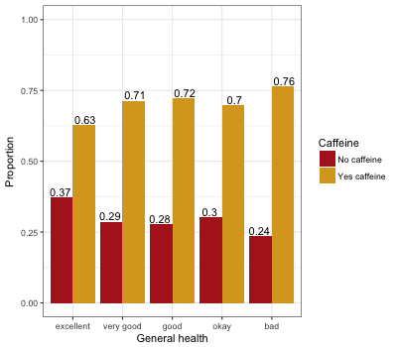
Examining the Association Between Caffeine Consumption
and General Health
Dara Stroup and Kaylee White
Biostatistics, California State University, Chico
Delete me & place your
LOGO
in this area.
Delete me & place your
LOGO
in this area.
Introduction
Results
Conclusion
When talking about caffeine, have you been told that it is good or bad for you? In today's world we often get mixed reviews and easily misinformed by the media. Previous studies conducted regarding a correlation between caffeine consumption and the general health of the consumer or the non-consumer have shown a significant correlation between high caffeine intake resulting in poor general health, and low caffeine intake resulting in patients with good general health (Richards & Smith 2016).
With this mixed view and the variety of data received, the goal of this research question is to discover the trends between how someone views their overall health and if they consume caffeine regularly.
Analysis Of Variance
Logistic Regression
After adjusting for the potential confounding factor of fast food consumption, caffeine consumption (1.018, CI 0.832-1.253, p <.05) was significantly and positively associated with the likelihood of being in good general health.
In this analysis, the odds ratio tells us that those who consumed caffeine in the last 24 hours are 1.02 times more likely to perceive themselves to be in good general health.
Based on these analyses, fast food consumption is a confounding factor because the association between caffeine consumption and general health is significant after accounting for fast food consumption.
General Health vs Fast Food
Table 1. Logistic Regression controlling for caffeine consumption and fast food consumption
 | OR | LCL | UCL
Intercept | 0.085 | 0.066 | 0.108
Caffeine | 1.018 | 0.832 | 1.253
Fast food | 1.298 | 1.032 | 1.647
After controlling for fast food consumption, caffeine consumers have 1.018 times the odds of reporting poor general health compared to non caffeine consumer.
After controlling for caffeine consumption, fast food consumers have 1.298 times the odds of reporting poor general health compared to non fast food consumers.
Fast food is a stronger predictor of general health than fast caffeine consumption.
Figure 1. Violin plot of General Health vs Fast Food Consumption
After further analysis, Figure 1 shows that there is sufficient evidence to conclude that the average amount of fast food consumed over a 7 day period is associated with the different levels of general health perception (p<.05).
Research Question
Do people who view their health to be good or excellent consume tend to drink caffeine more than those who view their health to be less than good or excellent?
Implications
Chi-Square
Results cannot determine how amount of caffeine consumed, amount of fast food consumed has any effect of general health as both we binary, “yes” or ”no” questions.
Also, types of caffeine consumed may have an effect on general health, for example consume black coffee versus energy drinks or sweetened beverages.
Measures
General Health and Caffeine Consumption
General Health: Individual’s perception of their general health. Responses ranged from excellent to poor.
20% excellent, 38% very good, 33%good, 8% okay, 1% bad.
Recoded to good health (containing excellent, very good and good) and poor health (containing okay and bad) for Logistic Regression Analysis
Caffeine: Whether caffeine was consumed over the last 24 hours.
30% did not consume caffeine, 70% consumed caffeine.
Fast Food: The number of times an individual consumes caffeine over a 7 day period. Mean=2.264. Any value larger than 30 was removed because that would mean the individual visited a fast food restaurant more than 4 times per day.
Recoded to Yes consumption over 7 day period, and No consumption over 7 day period for Logistic Regression Analysis.
Discussion
After initially comparing the proportion of caffeine consumers and non caffeine consumers to their respective general health levels, and finding a significant association between the two, an association was then found between the number of times an individual visits a fast food restaurant over a 7 day period and their perceived general health.
When controlling for caffeine consumption, it was found that those who consume fast food are more likely to report poor general health than non fast food consumers.
References
(
(
Richards, G., & Smith, A. P. (2016). Caffeine Consumption and General Health in Secondary School Children: A Cross-sectional and Longitudinal Analysis. Frontiers in Nutrition, 3, 52. http://doi.org/10.3389/fnut.2016.00052
Figure 2. Proportion of general health levels who did and did not consume caffeine in the last 24 hours.
Visually, Figure 2 shows an overwhelming, and consistently larger proportion of people who did consume caffeine over the 24 hour period for all levels of perceived general health.
There is sufficient evidence to conclude that the average amount of fast food consumed over a 7 day period is associated with different levels of general health perception (p<.05).
Data Collection
National Longitudinal Add Health Wave IV Survey
Consisted of 6.504 observations ages 24-3
Kwhite47@mail.csuchico.edu

