Slide 1

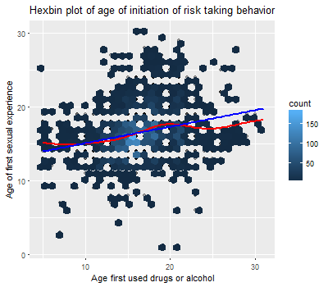
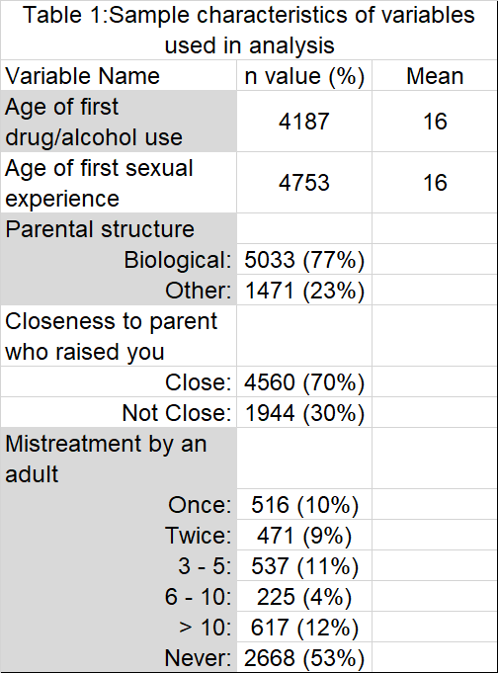
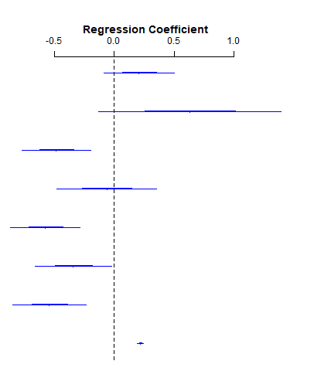
The association of parental structure and age of initiation of adolescent risk taking behavior
Keck, S., Shilling, T.
California State University, Chico
Introduction
Results
Discussion
Simple linear regression
Although researchers have found multiple variables associated with early adolescent risk taking behavior, there is little understanding of the parenting factors most salient for adolescent decision making. The present study attempts to better understand the association between initiation of two risk taking behaviors and whether certain parental dynamics influence this relationship. This study attempts to answer two research questions: 1) Is age of first drug/alcohol use and age of first sexual experience related?; and 2) Which aspect of parental structure best predicts age of initiation of risk taking behavior in adolescents? We predicted that parental dynamics would affect the relationship between age of first sexual experience and age of first drug/alcohol use.
Table 2. Linear model of Age1_sex ~ Age_1
The original model indicates that age of first sexual experience and age of first drug/alcohol use are significantly related (table 2). When testing for potential moderators and confounders, we found that all three variables of parental dynamics did not significantly change the relationship between age of first sexual experience and age of first drug/alcohol use. Thus, the prediction that parental dynamics affects the relationship between the two risk taking behaviors is incorrect. Rather than being moderating or confounding, parental dynamics were used as covariates in a multivariable model.
In the multivariable model, after controlling for age of first drug/alcohol use, closeness of parent-child relationship and levels of mistreatment, parental structure was not significantly associated with age of first sexual experience. Similarly, closeness of parent-child relationship was not significantly associated with age of first sexual experience after controlling for all other covariates..
After adjusting for age of first drug use, parental structure, and closeness of parent-child relationship, mistreatment by adults had a significant negative relationship with age of first sexual experience (figure 3). Mistreatment by adults and age of first drug/alcohol use co-vary with the outcome of age of first sexual experience.
 | Estimate | Std. Error | t value | p value
Intercept | 13 | .23 | 56 | 0
Age_1 | 0.22 | .014 | 16 | 2.4e-58
For every year older a person is for first time drug/alcohol use, their age of first sexual experience increases by .22 (95%CI: .20, .25, p-value < .0001).
There is a weak, positive, linear relationship between age first used drugs or alcohol and age first experienced sexual intercourse (r=.25).
Methods
Figure 1. Hexbin plot used as scatterplot alternative to illustrate an accurate representation of the high density data. The intensity of the color is equivalent to the concentration of data points within a spatial area of the chart. The darker the color, the higher density of data points.
Data Collection
Longitudinal Add Health survey wave IV
5114 respondents, age 24-32
Age of first drug or alcohol use (Age_1): two variables combined by subsetting data and selecting the youngest observation of the two variables.
Age of first sexual experience (Age1_sex): one variable; no major recoding.
Parental structure (pstructure): two variables regarding bloodline relation of mother and father parent figure. Recoded as one binary factor variable indicating “Biological” or “Other” (non-biological) relation.
Relationship to parental figure (prelationship): two variables regarding closeness of relationship with maternal and paternal parental figures. Recoded as one binary factor variable indicating “Close” or “Not Close.”
Mistreatment by adults (mistreat): one categorical variable grouped by number of times person was made to feel unwanted or unloved by an adult before the age of 18.
Multiple linear regression
Table 3. Confidence interval of levels of mistreatment for multivariable model
 | Low (2.5%) | High (97.5%) | P-value
Once | -.09 | -.03 | <.001
Twice | -.07 | 0.0 | <.05
3 - 5 | -0.9 | 0.3 | <.0001
6 - 10 | -0.5 | 0.3 | >.05
> 10 | -0.8 | -0.3 | <.001
Implications
prelationship_Close
pstructure_Bio
Mistreat_ >10
Mistreat_ 6-10
Mistreat_ 3-5
Mistreat_ Twice
Mistreat_ Once
Age_1
The topic of our research question shows that parental structure and closeness of parent-child relationship did not significantly change the relationship between age of first sexual experience and age of first drug/alcohol use. The adversity of negative experience showed to be most significant in predicting the age of first sexual experience more readily.
Further research involving different types of mistreatment by an adult is needed to better understand adolescent decision making and the associated level/type of mistreatment experienced. For example- verbal, physical, and sexual mistreatment may be associated differently with the response variable and may vary in strength and direction of the relationship.
One experience of mistreatment, age of first sexual experience decreased by -.54 (p<.001), compared to someone who never experienced mistreatment.
Two experiences of mistreatment, age of first sexual experience decreased by -.34 (p<.05), compared to someone who never experienced mistreatment.
3-5 experiences of mistreatment, age of first sexual experience decreased by -.58 (p<.0001), compared to someone who never experienced mistreatment.
6-10 experiences, age of first sexual experience decreased by -.06 (p>.05), compared to someone who never experienced mistreatment.
More than 10 experiences, age of first sexual experience decreased by -.48 (p<.001), compared to someone who never experienced mistreatment.
Analysis
Simple linear regression used to examine the relationship between age of first drug/alcohol use and age of first sexual experience. Multiple linear regression used to further examine the relationship between age of first sexual experience and three predictor variables including, parental structure, closeness of relationship to parent figure, and mistreatment by adults.
Figure 3: Regression coefficient plot for the multivariable model. Variables whose error bars intersect the reference line at 0 are not significant.
References
Bramlett MD, Radel LF. Adverse family experiences among children in nonparental care, 2011–2012. National health statistics reports; no 74. Hyattsville, MD: National Center for Health Statistics. 2014.
Fomby P, Cherlin AJ. Family Instability and Child Well-Being. American sociological review. 2007;72(2):181-204.
King V, Stamps KC, Hawkins DN. Adolescents with Two Nonresident Biological Parents: Living Arrangements, Parental Involvement, and Well-Being. Journal of family issues. 2010;31(1):3-30. doi:10.1177/0192513X09345833.
Langton CE, Berger LM. Family Structure and Adolescent Physical Health, Behavior, and Emotional Well-Being. The Social service review. 2011;85(3):323-357.
Pearson, J., Muller, C., and Frisco, M. L. (2006). Parental involvement, family structure, and adolescent sexual decision making. Sociological Perspectives, 49(1):67–90.
R Core Team (2017). R: A language and environment for statistical computing. R Foundation for Statistical Computing, Vienna, Austria. URL https://www.R-project.org/.
Wilder EI, Watt TT. Risky Parental Behavior and Adolescent Sexual Activity at First Coitus. The Milbank Quarterly. 2002;80(3):481-524.
Harris, Kathleen Mullan. 2009. The National Longitudinal Study of Adolescent to Adult Health (Add Health), Waves I & II, 1994–1996; Wave III, 2001–2002; Wave IV, 2007-2009 [machine-readable data file and documentation]. Chapel Hill, NC: Carolina Population Center, University of North Carolina at Chapel Hill.
Contact Stephanie Keck: stephanie.keck00@gmail.com
Notes:
1
Need to fix:
Hypothesis
error bars or CI for regression plot???
We predicted that parental dynamics would affect the relationship between age of first sexual experience and age of first drug/alcohol use. The prediction was incorrect since none of the three parental dynamics were found to moderate or confound the relationship between age of first sexual experience and age of first drug/alcohol use.
After controlling for age of first drug/alcohol use, closeness of parent-child relationship and levels of mistreatment, parental structure is not significantly associated with age of first sexual experience (p = 0.10). Similarly, after controlling for age of first drug/alcohol use, parental structure and levels of mistreatment, closeness of parent-child relationship is not significantly associated with age of first sexual experience(p=0.64).
After controlling for age of first drug/alcohol use, parental structure, and closeness of parent-child relationship, mistreat by adults had a significant negative relationship with age of first sexual experience (p-value ranged from <.0001 - 0.72 across all levels or mistreatment). This indicates that mistreatment by an adult is a covariate of age of first sexual experience.

