Slide 1

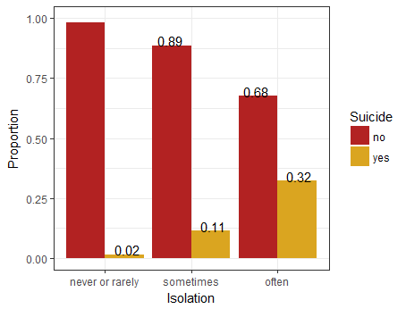
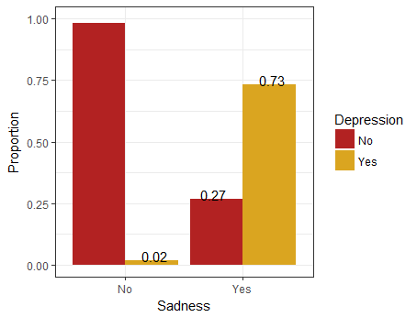
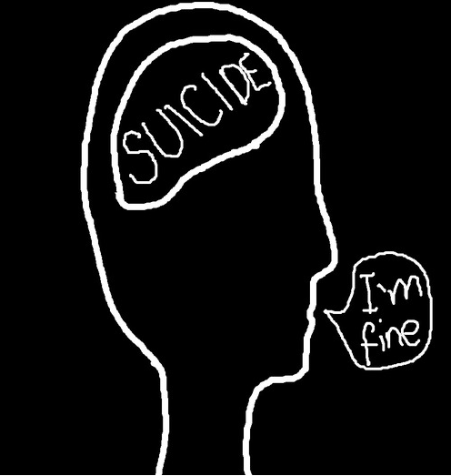
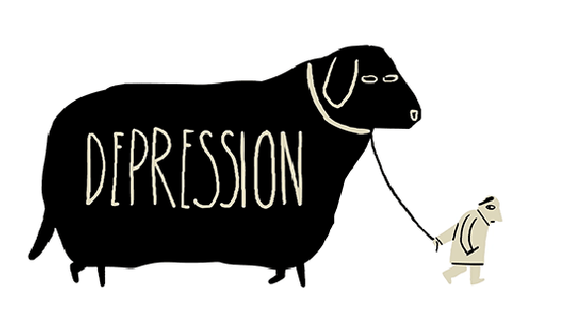
How Personality Traits Are Associated With
Depression and Suicide
By: Gomez G. and Pharn S.
California State University, Chico – Math315-01
Introduction
Results
After controlling for anger, individuals with sadness have 108.24 times the odds of being depressed compared to individuals who don't have sadness. After controlling for sadness, individuals with anger have 3.87 times the odds of being depressed compared to individuals who don't have anger.
After adjusting for the potential confounding factor of anger, sadness (108.24, CI 51.48-240.93, p < 0.0001) was still significantly and positively associated with the likelihood of being depressed.
Throughout history, neurotic personality types have shown to be strongly related to depression and/or suicide (Joshi and Yadav, 2017). Neuroticism is defined as the condition of experiencing feelings such as isolation, sadness, and anger in excessively greater frequencies than the average, mentally stable person. Evidence for this association was extrapolated from several resources, which show strong correlations linking neuroticism to depression and suicide, relative to other personality types. Because a neurotic personality type is a strong indicator for depression and suicide, it may be beneficial to investigate the personality traits which make up neuroticism, and determine which specific traits most significantly contribute to these results. Our referenced studies prompted this analysis on neurotic personality traits and their relation to depression and suicide, as well as an attempt to determine whether or not these traits act as potential risk factors for the aforementioned effects.
Research studies since the 1950s have identified several personality types that may contribute to depression and suicide. A study published by the Indian Journal of Health and Wellbeing, conducted on 80 subjects ages 18-40, found that personality type can lead to certain emotional and behavioral disorders, which are responsible for feelings of depression and alienation (Joshi and Yadav, 2017). A Scandinavian study using standardized personality measures discovered that hopelessness, neuroticism, and surprisingly extroversion may be useful markers of suicide risk (Brezo, Paris, & Turecki, 2006).
Hence, our research focuses on the issue of whether certain neurotic personality traits are related to depression and suicidal thoughts. This analysis specifically investigates the differing correlations between isolation and thoughts of suicide, when subjects did and did not admit to having a tendency to worry. Another analysis was conducted to compare the relationship between feelings of sadness and feelings of depression, specifically differentiating subjects who admitted to getting angry easily and those who did not.
Conclusion
Upon analysis of our study, one can observe a positive correlation between feelings of isolation and suicidal thoughts and between feelings of sadness and feelings of depression. Our graphical data supports our claim that only certain neurotic traits can predict the frequency of depression and thoughts of suicide. Feelings of isolation and sadness positively correlate with suicidal thoughts and feelings of depression, respectively.
Although our research articles were from overseas studies-India, Scandinavia, and Europe-the correlation between the chosen neurotic traits and their undesirable outcomes maintained significance in the majority of reports. Our chosen variables of the neurotic personality type showed significant relationships between feelings of depression and thoughts of suicide.
Further investigation of the relationship between feelings of isolation and thoughts of suicide was conducted. A chi-square test of equal proportions was conducted for the relationship of feelings of isolation and thoughts of suicide with worrying as the moderator. However, the results obtained were invalid because one level for isolation-“don’t worry”-had insufficient observations, so interpretation of the results would be meaningless.
Similarly, the relationship between feelings of sadness and feelings of depression was investigated further. A logistic regression was conducted for the relationship between sadness and depression with anger as the confounder. The results showed that being sad was still significantly associated with the likelihood of having depression after controlling for anger, so anger wasn’t a confounder. Even though the analysis showed that anger wasn’t a confounder, it was still useful because the odds ratios obtained from the analysis showed that sadness was a better predictor for depression than anger was.
Our results suggest that certain neurotic personality traits are associated with depression and suicide because the neurotic personality traits we analyzed were significantly and positively correlated with depression and suicidal thoughts. Also, the results revealed that some traits are stronger risk factors for depression and suicidal thoughts than others are.
Figure 1: Bar graph of the relationship between feelings of isolation and thoughts of suicide.
We can conclude that there is an association between the feeling of isolation from others and the thoughts of suicide (X2 = 122.4, df = 2, p < 0.0001). The proportion of feelings of isolation significantly differs between all pairs of thoughts of suicide. This graph shows that as the feeling of isolation becomes more frequent the thoughts of suicide also becomes more frequent.
Methods
Our sample came from the AddHealth Wave IV Code Book
Isolation - Asks how often do you feel isolated from others and includes four answers: “never”, “rarely”, “sometimes”, and “often”
Depression - Asks how often you felt depressed during the past seven days and includes four answers: “never or rarely”, “sometimes”, “a lot of the time”, and “most of the time or all of the time”
Sadness - Asks how often you felt sad during the past seven days and includes four answers: “never or rarely”, “sometimes”, “a lot of the time”, and “most of the time or all of the time”
Suicide Thoughts - Asks if you have seriously thought about committing suicide during the past 12 months and includes two answers: “no” and “yes”
Worrying - Asks if you worry about things and includes four answers: “strongly agree”, “agree”, “disagree”, and “strongly disagree”
Anger - Asks if you get angry easily and includes four answers: “strongly agree”, “agree”, “disagree”, and “strongly disagree”
We have changed all of our variables into categorical variables and have removed outliers and unnecessary answers that don’t contribute to the question from all of the variables.
For the isolation variable we have truncated the 4 levels into 3 levels. For the depression, sadness, worrying, and anger variables we have truncated the 4 levels within each variable into 2 levels
We used the chi-square test and the logistic regression test for our statistical analysis
Worrying was tested as a moderator for Isolation, and Anger was tested as a confounder for sadness.
Implications
Our results show that certain traits of neuroticism can be predictors for both depression and thoughts of suicide. However, we need to be careful as to not say that those certain traits are real predictors for both depression and thoughts of suicide because our results also show that some neurotic traits are moderated by each other.
Future research must be conducted on all traits defining neuroticism-feelings such as isolation, depression, sadness, and anger-while cycling the controlling for each trait. This way, we can be more confident in which specific traits of the neurotic personality type can really predict whether someone will experience depression and thoughts of suicide.
Figure 2: Bar graph of the relationship between feelings of sadness and feelings of depression.
Sample Characteristics
We can conclude that there is an association between the feelings of sadness and the feelings of depression (X2 = 488.21, df = 1, p < 0.0001). The proportion of feelings of sadness significantly differs between the two levels of feelings of depression. This graph shows that people who feel sad more often during the past 7 days will likely feel depressed.
Table 1: Our sample size and our variables’ observations with the proportions, in parentheses, that’s used in our research.
Sample | N = 994
Isolation | N = 5113 (19.4%)
Depression | N = 5113 (19.4%)
Sadness | N = 5113 (19.4%)
Suicide Thoughts | N = 5113 (19.4%)
Worrying | N = 4299 (23.1%)
Anger | N = 3790 (26.2%)
Table 2: The odds ratios and the lower and upper confidence level from the logistic regression analysis.
 | OR | LCL | UCL
Inercept | 0.01 | 0.01 | 0.02
Sadness | 108.24 | 51.48 | 240.93
Anger | 3.87 | 1.83 | 8.33
REFERENCES
Brezo, J., Paris, J., & Turecki, G. (2006). Personality traits as correlates of suicidal ideation, suicide
attempts, and suicide completions: a systematic review. Acta Psychiatrica Scandinavica, 113(3), 180-206. doi:10.1111/j.1600-0447.2005.00702.x
Duriez, B., Klimstra, T. A., Luyckx, K., Beyers, W., & Soenens, B. (2012). Right-Wing Authoritarianism:
Protective Factor Against or Risk Factor for Depression?. European Journal Of Personality, 26(5), 536-549. doi:10.1002/per.853
Joshi, R., & Yadav, K. (2017). Effect of ICBT on alienation among individuals with depression in relation to
personality type. Indian Journal Of Health & Wellbeing, 8(3), 234-236.
Yen, S., Shea, M. T., Sanislow, C. A., Skodol, A. E., Grilo, C. M., Edelen, M. O., & ... Gunderson, J. G.
(2009). Personality traits as prospective predictors of suicide attempts. Acta Psychiatrica Scandinavica, 120(3), 222-229. doi:10.1111/j.1600-0447.2009.01366.x
ggomez24@mail.csuchico.edu
spharn@mail.csuchico.edu

