Slide 1
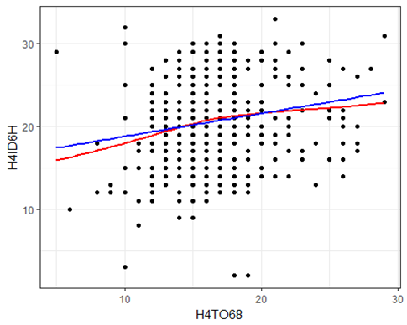
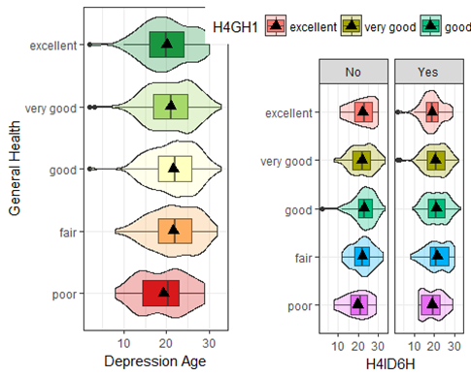
Marijuana Usage Age, Depression Diagnosis and & General Health among Different Age Groups
Mata , A. and Strickland, J.
California State University, Chico
Fall 2017, MATH 315
Abstract
Sample Characteristics & Variables
Implications
Marijuana, since being first discovered, has been used as a means of recreation by many people. A common notion about marijuana is that it is seen as a “safe” drug to use with no serious complications or side effects. Some individuals use marijuana as a means of coping with certain pressures in their lives such as exams, deadlines, relationships, and stress. Others, use it as a way of relieving boredom, frustration, anxiety, or even depression. On the contrary, some studies suggest that there is some correlation between marijuana consumption and depression. According to a study published by The Office of National Drug Control Policy, they found that teen marijuana use worsened depression symptoms (Office of National Drug Control Policy 2008. According to the Anxiety and Depression Association of America, Major Depression Disorder affects more than 16.1 million American adults, or about 6.7% of the U.S. population age 18 and older in a given year (Anxiety and Depression Association of America 2016) In our study, we hope to discover more trends trying to link and correlate marijuana consumption with depression.
Number of Participants from AddHealth | 5112
Age Ranges: | 24-32
Percent of Males: | 46.00%
Percent of Females: | 56.00%
Ethnicities | White, Black/African American, Asian/Pacific Islander, American Indian, Alaska Native.
In our study, we found that age of depression diagnosis and age of first encounter with marijuana are statistically correlated and that age of marijuana usage is a moderator for a age of depression and age of first encounter of marijuana usage. This leads us to ask more questions. In regards to gender. In one study, it was found that females have a higher rate of depression and had a higher rate of marijuana usage than males. (Crane 2015) Future studies with the AddHealth data should focus on weather gender is correlated with age of depression and age and marijuana usage while also exploring if gender is a moderator for age of depression diagnosis and for general health. Another thing that can be looked at is weather cigarette smoking and depression is higher or lower between ages. In the same study, it was found that males have a higher rate of smoking cigarettes and depression rates than females.(Crane 2015) It would be interesting to see if this is applicable to this sample.
Variables
Age of first use of marijuana
Age of diagnosis of depression
General health of participants (Excellent, very good, good, fair and poor.)
Results
Conclusion
Research Questions
Statistically significant but weak correlation between the Age of a person when they were first diagnosed with depression and the age of a person when they first used marijuana.
Marijuana is a moderator for age of depression diagnosis and for general health of the individuals sampled.
Does the age of depression diagnosis corollate to the age of first usage of marijuana?
Is marijuana a moderator for depression age and general health?
Methods & Materials
There was a statistically significant but weak correlation between the Age of a person when they were first diagnosed with depression and the age of a person when they first used marijuana, r(517)=0.18, p < 0.0001.
H4ID6H- Age of depression diagnosis.
H4TO68- Age of first usage of marijuana
References
Our study sample came from a codebook called AddHealth Wave IC Codebook, provided by the Carolina Population Center. Data was taken from individuals who are ages 24-32. While there were 5,114 participants, 5,113 individuals sampled had depression and 2,775 individuals had used marijuana in the past. In order to answer our questions proposed above, we did a correlation analysis and we conducted a moderation analysis to see if marijuana usage was a moderator for depression and general health.
Crane, N. A., Langenecker, S. A., & Mermelstein, R. J. (2015). Gender differences in the associations among marijuana use, cigarette use, and symptoms of depression during adolescence and young adulthood. Addictive Behaviors, 49, 33-39.
Harris, Kathleen Mullan. 2009. The National Longitudinal Study of Adolescent to Adult Health (Add Health), Waves I & II, 1994–1996; Wave III, 2001–2002; Wave IV, 2007-2009 [machine-readable data file and documentation]. Chapel Hill, NC: Carolina Population Center, University of North Carolina at Chapel Hill. DOI: 10.3886/ICPSR27021.v9.
Teen Marijuana Use Worsens Depression . (2008). Retrieved from https://www.ncjrs.gov/ondcppubs/publications/pdf/marij_mental_hlth.pdf
Facts & Statistics. (n.d.). Retrieved November 29, 2017, from https://adaa.org/about-adaa/press-room/facts-statistics
When looking at general health and the age of a person when they were first diagnosed with depression, we attempted to see if marijuana usage (No or Yes) would change the relationship between the two variables.
The original model yielded a p-value of (p=0.053) which is slightly significant. The stratified ANOVA models for marijuana users and non-users yielded p=values of (p=0.050) and (p=0.436) respectively. There is not a clear difference in the relationship between general health and the age of a person when they were first diagnosed with depression for those who use marijuana and those who don’t.
In conclusion, marijuana usage is a moderating variable for this relationship.

