Slide 1
The prediction: 11 DC restaurants will receive Michelin stars
Restaurant | Predicted | Actual
Fiola | 1
Corduroy | 1
Minibar | 3
Marcel’s | 1
Plume | 1
Komi | 2
Fiola Mare | 1
Sushi Taro | 1
Nora | 1
Obelisk | 1
Sakedokoro Makoto | 1
Restaurant | Actual

Slide 2
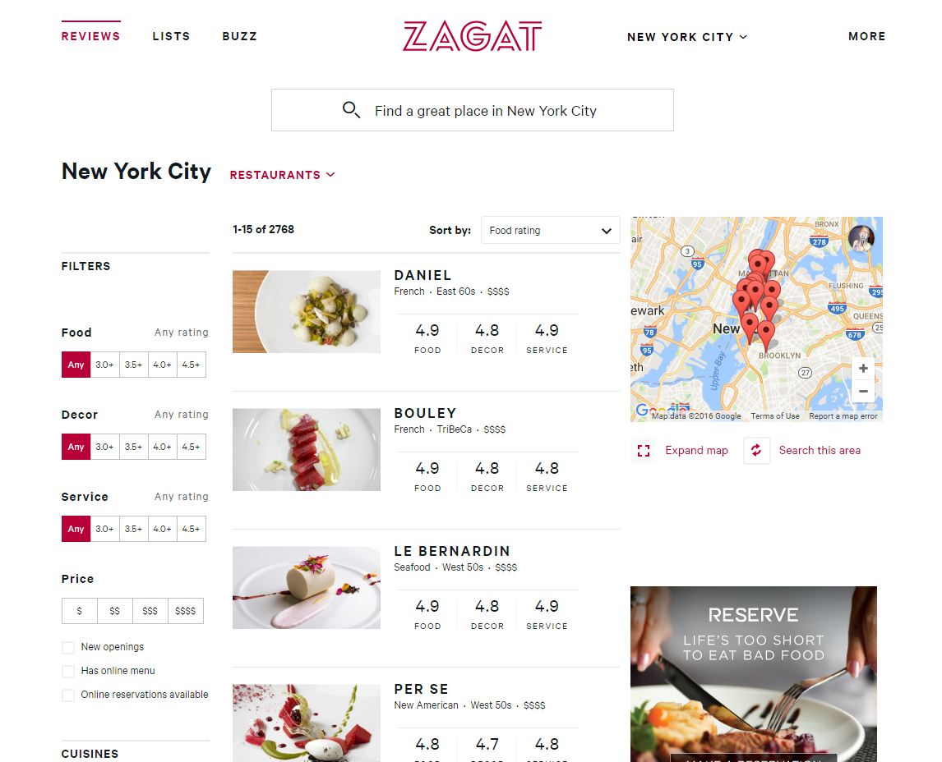
Variables
Cost
Cuisine
On open table?
Price level ($ - $$$$)
Food rating
Decor rating
Service rating
Notes:
Why Zagat?
Most Michelin restaurants are Zagat-rated
There are 3 US cities with Michelin stars – NYC, SF and Chicago. Zagat ratings exist in all three and in DC
I wanted to use something different than Yelp
How? Webscraping. I built a scraper to iterate through all these pages and pull restaurant data. I got data on over 2500 restaurants in NYC, 2000 in SF, and 1300 in Chicago.

Slide 3
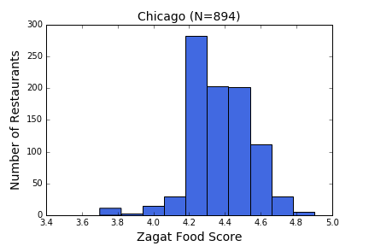
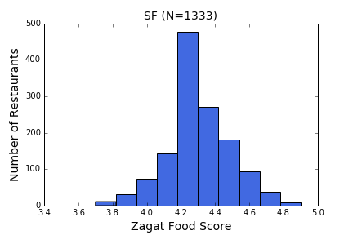
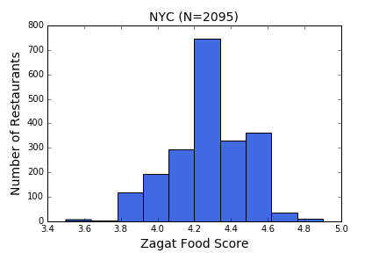
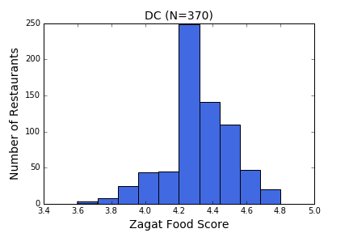
Across cities, Zagat food ratings spiked at 4.2
Notes:
I started with exploratory analysis to inform my modeling. Here’s something I noticed about the Zagat food ratings…
Because of this, I actually omitted all of the restaurants with a food rating below 4.2 in my modeling.

Slide 4
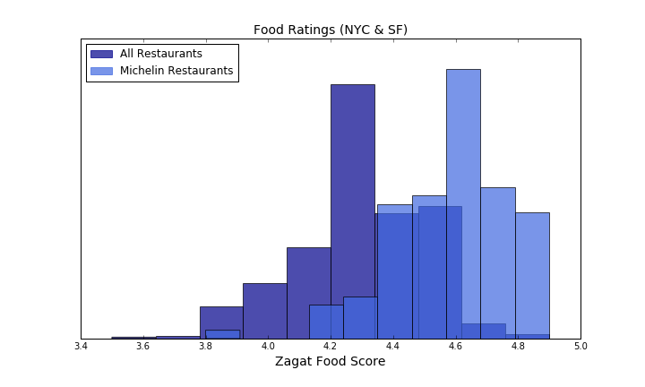
Michelin Restaurants have high Zagat food ratings
Notes:
As you can see, almost all Michelin restaurants included here have Zagat food scores over that 4.2 cutoff point

Slide 5
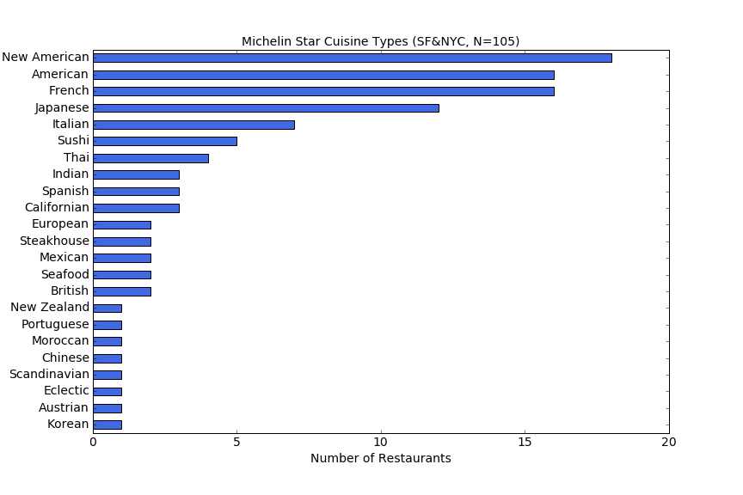
Certain cuisines receive Michelin stars more often
Running head

Slide 6
Michelin restaurants are more likely to be on Open Table
Running head

Slide 7
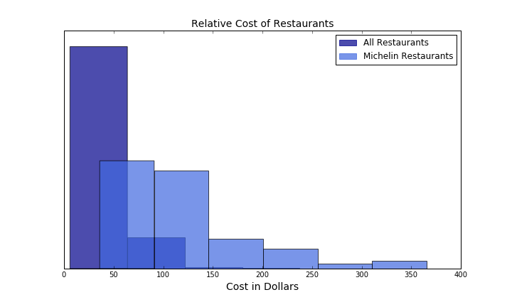
Michelin restaurants are also much more expensive
*Cost is cut off at $400 for visibility; some restaurants exceed this cost
Notes:
So, knowing that price is going to be important for a model in figuring out probability of being a Michelin restaurant… you have to think about different prices in different cities.

Slide 8
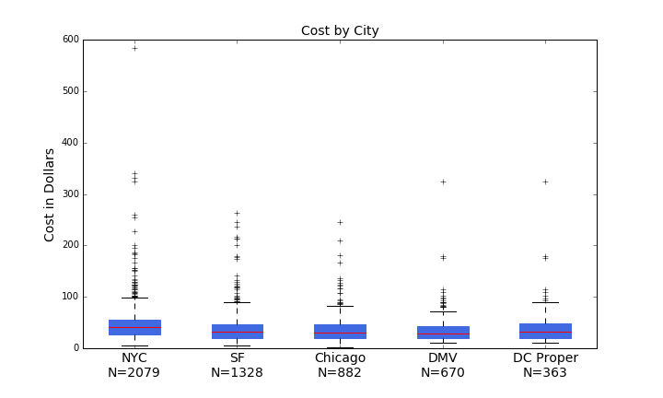
Some restaurants get really expensive…

Slide 9
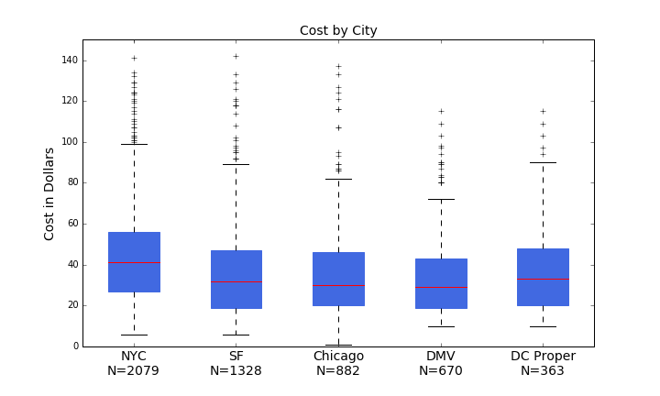
Cutting off outliers, prices vary across cities

Slide 10
Random Forest

Slide 11
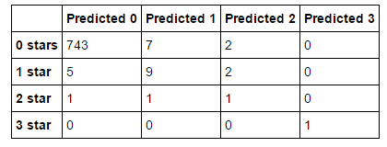
Trained with SF & NYC, tested with Chicago
Best Model Results in Chicago
Notes:
rfg = RandomForestRegressor(100, max_depth=8)
Cost is normalized, cutoff is 4.2 food score for restaurants

Slide 12
Cost was by far the most important model feature

Slide 13
Appendix

Slide 14
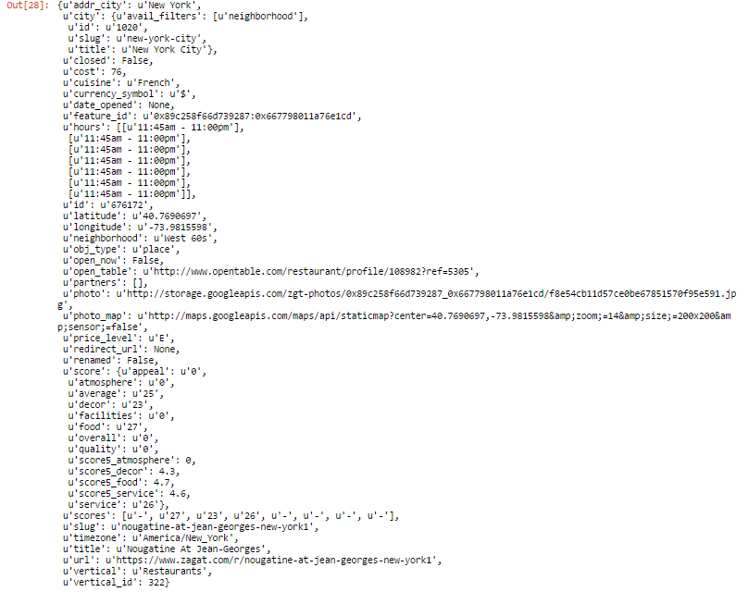
Sample JSON code from NY restaurant

Slide 15
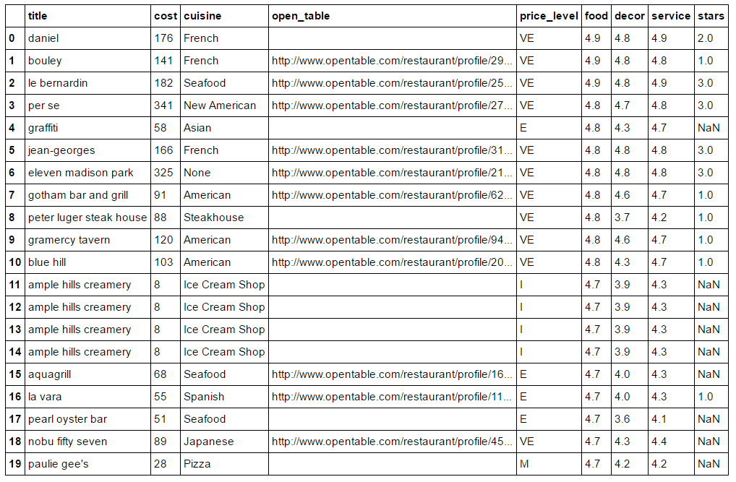
Notes:
Raw data

