Slide 1

Deep learning Unpacking Transformers, LLMs and image generation
Session 2

Slide 2
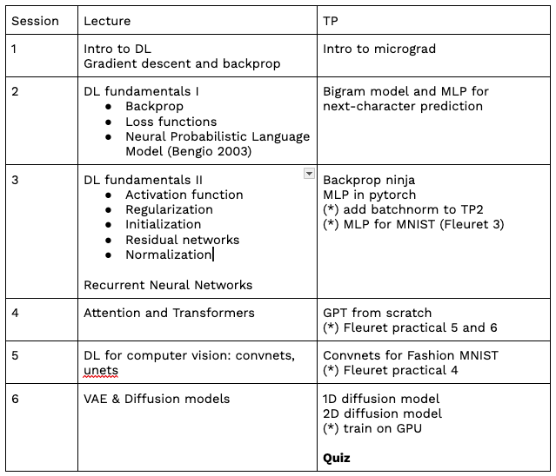
Syllabus

Slide 3
Important notes
Notebooks are scored from 0 to 4.
Always submit a notebook after class. Max score = 1/4 otherwise.
Exercises marked as (*) are required to get to 4. Max score = 2 otherwise.
No class on Feb 21st.
No class on March 27th –> last class on April 3rd. Be there!

Slide 4
There is no reason for deep learning to work
Training: Finding the global optimum of an arbitrary non-convex function is NP-hard (Murty & Kabadi, 1987).
Generalization: deep networks generate way more regions than training samples.

Slide 5
Let’s venture into the variations of a deep networks
Network architecture and inductive bias
Loss function
Activation function
Regularization
Initialization
Residual networks
Batch norm, layer norm

Slide 6
Inductive bias
Set of assumptions made by the model about the relationship between input data and output data.
Examples:
Minimum features
Maximum margin (SVM)
Minimum cross-validation error
Neural net architecture (convnet, transformer)

Slide 7
Do networks have to be deep?
Empirical evidence: shallow networks don’t work as well as deeper ones.
Intuition:
Deep networks can represent more complex functions with the parameter count
Deep networks are easier to train
Deep network impose better inductive bias

Slide 8
The challenges of depth
Vanishing/exploding gradients
Shattered gradients
In short, depth is required but comes with challenges that need to be addressed.

Slide 9
Let’s venture into the variations of a deep networks
Network architecture and inductive bias
Loss function
Activation function
Regularization
Initialization
Residual networks
Batch norm, layer norm

Slide 10
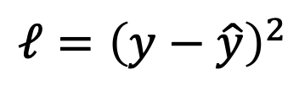
Loss functions
𝑥
f_{ω}
𝑦
$$𝓁={\left(y−\hat{y}\right)}^{2}$$
ground-truth

Slide 11
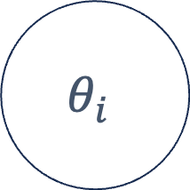

Loss functions
𝑥
f_{ω}
$$θ_{i}$$
$$f_{ω}(x_{i})=θ_{i}$$
Parameters of a distribution

Slide 12
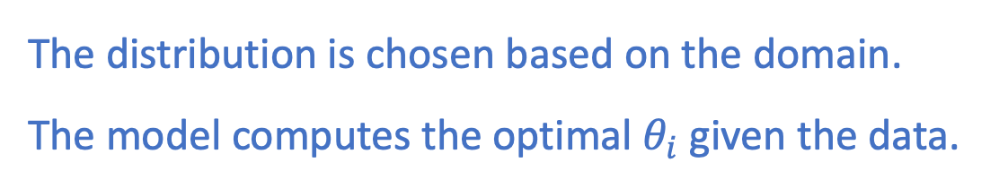
Loss functions
𝑥
f_{ω}
$$θ_{i}$$
$$f_{ω}(x_{i})=θ_{i}$$
The distribution is chosen based on the domain.
The model computes the optimal $θ_{i}$ given the data.

Slide 13

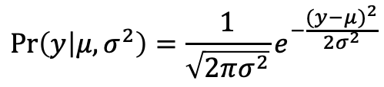

Loss functions
$$f_{ω}(x_{i})=θ_{i}$$
𝑥
f_{ω}
$$θ_{i}$$
Example: univariate regression
$$\operatorname{Pr}\left(y | μ,σ^{2}\right)=\frac{1}{\sqrt{2πσ^{2}}}e^{−\frac{{(y−μ)}^{2}}{2σ^{2}}}$$
$$θ$$

Slide 14
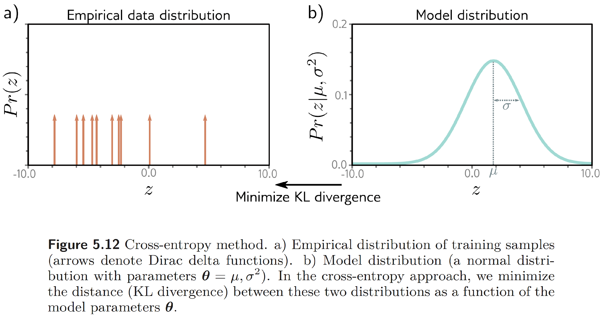


Given one data point
$$x_{i}$$
$$θ_{i}$$
Predict the corresponding distribution parameter

Slide 15

Given many data points
$$x_{i}$$
$$θ_{i}$$
Predict the corresponding distribution parameters
$$f_{ω}(x_{i})=θ_{i}$$

Slide 16
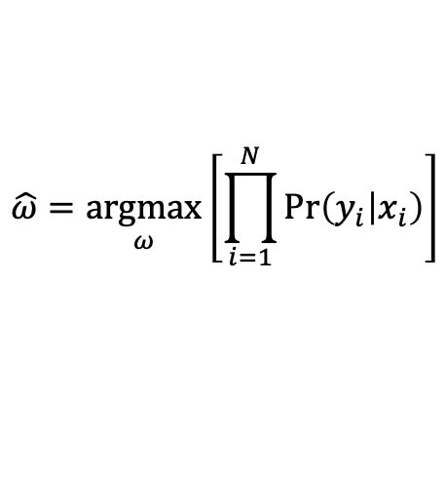
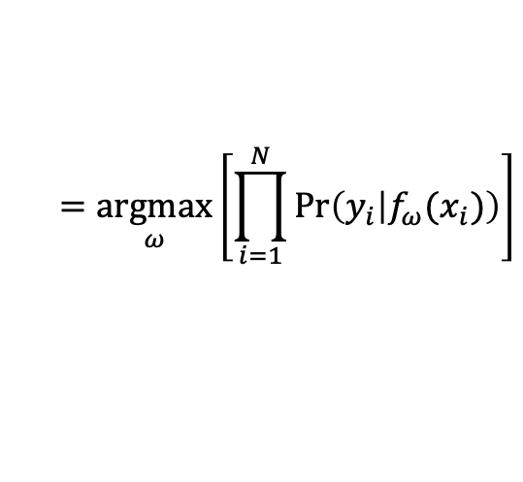
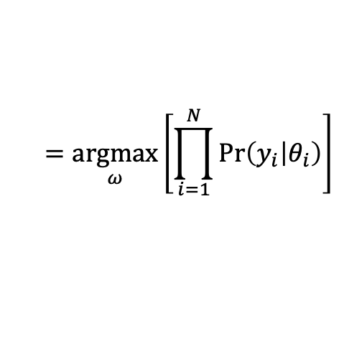
Loss functions
$$\hat{ω}=\underset{ω}{argmax}\left[\prod_{i=1}^{N}{Pr⁡\left(y_{i} | x_{i}\right)}\right]$$
$$=\underset{ω}{argmax}\left[\prod_{i=1}^{N}{Pr⁡\left(y_{i} | θ_{i}\right)}\right]$$
$$=\underset{ω}{argmax}\left[\prod_{i=1}^{N}{Pr⁡\left(y_{i} | f_{ω}(x_{i})\right)}\right]$$

Slide 17

Loss functions
$$Pr\left(y_{1}, y_{2},…,y_{N} | x_{1}, x_{2}, …, x_{N}\right)⁡$$
$$\hat{ω}=\underset{ω}{argmax}\left[\prod_{i=1}^{N}{Pr⁡\left(y_{i} | x_{i}\right)}\right]$$
Data is assumed i.i.d
$$=\underset{ω}{argmax}\left[\prod_{i=1}^{N}{Pr⁡\left(y_{i} | θ_{i}\right)}\right]$$
$$=\underset{ω}{argmax}\left[\prod_{i=1}^{N}{Pr⁡\left(y_{i} | f_{ω}(x_{i})\right)}\right]$$

Slide 18
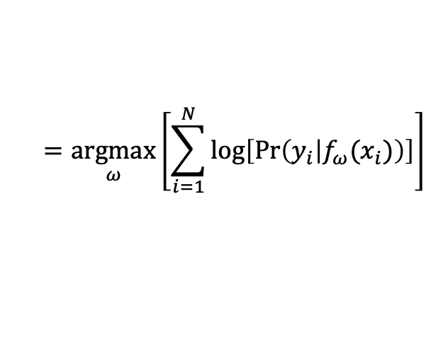
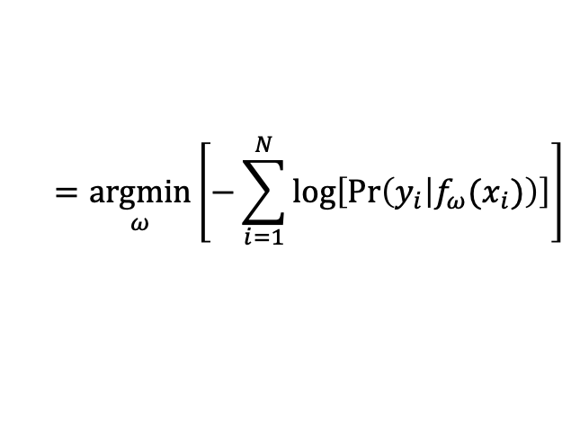
Loss functions
$$\hat{ω}=\underset{ω}{argmax}\left[\prod_{i=1}^{N}{Pr⁡\left(y_{i} | x_{i}\right)}\right]$$
$$=\underset{ω}{argmax}\left[\prod_{i=1}^{N}{Pr⁡\left(y_{i} | θ_{i}\right)}\right]$$
$$=\underset{ω}{argmax}\left[\prod_{i=1}^{N}{Pr⁡\left(y_{i} | f_{ω}(x_{i})\right)}\right]$$
$$=\underset{ω}{argmax}\left[\sum_{i=1}^{N}{log⁡\left[Pr⁡\left(y_{i} | f_{ω}(x_{i})\right)\right]}\right]$$
$$=\underset{ω}{argmin}\left[−\sum_{i=1}^{N}{log⁡\left[Pr⁡\left(y_{i} | f_{ω}(x_{i})\right)\right]}\right]$$
Negative log likelihood (NLL)

Slide 19
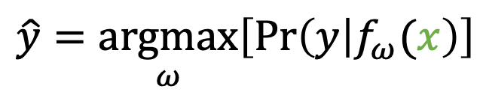
Inference
Given new input data
$$\hat{y}=\underset{ω}{argmax}\left[Pr⁡\left(y | f_{ω}(x\right)\right]$$
Optimal choice: maximum of the distribution
Or sample from the distribution!

Slide 20
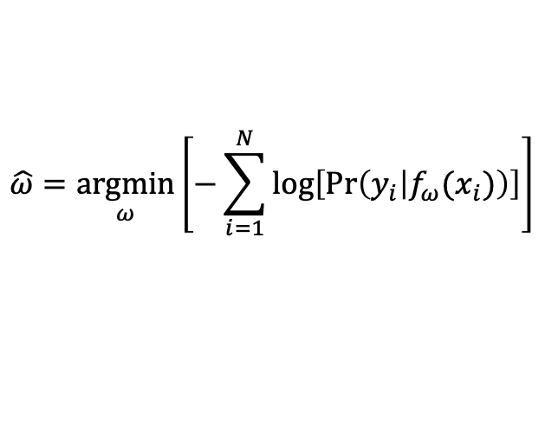
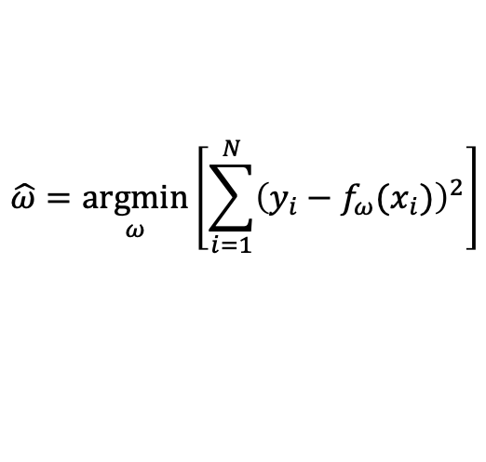
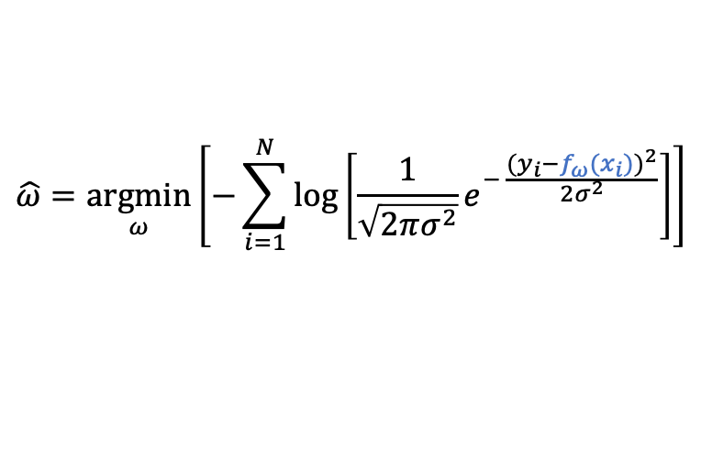
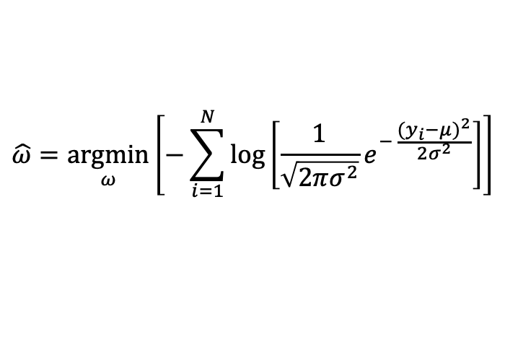
Loss functions
In the case of the univariate regression, the NLL is equivalent to least squares.
$$\hat{ω}=\underset{ω}{argmin}\left[−\sum_{i=1}^{N}{log⁡\left[Pr⁡\left(y_{i} | f_{ω}(x_{i})\right)\right]}\right]$$
Negative log likelihood (NLL)
$$\hat{ω}=\underset{ω}{argmin}\left[−\sum_{i=1}^{N}{log⁡\left[\frac{1}{\sqrt{2πσ^{2}}}e^{− \frac{{(y_{i}−μ)}^{2}}{2σ^{2}}}\right]}\right]$$
$$\hat{ω}=\underset{ω}{argmin}\left[−\sum_{i=1}^{N}{log⁡\left[\frac{1}{\sqrt{2πσ^{2}}}e^{− \frac{{(y_{i}−f_{ω}(x_{i}))}^{2}}{2σ^{2}}}\right]}\right]$$
$$\hat{ω}=\underset{ω}{argmin}\left[\sum_{i=1}^{N}{{\left(y_{i}−f_{ω}(x_{i})\right)}^{2}}\right]$$
least squares

Slide 21
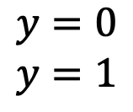

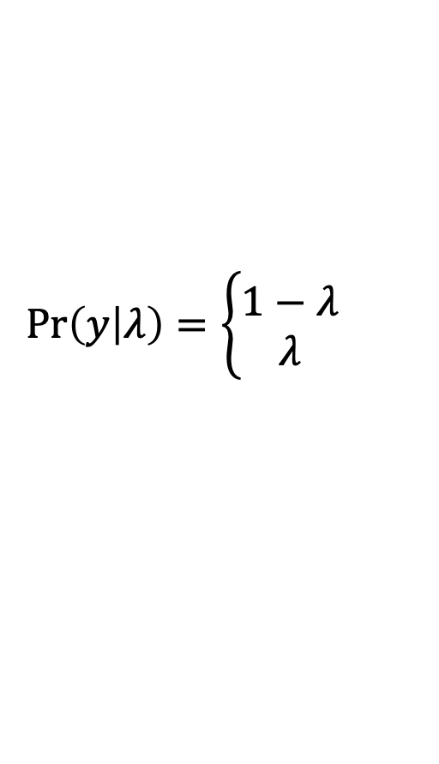
Loss functions
$$f_{ω}(x_{i})=θ_{i}$$
𝑥
f_{ω}
$$θ_{i}$$
Example: binary classification
$$\operatorname{Pr}\left(y | λ\right)=\left\{\begin{matrix}1−λ \\ λ\end{matrix}\right.$$
$$\begin{matrix}y=0 \\ y=1\end{matrix}$$
$$θ$$

Slide 22

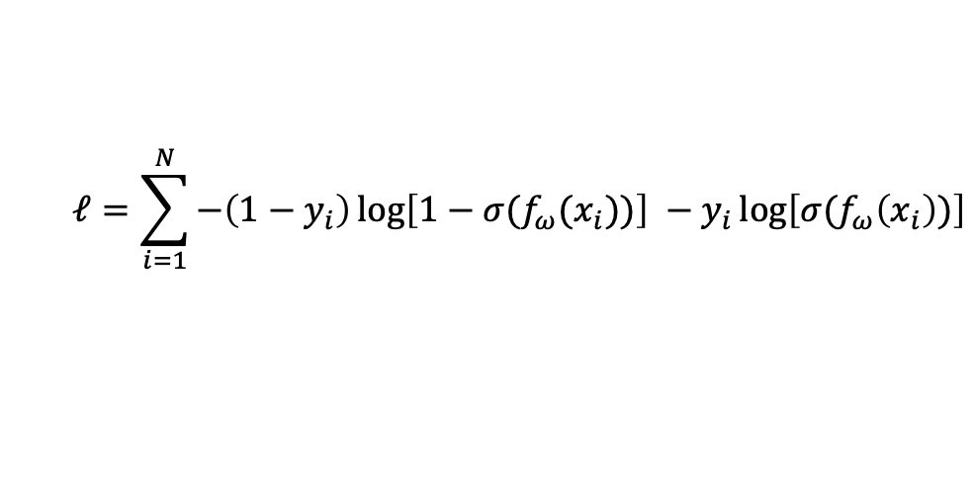
Loss functions
$$f_{ω}(x_{i})=θ_{i}$$
𝑥
f_{ω}
$$θ_{i}$$
Example: binary classification
$$\operatorname{Pr}\left(y | λ\right)=\left\{\begin{matrix}1−λ \\ λ\end{matrix}\right.$$
$$\begin{matrix}y=0 \\ y=1\end{matrix}$$
$$𝓁=\sum_{i=1}^{N}{−\left(1−y_{i}\right)\log\left[1−σ(f_{ω}(x_{i}))\right] −y_{i}\log\left[σ(f_{ω}\left(x_{i}\right))\right]}$$
NLL
$σ:$sigmoid function

Slide 23
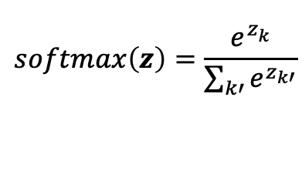

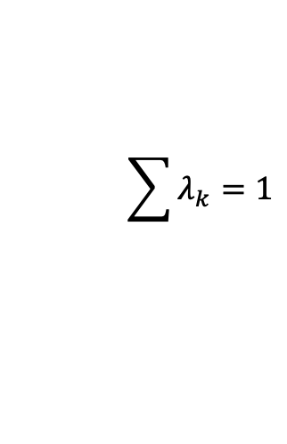


Loss functions
$$f_{ω}(x_{i})=θ_{i}$$
𝑥
f_{ω}
$$θ_{i}$$
Example: multiclass classification
$$\operatorname{Pr}\left(y=k\right)=λ_{k}$$
$$\sum{λ_{k}}=1$$
$${0<λ}_{k}<1$$
$$\operatorname{Pr}\left(\left(y=k | x\right)\right)={softmax}_{k}\left[f_{ω}(x)\right]$$
$$softmax\left(z\right)=\frac{e^{z_{k}^{ }}}{\sum_{k′}{e^{z_{k′}}}}$$

Slide 24
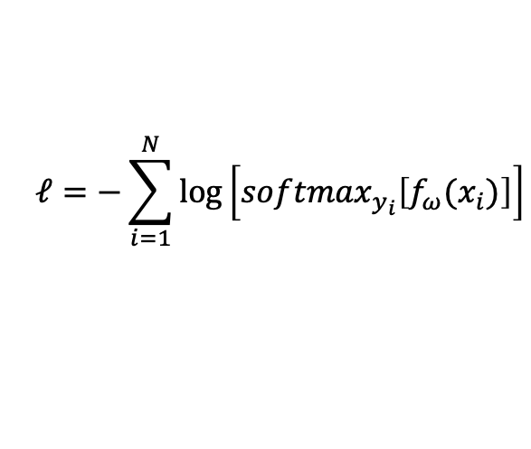
Loss functions
$$f_{ω}(x_{i})=θ_{i}$$
𝑥
f_{ω}
$$θ_{i}$$
Example: multiclass classification
$$\operatorname{Pr}\left(y=k\right)=λ_{k}$$
$$\sum{λ_{k}}=1$$
$$𝓁=−\sum_{i=1}^{N}{\log\left[{softmax}_{y_{i}}\left[f_{ω}(x_{i})\right]\right]}$$
NLL

Slide 25
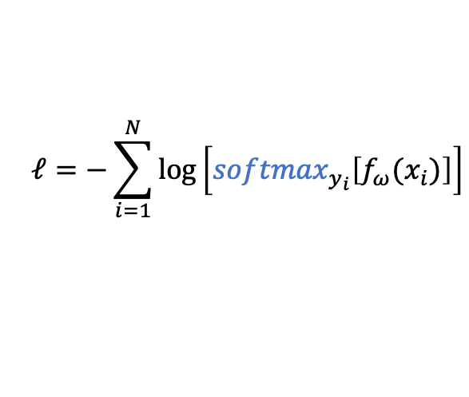
Loss functions
$$f_{ω}(x_{i})=θ_{i}$$
𝑥
f_{ω}
$$θ_{i}$$
Example: multiclass classification
$$\operatorname{Pr}\left(y=k\right)=λ_{k}$$
$$\sum{λ_{k}}=1$$
Wait, can I differentiate softmax?
Yes, and you will do it by hand in TP3!
$$𝓁=−\sum_{i=1}^{N}{\log\left[{softmax}_{y_{i}}\left[f_{ω}(x_{i})\right]\right]}$$
NLL

Slide 26
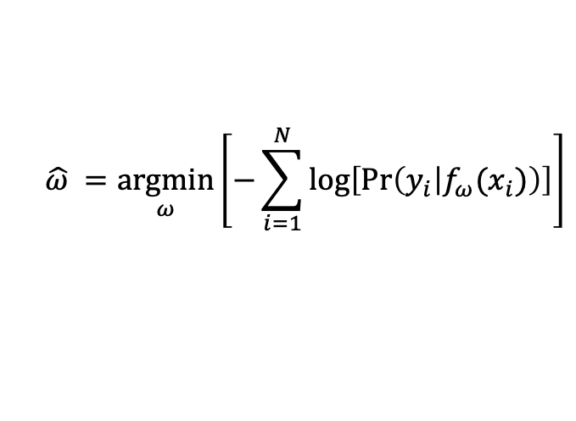
Loss functions
$$\hat{ω} =\underset{ω}{argmin}\left[−\sum_{i=1}^{N}{log⁡\left[Pr⁡\left(y_{i} | f_{ω}(x_{i})\right)\right]}\right]$$
Negative log likelihood (NLL)
is equivalent to the cross-entropy loss

Slide 27
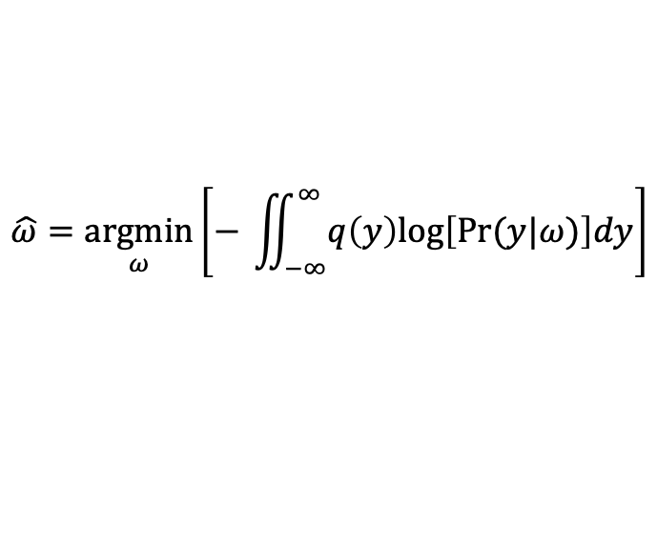
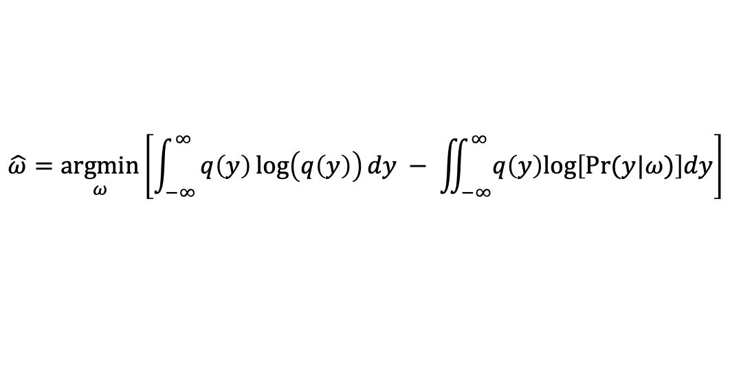
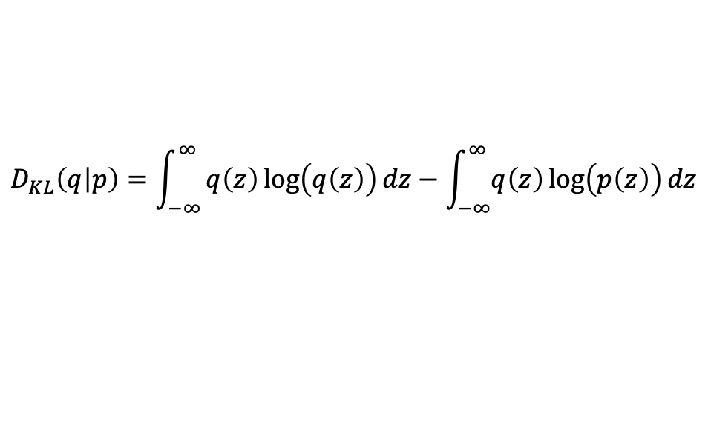
Loss functions
Given two distributions $q(z)$ and p$(z)$, the distance between the two distributions can be computed with:
$$D_{KL}\left(q | p\right)=\int_{−∞}^{∞}{q\left(z\right)\log\left(q\left(z\right)\right)dz−\int_{−∞}^{∞}{q\left(z\right)\log\left(p\left(z\right)\right)dz}}$$
Given an empirical distribution $q(y)$ and a model distribution $Pr\left(y | ω\right)$, we want to minimize the KL divergence:
$$\hat{ω}=\underset{ω}{argmin}\left[\int_{−∞}^{∞}{q\left(y\right)\log\left(q\left(y\right)\right)dy − \iint_{−∞}^{∞}{q\left(y\right)log⁡\left[Pr⁡(y|ω)\right]dy}}\right]$$
$$\hat{ω}=\underset{ω}{argmin}\left[− \iint_{−∞}^{∞}{q\left(y\right)log⁡\left[Pr⁡(y|ω)\right]dy}\right]$$

Slide 28
Loss functions
Given two distributions $q(z)$ and p$(z)$, the distance between the two distributions can be computed with:
$$D_{KL}\left(q | p\right)=\int_{−∞}^{∞}{q\left(z\right)\log\left(q\left(z\right)\right)dz−\int_{−∞}^{∞}{q\left(z\right)\log\left(p\left(z\right)\right)dz}}$$
Given an empirical distribution $q(y)$ and a model distribution $Pr\left(y | ω\right)$, we want to minimize the KL divergence:
entropy of q
divergence between q and p
$$\hat{ω}=\underset{ω}{argmin}\left[\int_{−∞}^{∞}{q\left(y\right)\log\left(q\left(y\right)\right)dy − \iint_{−∞}^{∞}{q\left(y\right)log⁡\left[Pr⁡(y|ω)\right]dy}}\right]$$
$$\hat{ω}=\underset{ω}{argmin}\left[− \iint_{−∞}^{∞}{q\left(y\right)log⁡\left[Pr⁡(y|ω)\right]dy}\right]$$

Slide 29

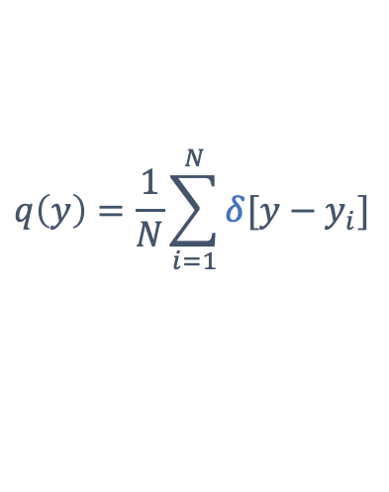
$$q\left(y\right)=\frac{1}{N}\sum_{i=1}^{N}{δ[y−y_{i}]}$$
Given many data points
$δ:$dirac
$$x_{i}$$
$$θ_{i}$$
Source: Understanding Deep Learning, S. Prince, 2023

Slide 30
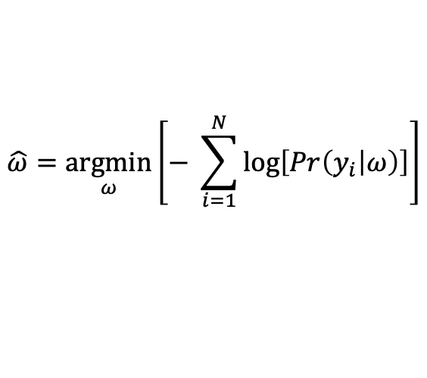
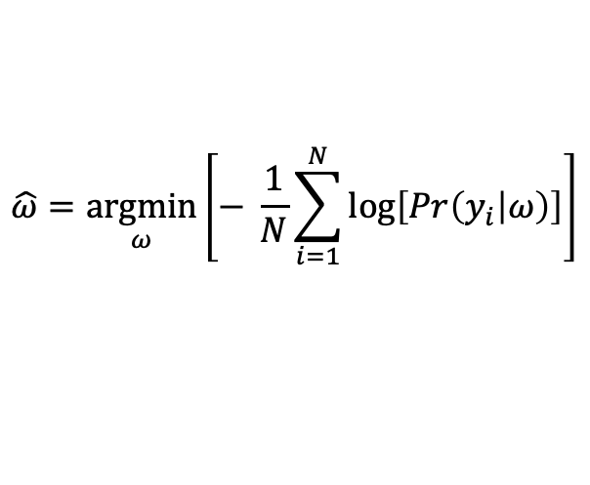
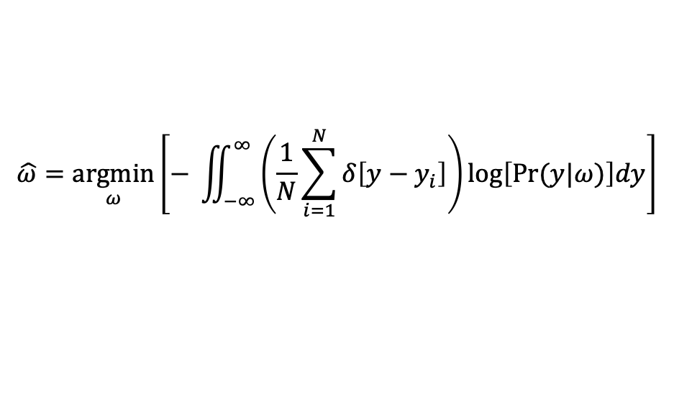
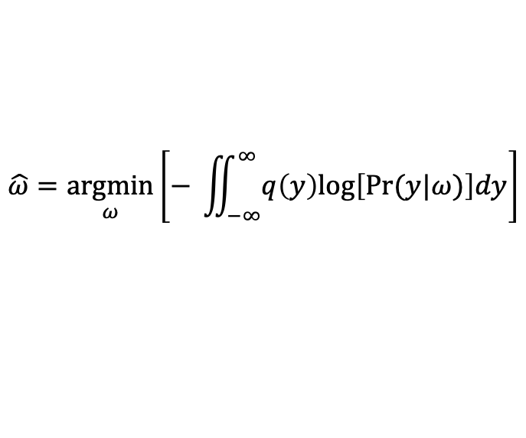
Loss functions
Given an empirical distribution $q(y)$ and a model distribution $Pr\left(y | ω\right)$, we want to minimize the KL divergence:
$$\hat{ω}=\underset{ω}{argmin}\left[− \iint_{−∞}^{∞}{q\left(y\right)log⁡\left[Pr⁡(y|ω)\right]dy}\right]$$
cross-entry loss
$$\hat{ω}=\underset{ω}{argmin}\left[− \iint_{−∞}^{∞}{\left(\frac{1}{N}\sum_{i=1}^{N}{δ\left[y−y_{i}\right]}\right)log⁡\left[Pr⁡(y|ω)\right]dy}\right]$$
$$\hat{ω}=\underset{ω}{argmin}\left[− \frac{1}{N}\sum_{i=1}^{N}{\log\left[Pr\left(y_{i} | ω\right)\right]}\right]$$
$$\hat{ω}=\underset{ω}{argmin}\left[− \sum_{i=1}^{N}{\log\left[Pr\left(y_{i} | ω\right)\right]}\right]$$
NLL

Slide 31
Given many data points
$$x_{i}$$
$$θ_{i}$$
Source: Understanding Deep Learning, S. Prince, 2023

Slide 32
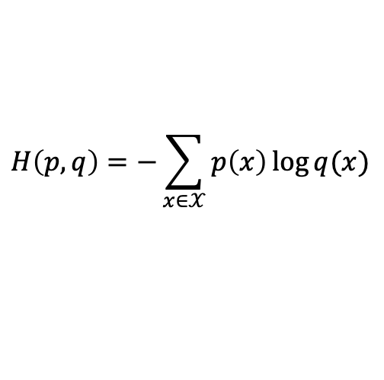
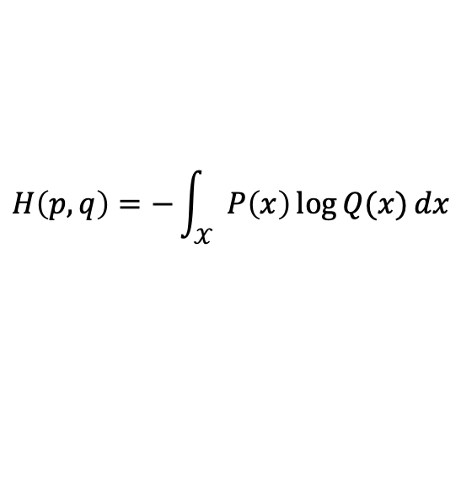

Loss functions
Definition of cross-entropy loss of distribution $p$ relative to distribution $q$ over the set $𝒳$:
$$H\left(p,q\right)=−E_{p}[\log{q}]$$
where $E_{p}[∙]$ is the expected value operator with respect to distribution p.
In the continuous case:
$$H\left(p,q\right)=−\int_{𝒳}{P\left(x\right)\log{Q(x)}dx}$$
In the discrete case:
$$H\left(p,q\right)=−\sum_{x∈𝒳}{p\left(x\right)\log{q(x)}}$$

Slide 33
TP2: makemore
Goal: Given a bunch of names, generate more “name-like” words.
1. Build a simple bigram model for next-character prediction
2. Build the same bigram model using the NLL loss
3. Implement a better model: [Bengio et al., 2003]

Slide 34



Step 1: bigram “by hand”
$$P_{27×27}$$
ix
$$θ_{i}$$
…
p = P[ix]
ix
$$x_{i}$$
…
ix = (sample from multinomial p)

Slide 35
Step 1: bigram “by hand”
The dot character (.) marks the beginning and end of a word.
When sampling, you need to stop when you hit that special character.
How to initialize a torch matrix of size 27x27 containing floats?

Slide 36
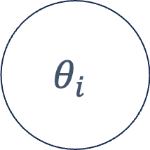
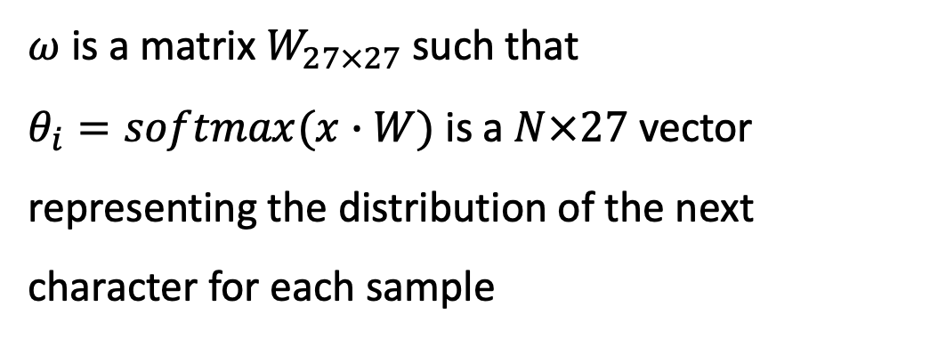


Step 2: bigram as a learnable matrix
$$f_{ω}(x_{i})=θ_{i}$$
𝑥
f_{ω}
$$θ_{i}$$
$$x_{i}=\left[0,0,0,1,0,…0\right]$$
$ω$ is a matrix $W_{27×27}$such that
$θ_{i}=softmax(x∙W)$ is a $N×27$ vector
representing the distribution of the next character for each sample
One-hot encoding of letter ‘d’

Slide 37
Step 2: bigram as a learnable matrix
$$x_{i}$$
…
One-hot encoding of letter ‘d’

Slide 38





Step 2: bigram as a learnable matrix
$$W$$
$$×$$
$$=$$
$$x_{i}$$
$$∘softmax$$
$$θ_{i}$$
…
…
One-hot encoding of letter ‘d’

Slide 39

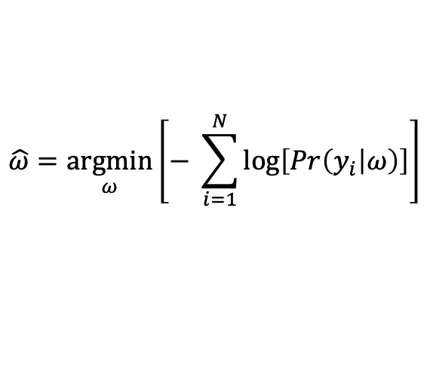
Step 2: bigram as a learnable matrix
$$W$$
$$×$$
$$=$$
$$x_{i}$$
$$∘softmax$$
$$θ_{i}$$
…
…
$$y_{i}$$
…
We want to minimize the KL divergence or NLL
$$\hat{ω}=\underset{ω}{argmin}\left[− \sum_{i=1}^{N}{\log\left[Pr\left(y_{i} | ω\right)\right]}\right]$$
NLL

Slide 40
Step 2: bigram as a learnable matrix
$$W$$
$$×$$
$$=$$
$$x_{i}$$
$$∘softmax$$
$$θ_{i}$$
…
…
$$y_{i}$$
…
We want to minimize the KL divergence or NLL
$$\hat{ω}=\underset{ω}{argmin}\left[− \sum_{i=1}^{N}{\log\left[Pr\left(y_{i} | ω\right)\right]}\right]$$
NLL

Slide 41
Step 2: bigram as a learnable matrix
…
…
…
…
$$x_{i}$$
…
$$θ_{i}$$
…
…
…
Loss = mean of log of the red values

Slide 42
Step 2: bigram as a learnable matrix
#forward pass
xenc = ??? # encode xs with F.one_hot
logits = ??? # multiply by W
counts = ??? # softmax
probs = ??? #
loss = ??? # sum of logs of probs

Slide 43
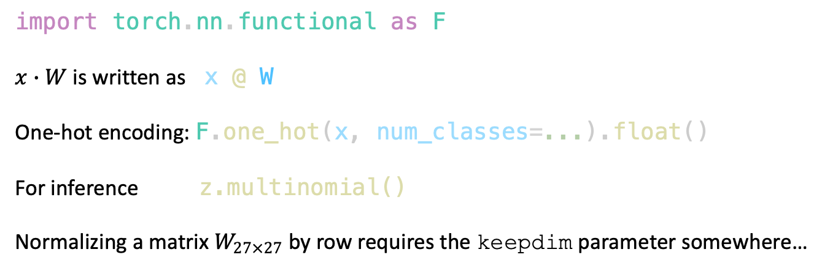
A few tips…
import torch.nn.functional as F
$x∙W$ is written as x @ W
One-hot encoding: F.one_hot(x, num_classes=...).float()
For inference z.multinomial()
Normalizing a matrix $W_{27×27}$ by row requires the keepdim parameter somewhere…

Slide 44
A few tips…
>>> a = torch.randn((7,7))
>>> a
tensor([[ 1.2555, 0.6821, 0.9131, -0.7238, 0.5636, -2.8689, -0.4744],
[ 2.1393, -0.8737, 2.4039, 0.0056, 0.6169, -0.2245, -0.2242],
[ 0.1821, -0.4250, -0.1115, -0.3568, -2.2182, 0.9574, 1.9415],
[-0.2646, 1.7013, -2.7297, 0.3786, -1.7883, 0.8484, -0.1894],
[-0.5430, -0.2352, 0.4820, -0.0737, 0.8632, 0.1648, 1.1864],
[ 1.3596, -0.6411, 2.9097, 0.9422, -0.0167, -0.1453, -0.6059],
[-0.4946, 0.2705, 0.5348, -1.8176, -1.3861, -1.0276, -1.0050]])
>>> a.sum(axis=1)
tensor([-0.6527, 3.8434, -0.0306, -2.0437, 1.8446, 3.8025, -4.9256])
>>> a.sum(axis=1, keepdim=True)
tensor([[-0.6527],
[ 3.8434],
[-0.0306],
[-2.0437],
[ 1.8446],
[ 3.8025],
[-4.9256]])

Slide 45
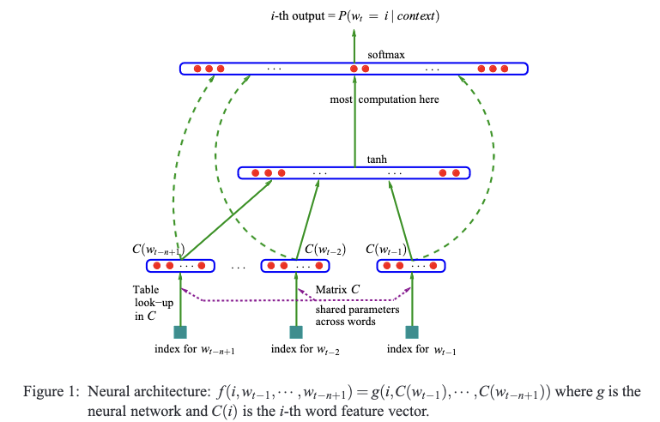
Step 3: A Neural Probabilistic Language Model
A Neural Probabilistic Language Model, Bengio et al, 2003

Slide 46



Step 3: A Neural Probabilistic Language Model
X_train = tensor([
[ 0, 0, 0],
[ 0, 0, 5],
[ 0, 5, 2], ...,
[25, 1, 14],
[ 1, 14, 14],
[14, 14, 9]])
$$logits=tanh⁡(W_{2}∙h+ b_{2})$$
$$h=tanh⁡(W_{1}∙emb+ b_{1})$$
emb = C[X_train[ix]]
emb = emb.view(…)
$C_{27x10}$= dictionary
A Neural Probabilistic Language Model, Bengio et al, 2003

