Slide 1
Template Engine
Nodejs

Slide 2
template engine?
目的 (Objective)：
將資料（Data）與模板（Template）結合
自動生成目標文件，提高開發效率, 統一開發模式
概念 (Concept)：
使用 YAML 進行配置
根據 YAML 配置，自動生成對應 Module

Slide 3
Core concept
Template (模板)
定義結構和佈局，包含變數和控制語法
範例: {{name}}, {{#each items}} ... {{/each}}
Data (資料)
提供模板渲染所需的內容
Renderer (渲染器)
將模板和資料結合，輸出最終文件

Slide 4
example
/** Controller 配置 **/
controllers:
name: "StatusController"
base_path: "statuses"
methods:
- name: "findAll"
http_method: "Get”
module:
name: "Status" /** 模組名稱 **/
tableName: "statuses" /** 對應資料表 **/
output_dir: ./custom_generated /** 輸出路徑 **/
fields: /** 欄位設定 **/
- name: "id"
type: "number"
primary_key: true
- name: "name"
type: "string"
generate_service: true /** 生成 Service **/
generate_repository: true /** 生成 Repository **/
/** Repository 方法 **/
repository:
methods:
- name: "findAll"
action: "findAll"
- name: "findOneById"
action: "findOne"
params:
- name: "id"
type: "number"
/** Repository 方法 **/
repository:
methods:
- name: "findAll"
action: "findAll"
- name: "findOneById"
action: "findOne"
params:
- name: "id"
type: "number"

Slide 5
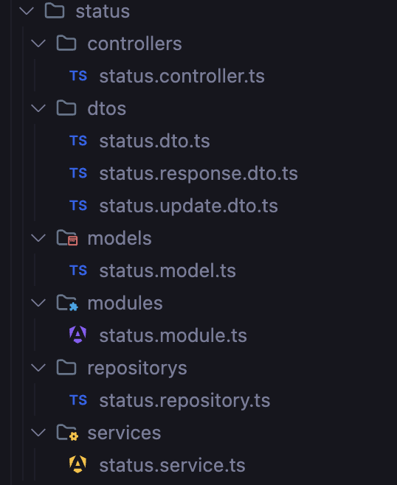
Module generated
This was generated based on the yml file.

Slide 6
Tech & tools used
HBS (Handlebars)
Nestjs
Node

Slide 7
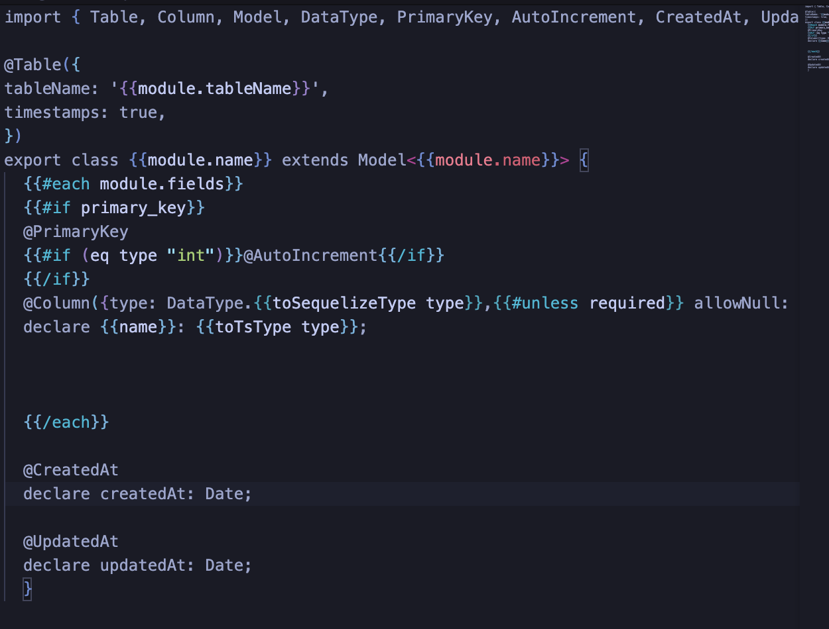
Model.hbs
Blueprint to render data and generate:
{{model_name}}.model.ts
Eg: status.model.ts

Slide 8
Aims
Completed
Module
Dto
Model
Service
Controller
Repository
Strategy
StrategyFactory
Database Connection
Upcoming wishes
Relation
Model
Services
Controller

