Slide 1
Where There is Life, There is Love

Slide 2

What am I going to do and what am I going to use for data?!

Slide 3

Process
Choose Data
Decide on what questions I wanted to answer with the data
Decide on technology stack to be used
Start HTML design
Reduce amount of data to come up with a new set of ‘final data’ to be analysed
Start cleaning and investigating ‘final data’
Start plotting/mapping
Deployment
More deployment
More and more deployment
Attempted deploying with Heroku, AWS, Azure, GoDaddy (paid hosting plan) then back to Heroku

Slide 4
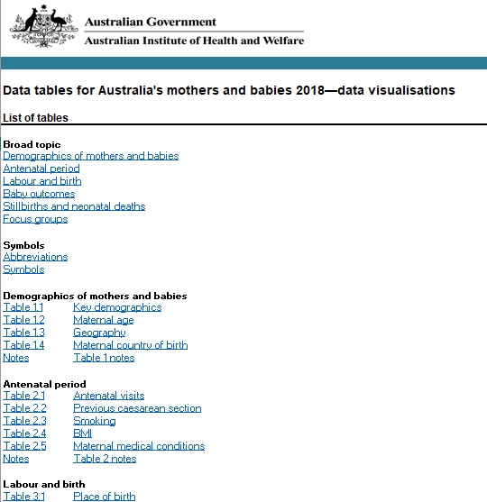
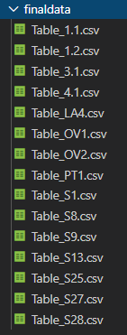
Data Sourcing & Decision Making
Wanted data with multiple variables to enable interesting results
Data source was in the form of excel workbooks
Decided to break the data down into a more manageable size
‘Final data’ set, derived for further work
‘Final data’ was derived by going through the initial questions I had written down to answer when I started my project
* 1 of 2 csv files downloaded

Slide 5








Infrastructure
VBA
Heroku
AWS
PostgeSQL
Flask
Machine Learning – Linear Regression
HTML/CSS
Javascript
Leaflet.js
Owl Carousel
D3.js
AmCharts.js

Slide 6
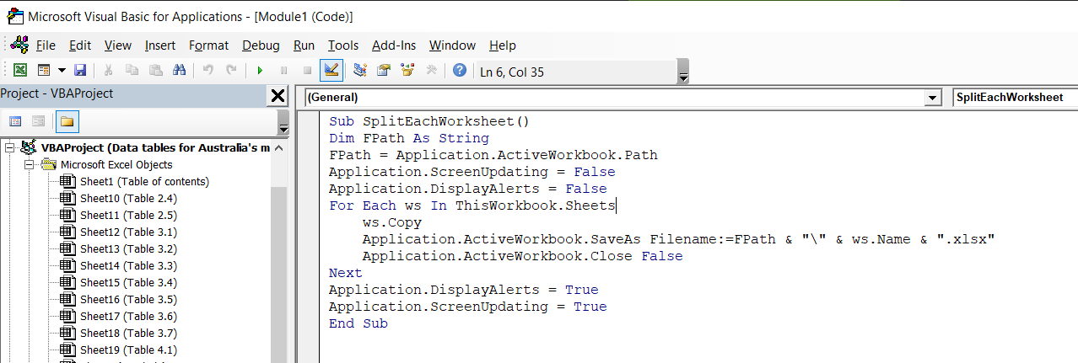
VBA
VBA was really important for me within this project, it was utilised in order to split each of the worksheets into their own excel file, which was a huge time saving in order to analyse and then create a final set of data to be utilised.

Slide 7
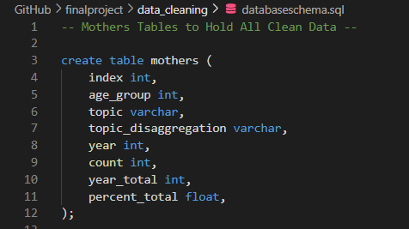
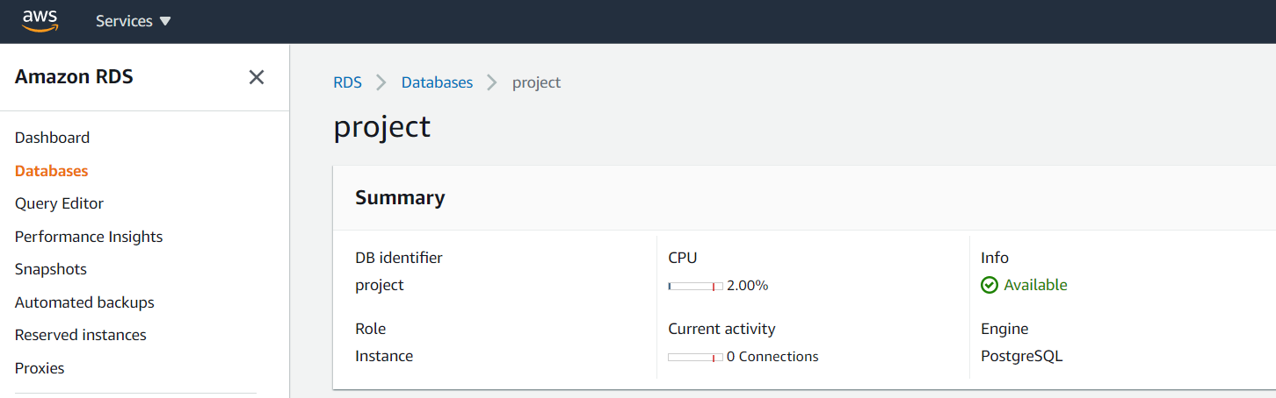
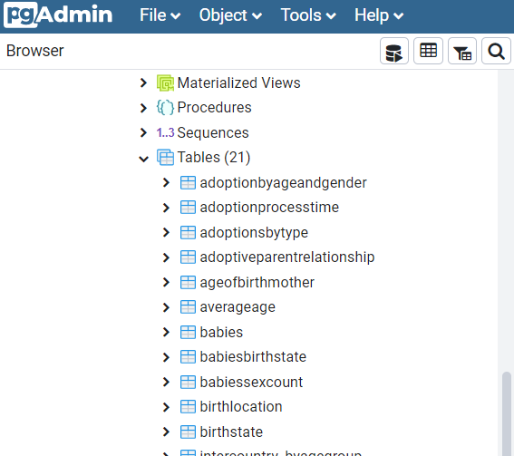
AWS & PostgreSQL
An AWS RDS instance was created in order to store my data, this was connected to my PostgreSQL Database in order to view and edit information with PGAdmin

Slide 8
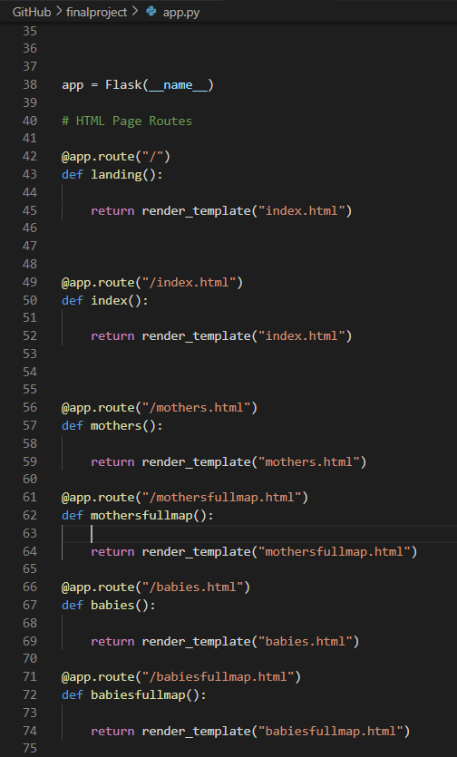
Flask
Flask is the one of the most important parts of my project.
Flask Process – Initial – Working Locally
Create the app which is able to render my HTML pages and link between each of them
Be able to call my data from DB through my flask app to create my own API (and have the data come through in the correct format)
Be able to access the data accurately to be able to plot
Flask Process – Current – Deployed on Heroku
App renders each of my HTML pages and links between each of them

Slide 9
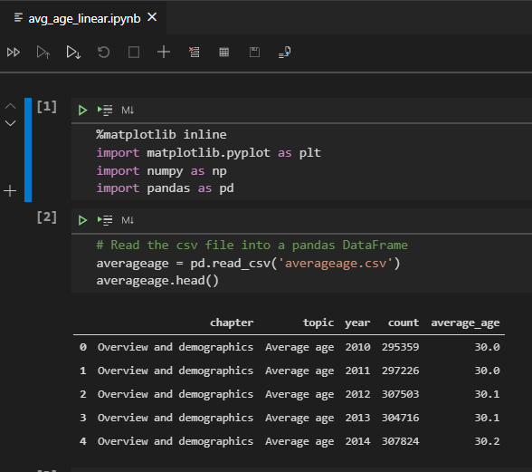
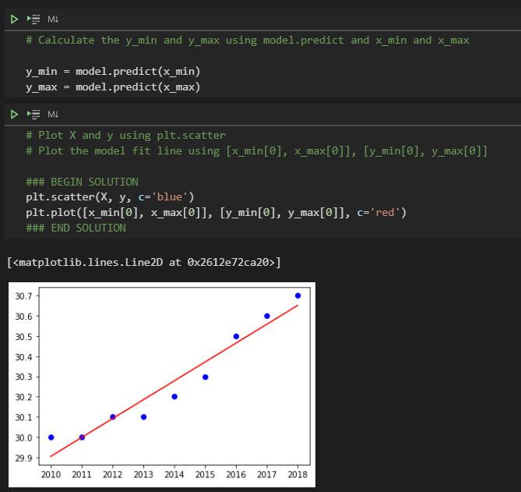
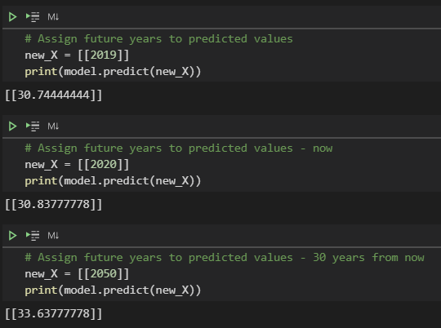
Machine Learning – Linear Regression
Linear Regression was used on one set of data, that was derived from a one excel file, taken from the ‘final data’ set. Simple machine learning model, but perfect for what I required, which was to be able to enter a year and to find out what the future average age of mothers would be in that year (or any year specified)

Slide 10
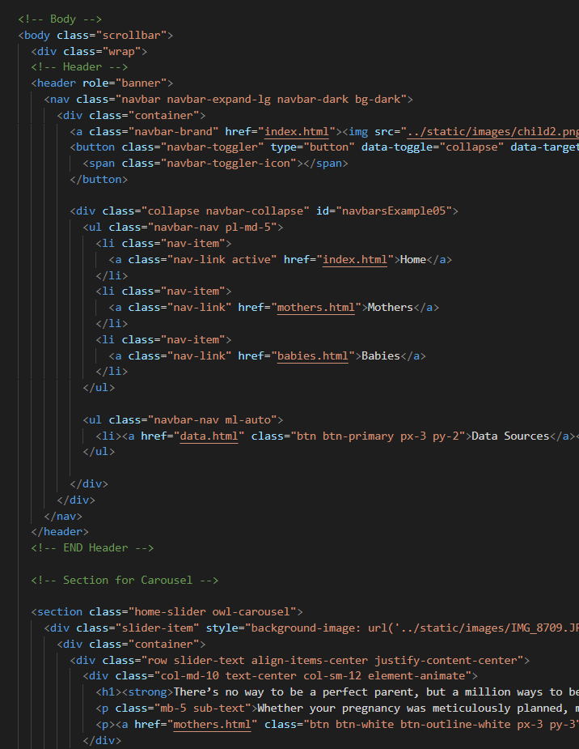
HTML/CSS/JavaScript
Aside from Flask, the HTML/CSS and JavaScript component(s) of my project are the most important to bring everything together.
The HTML framework is based on a couple of key libraries, Owl Carousel, and Bootstrap.
The charts utilise D3.js, amCharts.js and the maps are from Leaflet.js

Slide 11
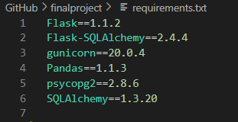



Heroku Deployment
There were a few key parts to my Heroku Deployment
requirements.txt file, to specify all of the packages required to be installed in Heroku when initialising the app
index.php file, in order to trick Heroku our app is a PHP Application.
Hypertext Preprocessor - PHP is a scripting language
Procfile, to specify the commands that are executed by the app on startup
composer.json file, specifys dependancies required, however even if there is none, a blank {} is required, to be recognised as a PHP application
Site Hosted on Heroku

Slide 12
Thanks!
Any questions?
You can find me at:
https://github.com/KirstieMcCown https://www.linkedin.com/in/kirstie-mccown/

