Slide 1
DASHBOARD DOCUMENTATION
---------------------------------------
BY - KIRT SWATCH (8800968)
Submitted to – Professor Amanda.

Slide 2
Submit Dashboard - Power BI (PBIX) file -
(File Attached below – Mental_Illness_US.pbix)
2. Submit Data – Submit data set or details to configure data access-
(File Attached below – Final_Polished_Dataset)
Final_Polished_Dataset

Slide 3
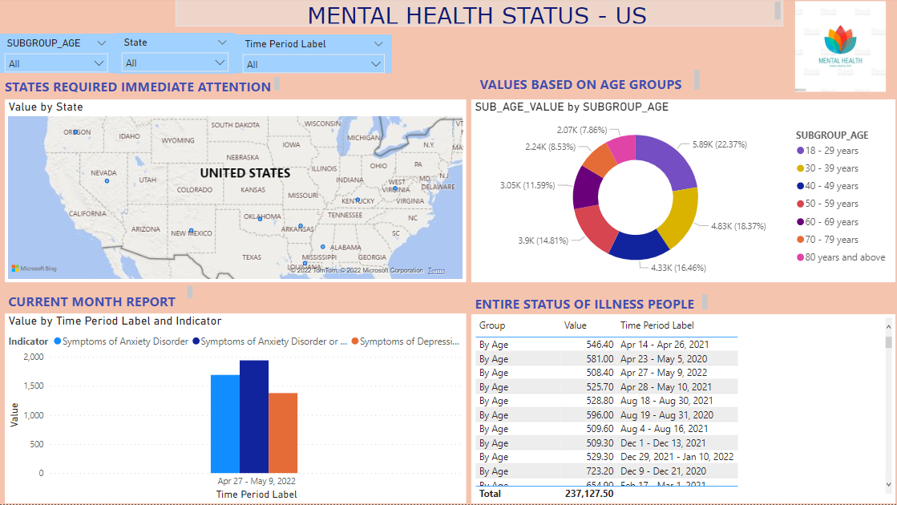
3. Dashboard Summary – Executive summary of the dashboard project, including description of the purpose, users, and screenshots of the layout and functionality.
SUMMARY - This Dashboard allows the doctors to search patients affected by mental health illness (Anxiety or Depression ) based on State (in US), Age group, Sexual Orientation, Ethnicity etc.
USERS & PURPOSE – All Baylor College Doctors , which they can decide where they need to open the mental cure clinic based on the dashboard data.
SCREENSHOT -

Slide 4
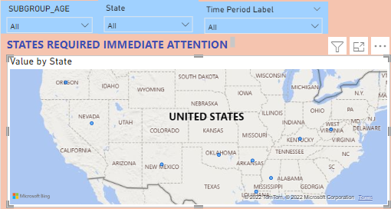
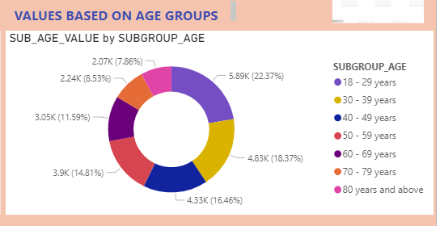
3. Dashboard Summary – continues …
First section of the dashboard explains the top 10 states in US having number of patients and those hotspots areas needs immediate help by opening hospitals or clinics. To check the exact numbers, click on blue dots for explained exact figures. Also added filters based on age, state and Time period.
2. Second section of the dashboard explains value of patients based on the different group ages. For instance, 18-29 Years group age is most affected by mental illness.

Slide 5
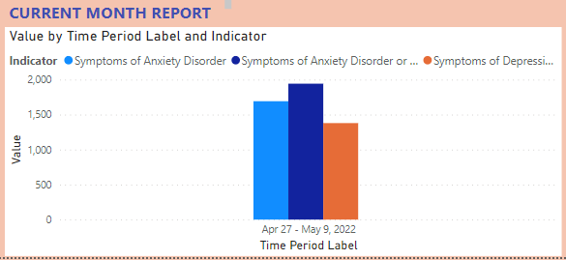
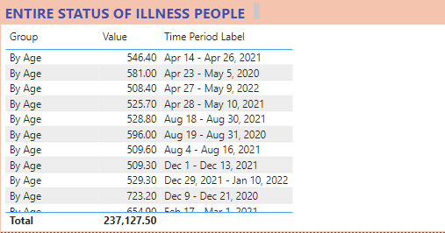
3. Dashboard Summary – continues..
3. This third section depicts the value (y - axis ) latest month report based on the Indicators (Anxiety, Depression or both)
4. This last portion of dashboard reports the sum of value based on age, Disability, sexual orientation , state of all Months' time period based on dataset.

Slide 6
4. Tester Instructions – List of steps for peer to configure your dashboard on their local machine
- Open the PowerBI PBIX File in your machine. Please note POWER BI software must be installed in your machine.
5. End-User Instructions –
- Data set includes Depression and Anxiety Mental illness patient's values, confidence level values based on different States in the united states , Age groups of patients , People with disability, sexual orientation patients etc. The recoded dataset has data from May 2020 till May 2022.
Doctors\End users can check the Dashboard and figure out the regions having most numbers mental disorder patients and act accordingly to open the clinics at hotspots. Please check the – “STATES REQUIRED IMMEDIATE ATTENTION” section in the dashboard to find out top 12 regions. In fact hover over near any figure to get insight of the data being shown in dashboard.
The data can be checked based on age group as well. There are filters as well on the top of the dashboard to filter the whole page based on Age, Time period and State.
For Troubleshooting – For this please check the excel sheet . Fields, Visualization and Filter options in the Power BI. Troubleshooting can also be done by manipulating the data being shown in the dashboard\by changing the values and observing the figures.

Slide 7
6. Design & Test Specifications – list the specifications from the Designer document, document and explain which requirements were met and unmet.
Pay attention to data quality – Yes, we are extracting the data from government site ‘Centers for disease control and prevention’
Include automated data – Not met, not sure how to implement automatic data upload to dashboard.
Add enough data for a complete picture – Yes, we have enough data in the dataset.
Data relevant to the job – Yes, I have polished the dataset and remove the unwanted data and rearrange few columns to fetch into the dashboard easily.
Add Sufficient filters – Yes, added filters on age, state and Time period.
All the dashboards must be dynamically responsive. – Yes, the dashboard is responsive.
Add sufficient colours that help to view the status easier. – Yes, the dashboard is flamboyant.
Rounding the numbers on your dashboard design should also be one of the priorities. - All the figures are rounded off till 2 decimal places.
Use labelling and formatting to your data that help to reduce the confusion. – Added heading on top of every design to make it easier to recognize the functionality.
Animation options can be one of the dashboard elements that give an additional neat visual impression. – Not met, not able to add animations to the dashboard.

Slide 8
7. Known Issues – Indicate, where required, the known issues or bugs within your dashboard
Issue 1 – The ‘subgroup’ column of the dataset is not pulling all the rows. Like – it contains following values –
- STATES
- SEXUAL ORIENTATION
- AGE GROUPS
- DISABILTIES
However, the dashboard is only pulling states of the US and ignoring other 3 options causing issues to showing data in the dashboard.
Issue 2 – We are not completely sure on the ‘value’ column ( showing some numbers ) if it depicts the number of Depressed \ Anxiety patients or not.
Issue 3 – We do not have up to date Dataset of the Mental Illness patients. The latest data is from May month. Also,
not sure on how to automatically upload the data so the report can show latest values.

