Slide 1
Used Cars Data Web Scraping Project
Internship Presentation

Slide 2
Contents
Introduction
3
Methodology
4
Dataset & Results
5
Visualizations & Findings
6
Conclusion
7

Slide 3
Introduction
3
Project Title: Web Scraping Used Car Data from Cars24
Objective: Scrape used car data for 5 brands (Hyundai, Tata, Honda , Renault,
Ford) in Mumbai
Scope: Collect 25 data points (5 models per brand) with details:
Car Name, Model Year, Kilometers Driven, Fuel Type,
Transmission Type, Price, Location
Tools: Python, Beautiful Soup, requests, pandas, seaborn,
matplotlib.

Slide 4
Methodology
Data Collection:
Defined URLs for each brand in Mumbai
Used requests to fetch HTML, Beautiful Soup to parse
Data Cleaning:
Converted Kilometers Driven and Price to float
Saved as cars.csv
Data Analysis:
Bar plot: Car counts by location
Scatter plot: Price vs. Kilometers Driven

Slide 5
Dataset & Results
Dataset (25 cars, 5 per brand):
Columns: Car Name, Model Year (2012–2024), Kilometers Driven (6.6k–110k km), Fuel Type (Petrol: 19, CNG: 3, Diesel: 3), Transmission (Manual: 20, Auto: 5), Price (1.98–7.64 lakhs), Location
Statistics (from df.describe()):
Kilometers Driven: Mean = 52.20k km, Min = 6.60k km, Max = 110.00k km
Price: Mean = 4.88 lakhs, Min = 1.98 lakhs, Max = 7.64 lakhs

Slide 6
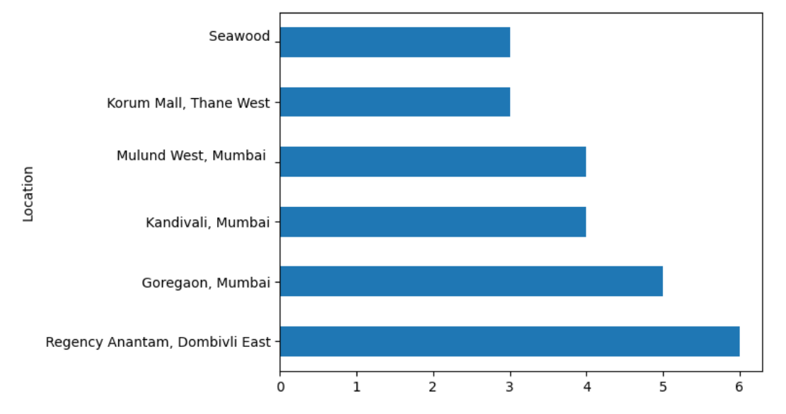
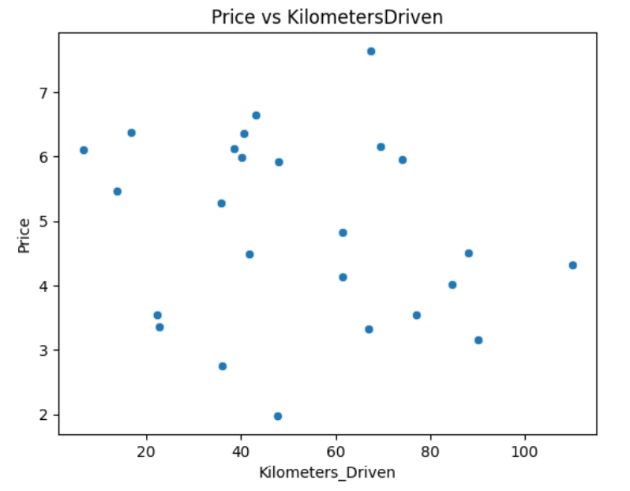
Visualizations & Findings
6
Car counts by location
Price vs. Kilometers Driven
Locations like Goregaon, Mumbai, and Regency Anantam, Dombivli East, have multiple listings
No clear linear relationship between price and kilometers driven

Slide 7
Conclusion
Scraped 25 used car listings from Cars24 for Mumbai
Processed data, visualized location distribution and price vs. kilometers driven
Saved as cars.csv
​

Slide 8
Thank you
Kirtana Arya Somyajula
kirtanaaryasomyajula@gmail.com

