Slide 1
Assignment Chart
Starting Procedure
1. Login New Recruiter User
2. View Recruiter Dashboard
3. View Job from Recruiter Dashboard
Career Site Procedure
4.Share this job Externally
5.Opt Career Site
6.Apply Now via Career Site
7.Fill up candidate details
On Career Site
8. Submit Application
9. Else Can Share with Friends
Candidate Movement Procedure
10. Can upload candidates in Bulk
11. Move on Applied Round
12. Accept the terms
13. Process till Offered Round
14. Else can opt Move to feature also if necessary
By :- Kirtee Shukla
Navi Mumbai

Slide 2
Database Queries
Basic syntax to get required information
Retrieve Job recruiters assigned to job created by you 🡪 job_recruiter
Select * from job_recruiter where job_seq= <your job seq> and job_recruiter.COMPANY_MSTR_SEQ=2
Retrieve all candidate details created by you 🡪 candidate, emp_refrl, user_profile
Select * from candidate cd INNER JOIN empl_refrl er ON cd.candidate_seq=er.candidate_seq INNER JOIN user_profile up ON up.user_profile_seq=er.user_profile_seq and up.user_id=< your email id> and cd.COMPANY_MSTR_SEQ=2
Retrieve job details created by you(by job_seq) 🡪 job, job_details
select * from job jb ,job_details jd
where jb.job_detail_seq=jd.job_detail_seq
and jb.job_seq=<your jobseq> and jb.COMPANY_MSTR_SEQ=2

Slide 3
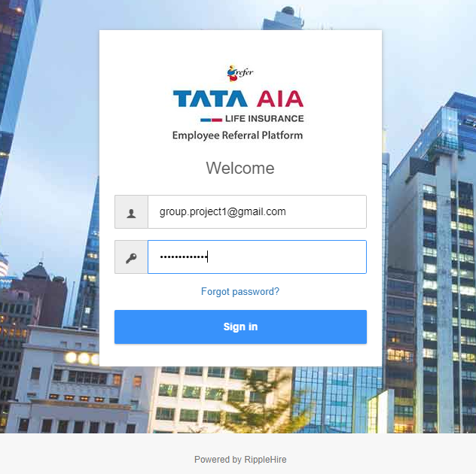
Login New Recruiter User

Slide 4
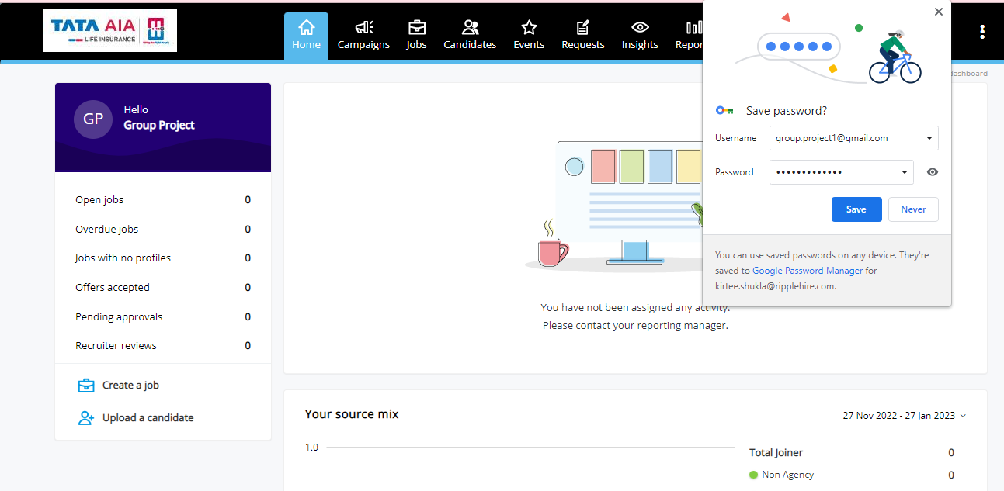
View Recruiter Dashboard

Slide 5
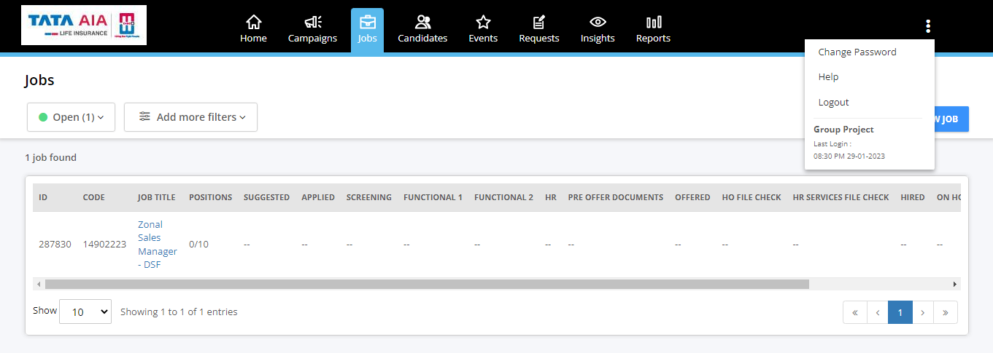
View Job from Recruiter Dashboard

Slide 6
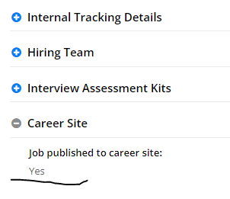
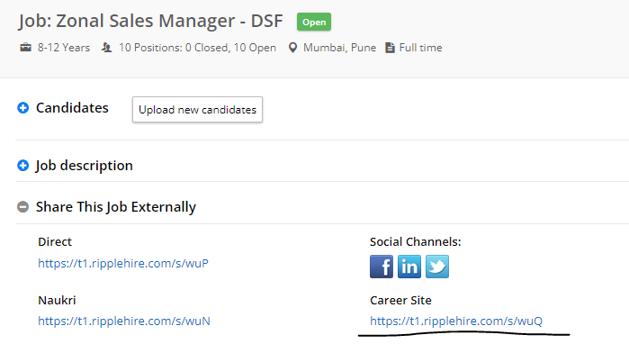
Share Job On Career Site

Slide 7

Apply Job On Career Site

Slide 8
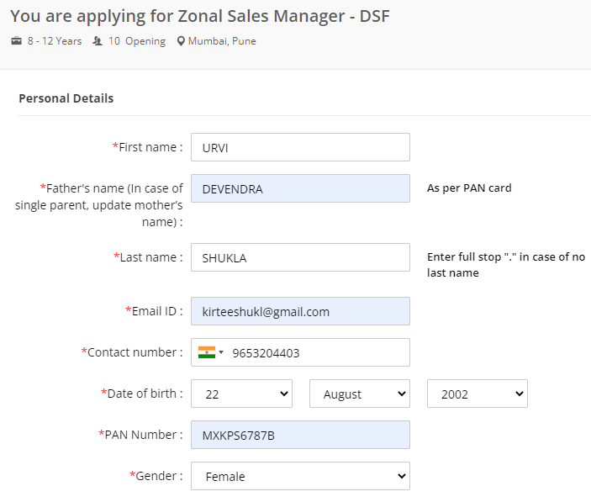
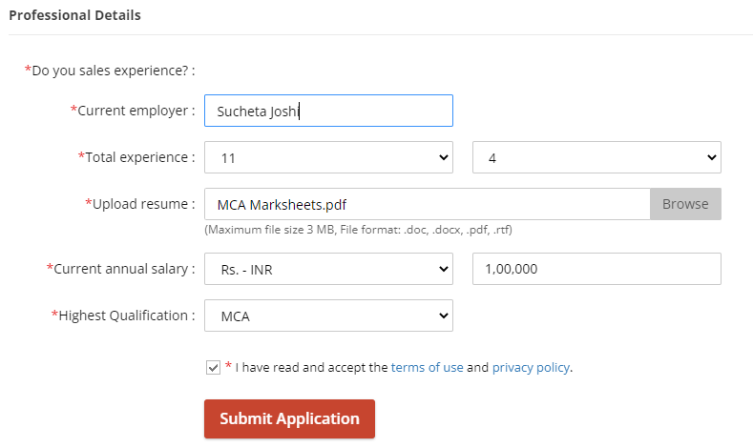
Fill Up Candidate Details On Career Site

Slide 9
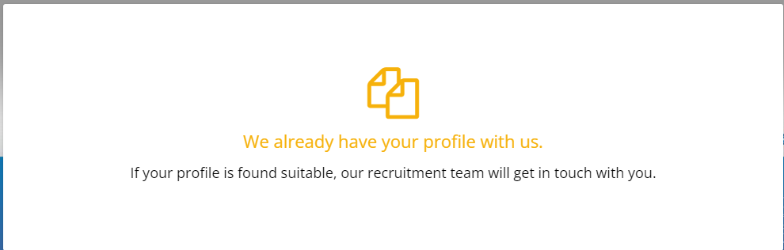
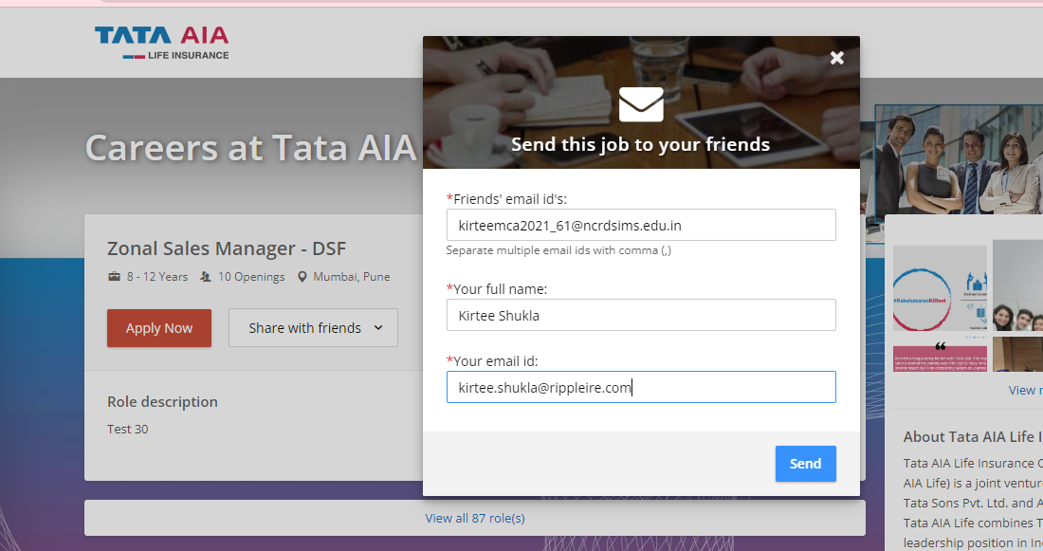
Submit Application

Slide 10
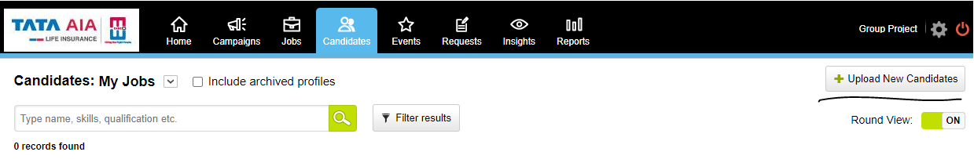
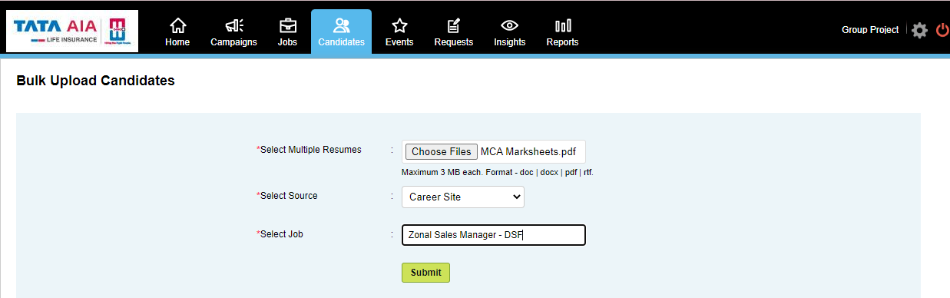
Upload New Candidates From Candidates Tab

Slide 11
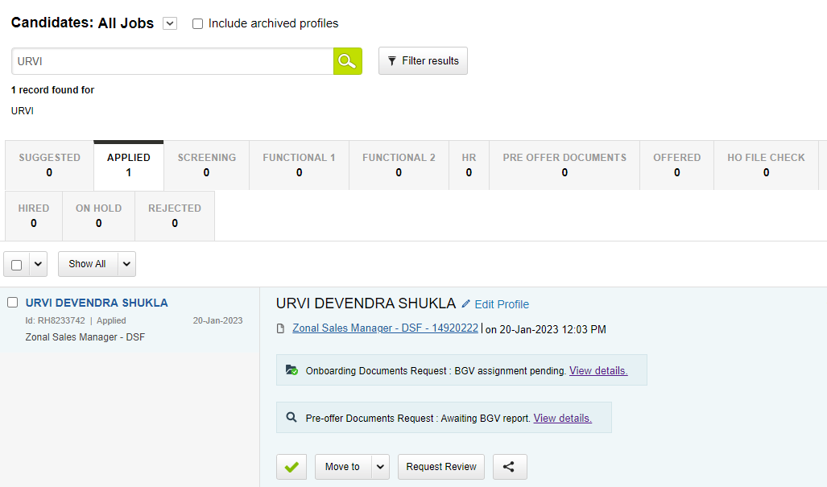
Candidate Move On Applied

Slide 12
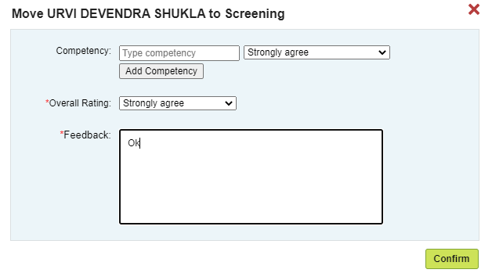
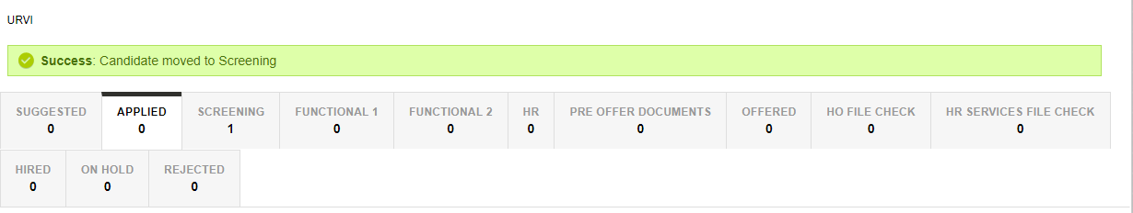
Candidate Move On Screening

Slide 13
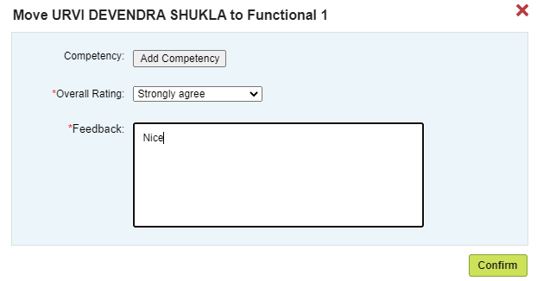
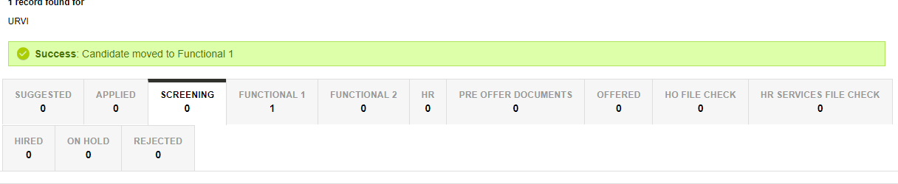
Candidate Move to FUNCTIONAL 1

Slide 14
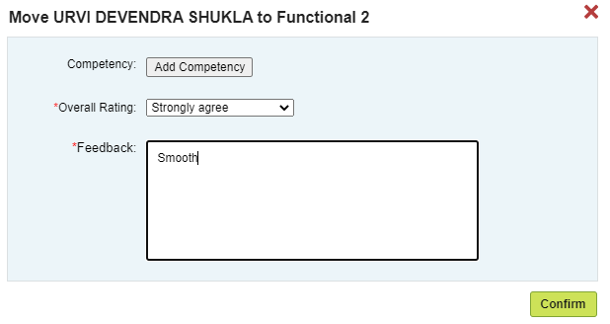
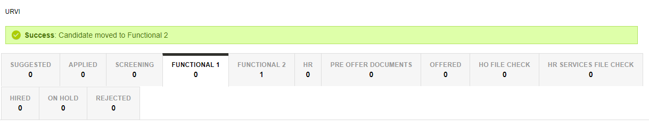
Candidate Move to FUNCTIONAL 2

Slide 15
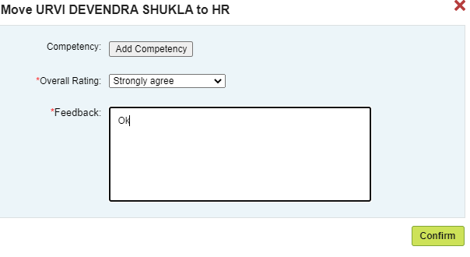
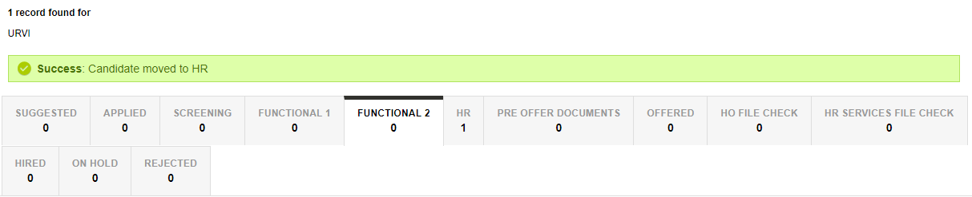
Candidate Move to HR

Slide 16
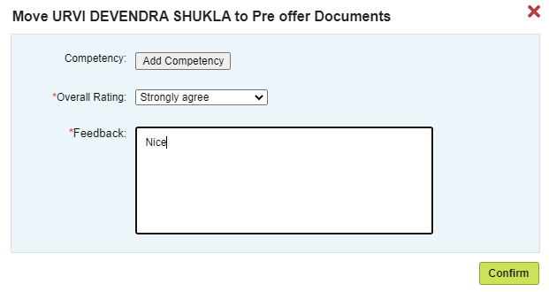
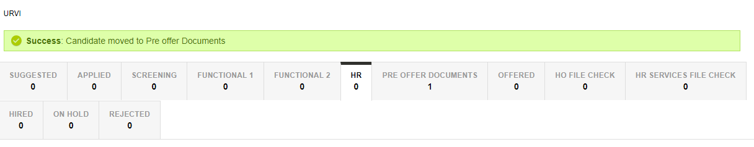
Candidate Move to Pre Offer

Slide 17
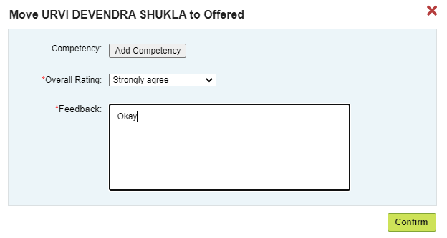
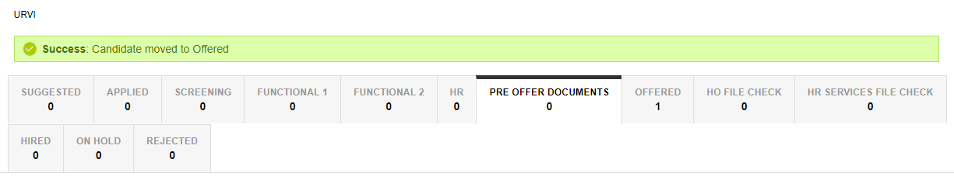
Candidate Move On Offered

Slide 18


