Slide 1

Predicting the success of bank telemarketing calls
Objective:
A Data-Driven Approach to predict the success of telemarketing calls for selling bank long-term deposits by creating a classification model based on neural net.
In addition, we want to devise a segmentation method based on Naïve Bayes to predict different likelihood of Client to become a subscriber.
Third objective is to assign clients in multiple groups by means of clustering, so business can measure how different clusters perform and can devise strategies for different groups.
Data:
The data is related with direct marketing campaigns (phone calls) of a Portuguese banking institution from 2008 to 2013.
https://archive.ics.uci.edu/ml/datasets/bank+marketing

Slide 2
Data Definition and Features
Features
1 – age (numeric)
2 - job : type of job (categorical: "admin.","unknown","unemployed", ……..,"management","housemaid, ")
3 - marital : marital status (categorical: "married","divorced","single"; note: "divorced" means divorced or widowed)
4 - education (categorical: "unknown","secondary","primary","tertiary")
5 - default: has credit in default? (binary: "yes","no")
6 - balance: average yearly balance, in euros (numeric)
7 - housing: has housing loan? (binary: "yes","no")
8 - loan: has personal loan? (binary: "yes","no")
# related with the last contact of the current campaign:
9 - contact: contact communication type (categorical: "unknown","telephone","cellular")
10 - day: last contact day of the month (numeric)
11 - month: last contact month of year (categorical: "jan", "feb", "mar", ..., "nov", "dec")
12 - duration: last contact duration, in seconds (numeric)
# other attributes:
13 - campaign: number of contacts performed during this campaign and for this client (numeric, includes last contact)
14 - pdays: number of days that passed by after the client was last contacted from a previous campaign (numeric, -1 means client was not previously contacted)
15 - previous: number of contacts performed before this campaign and for this client (numeric)
16 - poutcome: outcome of the previous marketing campaign (categorical: "unknown","other","failure","success")
Output variable (desired target):
17 - y - has the client subscribed a term deposit? (binary: "yes","no")
Total number of records: 45 thousand, with 16 features and 1 target variable
We have assigned “Class” label; class 0 (positive) for records subscribed to term deposit (y=yes) and Class=1 for N. As our positive result class is of people who are subscribing to deposit account.

Slide 3
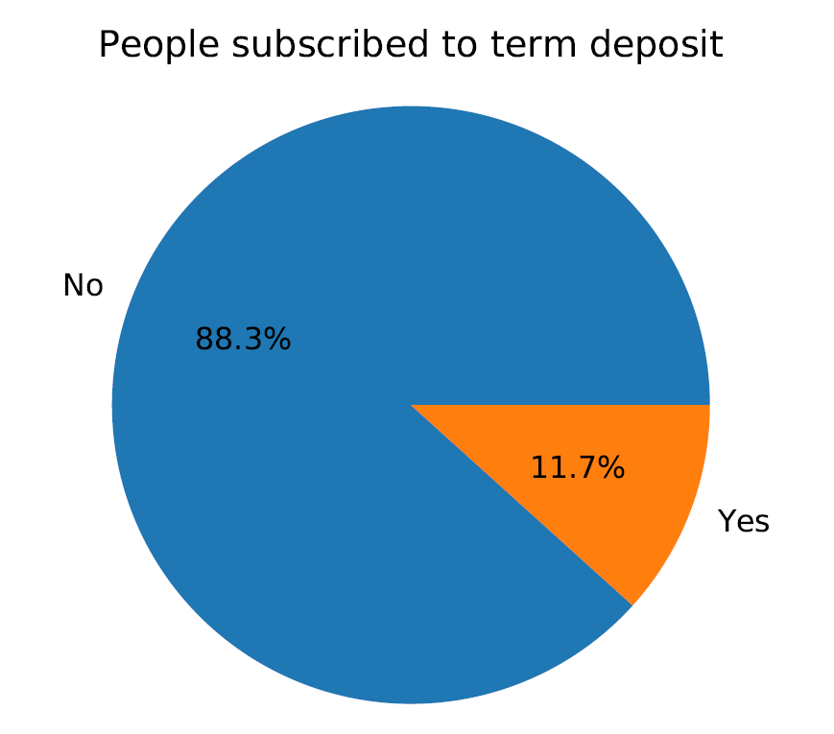
Data Discovery:
Before applying modelling, we need to do the data discovery to see what all data preprocessing we require or any other transformation we need to do.
The very first thing that we have noticed in our data is that we have both categorical and continuous variables. So, we need to handle them appropriately before classification.
The data don’t have missing values or having bad records, but it has several outliers for different features that we have eliminated.
The next thing we have observed is that the number of features is little high. In the published paper, it has mentioned that they have already reduced the features, but we will still subject it to different feature selection methods and compare the results of classifiers with full features vs reduced feature set.
The fourth thing we have observed is that the data has class imbalance with only 11% of records in subscribed Class, as shown in the pie chart here.

Slide 4
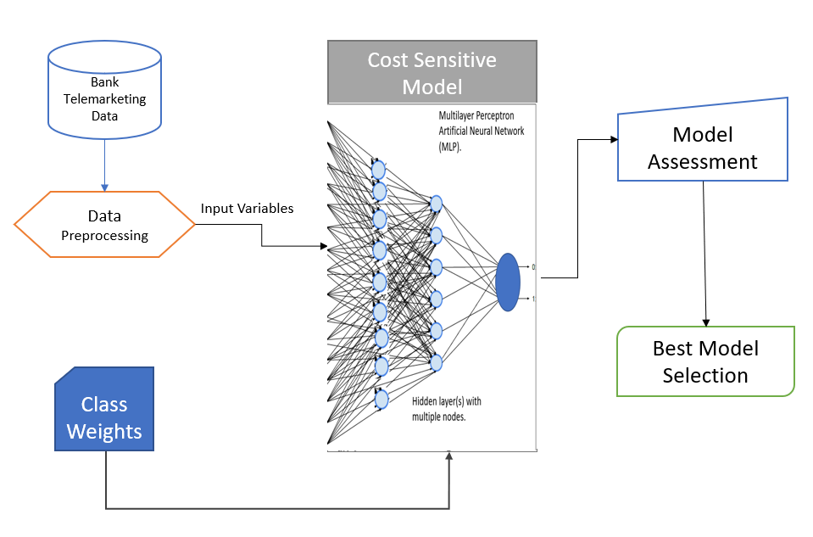
Classification
I have used Artificial Neural network to classify the clients as potential subscriber or not.
The benefit of using ANN is that it can learn and model non-linear and complex relationships, which is important for the real-life dataset like bank telemarketing.
To address the class imbalance, I have implemented Cost-sensitive model through re-weight of class errors, and it has resulted in significant performance jump from 42% to 86% in Recall rate.
Iteratively executed classification with different class weight factors and different hyper parameters for Neural Network and store the classification performance metrics like TP, FP, TN, FN, Recall, Accuracy, Precision to select the best architecture, model and hyper-parameters.

Slide 5
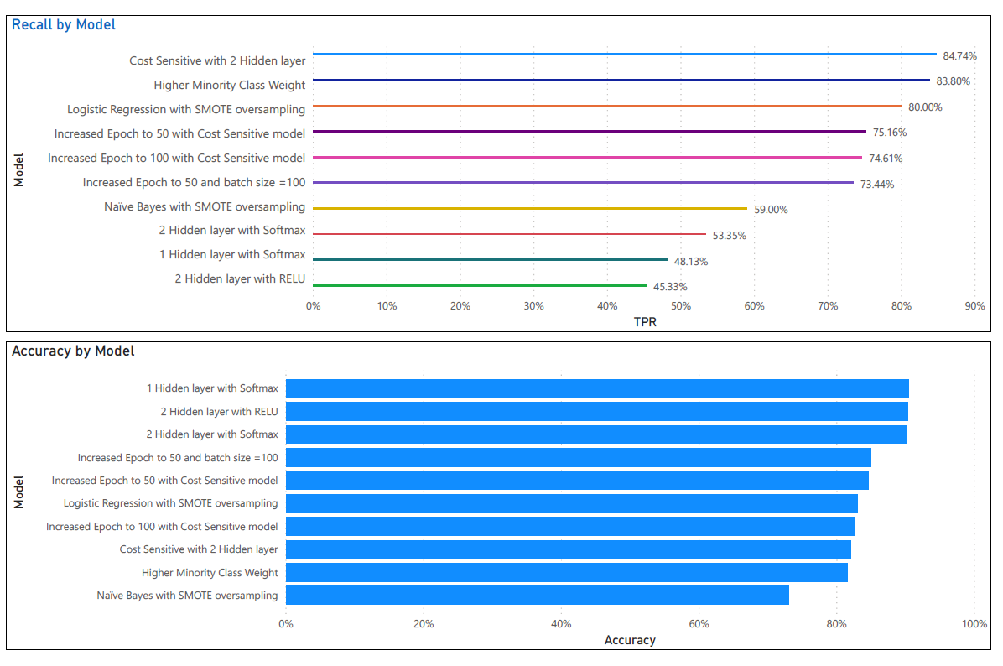
Classification
Performance of different architecture, activation functions and hyper-parameters are shown here for comparison.
As our main goal was to find people who will subscribe to term deposit, we are interested in high Recall value.
The key observation here is to see the jump in performance after class imbalance handling.
I have also used the Naïve Bayes and Logistic regression methods on the same dataset with class imbalance handling and observed that the ANN has better Recall and Accuracy.
Another observation is increasing the epoch and batch size beyond a certain point has no positive impact, contrary it will reduce performance, so we must find optimal values for all hyper-parameters which is a very difficult task.

Slide 6
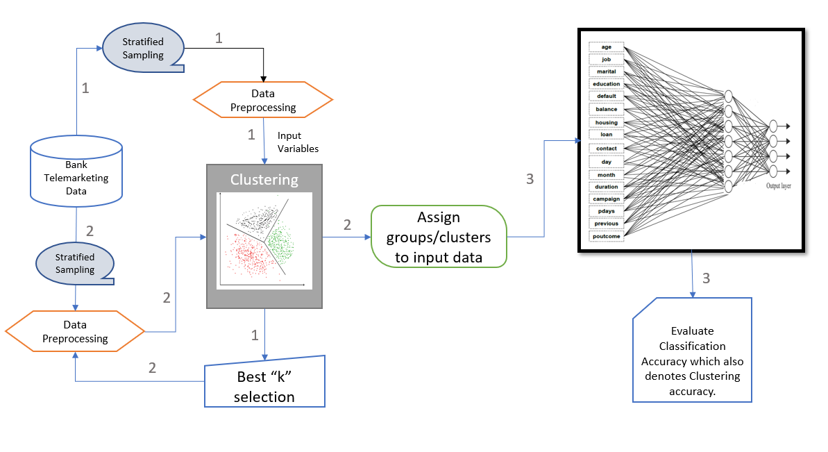
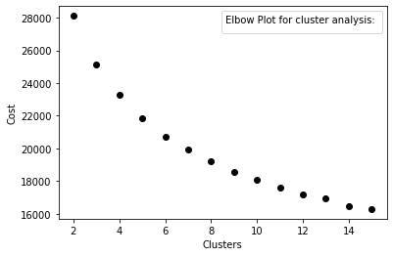
Clustering:
Assign the clients in multiple groups by means of clustering based on their similarity of features.
I have used K-Prototype, which is a simple combination of K-Means and K-Modes in clustering mixed attributes. It is a great tool for applying unsupervised machine learning for mixed data type.
First, I have run the iterative clustering with small stratified sample to find the optimal number of clusters.
Used External evaluation method to assess the quality of clustering by treating each cluster as a separate Class and build a multi-class Neural Network classification model on top of it to find the performance. If the clusters are of high quality, the classification model will be able to predict them with high accuracy.
We found the overall accuracy for K-Prototype clustering by means of multi-class ANN network at 96% which is quite good and proves that the clusters are of high quality.

Slide 7
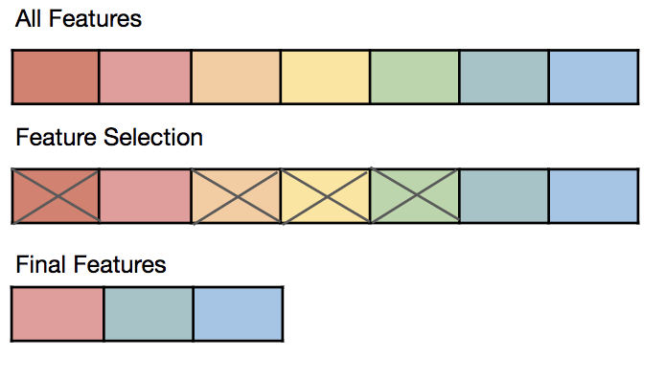
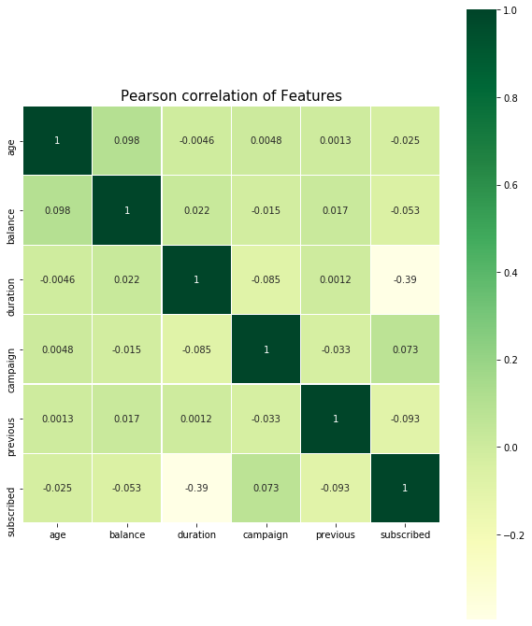
Feature Selection
Feature selection plays a vital role in the performance and training of any machine learning model.
Ideally, we should only retain those features in the dataset that help our ML model learn something.
Recursive feature elimination using logistic regression as the model:
First, the estimator is trained on the initial set of features and the importance of each feature is obtained either through a coefficient attribute or through a feature importance.
Then, the least important features are pruned from the current set of features.
Recursive feature elimination (RFE) select features by recursively considering smaller and smaller sets of features. The features which were selected are ranked as 1.
Columns selected from logistic RFE are:
[age,balance,campaign,contact,default,duration,housing,loan,pdays,previous]
Genetic Algorithm:
Genetic algorithm is one of the most advanced method for feature selection.
It usually performs better than traditional feature selection techniques and manage data sets with many features.
Columns selected from GA feature selection are:
[age,balance,contact,default,duration,education,loan,marital,poutcome,previous]
Classification ran with reduced feature set has slightly better performance, which is quite good since initial data itself has been provided with only applicable attributes, and reduced from 210 to 16 attributes, yet we are able to reduce it further.

Slide 8
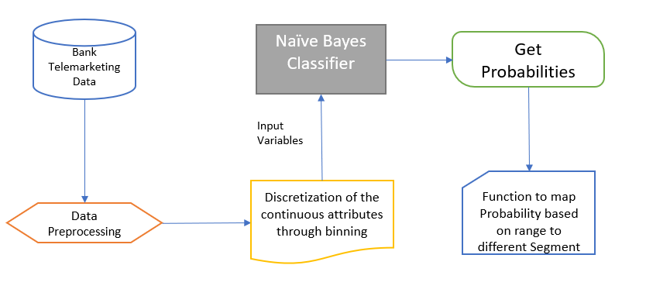
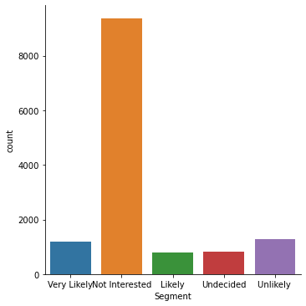
Segmentation
Instead of basic classification of client as likely subscriber or not, we want to perform advanced multi-class classification or segmentation based on confidence score, so we can classify client as ‘Very likely’, ‘Likely’, ‘Less Likely’ or ‘Not Likely’ subscriber.
I have used Naïve Bayes classifier and instead of collecting output as Class, I have collected probability for both positive and negative class and then subject the result to a pre-defined function which provides segment of client as based on range of probability.

Slide 9

Presented By: Kirtesh Jha

