Slide 1
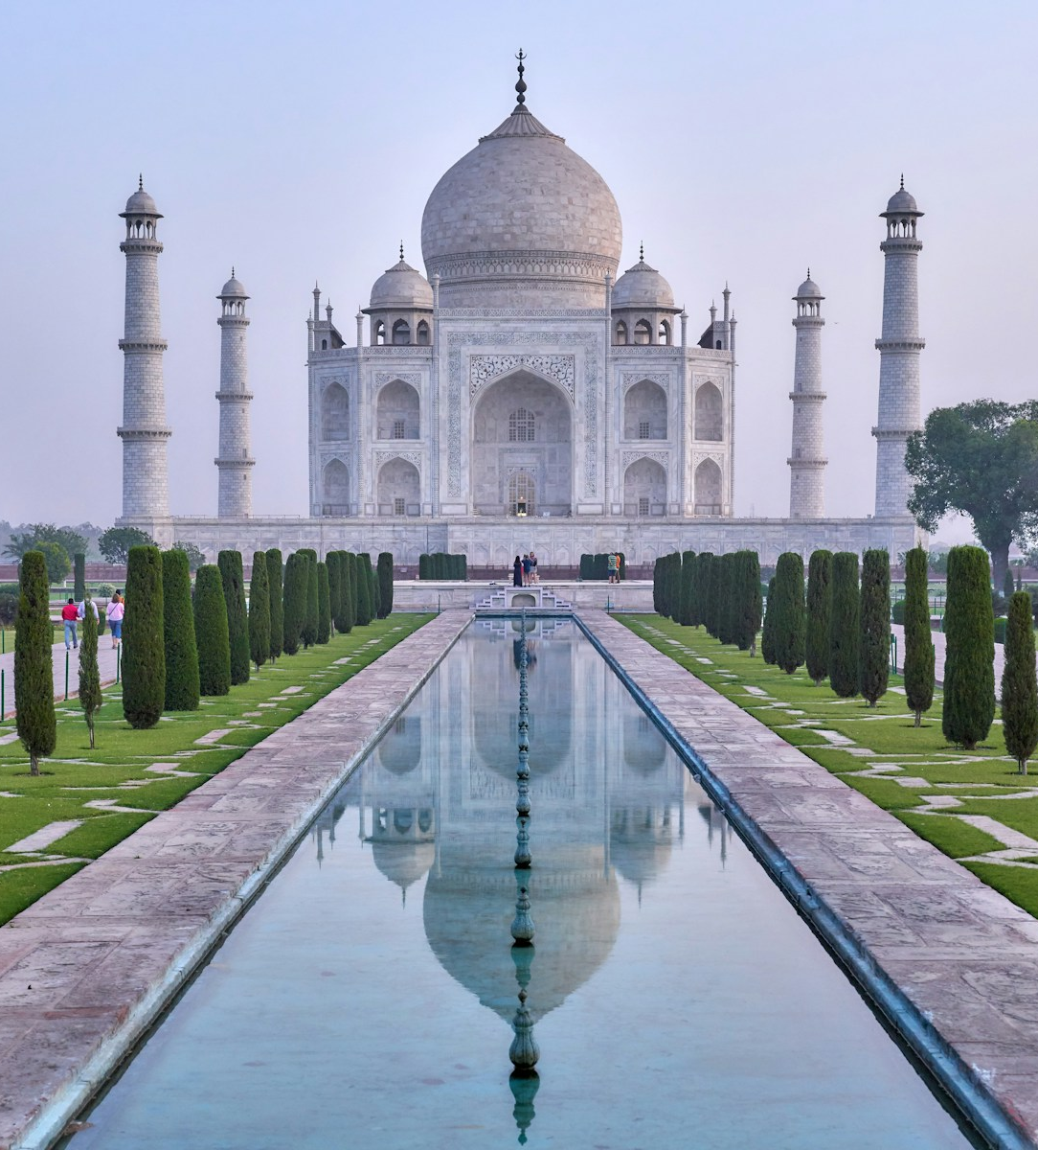
MACHINE LEARNING PROJECT
Tourist Destination
Recommendation
System Using KNN
A profile-based way to shortlist trips across India
Python, Streamlit, Pandas, NumPy and scikit-learn
Notes:
Slide 1 — Tourist Destination Recommendation System Using KNN
“Good morning everyone. My project is a Tourist Destination Recommendation System that uses the K-Nearest Neighbors algorithm, or KNN. It compares a traveler’s budget, trip length, and interests with example destination profiles, then suggests the five closest matches. I’ll explain the data, how the algorithm works, and how the app presents its results.”

Slide 2
Project objective
Turn a short set of travel preferences into a ranked destination shortlist.
The travel choice has
more than one dimension
01
02
03
Describe the trip
Compare profiles
Explain the shortlist
A budget and a free weekend matter. So do the experiences a traveler wants from the trip.
Budget, days away and four interest ratings form one profile.
KNN measures distance to the curated destination rows.
The app shows five names, sample budgets, days and distances.
This project compares all of those inputs together and returns five nearby destination profiles.
02
Notes:
Slide 2 — Project objective
“Choosing a destination involves more than one thing. A traveler may have a budget and a limited number of days, but they also have personal interests. This project combines those preferences and compares them with the destinations in its dataset. The result is a ranked shortlist. It’s a learning project, so it doesn’t provide live prices or book trips.”

Slide 3
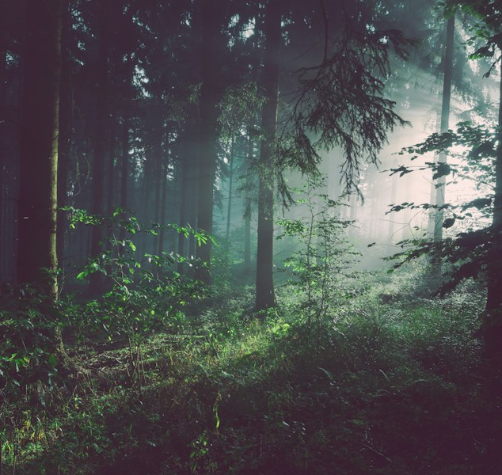

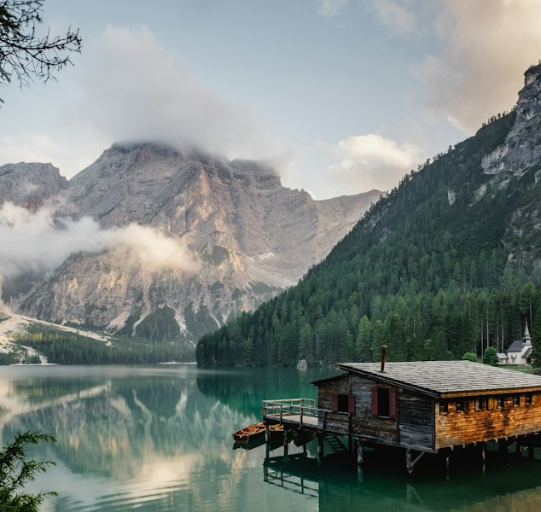
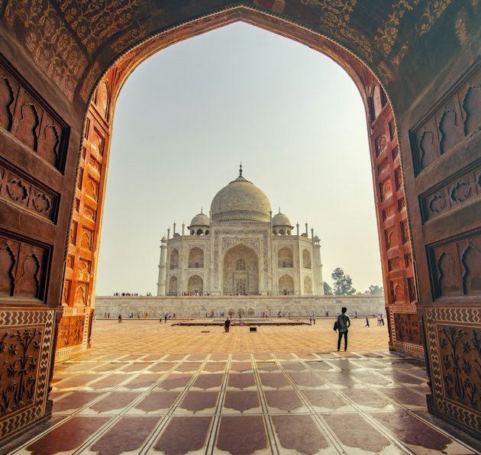
The traveler profile
Two trip constraints and four interest ratings become six numeric model inputs.
Trip constraints
Rate each interest from 1 (low) to 10 (high)
Budget
₹30,000
Time away
5 days
Nature
Beach
Adventure
Culture
Scenery and outdoors
Coastal experiences
Active experiences
History and heritage
Illustrative input profile shown for the worked example
03
Notes:
Slide 3 — The traveler profile
“The app builds a traveler profile from six numeric inputs. Two describe the trip: budget and number of days. The other four are interest ratings for nature, beaches, adventure, and culture, each on a scale from one to ten. The example we’ll use has a budget of thirty thousand rupees, five days, and ratings of seven, four, six, and seven.”

Slide 4
The destination dataset
A compact CSV provides the profiles the app can recommend.
35
₹14k–₹58k
2–8
4
destinations
sample budgets
suggested days
regions
Rows by region
Coverage is uneven
North and South India account for 25 of the 35 rows. The model can only retrieve destinations present in this file.
All budget figures and interest scores are illustrative project data.
04
Notes:
Slide 4 — The destination dataset
“The dataset contains 35 destination profiles. Their illustrative budgets range from fourteen thousand to fifty-eight thousand rupees, and their suggested stays range from two to eight days. The chart shows how many destinations belong to each region. North and South India account for 25 of the 35 entries, so the dataset has more coverage in those regions.”

Slide 5
What each destination row contains
Destination, State and Region provide context. Six numeric columns drive the KNN distance.
Model field | Meaning | Representation
Budget | Illustrative trip estimate | Indian rupees
Days | Suggested trip duration | Whole days
Nature | Nature and scenery interest | Score from 1 to 10
Beach | Beach interest | Score from 1 to 10
Adventure | Adventure interest | Score from 1 to 10
Culture | Culture and history interest | Score from 1 to 10
Example row
Shimla
₹26,000 · 5 days
Nature 9
Beach 1
Adventure 6
Culture 7
Himachal Pradesh and North India are metadata for display and filtering. They are not model features.
05
Notes:
Slide 5 — What each destination row contains
“Each row contains a destination name, budget, duration, and four interest scores. For example, Shimla has a sample budget of twenty-six thousand rupees and a suggested stay of five days. Its interest scores are nine for nature, one for beaches, six for adventure, and seven for culture. State and region help with display and filtering, but they aren’t included in the distance calculation.”

Slide 6
Why the app standardizes its features
The inputs use different units and ranges, so raw distances would be misleading.
Before scaling
StandardScaler
Budget values are in tens of thousands of rupees. Interest scores sit between 1 and 10.
z = (x − μ) / σ
Subtract the feature mean, then divide by its standard deviation.
A raw Euclidean distance would be dominated by the budget numbers.
Fit once on destination rows. Transform the traveler with that same scaler.
Standardized inputs
Budget · Days · Nature · Beach · Adventure · Culture
06
Notes:
Slide 6 — Why the app standardizes its features
“The inputs use different scales. Budget is measured in thousands of rupees, while interests range from one to ten. If we calculated distance directly from those raw values, budget could dominate the result. StandardScaler addresses this by subtracting each feature’s mean and dividing by its standard deviation. The app fits the scaler on the destination data, then uses that same scaler for the traveler.”

Slide 7
KNN is a nearest-profile search
The app retrieves similar rows rather than predicting a destination category.
What the settings mean
NEIGHBOR SEARCH
NearestNeighbors(
n_neighbors=5,
metric="euclidean"
)
k = 5
Return up to five destination profiles.
Euclidean
Measure straight-line distance across the six scaled values.
No labels
The search retrieves nearby rows. It does not predict a destination class.
d = √( Σᵢ₌₁⁶ (zᵢ − z′ᵢ)² )
Euclidean distance across six scaled features
The search returns destination row indices and their distances.
07
Notes:
Slide 7 — KNN is a nearest-profile search
“The app uses scikit-learn’s NearestNeighbors with Euclidean distance and asks for five neighbors. You can think of each traveler and destination as a point described by six scaled values. The algorithm finds which destination points are closest. This implementation retrieves existing rows; it doesn’t learn destination categories or predict a class. A smaller distance means the profiles are closer.”

Slide 8
Recommendation pipeline
Each stage uses the same feature order and the same fitted scaler.
01
02
03
04
05
Read
Prepare
Filter
Rank
Present
Load the CSV and the traveler's submitted profile.
Select six numeric columns and standardize all destination rows.
Optionally restrict eligible rows to one region.
Transform the profile and query Euclidean neighbors.
Show up to five destinations with sample trip details.
Region filtering narrows candidates. It does not change the global scaler.
08
Notes:
Slide 8 — Recommendation pipeline
“First, the app reads the CSV and selects the six numeric features. It standardizes the destination profiles, then optionally narrows the candidates to one region. Next, it transforms the traveler’s profile using the same scaler and asks KNN for the nearest destinations. Finally, it displays the destination names, sample trip details, and distances. The region filter changes which destinations can be returned, but it doesn’t change the scaler.”

Slide 9
Worked example: the default traveler profile
These are the five results shown when the app uses its default values and All India.
₹30,000, 5 days, Nature 7, Beach 4, Adventure 6 and Culture 7
Rank | Destination | Est. budget | Stay | Distance
1 | Shimla | ₹26,000 | 5 days | 1.21
2 | Darjeeling | ₹27,000 | 5 days | 1.36
3 | Shillong | ₹30,000 | 5 days | 1.42
4 | Kutch | ₹24,000 | 4 days | 1.53
5 | Sundarbans | ₹30,000 | 4 days | 1.55
Lower distance means a closer overall match across the six standardized features.
09
Notes:
Slide 9 — Worked example: the default traveler profile
“This table shows the app’s recommendations for the default profile: thirty thousand rupees, five days, and interest ratings of seven, four, six, and seven. With All India selected, Shimla ranks first at a distance of 1.21. Darjeeling is second, followed by Shillong, Kutch, and Sundarbans. These budgets and stays come from the sample dataset.”

Slide 10
What Shimla's comparison explains
The expanded result compares the four interest scores with the traveler's ratings.
Worked example
The interest profile
Traveler profile vs Shimla
Nature is close: 7 vs 9. Adventure and Culture match: 6 vs 6 and 7 vs 7. Beach differs: 4 vs 1.
What the chart leaves out
Budget and days also affect KNN distance. This chart explains interest similarity only.
10
Notes:
Slide 10 — What Shimla’s comparison explains
“This chart compares the traveler’s four interest ratings with Shimla’s assigned scores. The nature ratings are fairly close: seven for the traveler and nine for Shimla. Adventure and culture match exactly in this example. The beach scores differ. This chart explains the interest part of the profile. Budget and days also affect the KNN distance, so the chart doesn’t explain the entire ranking by itself.”

Slide 11
How to read a recommendation
Each result combines a ranked match with enough context to inspect it.
In each result
MATCH DISTANCE
01
Destination and location
Name, state and region identify the matched row.
1.21
02
Estimated trip budget and stay
Read these as illustrative profile values.
03
Match distance
Shimla
Smaller values mean closer profile distance.
Ranked first for the worked example. The value is a scaled distance, not a percentage.
04
Interest explanation
Expand the result to compare the four interest scores.
A low distance is not a probability or a guarantee of trip fit.
11
Notes:
Slide 11 — How to read a recommendation
“A result shows the destination and location, its sample budget and suggested stay, its KNN distance, and an explanation of its interest scores. In this example, Shimla’s distance is 1.21. That number is a distance in standardized feature space. It isn’t a percentage, probability, or guarantee that the destination will suit every traveler. The budget is also a comparison, not a strict filter.”

Slide 12
How the project is implemented
A small Streamlit app connects the CSV, the distance search and the result view.
01
Streamlit
Collects budget, days, interests and region. Renders the ranked results.
02
Pandas and NumPy
Pandas loads and selects CSV columns. NumPy represents the submitted profile and row positions.
03
scikit-learn
StandardScaler transforms features. NearestNeighbors retrieves the closest profiles.
04
CSV dataset
Stores 35 destination profiles, interest scores and location metadata.
app.py coordinates the flow. requirements.txt pins the Python packages.
12
Notes:
Slide 12 — How the project is implemented
“Streamlit provides the interactive form and displays the results. Pandas reads the CSV, and NumPy helps represent the traveler’s profile and locate matching rows. Scikit-learn supplies StandardScaler and NearestNeighbors. The file app.py coordinates these parts, while requirements.txt lists the package versions needed to run the app.”

Slide 13
Limits of the current recommendation
The output depends on the coverage and assumptions in this small sample dataset.
What the app can do
What the results do not represent
Rank the stored destination profiles by standardized distance.
Narrow the candidate set to one of the listed regions.
Show how the interest scores compare.
Live market prices or availability.
Verified reviews or official interest ratings.
A strict budget cap, travel time, season or accessibility constraint.
A guarantee that a trip suits a traveler.
This is a transparent ML learning demo built on illustrative project data.
13
Notes:
Slide 13 — Limits of the current recommendation
“The recommendations depend on a small dataset of 35 destinations. Its budgets and interest scores are illustrative, rather than live prices or verified reviews. The app doesn’t account for availability, season, travel time, or accessibility. It also doesn’t exclude a destination just because its sample budget is higher than the traveler’s budget. This is best understood as a transparent machine-learning demo.”

Slide 14
KEY TAKEAWAY
A clear path from
travel preferences to
a ranked shortlist
Six standardized profile features.
Five nearest destination examples.
A distance the user can inspect.
Questions
Notes:
Slide 16 — Key takeaway
“To summarize, the app converts six traveler inputs into a standardized profile, finds the five closest destination profiles with KNN, and shows results the user can inspect. The most important idea is that the distance is a measure of similarity within this sample dataset, not a promise of the perfect trip. Thank you. I’m happy to take questions.”

