Slide 1
Employee Data Analysis using Excel
STUDENT NAME: D. KIRUTHIGA
REGISTER NO: 122203083
DEPARTMENT: B. COM ( CORPORATE SECRETARYSHIP)
COLLEGE: MAHALASHMI WOMEN'S COLLEGE OF ARTS AND
SCIENCE

Slide 2
PROJECT TITLE
Employee Performance Analysis using Excel

Slide 3


AGENDA
Problem Statement
Project Overview
End Users
Our Solution and Proposition
Dataset Description
Modelling Approach
Results and Discussion
Conclusion
3/21/2024 Annual Review

Slide 4

PROBLEM STATEMENT
Employee performance analysis involves evaluating an individual's job effectiveness, productivity, and contribution to organizational goals.
It includes assessing skills, achievements, strengths, and areas for improvement.
This analysis helps in identifying training needs, making promotion decisions, and enhancing overall team performance and job satisfaction.

Slide 5

PROJECT OVERVIEW
Analyzing an employee performance dataset involves examining metrics such as productivity, attendance, and feedback scores.
Techniques include statistical analysis, trend identification, and comparison against benchmarks.
This process helps in recognizing high performers, uncovering training needs, and making informed decisions about promotions and role adjustments.

Slide 6

WHO ARE THE END USERS?
IT Companies.
Industries.
Banks.
Marketing field.

Slide 7

OUR SOLUTION AND ITS VALUE PROPOSITION
Conditional Formatting
Filtering
Employee Data
Formula used to Identify Performance Level
Pivot Table for Summarising
Bar Chart
Pie chart

Slide 8
Dataset Description
Employee data downloaded from edunet dashboard.
Features:
Totally 26 features were available. In that 11 features were considered.
Names - in text.
Employee Type.
Business Unit.
Performance level.
Employee rating
Gender - male, female.
Performance Score

Slide 9

THE "WOW" IN OUR SOLUTION
=IFS(I2>=5,"Excellent",I2>=4,"good",I2>=3,"average",true," poor")
3/21/2024 Annual Review
9

Slide 10
MODELLIING
Data Collection
Downloaded the data from edunet student’s dashboard.
Feature Collection:
Highlighted data which is required using the fill option.
Data Cleaning:
Identified the missing values using conditional formatting.
Removed / Filtered the missing data using filter-filter by colour.
Performance level:
Performance Score Analysis is based on the type is filtered by gender (All employees)

Slide 11
MODELLIING
Summary:
Pivot table is created to summarise the data.
Row labels- It is considered as Business Unit.
Column labels-describe the performance level.
Filter- By gender where I prefered the male employees in this data.
Values- To make a count used first name for count of employees in each field.
Visualization:
Used the graph chart to analyze the employees (in units) in the department type category .
Used the pie chart to analyze the employees overall percentage in the department type category.

Slide 12
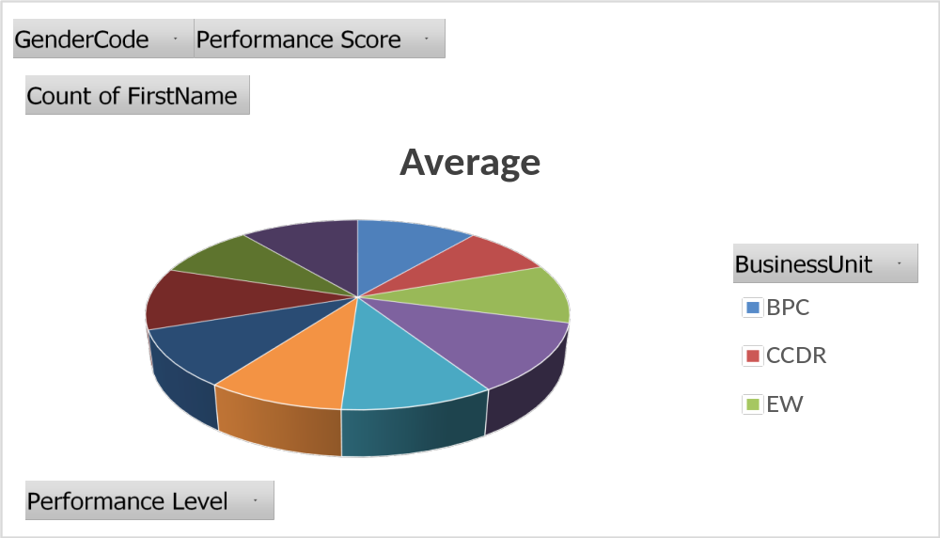
RESULTS
12

Slide 13
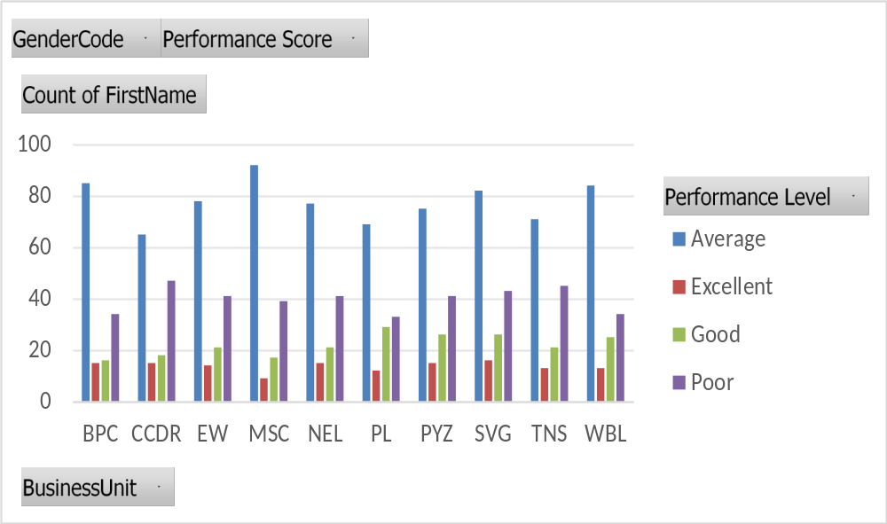
RESULTS
13

Slide 14
conclusion
Therefore the production department employees performs higher comparing to other department and whereas admin offices performs lower comparing to other department.
Hence the Business Unit employees works more efficiently and effectively comparing to Business Unit according to the employee data given.

