Slide 1
Kirthi Venkatraman
Lead Data Analyst @ Neustar
- Passion for Problem Solving

Slide 2
Brief Background
Graduate degrees in Math and Computer Science
Academic Experience (5 years)
Private Sector and Startup (5 years)
Public Sector (18 years)
Like Research and Development
Big Fan of Mike Bostock (d3.js creator)
Volunteer High School Math Olympiad Coach
Notes:
Have volunteered at NSF.org and also at Fairfax Math Circle

Slide 3
Some Publications
Prolog Interpreter Design (Dec 1984)
Using Vowel Count Method on Double Columnar Transposition Ciphers
  MS Dissertation at University of Maryland (Dec 1990)
Embracement of Hadoop – A Pragmatic Analysis
  White Paper Analyzing Information Gathering, Sharing and Aggregating in USDOJ (Mar 2015)
Mastering Python Data Visualization
  Book published by Packt Publishing (Oct 2015)

Slide 4
Algorithms Developed
Convolve Digital and Analog Signal Spectrum
  To compute signal interference and prepare calibration
Optimizing the linkchecker for broken links
Latent Semantic Indexing (Information Retrieval)
  To correlate semantically related terms
  Used NLP and Wordnet
Text Categorization using NLTK,Python
  To evaluate questions about drugs on MEDLINE Search Engine

Slide 5
Algorithms Developed - 2
Analytical Study of FDA and Clinical Trials
  Connected the dots and produced results based on several hypotheses about drug care for critical diseases (Mar 2014)
Scalable algorithm to map a visible data to a randomized encrypted data
  Due to privacy issues, the goal was to encrypt private data in a randomized way
Scalable algorithm using Python and Hive to solve IP-Address search problem
  Searching if an IP-Address falls within range of IP-Address

Slide 6
Polyglot and Poly-Paradigm Programming (PPP)
Is This New?
  PPP is not new, EMACS used C-kernel and Lisp to use the power of both C and Lisp.
Use Java, Python and HIVE
  Java to create UDF
  Python to efficiently transform, map and/or reduce
  Hive to store and retrieve from HDFS
Other Combinations
  HIVE and scikit-learn
  HIVE and Apache Mahout (Not used this)
  (Depends on preferences, both have their strengths)

Slide 7
Transform Example
Using HIVE and Python
ADD FILE /usr/local/example/trunc_array.py;
-- Input table has id,ethnicity,zipcode,county,agegender (list separated by |)
SET hivevar:input_table=user_ip_agegender_all;
-- Input table has id,ethnicity,zipcode,county,agegencount (list separated by |)
SET hivevar:output_table=user_ip_agegen;
DROP TABLE IF EXISTS ${output_table};
CREATE TABLE ${output_table} AS
SELECT TRANSFORM(id,ethnicity,zipcode,county,agegender)
USING "trunc_array.py”
AS id,ethnicity,zipcode,county,age,gender
FROM ${input_table}

Slide 8
Transform Example
Using HIVE and Python – 2
#!/usr/bin/env python
import sys
for line in sys.stdin:
id,ethnicity,zipcode,county,agegenderstr = line.split('\t’)
if agegenderstr.strip(): #if-else-1
# Some algorithm to extract and re-order the age-gender
# In some cases one might just need the counts.
agegenderlist = agegenderstr.split('|')[:5]
for item in agegenderlist:
if '-' in item:
age,gender = item.split('-’)
print ('\t'.join([id,ethnicity,zipcode,county] + [age] + [gender]))
else: print (line)
#end if-else-1
#end for

Slide 9
UDF Example
public class ArraySum extends UDF {
public double evaluate(List<Double> value) {
double sum = 0;
for (int i = 0; i < value.size(); i++) {
if (value.get(i) != null) { sum += value.get(i); }
} // endfor
return sum;
} // evaluate
} // ArraySum
public interface GenericUDF {
public Object evaluate(DeferredObject[] args) throws HiveException;
public String getDisplayString(String[] args);
public ObjectInspector initialize(ObjectInspector[] args) throws UDFArgumentException;
}

Slide 10
Machine Learning
Applied k-Means Classification on Clinical Trials data with primary focus on Breast Cancer, Prostate Cancer and Heart Disease
  With variable number of trials depending on the region
Applied SVMs on Breast Cancer
  Using some features, relapse/non-relapse, gene anagram

Slide 11
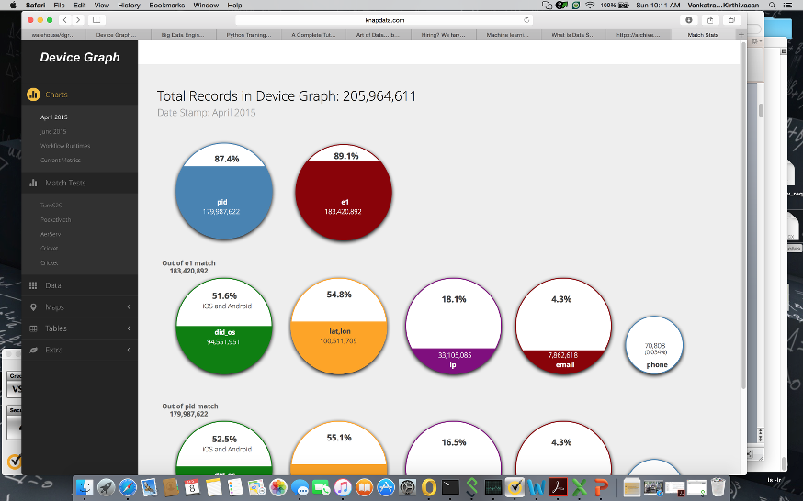
Dashboards using HTML5, d3.js and Python

