Slide 1
School Management System in Java
Mini Project using OOP Concepts
PRESENTED BY Kirthika S
Tagore Engineering College
Enrollment Number : EBEON03251076511
Batch : 2024-14789

Slide 2
Project Overview
A console-based School Management System using Java
Manages students, teachers, and financial records
Demonstrates OOP concepts like classes, objects, and encapsulation
Tracks fees paid by students and salaries paid to teachers
Calculates total money earned and spent by the school
Simple, scalable structure – can be extended with databases or GUI later

Slide 3
Objectives
Simulate a basic school structure
Apply core OOP concepts
Track student fees
Handle teacher salaries
Monitor total earnings and expenses
Provide dynamic and real-time outputs
Form a base for advanced versions

Slide 4
Technologies Used
Java – Programming Language Used as the core language to implement the project logic and structure.
OOP Concepts – Classes & Objects Core building blocks to model real-world entities like students and teachers.
Encapsulation Data and methods are wrapped together in classes to ensure data integrity and access control.
Inheritance Can be used to extend functionalities by creating subclasses in future upgrades.
IDE – Visual Studio Code / IntelliJ Code written and executed using developer-friendly editors with syntax support.

Slide 5
System Architecture
Classes:
Student
Teacher
School
Main Flow:
Create teachers and students
Process fees and salaries
Update financials in the School class

Slide 6
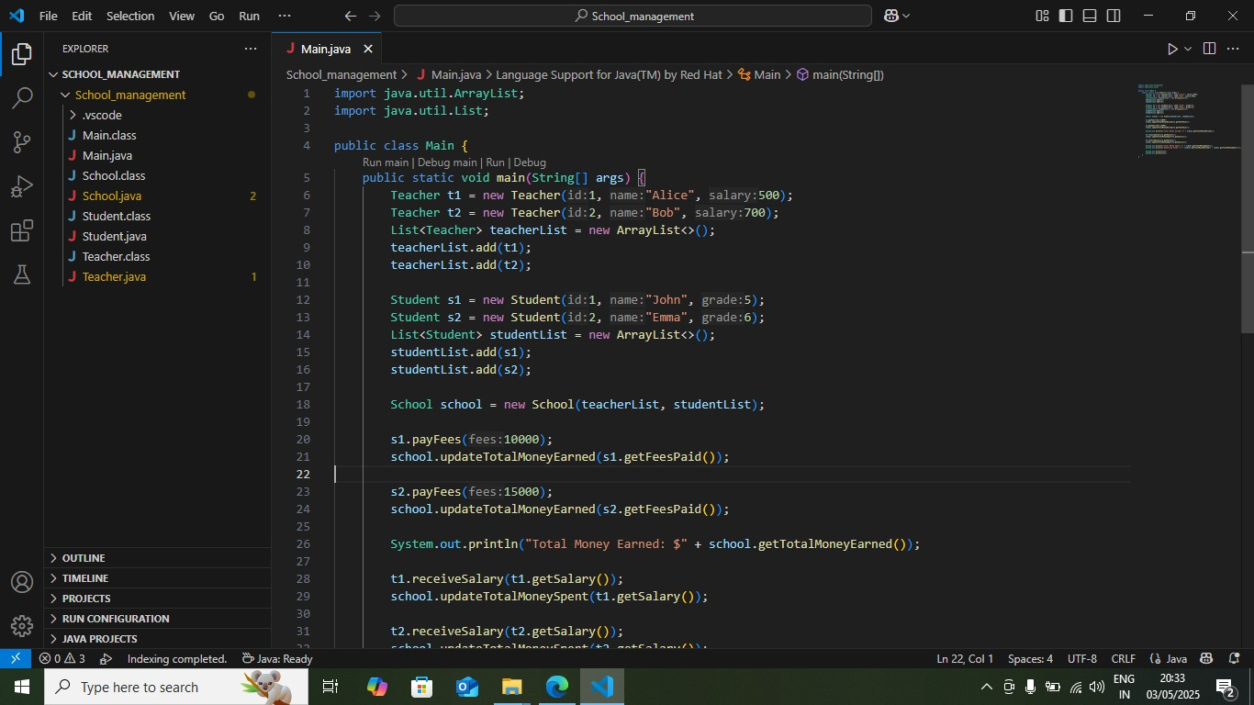
Coding

Slide 7
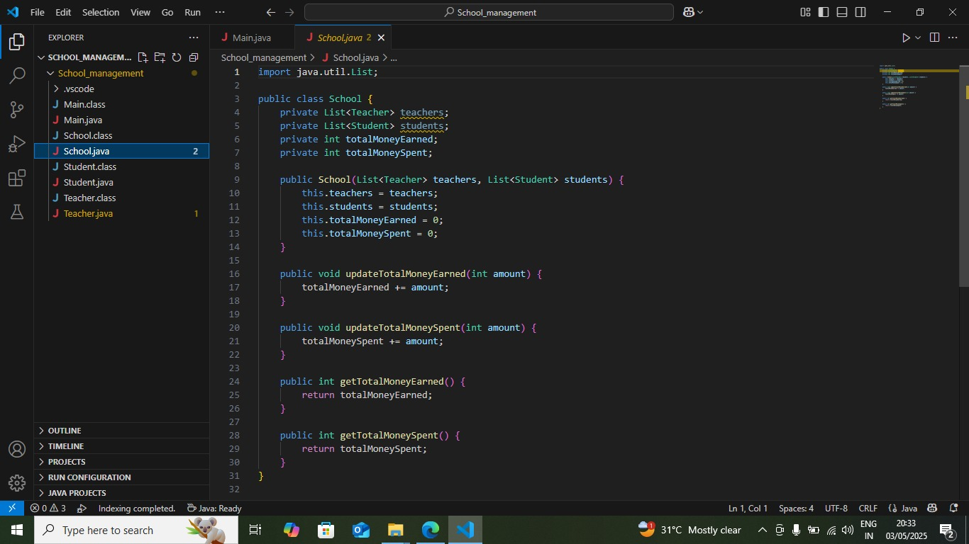

Slide 8
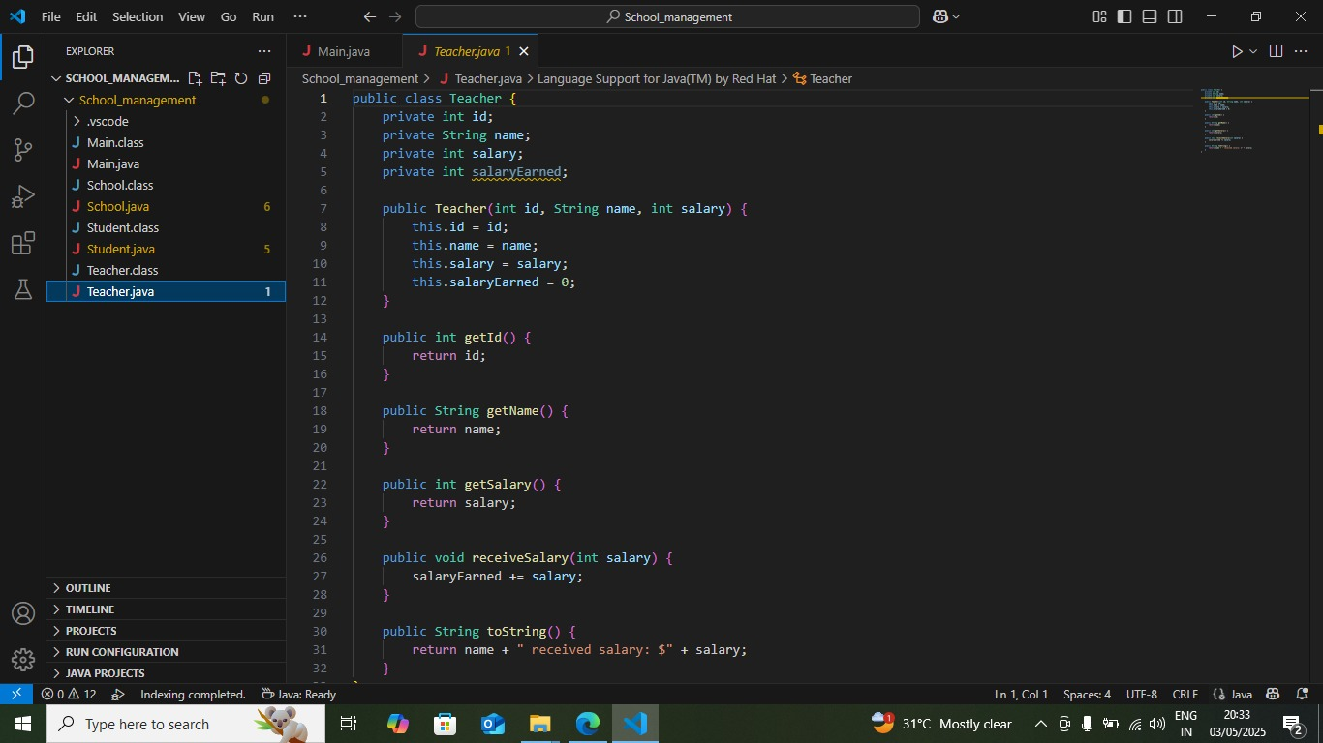

Slide 9
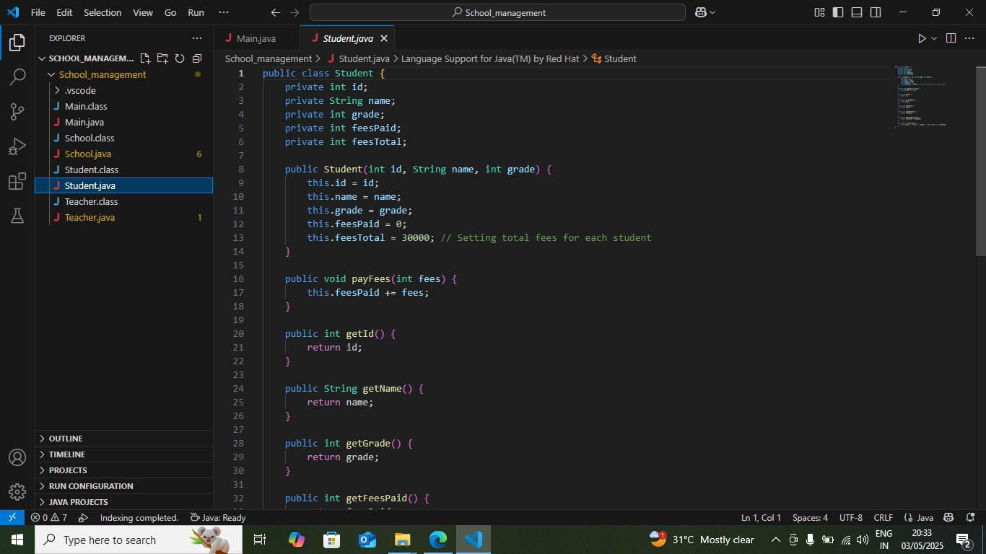

Slide 10
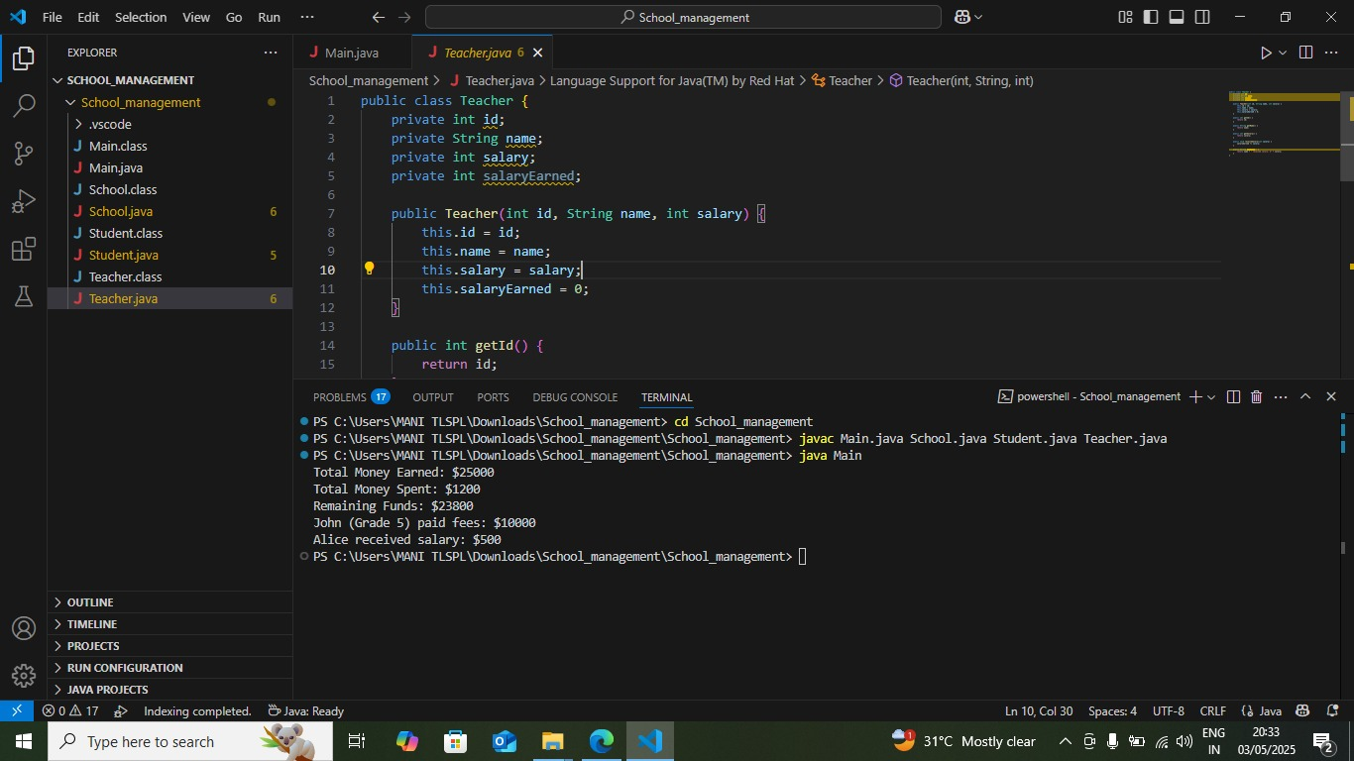
Output

Slide 11
Conclusion
The School Management System project demonstrates the power and clarity of Object-Oriented Programming in Java.
It models real-world entities like students and teachers in a simple yet effective way.
Through fee and salary tracking, the project simulates core administrative tasks of a school.
The modular structure ensures that this system is not just a mini project but a strong foundation for future enhancements like database integration or GUI development.
Overall, this project is a practical example of how Java can be used to build real-world applications with clean, maintainable code.

Slide 12
Thank You

