Slide 1
Report on
Anomaly Detection in medical images
By
Kirti Padhi
B121025

Slide 2
REQUIREMENT
Building an Anomaly Detection Model:
Creating a model that can detect anomalies in medical images, such as identifying tumors or lesions that deviate from normal patterns.
Project Planning:
We will collect the Brain MRI scan dataset from kaggle datasets.
Will train the model based on the data and then select the model with high accuracy and precision.
Anomaly Detection Model (Visual Geometry Group 16)
Our model excels in brain tumor detection within MRI scans, employing three deep learning models—two simple CNNs with varying layer depths and a VGG 16 model. The dataset categorizes brain MRI scans into 'yes' (tumor present) and 'no' (normal). Comparison of model performances reveals insights into the impact of architecture complexity on anomaly detection accuracy.

Slide 3
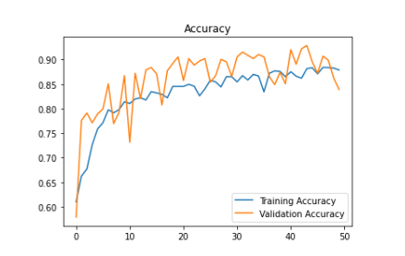
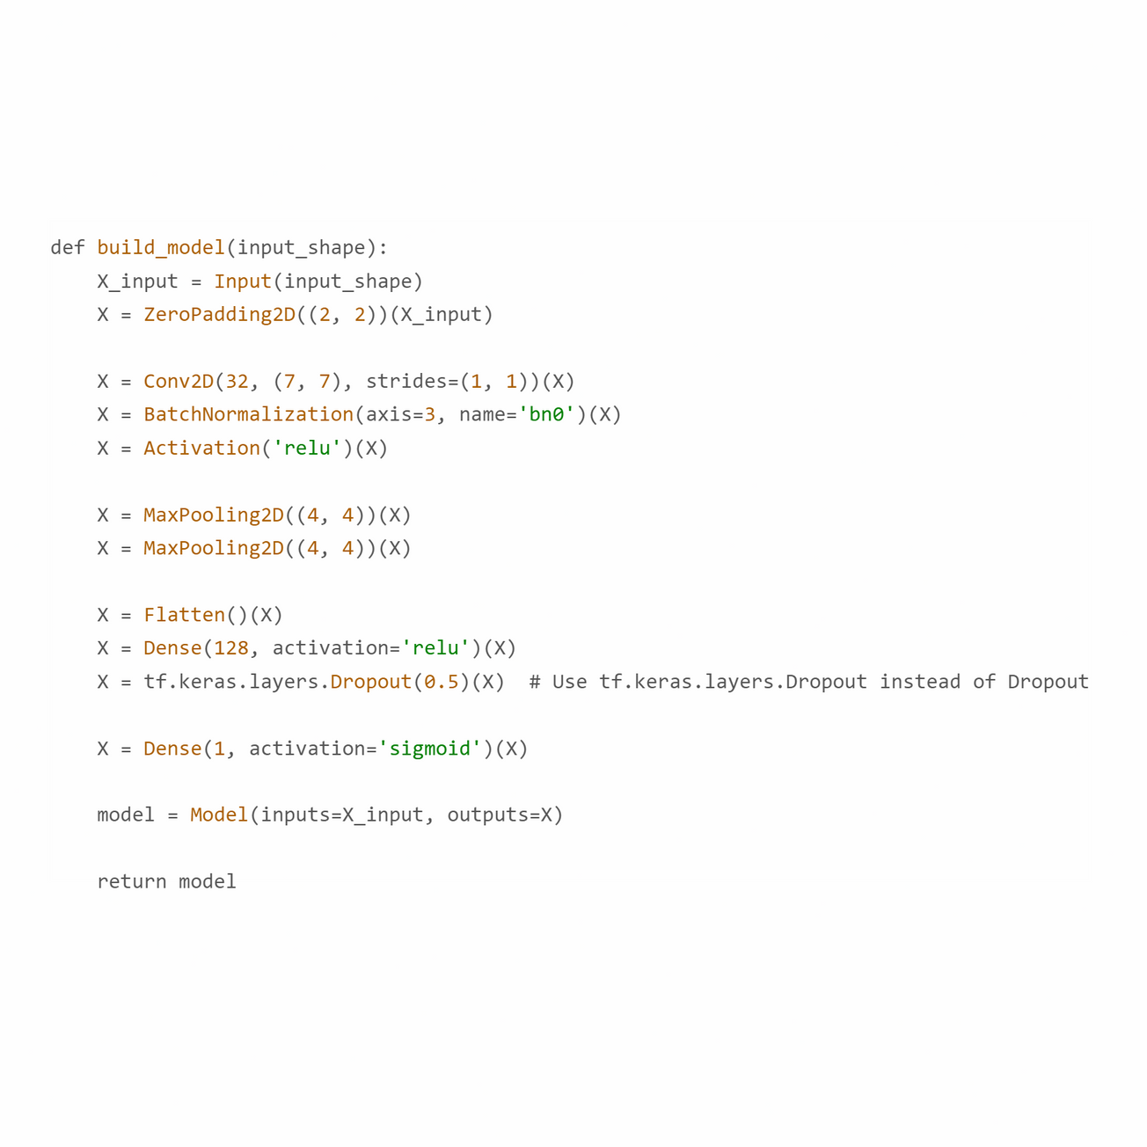
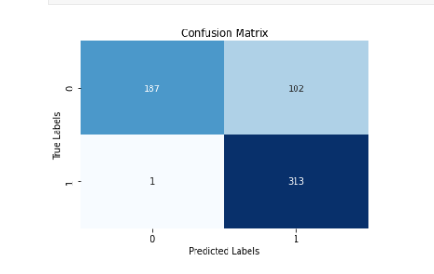
First CNN model
Structure of the model
Achieved Accuracy is 82.92%

Slide 4
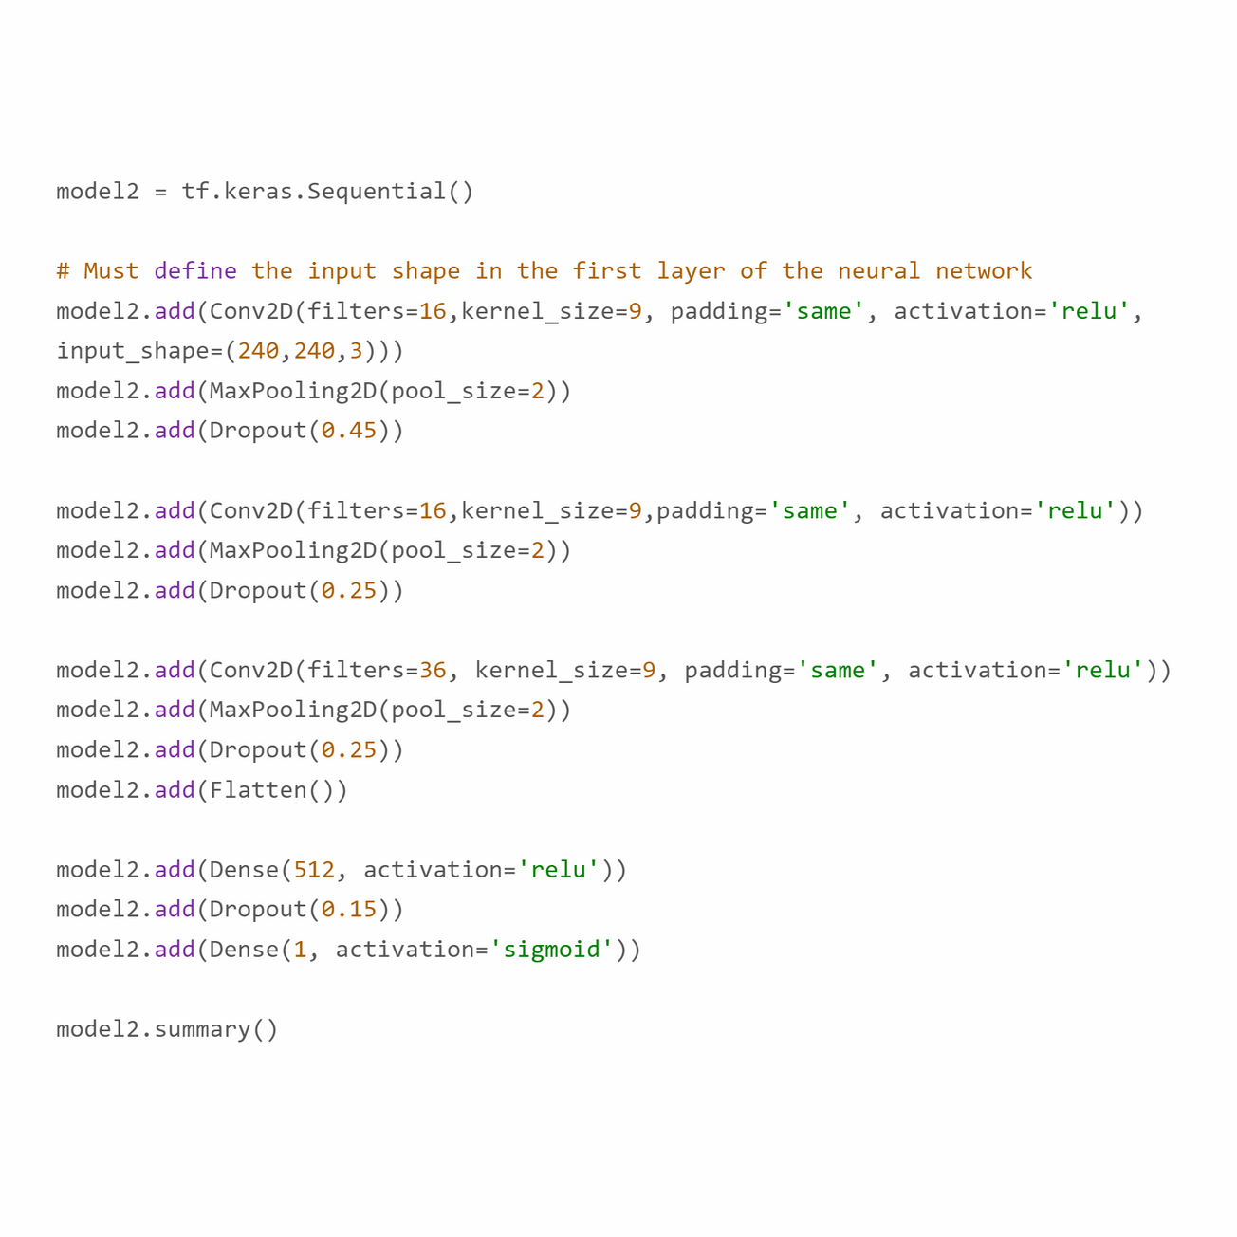
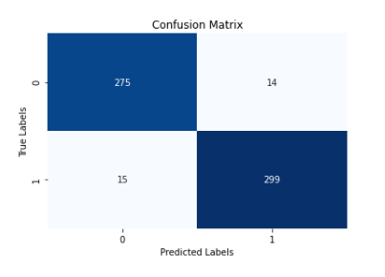
Second CNN model
Structure of the model
Achieved Accuracy is 95%

Slide 5
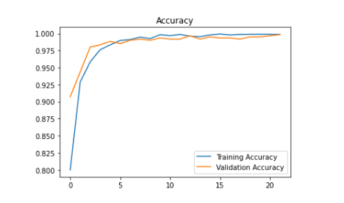
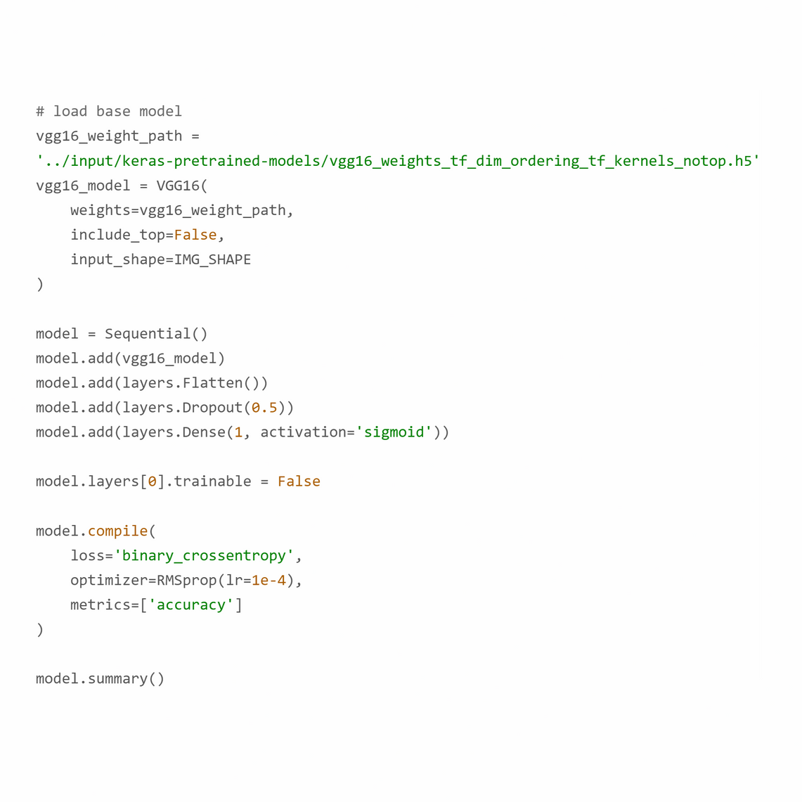
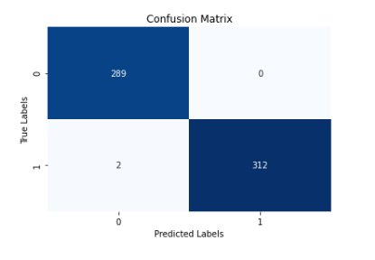
Transfer learning Model by VGG-16
Structure of the model
Achieved Accuracy is 99%

