Slide 1

Note: The data and information in this document is reflective of a hypothetical situation and client. This document is to be used for KPMG Virtual Internship purposes only.
Sprocket Central Pty Ltd
Data analytics approach
[Division Name] - [Engagement Manager], [Senior Consultant], [Junior Consultant]

Slide 2
Note: The data and information in this document is reflective of a hypothetical situation and client. This document is to be used for KPMG Virtual Internship purposes only.
Agenda
Introduction
Data Exploration
Model Development
Interpretation

Slide 3
Note: The data and information in this document is reflective of a hypothetical situation and client. This document is to be used for KPMG Virtual Internship purposes only.
Introduction
In this presentation we will provide important insights relate to customer purchasing behaviour, trends and various factors which will boost business
1)Most purchased brands
2)Most purchased product line
3)Most purchased product class and category
4)% of wealth segment
5)Profit trend
6)Proportion of job_industry_Category
7)Age group
8)% of customers by state
9)% of people by property_evaluation
Place any supporting images, graphs, data or extra text here.

Slide 4
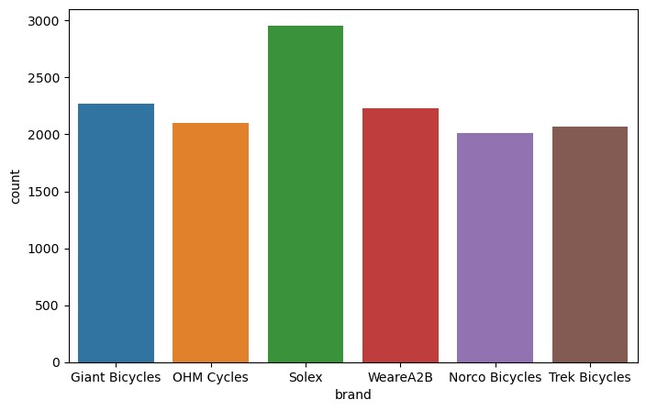
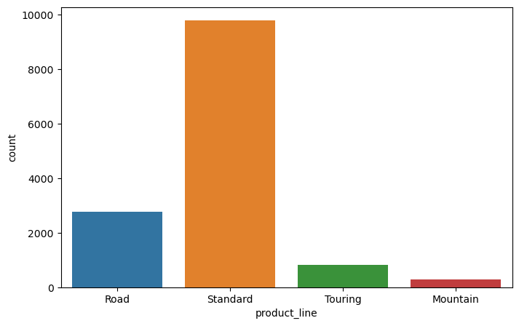
Note: The data and information in this document is reflective of a hypothetical situation and client. This document is to be used for KPMG Virtual Internship purposes only.
Data Exploration
Our most purchased brand and product line
SOLEX IS THE MOST PURCHASED BRAND
Standard products are purchased most

Slide 5
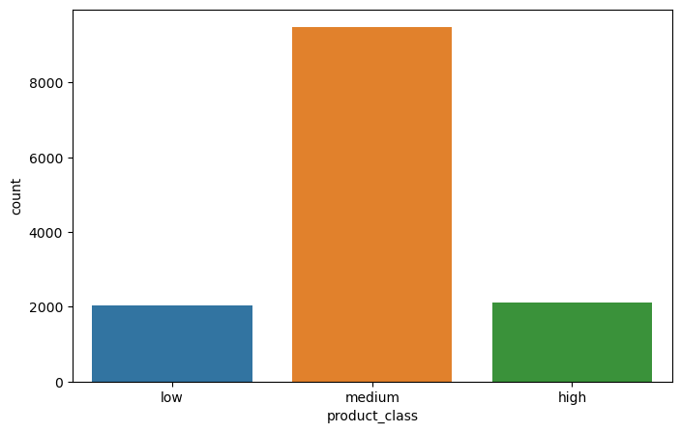
Note: The data and information in this document is reflective of a hypothetical situation and client. This document is to be used for KPMG Virtual Internship purposes only.
Data Exploration
Our most purchased product class and size
Medium class product are purchased most
Standard products are purchased most

Slide 6
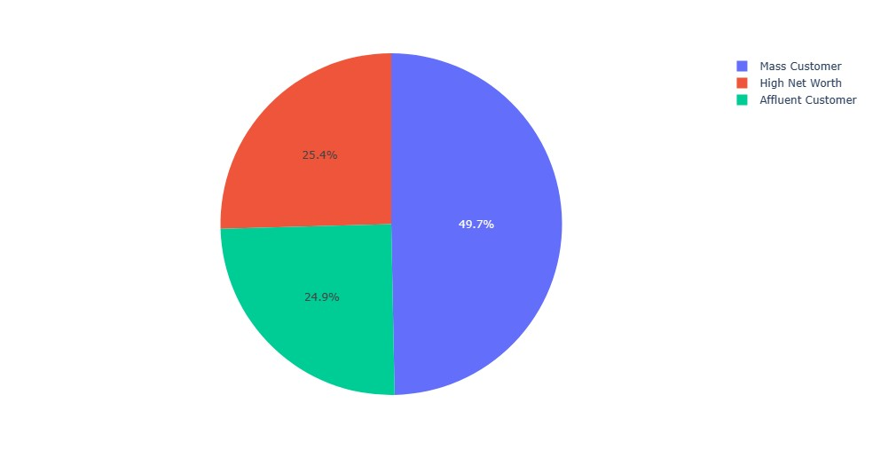
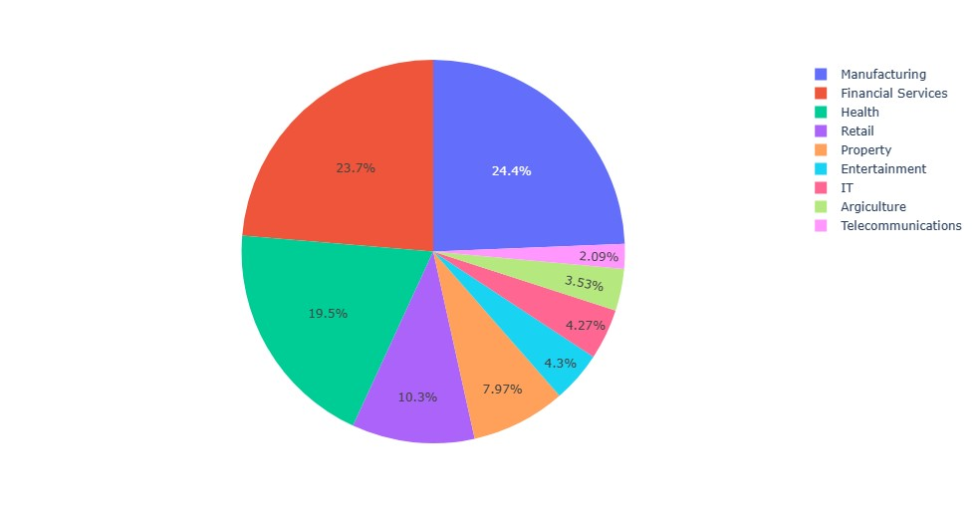
Note: The data and information in this document is reflective of a hypothetical situation and client. This document is to be used for KPMG Virtual Internship purposes only.
Data Exploration
Distribution of customers by wealth segment and property evaluations
% of customer segment
MASS CUSTOMERS category of wealth segment has most proportion of purchase
% of property evaluation
MANUFACTURING,FINANCIAL SERVICES AND HEALTH SECTORS ARE OUR MAIN SECTOR CUSTOMERS

Slide 7
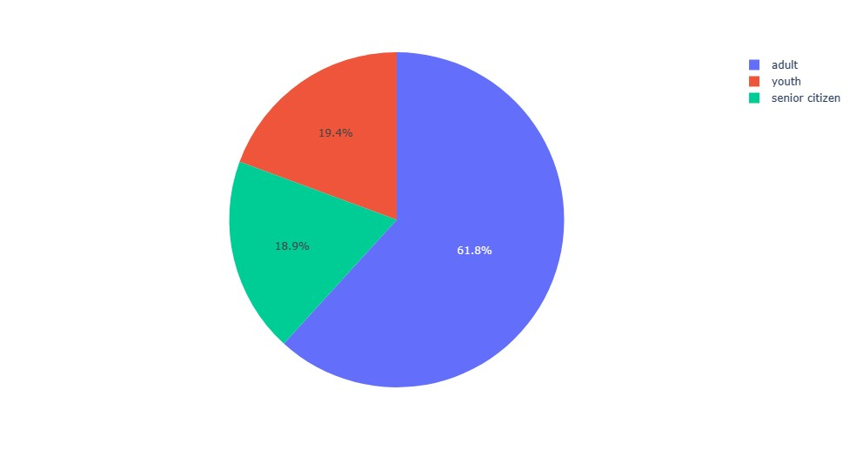
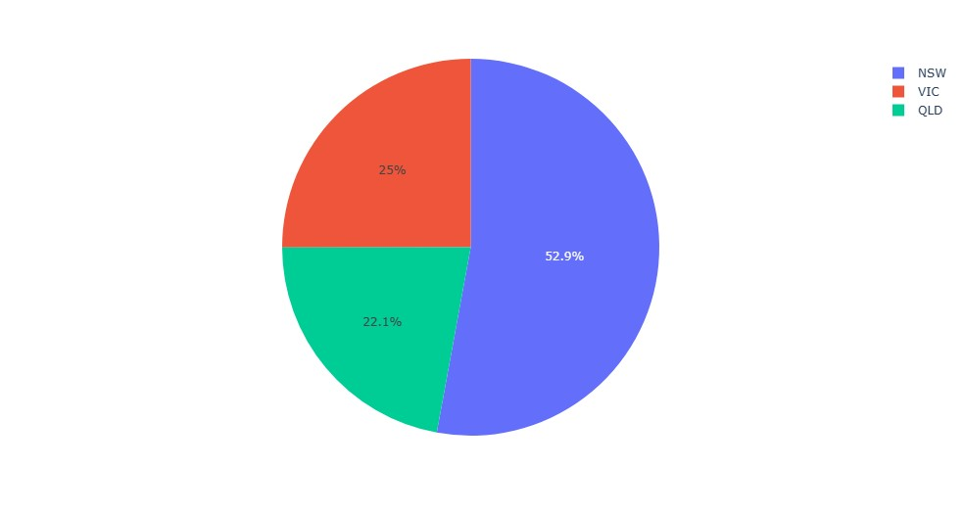
Note: The data and information in this document is reflective of a hypothetical situation and client. This document is to be used for KPMG Virtual Internship purposes only.
Data Exploration
Distribution of Age Group
Adult people (31-55) are our major customers
We have our major customers from North South Wales

Slide 8
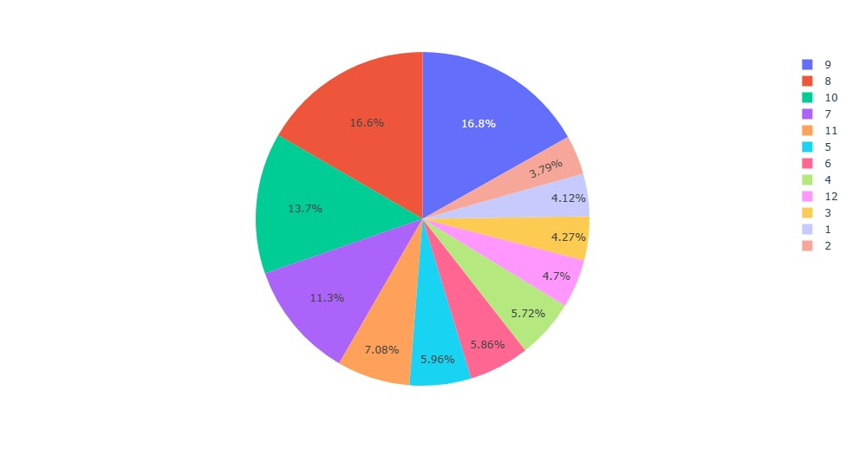
Note: The data and information in this document is reflective of a hypothetical situation and client. This document is to be used for KPMG Virtual Internship purposes only.
Data Exploration
Distribution of Property valuations
CUSTOMERS WITH PROPERTY EVALUATION WITH 8,9,7,10 ARE OUR MAJOR CUSTOMERS
Other factors like gender, car owned by customers have uniform distributions.

Slide 9
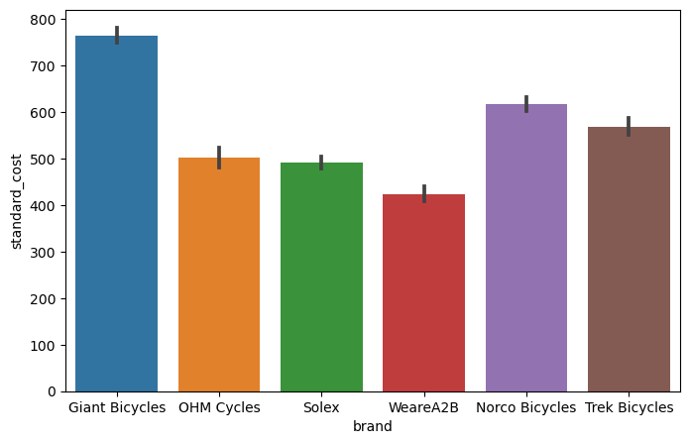
Note: The data and information in this document is reflective of a hypothetical situation and client. This document is to be used for KPMG Virtual Internship purposes only.
Model Development
Variation of brand with cost
Giant Bicycles are costliest brand while WeareA2B is cheapest. OHM Cycles and Soles are moderate and hence are most purchased
Place any supporting images, graphs, data or extra text here.

Slide 10
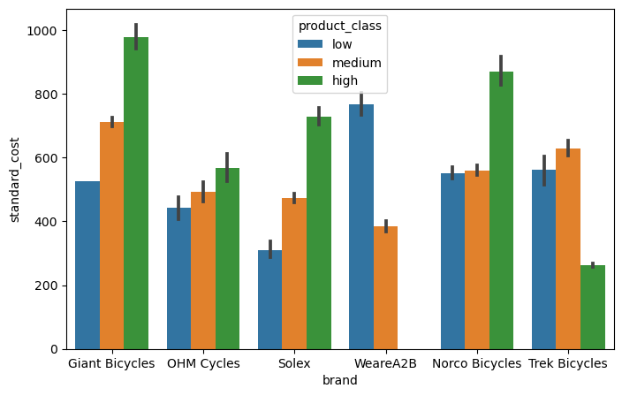
Note: The data and information in this document is reflective of a hypothetical situation and client. This document is to be used for KPMG Virtual Internship purposes only.
Model Development
Variation of brand with cost
WearA2B does not sell high quality products they have more sold in low quality products. Giant bicycles is costly for every class product
Place ges, graphs, data or extra text here.

Slide 11
Note: The data and information in this document is reflective of a hypothetical situation and client. This document is to be used for KPMG Virtual Internship purposes only.
Model Development
Variation of brand with cost with hue to product_class
WearA2B does not sell high quality products they have more sold in low quality products. Giant bicycles is costly for every class product
Place ges, graphs, data or extra text here.

Slide 12
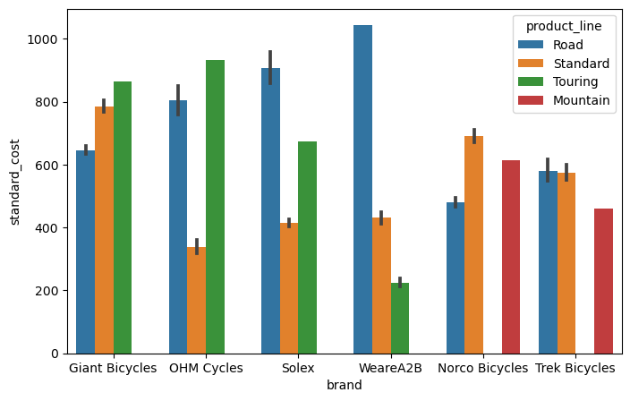
Note: The data and information in this document is reflective of a hypothetical situation and client. This document is to be used for KPMG Virtual Internship purposes only.
Model Development
Variation of product line with cost
MOUNTAIN PRODUCT_LINE PRODUCTS ARE MOSTLY COSTLY FROM NORCO BICYCLES AND TREK BICYCLES WHILE TOURING PRODUCT_LINE PRODUCTS ARE MOSTLY COSTLY FROM OHM CYCLES AND GIANT BICYCLES AND ROAD PRODUCT_LINE ARE MOST COSTLY FROM WEARA2B
Place ges, graphs, data or extra text here.

Slide 13
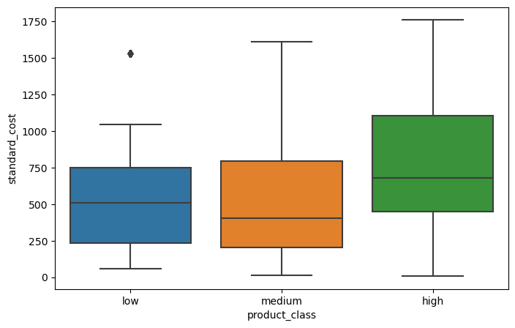
Note: The data and information in this document is reflective of a hypothetical situation and client. This document is to be used for KPMG Virtual Internship purposes only.
Model Development
Variation of product class with cost
low and medium class products have approximately same cost
Place ges, graphs, data or extra text here.

Slide 14
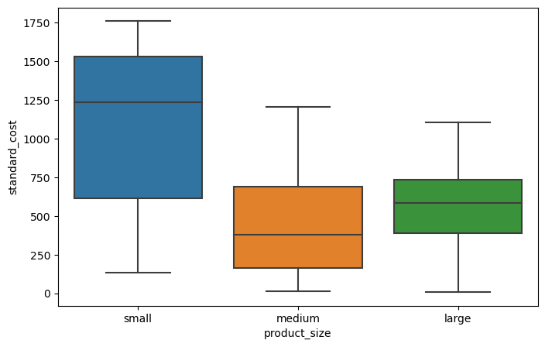
Note: The data and information in this document is reflective of a hypothetical situation and client. This document is to be used for KPMG Virtual Internship purposes only.
Model Development
Variation of product size with cost
SMALL SIZE PRODUCTS ARE MOST COSTLY. MEDIUM SIZE PRODUCTS HAS WIDER COST RANGE THAN LARGE SIZE COST
Place ges, graphs, data or extra text here.

Slide 15
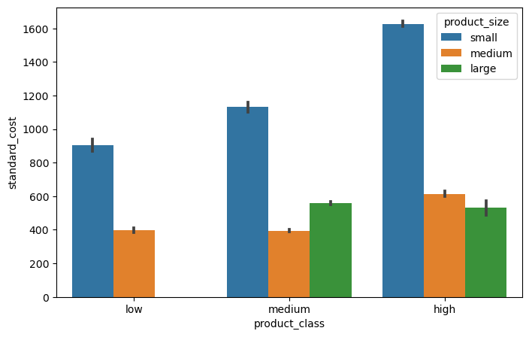
Note: The data and information in this document is reflective of a hypothetical situation and client. This document is to be used for KPMG Virtual Internship purposes only.
Model Development
Variation of product size with cost
small size products are most costly in any class.
In 'low' product_class we don't sell large size products
In medium product class cost of medium size is less than large size
Place ges, graphs, data or extra text here.

Slide 16
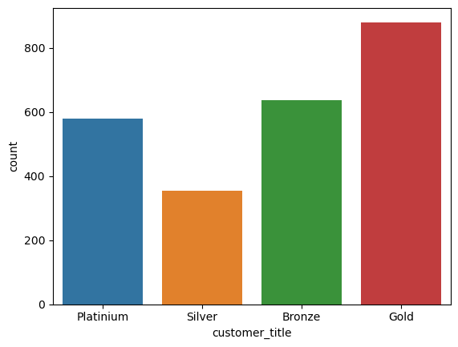
Note: The data and information in this document is reflective of a hypothetical situation and client. This document is to be used for KPMG Virtual Internship purposes only.
Model Development
Variation of product size with cost
We have mostly gold customer_title
Customer_title is calculated on the basis of rfm analysis
Place ges, graphs, data or extra text here.

Slide 17
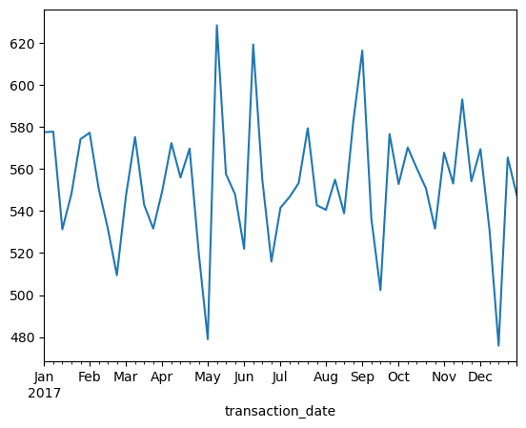
Note: The data and information in this document is reflective of a hypothetical situation and client. This document is to be used for KPMG Virtual Internship purposes only.
Interpretation
Trend of profit with with transaction date
FOR A GOOD BUSINESS PROFIT MUST ALWAYS BE AN INCREADING CURVE WE HAD LEAST AMOUNT OF PROFIT IN MAY AND DECEMBER AFTER WHICH IT INCREASED AND NOW IT IS DECREASING WHICH IS NOT A GOOD SIGN!
Place any supporting images, graphs, data or extra text here.

Slide 18
Note: The data and information in this document is reflective of a hypothetical situation and client. This document is to be used for KPMG Virtual Internship purposes only.
Interpretation
Trend of profit with with transaction date
FOR A GOOD BUSINESS PROFIT MUST ALWAYS BE AN INCREADING CURVE WE HAD LEAST AMOUNT OF PROFIT IN MAY AND DECEMBER AFTER WHICH IT INCREASED AND NOW IT IS DECREASING WHICH IS NOT A GOOD SIGN!
Place any supporting images, graphs, data or extra text here.

Slide 19
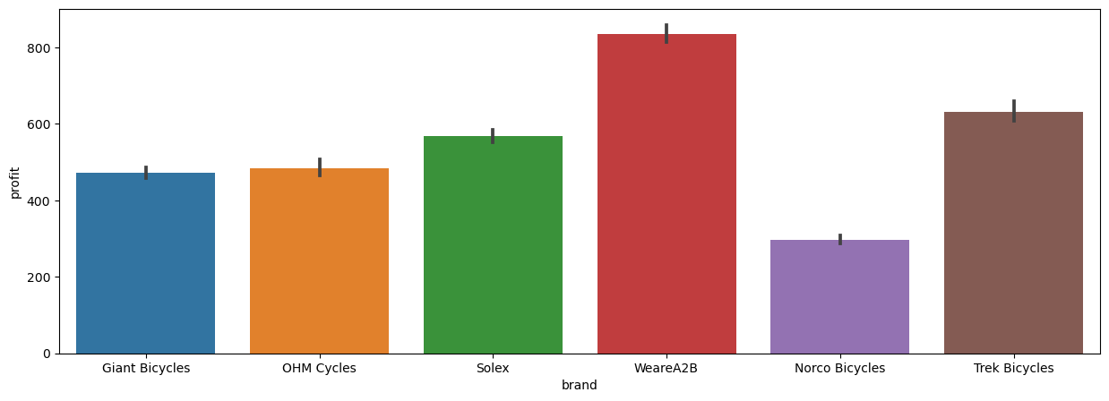
Note: The data and information in this document is reflective of a hypothetical situation and client. This document is to be used for KPMG Virtual Internship purposes only.
Interpretation
PROFITABLE BRANDS
WEARA2B EARNS HIGHEST AMOUNT OF PROFIT
Place any supporting images, graphs, data or extra text here.

Slide 20
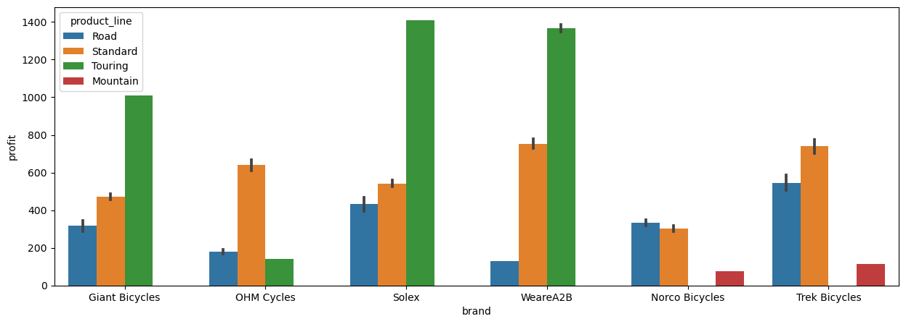
Note: The data and information in this document is reflective of a hypothetical situation and client. This document is to be used for KPMG Virtual Internship purposes only.
Interpretation
PROFITABLE PRODUCT LINE IN DIFFERENT BRANDS
TOURING IS THE MOST PROFITABLE PRODUCTLINE IS FEW BRAND
Place any supporting images, graphs, data or extra text here.

Slide 21
Note: The data and information in this document is reflective of a hypothetical situation and client. This document is to be used for KPMG Virtual Internship purposes only.
Appendix

