Slide 1

Title -
Supermarket Sales Data Analysis
(Data Analytics Capstone Project Python • Power BI • GitHub)
Presented by: Kirti Katte

Slide 2

Project Overview
This project analyzes supermarket sales transaction data.
The analysis focuses on sales performance, customer behavior, product lines, cities, and payment methods.
Python was used for data preparation, EDA, and visualization.
Power BI was used to create an interactive dashboard.
The project provides data-driven insights and business recommendations.

Slide 3
Dataset & Tools Used
Dataset
Supermarket Sales Dataset
1,000 records
17 columns
Time period: January–March 2019
Domain: Sales / Retail Analytics
Tools
Python
Pandas & Matplotlib
Google Colab
Power BI
Git & GitHub

Slide 4
Data Cleaning & Exploratory Data Analysis
Checked dataset shape, columns, and data types.
Checked missing values and duplicate records.
Verified important numerical and categorical values.
Converted the Date column into datetime format.
Performed descriptive statistics and correlation analysis.
Analyzed sales by product line, city, and month.
Checked outliers using the IQR method.

Slide 5
Data Visualizations
Total Sales by Product Line — Bar Chart
Total Sales by City — Bar Chart
Monthly Sales Trend — Line Chart
Payment Method Distribution — Pie Chart
Unit Price vs Quantity — Scatter Plot

Slide 6
Power BI Dashboard
Interactive dashboard created using Power BI.
KPI Cards: Total Sales, Total Gross Income, Total Quantity Sold.
Visuals: Sales by Product Line, Sales by City, Monthly Sales Trend, Payment Method Distribution.
Slicers: City, Product Line, Customer Type.
The dashboard allows users to interactively explore sales performance.

Slide 7
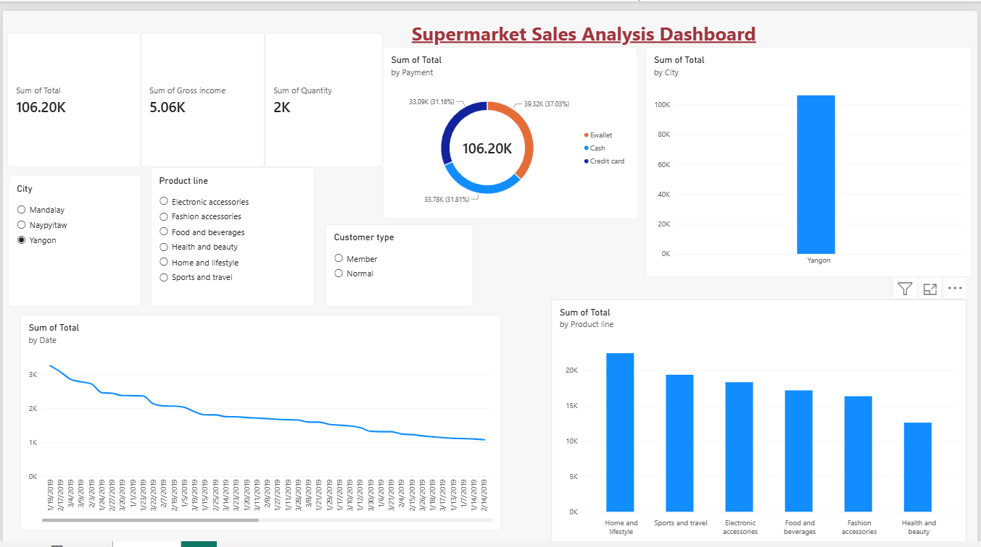
Dashboard Screenshot (Power BI)

Slide 8
Key Insights
Food and Beverages was the highest-performing product line.
Health and Beauty had comparatively lower sales.
Naypyitaw recorded the highest total sales among the cities.
January had the highest monthly sales, while February was lower.
E-wallet was the most frequently used payment method.
Quantity sold showed a strong positive relationship with total sales.
Both Member and Normal customers contributed significantly to sales

Slide 9
Business Recommendations & Conclusion
Promote low-performing product lines with targeted offers and combo deals.
Improve sales in lower-performing cities through local promotions.
Use monthly sales trends for better inventory planning.
Continue supporting digital payment methods and suitable offers.

Slide 10
Conclusion
The project used Python and Power BI to analyze supermarket sales data.
The analysis identified important patterns in products, cities, customers, payment methods, and sales trends.
These insights can support better sales, inventory, marketing, and customer-engagement decisions.

