Slide 1
Predicting Length of Stay of Patients
Team:
Apeksha Bhise
Nikhitha Sama
Kirti Tiwari
David Lam

Slide 2
Goal: To Predict Length of Stay of Patients at the time of admission
Healthcare quality can be determined by multiple factors:
Assessing patient satisfaction (in terms of financial costs)
Improving operational costs
Monitoring quality of Healthcare facilities
Hospital inpatient care constitutes almost one-third of all health care expenditures in the United States. [Overview of Hospital Stays in the United States, 2012 Audrey J. Weiss, Ph.D. and Anne Elixhauser, Ph.D]
Our objective – To predict length of stay as early as in the preadmission stage of a patient so that hospital’s admission management can monitor and improve the quality of inpatient care and
Why predicting accurate length of stay is important:
Improves Resource Utilization at hospitals
Minimize nonvalue added care time
Better prioritization of patient discharge
Real-time demand capacity management (RTDC) - clinicians convene each morning to predict patients able to leave the same day and prioritize their remaining tasks for early discharge

Slide 3
Prior Work
MHG-LOS-Reduction Case-study
This work was done by Memorial Hospital at Gulfport, to improve Patient satisfaction
Their approach was to use Systematic, Data-Driven process to Lower Length of Stay and Improve Care Coordination
Results:
$2 million in cost savings, the result of decreased LOS and decreased utilization of supplies and medications.
0.47-day percentage point reduction in LOS.
Improved care coordination and physician engagement have successfully reduced LOS.
The 30-day readmission rate has remained stable.
3% increase in the number of discharges occurring on the weekend.

Slide 4
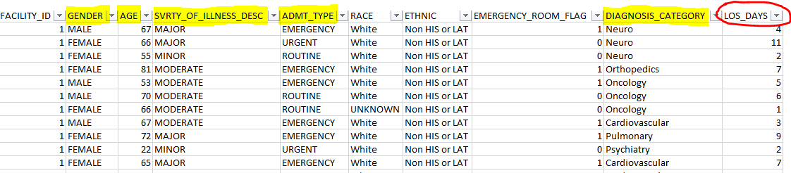
Data Sourcing
The data was extracted and put together by combining/joining multiple tables from different sources such as Electrical Medical Record system (Cerner EMR) and Healthcare Financial service system (Soarian Financial).
The dataset has 5 years of non-sensitive adult inpatient data of a hospital.

Slide 5
Predictors to be considered
Predictor | Reason
Gender | Based on studies, it is seen that females tend to stay longer at a healthcare facility , and thus gender will be an important criteria for determining the length of stay
Age | The older a person, the more time he would need for the treatment. Thus age should be considered.
Severity of Illness | Severity of illness , whether it is minor, moderate or major would determine the length of stay. If the severity is minor, there is a possibility that the length will be less.
Admit Type | The category of admit type , emergency, urgent or routine, would be important to determine the length of stay. If it is a routine visit for a patient, the length of stay would be probably less.
Diagnosis Category | There are various categories for diagnosis that a patient might have like neuro, cardiovascular , which would determine the duration of a patient's stay. The type of category will be important to be considered here.

Slide 6
The Plan…
Doing data cleaning if needed (Clean up ‘NA’, missing value)
Doing descriptive analysis on the dataset: ggplot, Correlation matrix, etc
Data Modeling: MLE Regression, Poisson Models, Quasipoisson, and Negative Binomial Model.
Quality check of the models: test assumption for the best stable model.
Report our finding/key insight through the model.
Improve the model if possible

Slide 7
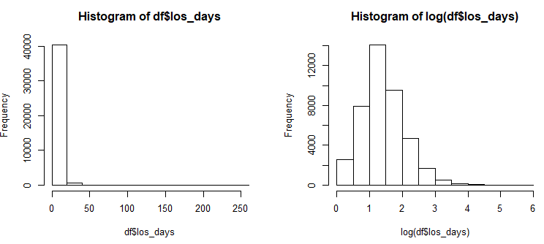
Current Work
Cleaned data as we had some NULL, NA and Unknown values.
Visualized distribution of Y which is los_days
Identified which list of variables are important to begin with mle models
As we are predicting number of days which is count data, so we run below poisson models as well

Slide 8
Current Work Cont.
MLE Model:
mle <- glm(log(los_days) ~ gender + age + svrty_of_illness_desc + admt_type + diagnosis_category , data=df, family=gaussian)
Poisson model:
poisson = glm(los_days ~ gender + age + svrty_of_illness_desc + admt_type + diagnosis_category , data=df, family=poisson (link=log))
Quasipoisson Model:
qpoisson = glm(los_days ~ gender + age + svrty_of_illness_desc + admt_type + diagnosis_category, data=df, family=quasipoisson (link=log))
Negative Binomial Model:
nb <- glm.nb(log(los_days) ~ gender + age + svrty_of_illness_desc + admt_type + diagnosis_category, data=df)

Slide 9
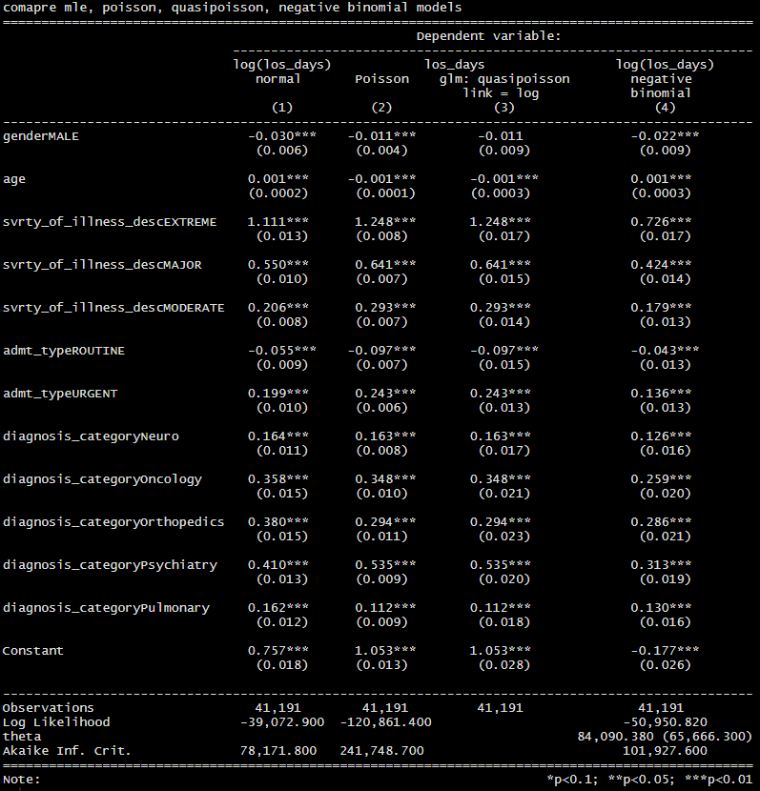
Current Work : Model Results

Slide 10
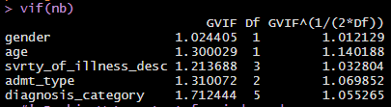
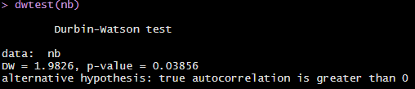
Test Model Assumptions
Poisson models are robust to violations in normality of residuals, homoscedasticity, and linearity. However, we must still test for multicollinearity between predictors and independence(autocorrelation).
VIF test for multicollinearity: None of the predictors have VIF > 5. Hence, we conclude that there is no multicollinearity in our model.
Durbin-Watson test for independence: since DW = 1.9836 is close to 2, no autocorrelation

Slide 11
Interpretations
The length of stay decreases by 2.2% for males as compared to females. This could be because of males have a better recovery rate than females.
The length of stay increases by 0.1% as a patient gets older by a year.
The length of stay increases by 72% than the minor illness if the severity of illness is extreme. The length of stay increase by 42% if the severity of illness is major as compared to minor. The length of stay increases by 18% if the severity of illness is moderate as compared to minor.
The length of stay is highest if the patient is admitted in Urgent care , followed by Emergency admit and Routine Admit. The duration increases by 13.6% if the admit type is Urgent as compared to Emergency admit.
The length of stay decrease by 4.3% if the patient is admitted on a routine basis or checkup as compared to Emergency admit.
Length of stay is the highest for patients who are diagnosed with Psychiatry conditions and is the lowest for patients with cardiovascular conditions. The stay increases by 31.3% for the Psychiatry patients as compared to cardiovascular.

Slide 12
Actionable Recommendations
Actionable Recommendations to Hospitals :
For the patients with high LOS, hospitals can opt for proper treatment plan which can help in reducing the length of stay
Knowing LOS beforehand hospital can plan for unit capacity, beds, rooms, staffs in advance to ensure smooth patient flow from the operating room
In certain cases of delays in discharging patients, factors impacting the discharge time/ days can be addressed soon (during the time of admit) and necessary measures can be taken
Predicting the length of stay of the patients, the hospitals can categorize the patients based on their duration. This will keep the patients with less duration in a different ward and will help the hospital allocate its manpower in a more efficient way.

Slide 13
Thank You

