Slide 1
Project - “Designing of quadcopter” (Solidworks)
Project under Aeroclub MNNIT Allahabad
-Kirti Gupta

Slide 2
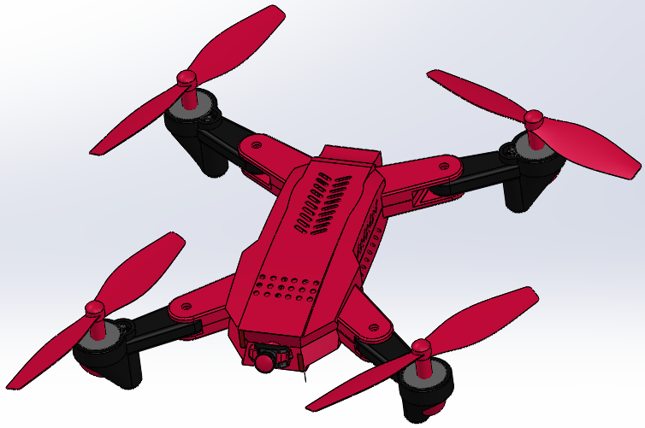
Quadcopter
Main Structure

Slide 3
Drone Components & its Working:- 1. Drone Motor Drones (quadcopters) have two clockwise motors and two counter clockwise motors to equalize the turning force produced by the rotating propellers. This is because of Newton’s Third Law which states that for every action there is an equal and opposite reaction. So having an equal number of motors counteracting each other provides stability through equalizing the turning force. 2. Drone Propellers As drones (quadcopters) have two counter clockwise motors and clockwise motors, it also has two different propellers, one for each motor direction. Each propeller rotates pushing the air down on the airfoil surface creating an area of lower pressure on top of the propeller and an area of higher pressure below it resulting in a difference of pressure thus pushing the drone up. 3. Drone Flight Controller This is the brain of the drone. The flight controller takes in inputs from the GPS module, compass, obstacle avoidance sensors, and the remote controller and processes it into information that is given out to the ESCs to control the motors. 4.GPS Module The global positioning satellite module uses two different global positioning systems to pinpoint the drone’s location. 5.Electronic Speed Controller (ESC) The ESCs are connected to the power distribution board (the battery) and the flight controller, as the ESCs receive signals from the flight controller it changes the amount of power given to each of the motors. 6.Power Port Module This monitors the amount of power coming from the battery and distributes it to the drone’s ESCs and the fight controller.

Slide 4
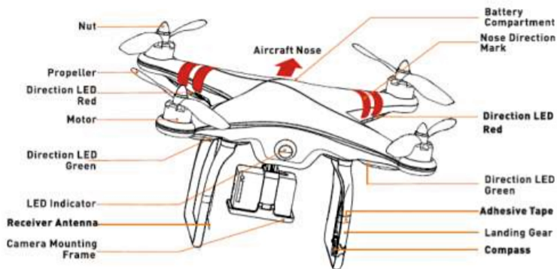
Quadcopter Components:-

Slide 5
7. Obstacle Avoidance Sensors This drone has stereo vision sensors on the front and on the bottom, these sensors work in pairs, just like your eyes. These sensors calculate depth by identifying which image pixels from each sensor correspond to the same point. From this, the drone is able to calculate the distance it is from the object in front of it as the distance between the sensors is constant. 8. 3 Axis Gimbal This is how drone footage is kept so still and stabilized. A motor is placed on the 3 different axes around the camera. When the sensors detect motion on any of these axes, the motors counteract the motion to cancel it. This happens almost instantly as thousands of calculations are executed to provide smooth footage. 9. Drone Camera A lens opens at the front of the camera and light streams in. An imaging sensor captures the incoming light rays and then processes it into a digital image. 10. Drone Battery These batteries are ‘intelligent’ meaning that they have over-charge protection, temperature data, charge cycle history, and communicate power output to the drone. This is to ensure the battery is safe to use repeatedly and so that there are no problems during flight. 11. Drone Antennas Inside the legs of the drone is the transmission system which relays information from the drone to the controller and from the controller to the drone. Also, in the legs of this drone is two compass sensors which relay its direction to the flight controller.

Slide 6
12. Downward Ultrasonic Obstacle Avoidance Sensor One sensor sends out a high-frequency sound pulse and the other sensor receives the pulse. Based on the amount of time between sending the pulse and receiving the pulse the drone calculates the height of the drone off the ground. 13. Flight LED These flash various colors to show the user what direction the drone is facing. The two flashing red lights show the front of the drone (the direction the camera is facing). The two green flashing lights are the back of the drone.
14. Joysticks These translate the physical movement of the sticks into information that the controller can use to communicate with the drone. The left joystick moves the drone up and down and does pan right and pan left. The right joystick moves the drone forward and backward and does drift right and drift left. 15. Main Remote Controller Board This receives information from the drone about its location, altitude, and what the camera is seeing. It also takes inputs from the joysticks and sends the commands to the flight controller. 16. Main Camera Board This processes information from the imaging sensor and gimbal motors to ensure stable footage. This board also processes the camera information and writes the image to the micro SD card.

Slide 7
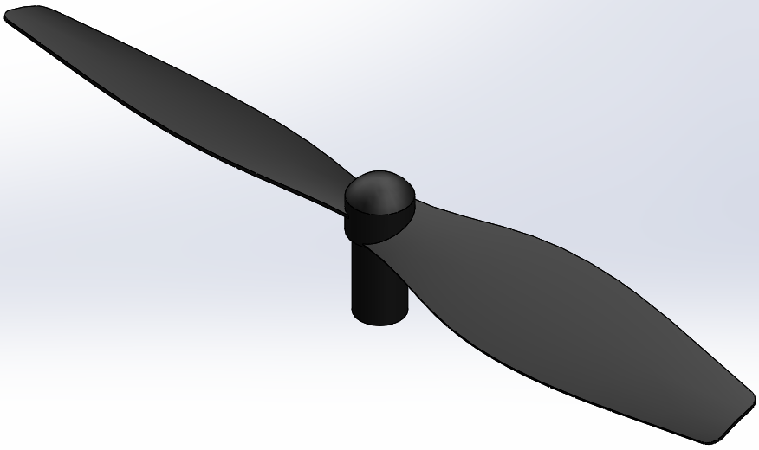
Impeller Blade
Propeller
Propellers are devices that transform rotary motion into linear thrust. The drone propeller provides lift for the aircraft by spinning and creating an airflow, which results in a pressure difference between the top and bottom surfaces of the propeller.
Material used:-
These propellers are generally made from plastics such as nylon, which are reinforced with carbon or glass fibers. ... The use of plastics also helps reduce signal interference from metal materials. With high-performance plastics from LANXESS, drones fly higher, faster and further – as well as safer.
Tools used:-
Fillet , Circular Sketch Pattern , Thicken , Lofted Surface , Extruded Cut , Revolved Boss/Base , circle , line , hexagon.

Slide 8
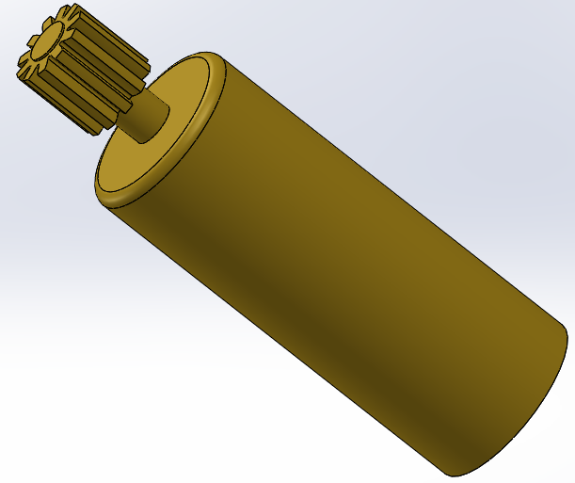
Gear
Gear, machine component consisting of a toothed wheel attached to a rotating shaft. Gears operate in pairs to transmit and modify rotary motion and torque (turning force) without slip, the teeth of one gear engaging the teeth on a mating gear.
Material used:-
Gears can be made of all sorts of materials, including many types of steel, brass, bronze, cast iron, ductile iron, aluminum, powdered metals, and plastics.
Tools used:-
Fillet , Circular Sketch Pattern , Extruded Cut , Revolved Boss/Base , circle , line ,3 Point Arc .

Slide 9
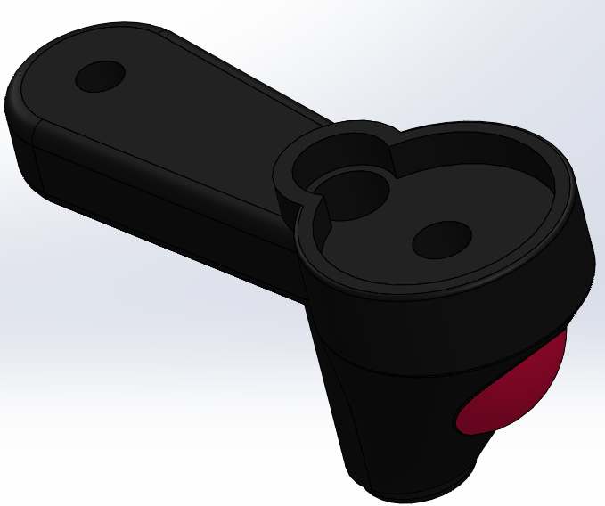
Leg
Inside the legs of the drone is the transmission system which relays information from the drone to the controller and from the controller to the drone. Also, in the legs of this drone is two compass sensors which relay its direction to the flight controller.
Material used:-
LANXESS's Durethan plastics are in use for drone propellers but are also suited for drone bodies and landing gear . Plastics manufacturer says that its short glass fiber reinforced Durethan polyamide material is suitable to be used in drones.
The Legs are generally made from plastics such as nylon, which are reinforced with carbon or glass fibers.
Tools used:-
Fillet , Extruded Boss , Lofted Boss/Base , Extruded Cut , Revolved Boss/Base , circle , line .

Slide 10
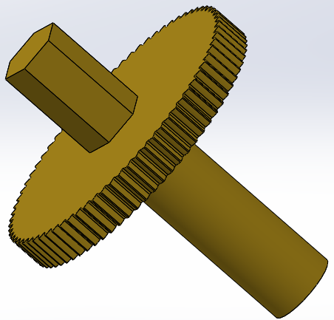
Arm Gear
Arm Gear is fixed in leg part of Drone and it control the motion of propeller . It is spur gear type . Spur gears are the most easily visualized common gears that transmit motion between two parallel shafts. Because of their shape, they are classified as a type of cylindrical gears. Since the tooth surfaces of the gears are parallel to the axes of the mounted shafts, there is no thrust force generated in the axial direction.
Material used:-
Cast iron provides durability and ease of manufacture.
Alloy steel provides superior durability and corrosion resistance. Minerals may be added to the alloy to further harden the gear.
Cast steel provides easier fabrication, strong working loads and vibration resistance.
Carbon steels are inexpensive and strong, but are susceptible to corrosion.
Aluminum is used when low gear inertia with some resiliency is required.
Brass is inexpensive, easy to mold and corrosion resistant.

Slide 11
Copper is easily shaped, conductive and corrosion resistant. The gear's strength would increase if bronzed.
Plastic is inexpensive, corrosion resistant, quiet operationally and can overcome missing teeth or misalignment. Plastic is less robust than metal and is vulnerable to temperature changes and chemical corrosion. Acetal, delrin, nylon, and polycarbonate plastics are common.
Other material types like wood may be suitable for individual applications.
Tool used:-
Fillet , Circular Sketch Pattern , Extruded Cut , Revolved Boss/Base , circle , line , 3 Point Arc , Hexagon.

Slide 12
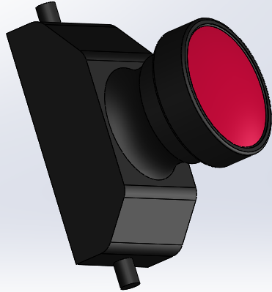
Camera/Light
Drone Anti-Collision Lights / Camera
Camera:-
Unmanned vehicles such as UAVs (unmanned aerial vehicles), drones, UGVs (unmanned ground vehicles) and ROVs (remotely operated vehicles) may use a wide variety of cameras to capture different kinds of imagery, such as photos, thermal images, multispectral images for applications such as precision agriculture, and infrared for heat signature detection.
UAV camera systems and imaging systems used in unmanned applications include HD cameras, embedded cameras, thermal cameras, infrared (IR) camera sensors, OEM camera cores and camera modules.
Light:-
Drones utilize alternating colored LED lights to display a variety of information, some of which also alternate with red in various ways. The most common LED colors used in drones other than red are green, blue, and white. Some drones may have additional colors such as orange/yellow and purple for other uses. Types of Drone Lights:-
Anti-Collision , Short range search lights , Long distance search lights (To See , Pilot depth , perception , Obstacle avoidance , Better camera resolution) ,
Visible vs thermal (long wave infrared) .

Slide 13
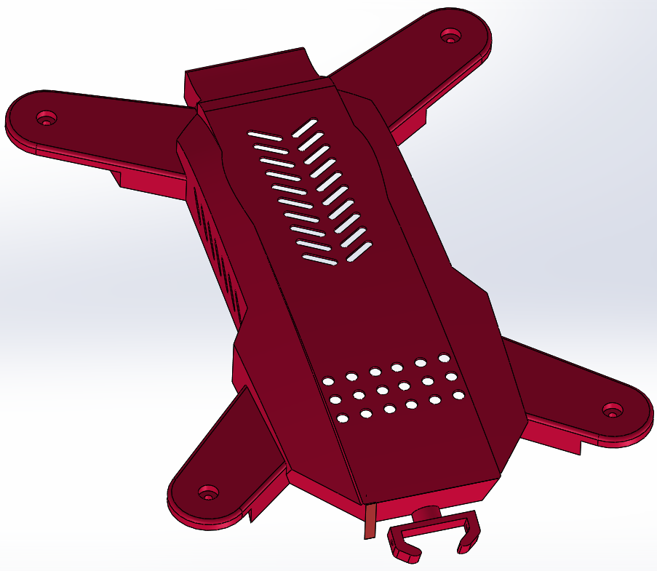
Frame
Frame -The structure that holds all the components together. One of the most important part of quadcopter is its frame because it supports motors and other electronics and prevents them from vibrations. You have to be very precise while making it. They need to be designed to be strong but also lightweight.
Material used:-
WOOD
If you’re trying to build a drone as cheaply as possible, then consider using a wooden frame. Wood isn’t the most aesthetically appealing option out there, but it’s certainly one of the most inexpensive.
CARBON FIBER
If you can afford it, I would highly recommend building your frame out of carbon fiber. The reason why is simple: carbon fiber is very tough and extremely lightweight. It’s this combination that will make your RC drone fly better and consume less energy.
PCB
Also known as “Printed Circuit Board”, this is a type of material that shares the same basic structure and properties as fiberglass. Unlike fiberglass, PCD is always flat. Frames that are less than 600mm in size typically use PCB for the bottom and top plates. In fact, small quadcopter frames can be built entirely from a single printed circuit board.

Slide 14
PLASTIC
Most commercial RC drones that you buy today come with plastic frames. 3D printed molded plastic frames have become an incredibly popular amongst DIY drone enthusiasts. Generally, using a 3D printer to create a perfectly shaped plastic frame is something that only works on smaller drones.
G10
Epoxy-LaminateG10 is a variation of fiberglass that’s often used as a less expensive alternative to carbon fiber. From the outside, G10 and carbon fiber look almost identical, but they do vary slightly in their basic properties.
ALUMINUM
Aluminum can also be used when building your frame. It’s lightweight (though not as lightweight as carbon fiber), flexible, and is relatively easy to work with. Another benefit to aluminum frames is that this type of material is both inexpensive as well as readily accessible.
Tools used:-
Fillet , Linear Sketch Pattern , Extruded Cut , Straight Slot , circle , line , Shell , Extruded Boss , Lofted Boss/Base , Extruded Cut , Mirror , Lofted Cut.

Slide 15
Frame Dimension:-
Experts | RC Groups | Ryan Harrell | Joshua Bardwell | UAV Futures (Stew)
Nano | – | 80 – 100 mm | – | Small toys
Micro | 150 mm or less | 120 – 160 mm | 90 – 180 mm | 1″ props
Mini | 150 – 300 mm | 170 – 280 mm | 190 – 250 mm | 2″ – 4″ props
FPV Racing Classes
Class | Frame | Prop (Max) | Weight (Max) | Battery (Max)
Tiny Whoop | No Limit | 31 mm | 35 g | 1s lipo
Micro | No Limit | 66 mm | 150 g | 2s lipo
3s | 305 mm | 6″ (152 mm) | 800 g | 3s lipo
4s | 305 mm | 6″ (152 mm) | 800 g | 4s lipo
Open | No Limit | No Limit | 800 g | No Limit
Dimension With respect to propeller
Prop Size | Min. Frame Size
1″ | 40 mm
2″ | 75 mm
3″ | 110 mm
4″ | 145 mm
5″ | 180 mm
6″ | 220 mm

Slide 16
Sensors in Quadcopter:- . Gyroscope The most basic of drone sensors, gyroscopes are cheap and basic enough to be integrated into even cheap mini-drones. . Barometer Barometers are sensors that measure air pressure. In drones, this air pressure information is used to determine the drone’s altitude. . Accelerometer The accelerometer of a drone works together with its gyroscope to determine changes in its position and movement. . GPS GPS technology has played a huge role in allowing drones to fly autonomous missions. ... Magnetometer. In cases where determining the drone’s heading using only GPS location is not appropriate, a drone needs to have a magnetometer. . Rangefinder There are different types of rangefinders found in drones but all of them perform a simple task: to determine how far away from the ground the drone is. . Inertial Measurement Unit (IMU) An IMU is not exactly a separate sensor of the drone but is instead a collaboration of several sensors. . Obstacle avoidance Obstacle avoidance sensors isn’t exactly a standard feature in drones. In fact, you would probably only find these sensors in the more expensive and higher end models.

Slide 17
THE FUTURE OF DRONES:-
Start a game-changing career working with dynamic drone technology. From a military innovation, to an exciting hobby, to a technology that’s transforming commercial industries, the use of drones has rapidly changed over the past years — and future opportunities in the field are limitless.
How Drone Technology Is Changing Industries:-
Drones are becoming commonplace in both the commercial and non-profits sectors. In the near future their use will be even more widespread.
Agriculture: The Environmental Protection Agency already utilizes drones technology to manage livestock and survey crops. In the future farmers and ranchers could use unmanned aircraft to strategically monitor and spray their crops.
Conservation: Unmanned aircraft are being used to monitor endangered species and map the changes in various ecosystems around the globe. As drone technology advances, the use and impact of unmanned aircraft in conservation efforts will expand.
Delivery/fulfillment: Anything the postman can carry can also be delivered by drone. Food, prescriptions, that last-minute birthday gift for your dad—in the near future, there will be big changes in the way packages arrive to our doors.
Disaster mitigation and relief: Drones can go places that humans can’t access, so they are an ideal solution for dangerous search and rescue efforts, as well as for delivering emergency supplies to remote locations and disaster areas.

Slide 18
Logistics: Heavy-duty drones can replace trucks for inventory management and moving goods between warehouses. This is likely to decrease the number of semis you see on the road.
Filmmaking and photography: Low-budget filmmakers are already using drones to capture the aerial shots and Hollywood will soon be hiring full crews of drone Unmanned aircraft are also gaining ground with photojournalists who want to capture breaking news from above.
ISPs: Big tech companies like Facebook and Google are experimenting with solar powered drone technology to beam Internet to remote locals. This could transform connectivity as we know it.
Law enforcement: In Seattle and Miami, police forces have already applied for permits to use drones, and we’ll likely begin to see unmanned aircraft supplementing police presence at large public events.
Real Estate: Real Estate listings are poised to change completely with high-definition videos capture by drones that fly through neighborhoods, and into every room in a listed house.

Slide 19
Number of Ways Drones Will Impact Society:-
1. Defense
2. Emergency Response
3. Humanitarian Aid & Disaster Relief
4. Conservation
5. Disease Control
6. Healthcare
7. Agriculture
8. Weather Forecasting
9. Maritime
10. Waste Management
11. Manufacturing & Inventory Management
12. Mining
13. Construction Planning
14. Infrastructure Development
15. Insurance
16. Realty
17. Urban Planning
18. Personal Transportation
19. Airlines
20. Telecommunications
21. Internet
22. Outdoors
23. Tourism & Hospitality
24. Live Entertainment
25. Sports
26. Hollywood
27. Advertising
28. Retail
29. Energy
30. Underground Economies And Fighting Crime
31. Fitness
32. Food Services
33. Journalism And News Coverage
34. Air Travel
35. Gaming
36. Space
37. Education
38. Security
https://www.cbinsights.com/research/drone-impact-society-uav/

Slide 20
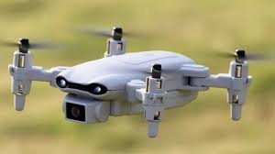
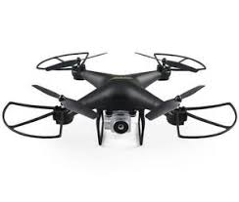
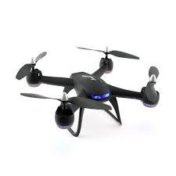
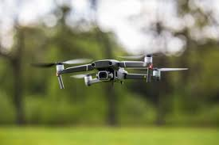
THANK YOU

