Slide 1
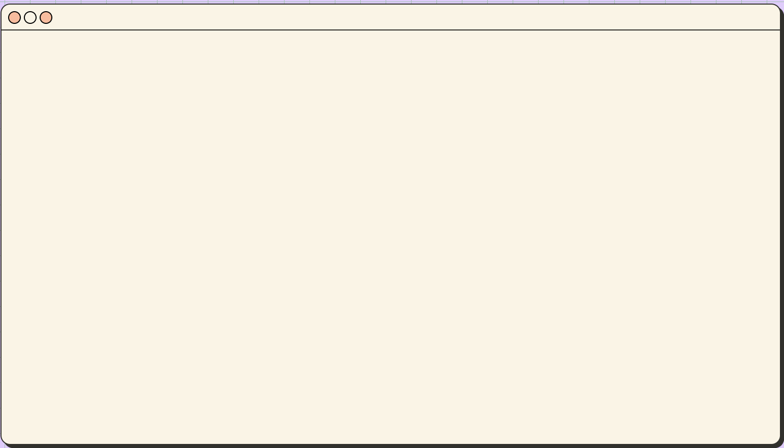

Drone Artificial Intelligence
Automated 3D Reconstruction

Slide 2
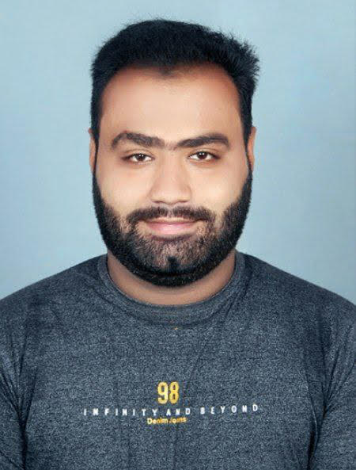
> Whoami
I’m Priyank Basrani
Electronics & Communication Engineer
Having a certificate in Industrial Automation Specialist confirming National Skill Qualification framework level 5
Held first position in PCB designing in Abhyanta 2018 held my OM institute, India

Slide 3
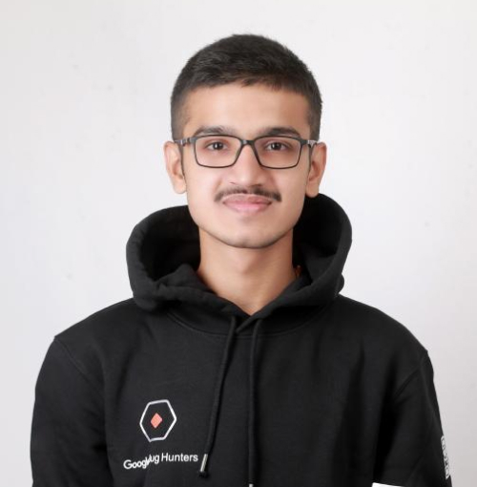
> Whoami
I’m Kirtikumar
Browser & Kernel Hacker
World Record - Youngest Cyber Security Researcher & Ethical Hacker
World Cyber Games 2019 (Asia 7th, World's Top 32) - Seoul, South Korea
Hack-A-Sat 2020 Satellite Hacker
National Representative in BRICS 2020 for India
Google Play Security Research's Top Researcher for 2022
Youngest Tech-Savvy Awardee
Penetration Tester of the Year 2018 in London
Represented India in the High Technology Championship - AI, ML, & Neural Network
Games of Future, Kazan - Competitive Programming Finalist
Gold Medalist in drone AI, BRICS Kazan

Slide 4
What we are going to hack for?
A drone-powered AI pipeline
A neural-network-based insulator detection system
A geometry-engine for wire sag modelling
A photogrammetry system to extract tower locations
A 3D reconstruction engine to build:
Tower axes
Wire attachment points
A web interface to visualize the digital twin
A GIS-friendly GeoPackage for professional powerline analysis

Slide 5
Ingredients of the Food?
Drone:
Neural Network:
Clover 4
Skyris Pro
Rasberry Pi 4
Wi-Fi Module
Gyroscope Sensor
ESC
BLDC Motor
Pi Camera
Flight Controller
YOLOv8 – Insulator detection
Detectron2 – Tower & wire segmentation
SciPy – Catenary curve estimation
OpenSfM / OpenDroneMap – Photogrammetry
PDAL – LiDAR point cloud processing
PyTorch, TensorFlow, OpenCV, NumPy, Pandas

Slide 6
Details on Ingredients
Dataset:
ALS Point Clouds (.laz)
UAV Aerial Photogrammetry (JPEGs + EO files)
DSM/DTM terrain rasters
Orthomosaic imagery
Real-world transmission line segments
Drone:
Clover 4 with Pi4 + HD camera
Backend/Web
NodeJS (Web Dashboard for Visualization)
FastAPI for transferring model outputs

Slide 7
What we are cooking today?
Dataset: Powerline Dataset provided by the Championship organizers
Drone: Clover 4
Circuit: Rasberry Pi 4
WebPanel: NodeJS (through FastAPI)

Slide 8
Neural Network:
Dataset refining
Data Preprocessing
Training Model
Percentage calculation
Finding Probability (Between 0 to 1)
Accuracy
Captioning

Slide 9
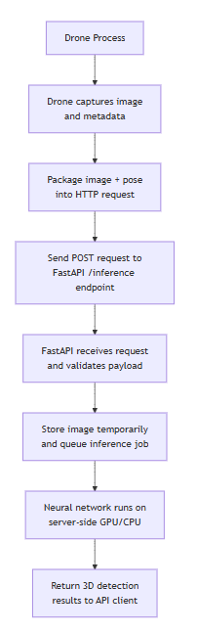
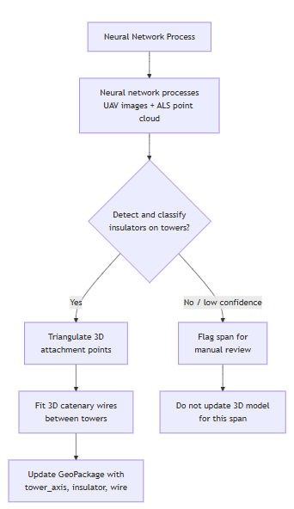
Drone Camera and Neural Network Combination

Slide 10
Approach for solving the problem set:
Drone Camera + Neural Network Combo
Drone captures high-resolution overlapping imagery
Pixel coordinates → converted to 3D via photogrammetry
Insulator detections → triangulated using EO parameters
Wire spans reconstructed between attachment points
Entire line reconstructed in 3D

Slide 11
Would you like to enjoy the whole integrated model in action?

Slide 12
Can Neural Network only identify from a photo? What if the Neural network wants to do it in real time? Can it recognize from Video?

Slide 13
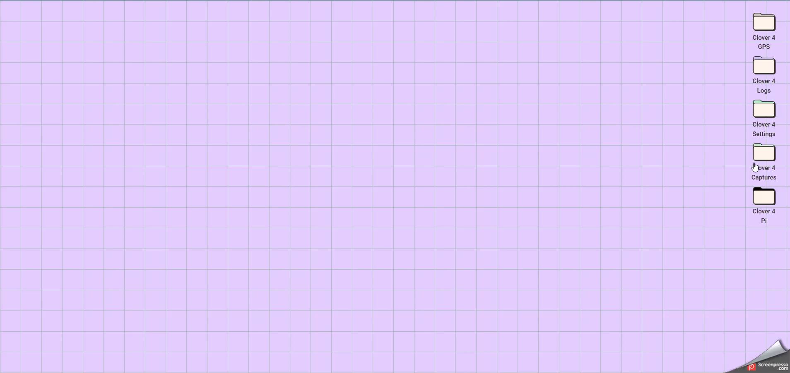

Slide 14
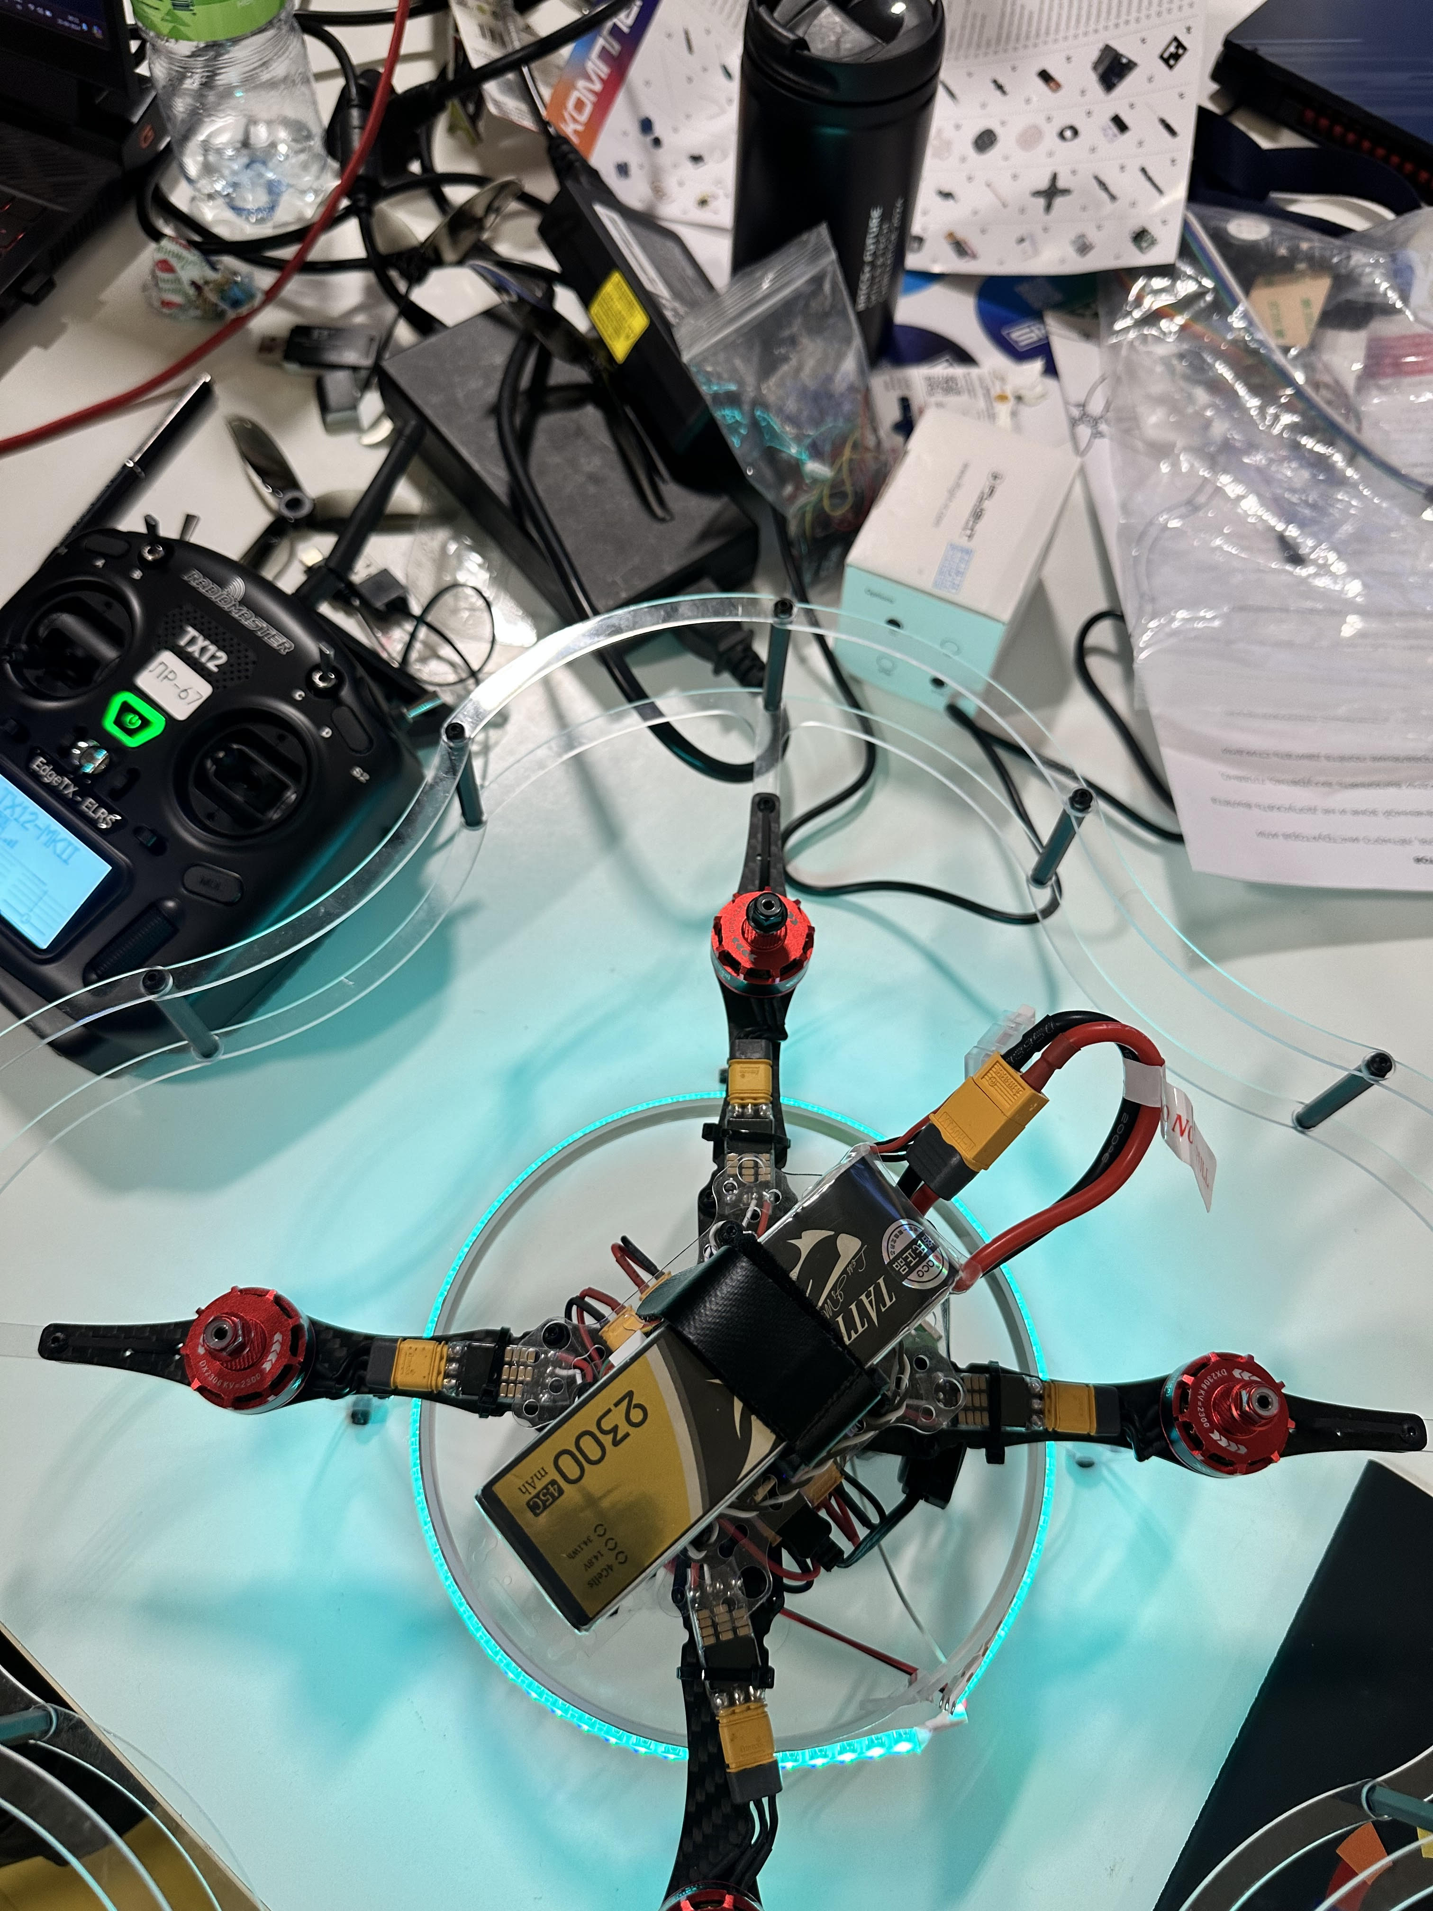
Assembled drone providing connection through FastAPI
Autonomous Path
Manual Handling
GPS Dest Part
Path for Obstacle detection

Slide 15
Pro’s for using my Product?
Higher Accuracy
Exceptionally bridged
Real time training
Adjustable
Least memory consumption (~1.4GB)
Least failure

Slide 16
Con’s? Really?
Huge datasets
Time-intensive training
Requires strong GPU for first-time model training
Complex pipeline
Needs technical understanding
But…

Slide 17
Why These Cons Don’t Matter
Automation replaces human work
Faster inspection of hundreds of kilometers
Enhanced safety
Real-time clearance monitoring
Supports multiple utility companies
Ideal for smart grid + digital twin applications
Saves cost and time in field surveys

Slide 18
Real-life question:
One and only. Why rebuild powerlines using drones + AI?

Slide 19
Because….
Manual inspection is dangerous
Human resources are limited
LiDAR-based inspection is expensive
Vegetation + sag clearance violations cause outages
AI helps prevent failures before they happen
Digital twins enable better asset management

Slide 20
What Can This System Do in Real Life?
Detect dangerously sagging wires
Identify vegetation encroachment
Precisely locate insulator wearing
Provide 3D models for engineers
Monitor tower tilt
Predict maintenance needs
Real-time drone patrol & inspection

Slide 21
This has caught our attention, can we view your product and decide to grab it?

Slide 22
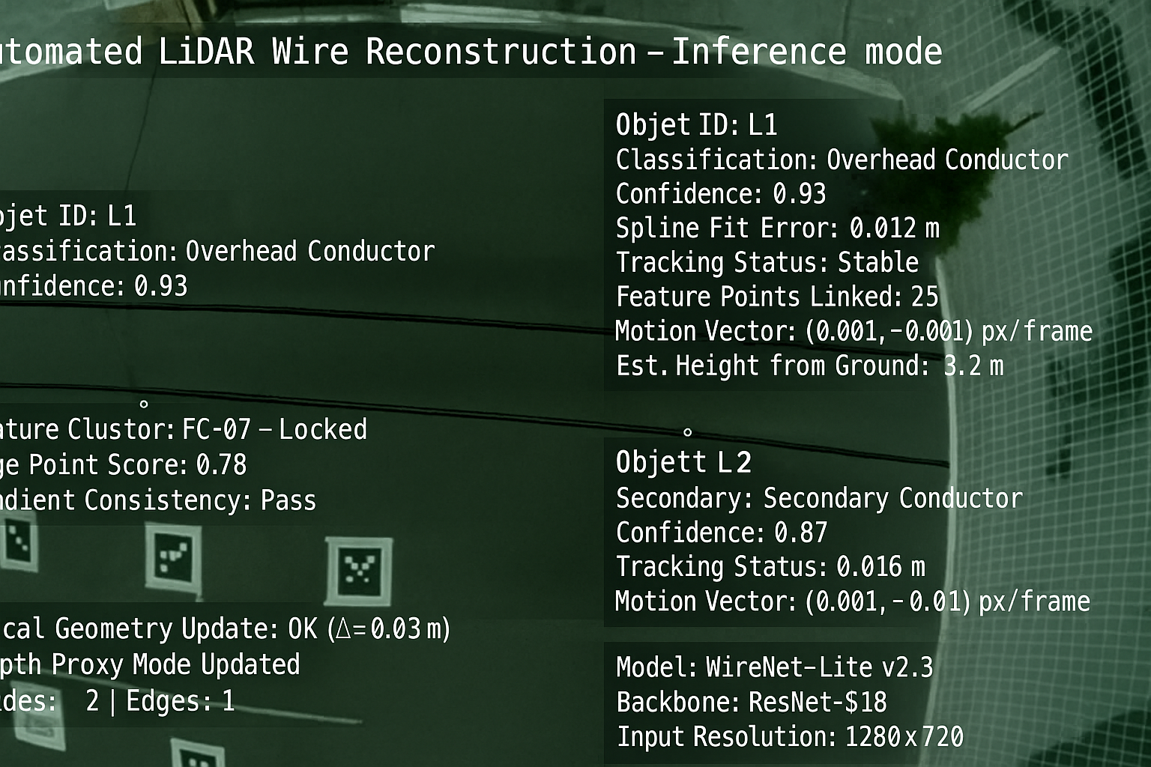
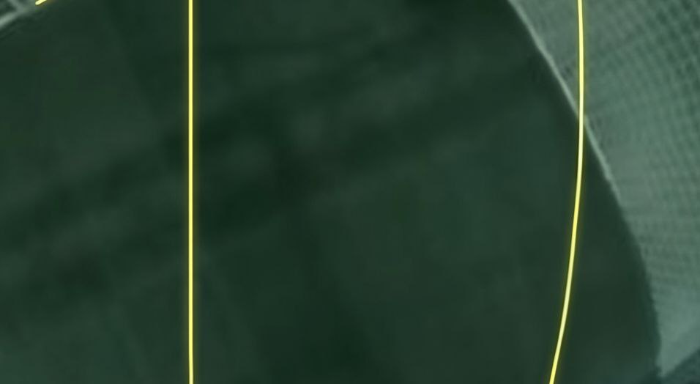
Images captured by drone processed by Neural Network

Slide 23
Are you curious about anything related to my product?
Want to talk anything about technology?
Got any exciting idea to implement?
Got any suggestions?

Slide 24
How to get in touch and make life easier with me using tech?
E-mail: kirtiar15502@gmail.com
research@kirtikumarar.com

