Slide 1
Array
Basic data structure

Slide 2
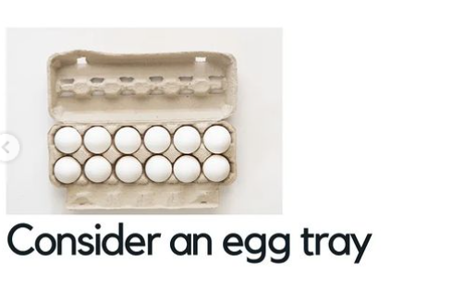
Let’s take an example to understand array
In an egg tray we have all the eggs in a continous manner one after another
Here we can also modify egg
tray like removing an or specifically
Choose any one egg of our choice

Slide 3
Now think of an egg tray and an array
Egg tray is the array and and eggs are the elements of array
And egg is the name of array
And meat is the datatype of array
No. of eggs is size of array
For example :
Meat egg[5] ={0,0,0,0,0};
Int array[5]={1,2,4,5,6};
Int is an integer type datatype which stores number’s

Slide 4
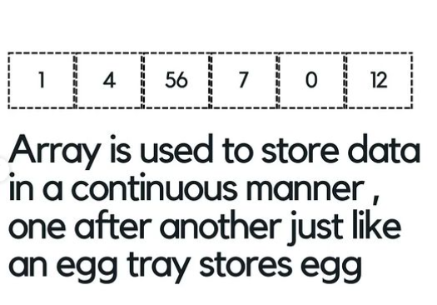

Slide 5
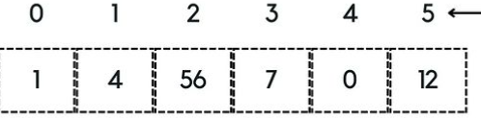
Array properties
Array has index number which starts from 0 that help’s us to perform operations like insertion ,deletion, modification
Like array[0] is storing value 1
Array elements has different addresses
Array size depends on the size of its datatype
Elements are of same datatype like if array is of integer datatype then it will only store the numbers

