Slide 1

TITLE PAGE
Problem Statement ID –1710
Problem Statement Title-Enhancing Navigation for Railway Station Facilities and Locations
Theme-Transportation & Logistics
PS Category- Software
Team ID-
Team Name (Bytes Brigade)

Slide 2









IDEA STATION GUIDE
MULTI PLATFORM NAVIGATION
INTEGRATION
With existing platforms like IRCTC , etc..
Accessible in Android,
iOS , digital Kiosks.
3D MAPS
Interactive Maps
Interactive Navigation with zoom and rotate option.
Making the visualization easy using AR.
3D STATION GUIDE
UPDATES
FOR DISABLES
Voice guide, wheel chair friendly routes.
Instant updates on platform changes & train delay .
USER EXPERIENCE
SECURITY
Simple & easy to access using VR Technology.
Live location of user is protected using API.

Slide 3











TECHNICAL APPROACH
DBMS
FOR KIOSKS
SQL
THREE.JS
PUSH NOTIFICATION
VOICE
ACCESS
FIRE BASE
GOOGLE CLOUD
NODE JS
OPENSTREET MAP API
MAP DATA
BACKEND
FLUTTER
UNITY
3D MODEL
FRONTEND
FIGMA
BLENDER
3D MAP DESIGN
UI/UX DESIGN

Slide 4
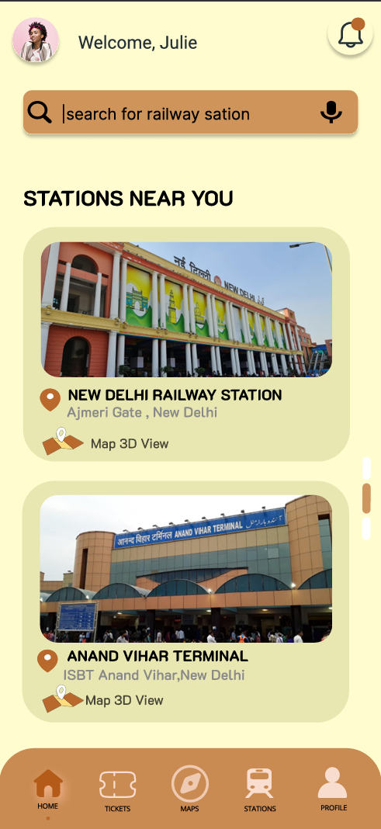
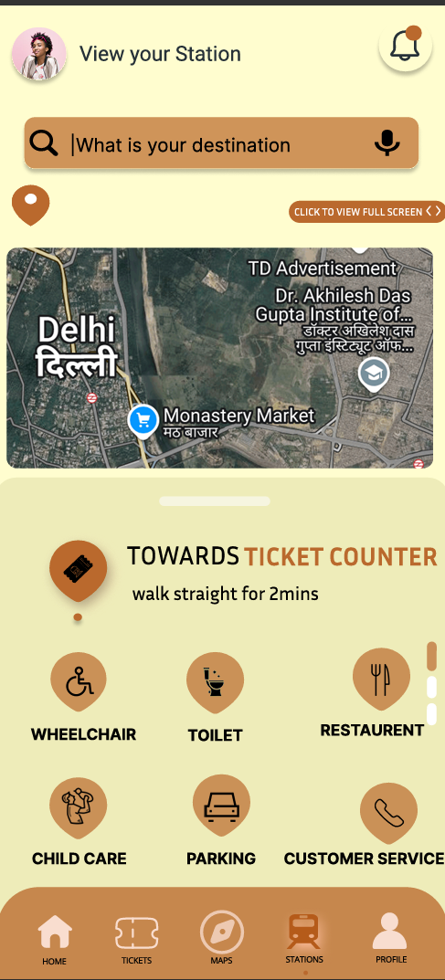
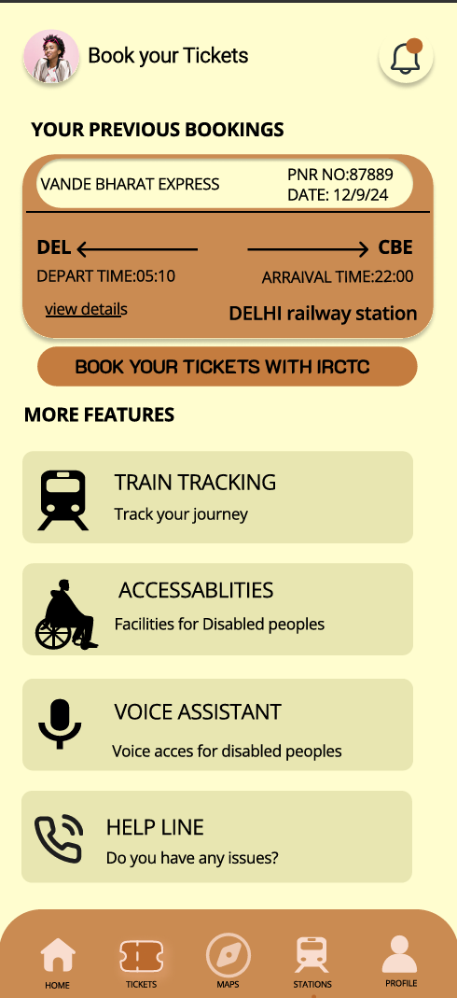
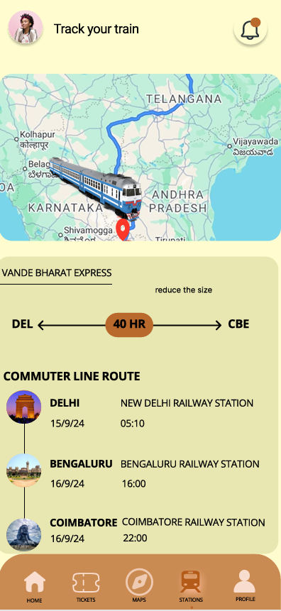
FEASIBILITY AND VIABILITY

