Slide 1


SMART INDIA HACKATHON 2026
Problem Statement ID - SIH26129
Problem Statement Title - System integration and interoperability among government digital platforms,resulting in fragmented service delivery Theme - Miscellaneous
PS Category – Software
Team Name – OneDesk
1

Slide 2

PROBLEM SOLUTION AND UNIQUENESS
One Citizen, One Government, One Experience.
SOLUTION
ADDRESSAL APPROACH
Federated Identity — one OneDesk ID unifies every department's citizen record, while each department keeps its own data.
Consent-Based Exchange — purpose-bound, time-limited, revocable access, modelled on India's DEPA / Account Aggregator standard.
Unified Application Tracking — one live status across Identity, Business Registry, Tax and Municipal verification steps.
Universal Connector Framework — REST, legacy SOAP and database systems join through adapters, no rewrite needed.
Operations Console — real-time visibility into workflows, data quality, SLAs and full audit trails for officials.
Secure Data Exchange: A canonical field-level mapping layer resolves schema mismatches — e.g. full-name/DOB vs name/dateOfBirth — before any record crosses a department boundary.
Trust & Accountability: Purpose-bound consent tokens plus an immutable audit ledger mean access without valid consent is blocked outright, not logged after the fact.
Zero-Trust Security: Every service-to-service call is encrypted and mutually authenticated, with automated backups and alerting keeping the platform resilient by default.
✓
Every cross-department request is authenticated, signed and logged end-to-end through Keycloak.
WHAT MAKES ONEDESK DIFFERENT
1
2
3
4
5
Keycloak-Powered Identity
Zero Data Re-Entry
Graceful Degradation
Progressive Modernization
Full Traceability
One Keycloak realm mints every OneDesk ID and access token — no separate logins.
Submit once — departments reuse the same verified record instead of asking again.
If a department's system goes down mid-workflow, only that step pauses and retries.
Legacy systems join via adapters now and modernize later, on their own timeline.
Every access and consent event is timestamped, for auditors and citizens alike.
ONE IDENTITY
ONE APPLICATION
ONE PLATFORM
ONE TRUST
2
ONE EXPERIENCE

Slide 3
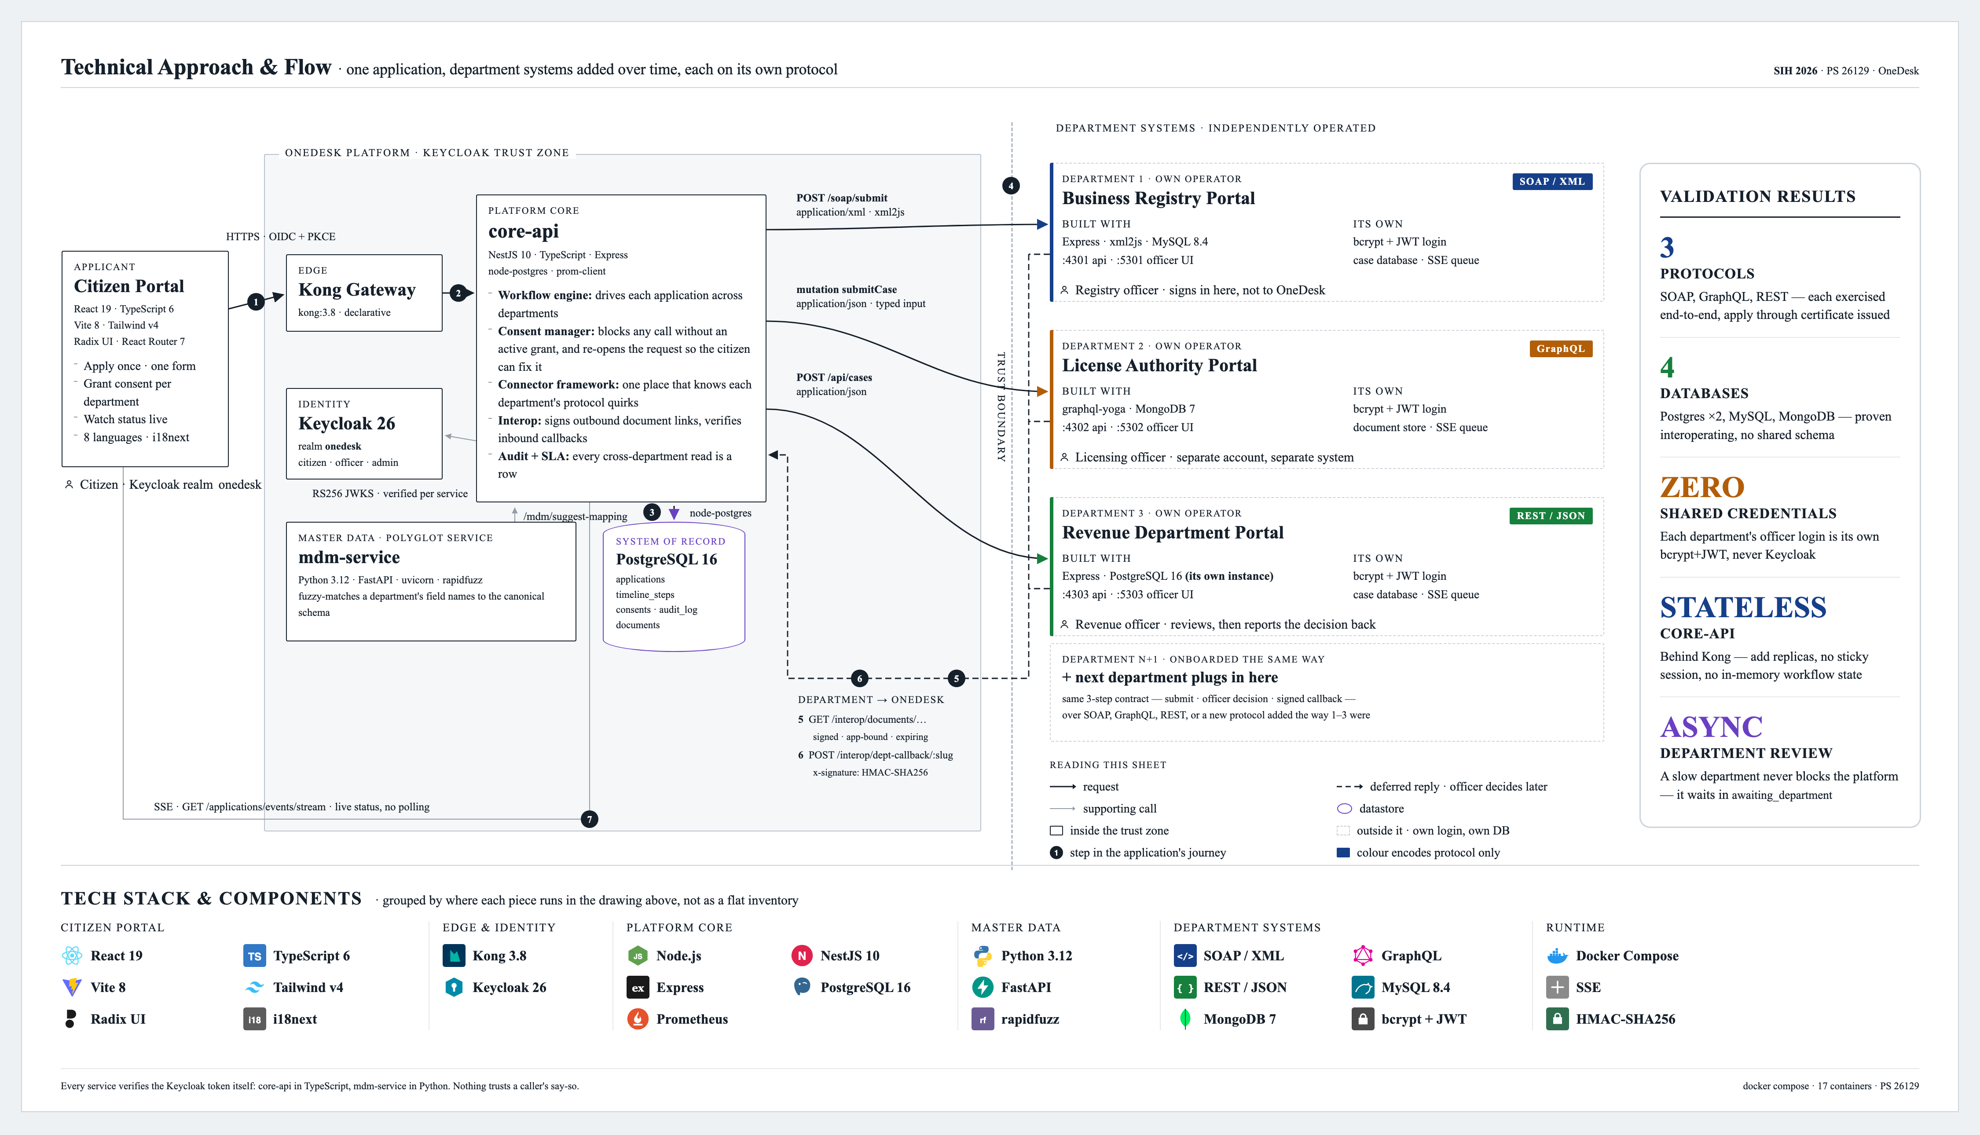
TECHNICAL APPROACH
One Citizen, One Government, One Experience.

Slide 4
FEASIBILITY AND VIABILITY ANALYSIS
One Citizen, One Government, One Experience.
POTENTIAL CHALLENGES AND RISKS
Legacy & Scalability: Old systems, inconsistent data, high traffic, and failures make integration difficult.
Trust & Adoption: Departments may hesitate to share data, while citizens need clear consent and control.
Security & Privacy: Requires encryption, access control, consent management, auditing, and secure data sharing.
.
System Replacement
Legacy SOAP or database systems require full replacement to integrate.
Adapter Layer
Modern API gateways and adapters wrap existing systems to lower rebuild costs.
IDEA FEASIBILITY
Schema Fragmentation
Departments maintain disparate database schemas causing data silos.
Canonical Mapping
Common fields map to a canonical schema without forcing database changes.
Bolted-on Security
Security and privacy controls are added as secondary features.
Consent-Based Access
Access is blocked by design without a valid consent token.
STRATEGIES FOR OVERCOMING CHALLENGES
Legacy & Data Quality: Standard adapters, data validation, and identity matching ensure accurate data.
Trust & Adoption: Simple consent controls and small pilot programs build trust.
Security, Privacy & Resilience: Zero-trust security, encryption, audit logs, backups, alerts, and automatic recovery ensure safe and reliable operation.
High Friction
Departments face significant pressure to change internal systems.
Low Friction
Departments retain system ownership by adding thin connectors.
Big-Bang Integration
Large-scale, simultaneous system integration is required.
Pilot-First Approach
Conditional routing allows for incremental, department-by-department deployment.

Slide 5
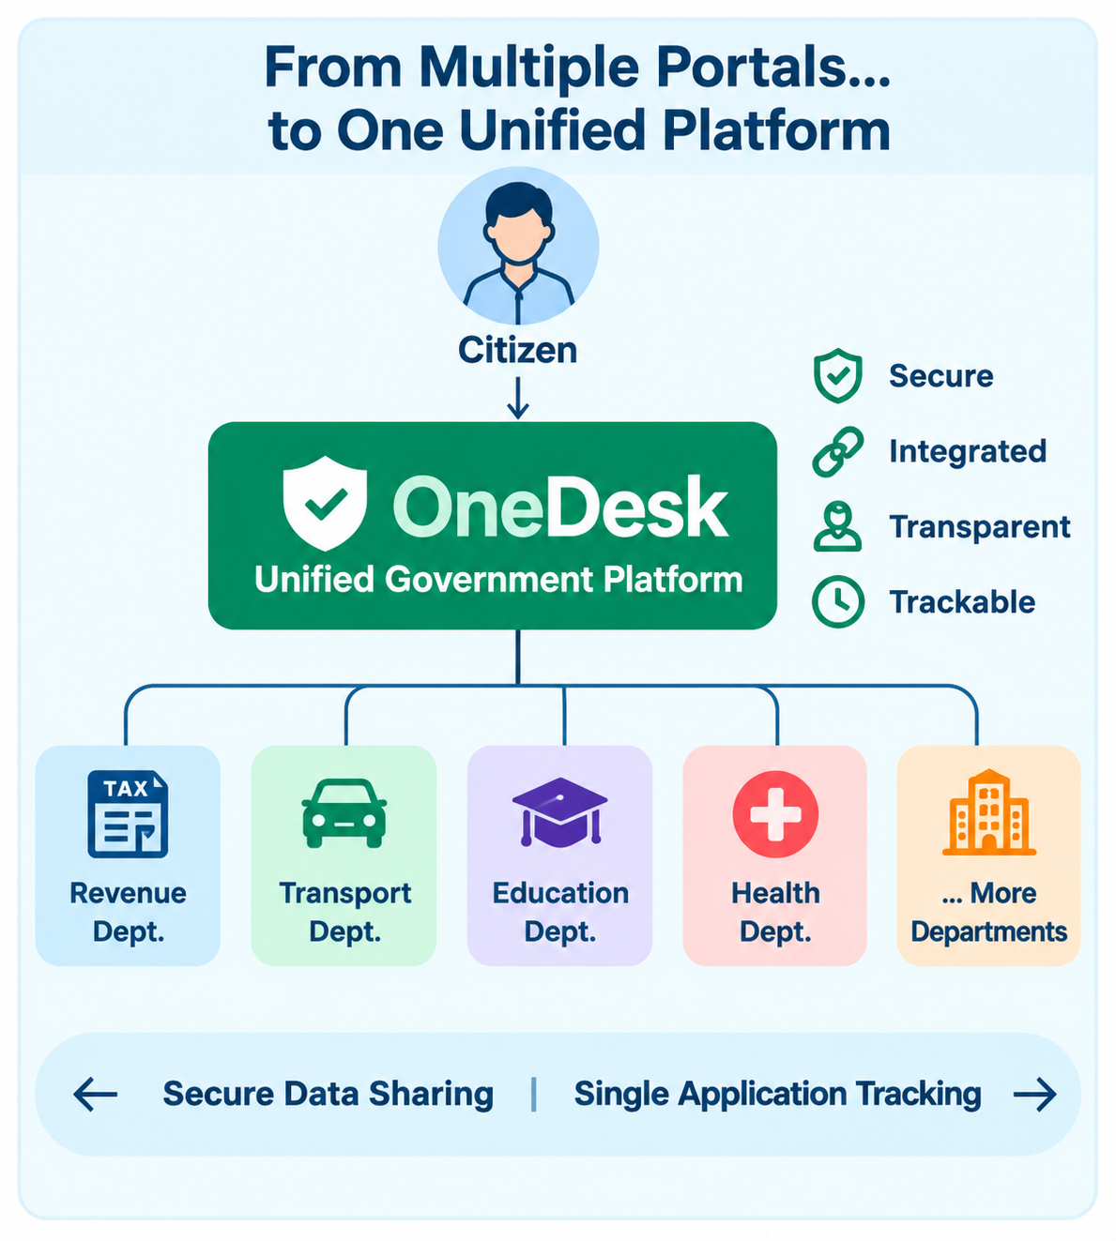
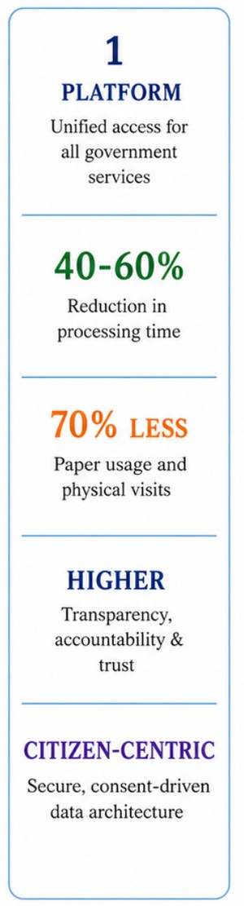












IMPACT AND BENEFITS
One Citizen, One Government, One Experience.
IMPACT
IMPACT
BENEFITS
BENEFITS
Social
Citizens
Greater transparency, trust and accessibility.
Faster, transparent, hassle-free services.
Rural Citizens
Economic
Lower processing costs and delays.
Less travel, paperwork no middlemen.
Officers
Governance
Better coordination and accountability.
Less manual verification and faster processing
Environmental
Businesses
Less paper and travel.
Faster approvals and simplified licensing.
Data Privacy
Administrators
Consent-based, secure data sharing.
Better monitoring and data-driven decisions.
Scalability
Vulnerable Groups
OneDesk adds an integration layer — existing departmental systems remain unchanged
Extendable across departments and services
Reduced time, travel and effort.
STAKEHOLDER
Citizens / Users
Government Departments
Government Officials
Easy service access & application tracking
Less paperwork & office visits
Secure data sharing & verification
Less manual work & faster service delivery
Efficient application, workflow & management
Better monitoring & transparency

Slide 6
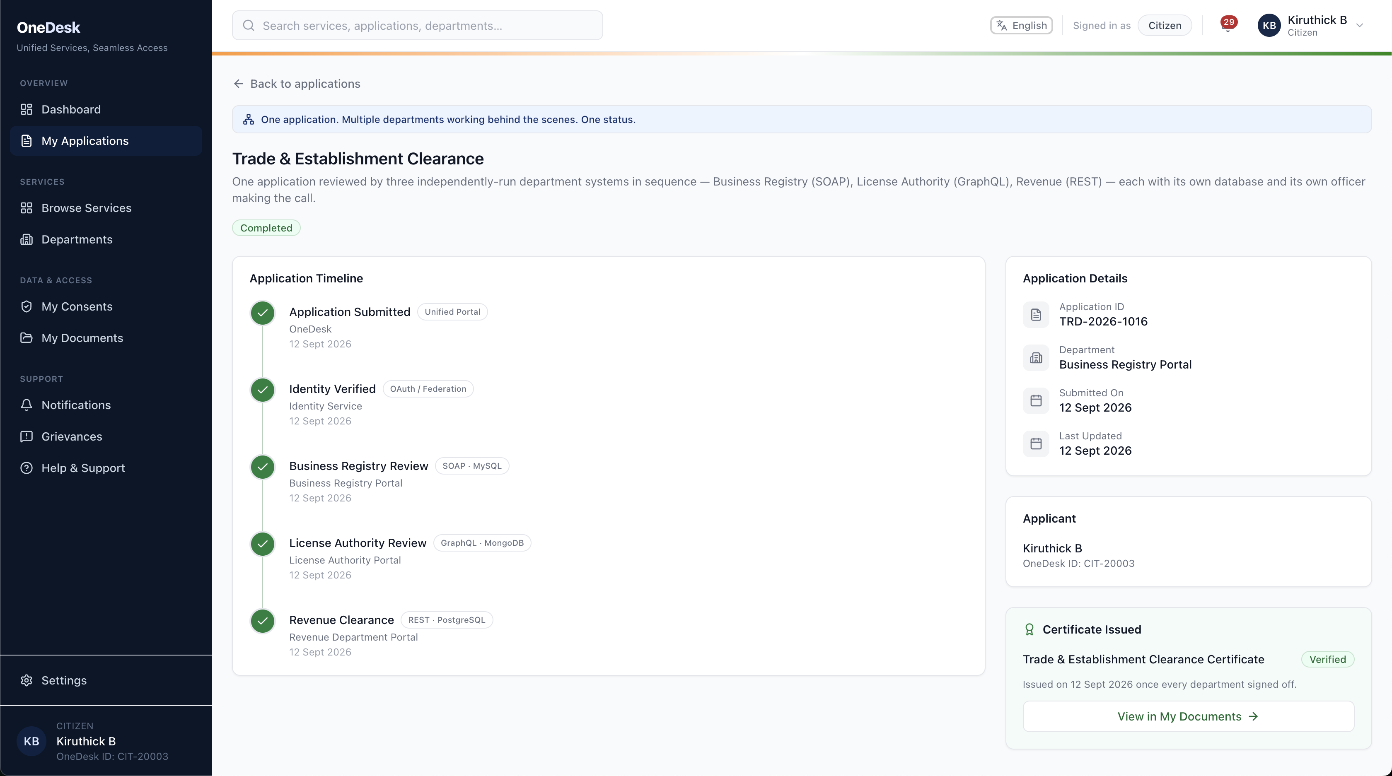
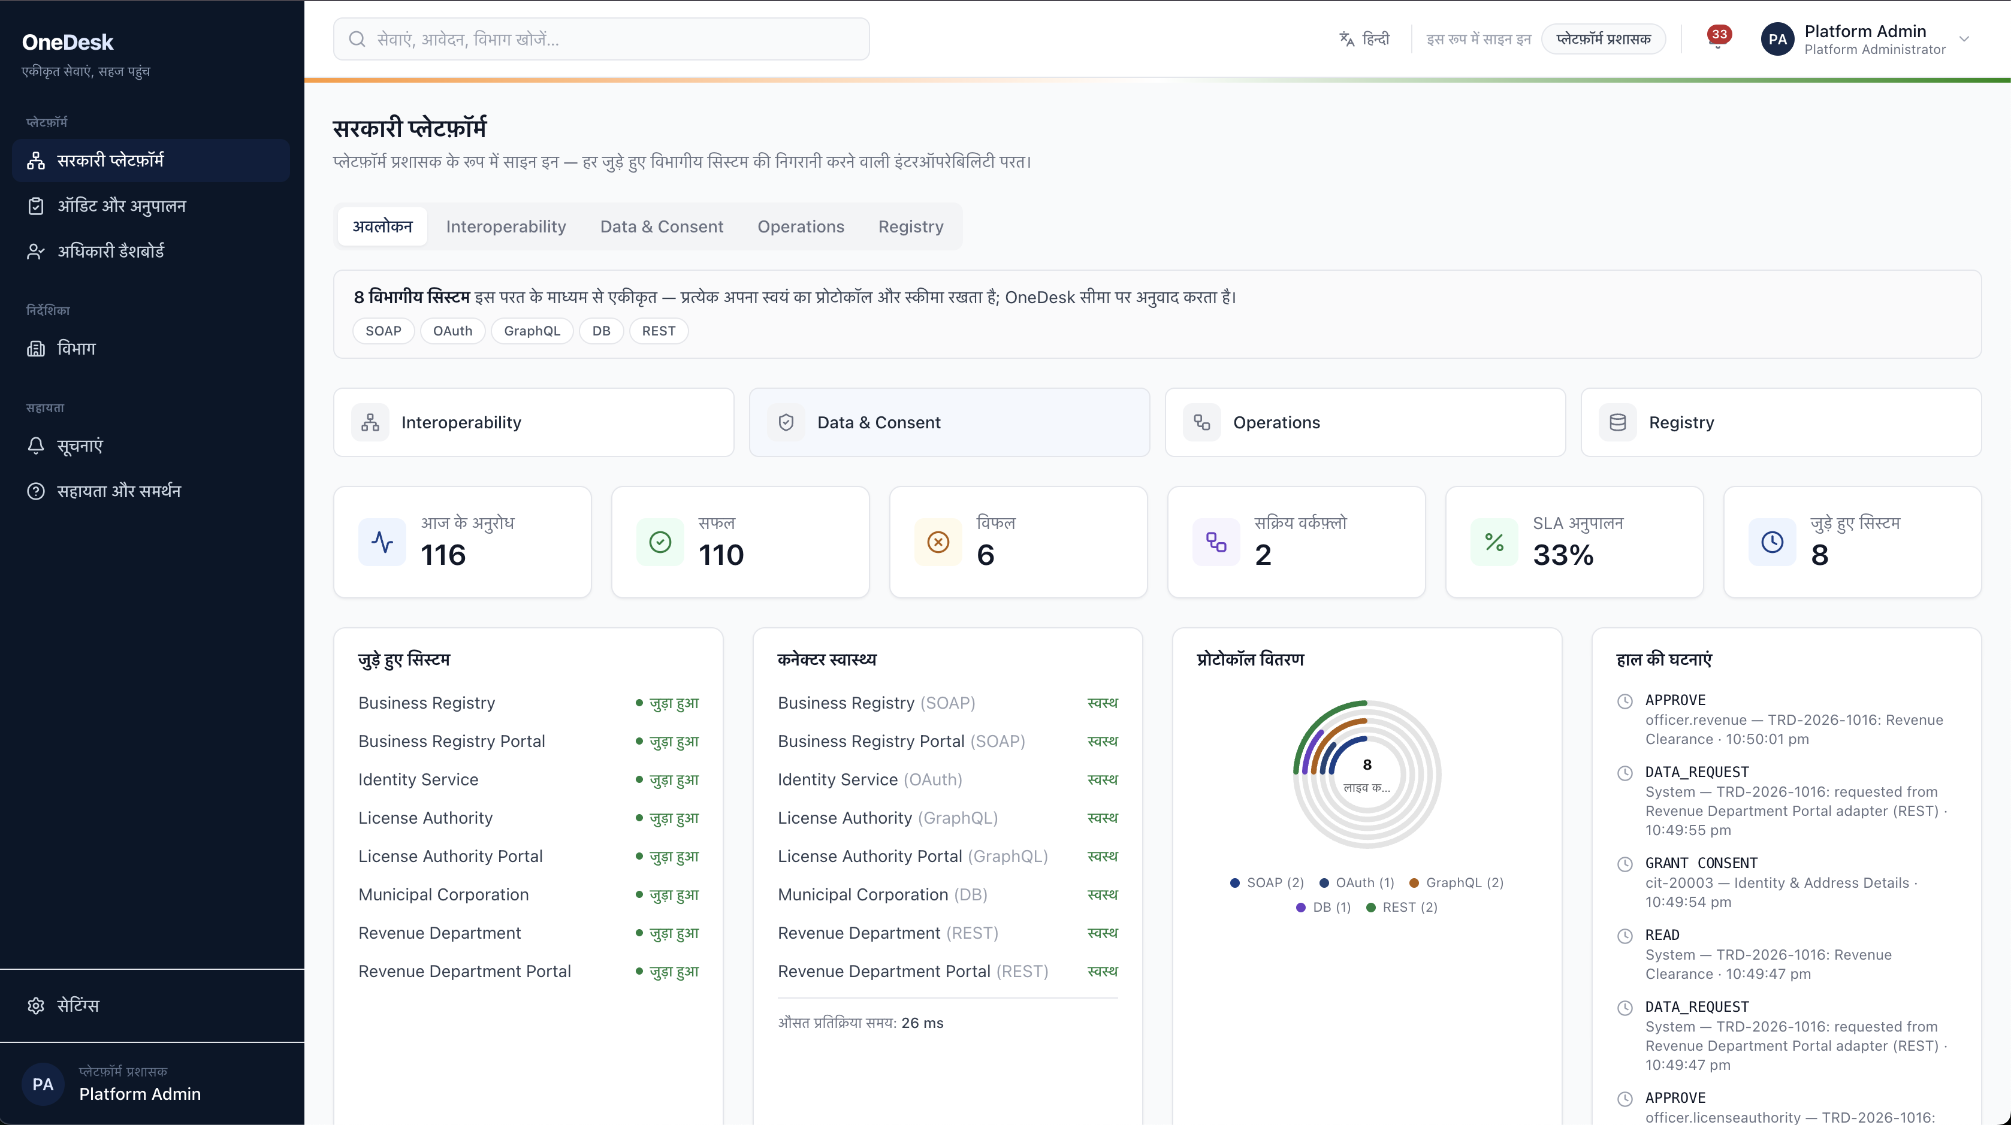
RESEARCH AND REFERENCES
One Citizen, One Government, One Experience.
Government & Interoperability Frameworks
Technical Standards & Integration
Research & Academic Papers
● India API Setu MeitY · National interoperability platform
● India Enterprise Architecture (IndEA) 1.0 Govt. of India enterprise framework
● India Stack UIDAI · NPCI · MeitY - Aadhaar, eKYC, UPI, DigiLocker
● X-Road Data Exchange Layer Estonia · national X-Road backbone
● OAuth 2.0 Authorization Framework RFC 6749 · IETF
● OpenID Connect Core 1.0 Identity layer over OAuth 2.0
● Canonical Data Model Enterprise Integration Patterns
● API Gateway Pattern microservices.io
● Sarantis et al. - Greek EGIF IEEE · one-stop service provision
● E-gov Data Interoperability, Hong Kong IEEE
● One-Stop-Shop e-Government Paradigm IEEE
● Cross-Border Interoperable Identity arXiv, 2023 · developing countries
4 SOURCES
4 SOURCES
4 SOURCES
HOW RESEARCH SHAPED ONEDESK
Government Frameworks
→
Standards
→
Research
→
Architecture
→
OneDesk
API Setu · IndEA
OAuth2 · OIDC · X-Road
IEEE · arXiv papers
Gateway · canonical model
production system
Citizen Experience
Admin & Interoperability
✓ One application, tracked across three independent departments
✓ Live timeline - per-department status, no manual follow-up
✓ Consent-gated data sharing, visible to the citizen at every step
✓ Certificate issued automatically once every department signs off
✓ Single pane over every connected department system
✓ Per-protocol health - SOAP, GraphQL, REST, DB connectors
✓ Live protocol distribution and SLA compliance metrics
✓ Full audit trail of every cross-department data request
TEAM
Kiruthick B · CSE
Kaviya R · CSE
Indhuja V S · CSE
Shreeja Y · CSE
Sriram T R · CSE
Siva Sidh Kumar P · CSE
FUTURE WORK
→ Per-officer accounts and role-based access on department portals - today each portal runs on one shared seeded officer login
→ Production-grade deployment - orchestration and horizontal scaling beyond today's single-node Docker Compose setup
→ Wire the existing Prometheus metrics into a Grafana dashboard with SLA-breach alerting
GitHub : One Desk - System Integrations and Interoperability among Govt Orgs

