Slide 1


SMART INDIA HACKATHON 2026
Problem Statement ID - SIH26129
Problem Statement Title - System integration and interoperability among government digital platforms,resulting in fragmented service delivery Theme - Miscellaneous
PS Category - Software
Team ID - 139985
Team Name - OneDesk
1

Slide 2

PROBLEM SOLUTION AND UNIQUENESS
One Citizen, One Government, One Platform.
SOLUTION
ADDRESSAL APPROACH
Federated Identity - OneDesk ID unifies every department's citizen record, while each department keeps its own data.
Consent-Based Exchange - requirement-bound, time-limited, revocable access, modelled on India's DEPA (Data Empowerment and Protection Architecture) / Account Aggregator standard.
Unified Application Tracking - one live status across Identity, Government Registries, different departments like (Tax, Municipal, Revenue) verification steps, reducing delays and multilingual support across all the languages.
Universal Connector Framework - REST, legacy SOAP and database systems join through adapters without rebuilding the existing systems
Operations Console - real-time visibility into workflows, data quality, SLAs (Service Level Agreement) and full audit trails for officials.
Data Format Matching: A common data mapping layer resolves schema mismatches - e.g. full-name/DOB vs name/dateOfBirth - before any record crosses a department boundary.
Trust & Accountability: Consent-based access ensures that data can be accessed only with valid permission, while an immutable audit log records every authorized data access for transparency and accountability.
Zero-Trust Security: Every service-to-service call is encrypted and mutually authenticated, with automated backups and alerting keeping the platform resilient by default.
Role-Based Access: Each department can access only the data needed for its work.
Every cross-department request is authenticated, signed and logged end-to-end through Keycloak.
WHAT MAKES ONEDESK DIFFERENT
1
2
3
4
5
Keycloak-Powered Identity
No Repeated Data Entry
System Recovery
Easy Modernization
Complete Traceability
A single login lets users access all the services without signing in separately.
Submit once - departments reuse the same verified record instead of asking again.
If a specific department's system goes down mid-workflow, only that step pauses and retries.
Legacy systems join via adapters now and modernize later, on their own timeline.
Every access and consent event is timestamped, for auditors and citizens alike.
ONE IDENTITY
ONE APPLICATION
ONE PLATFORM
ONE TRUST
2
ONE EXPERIENCE

Slide 3
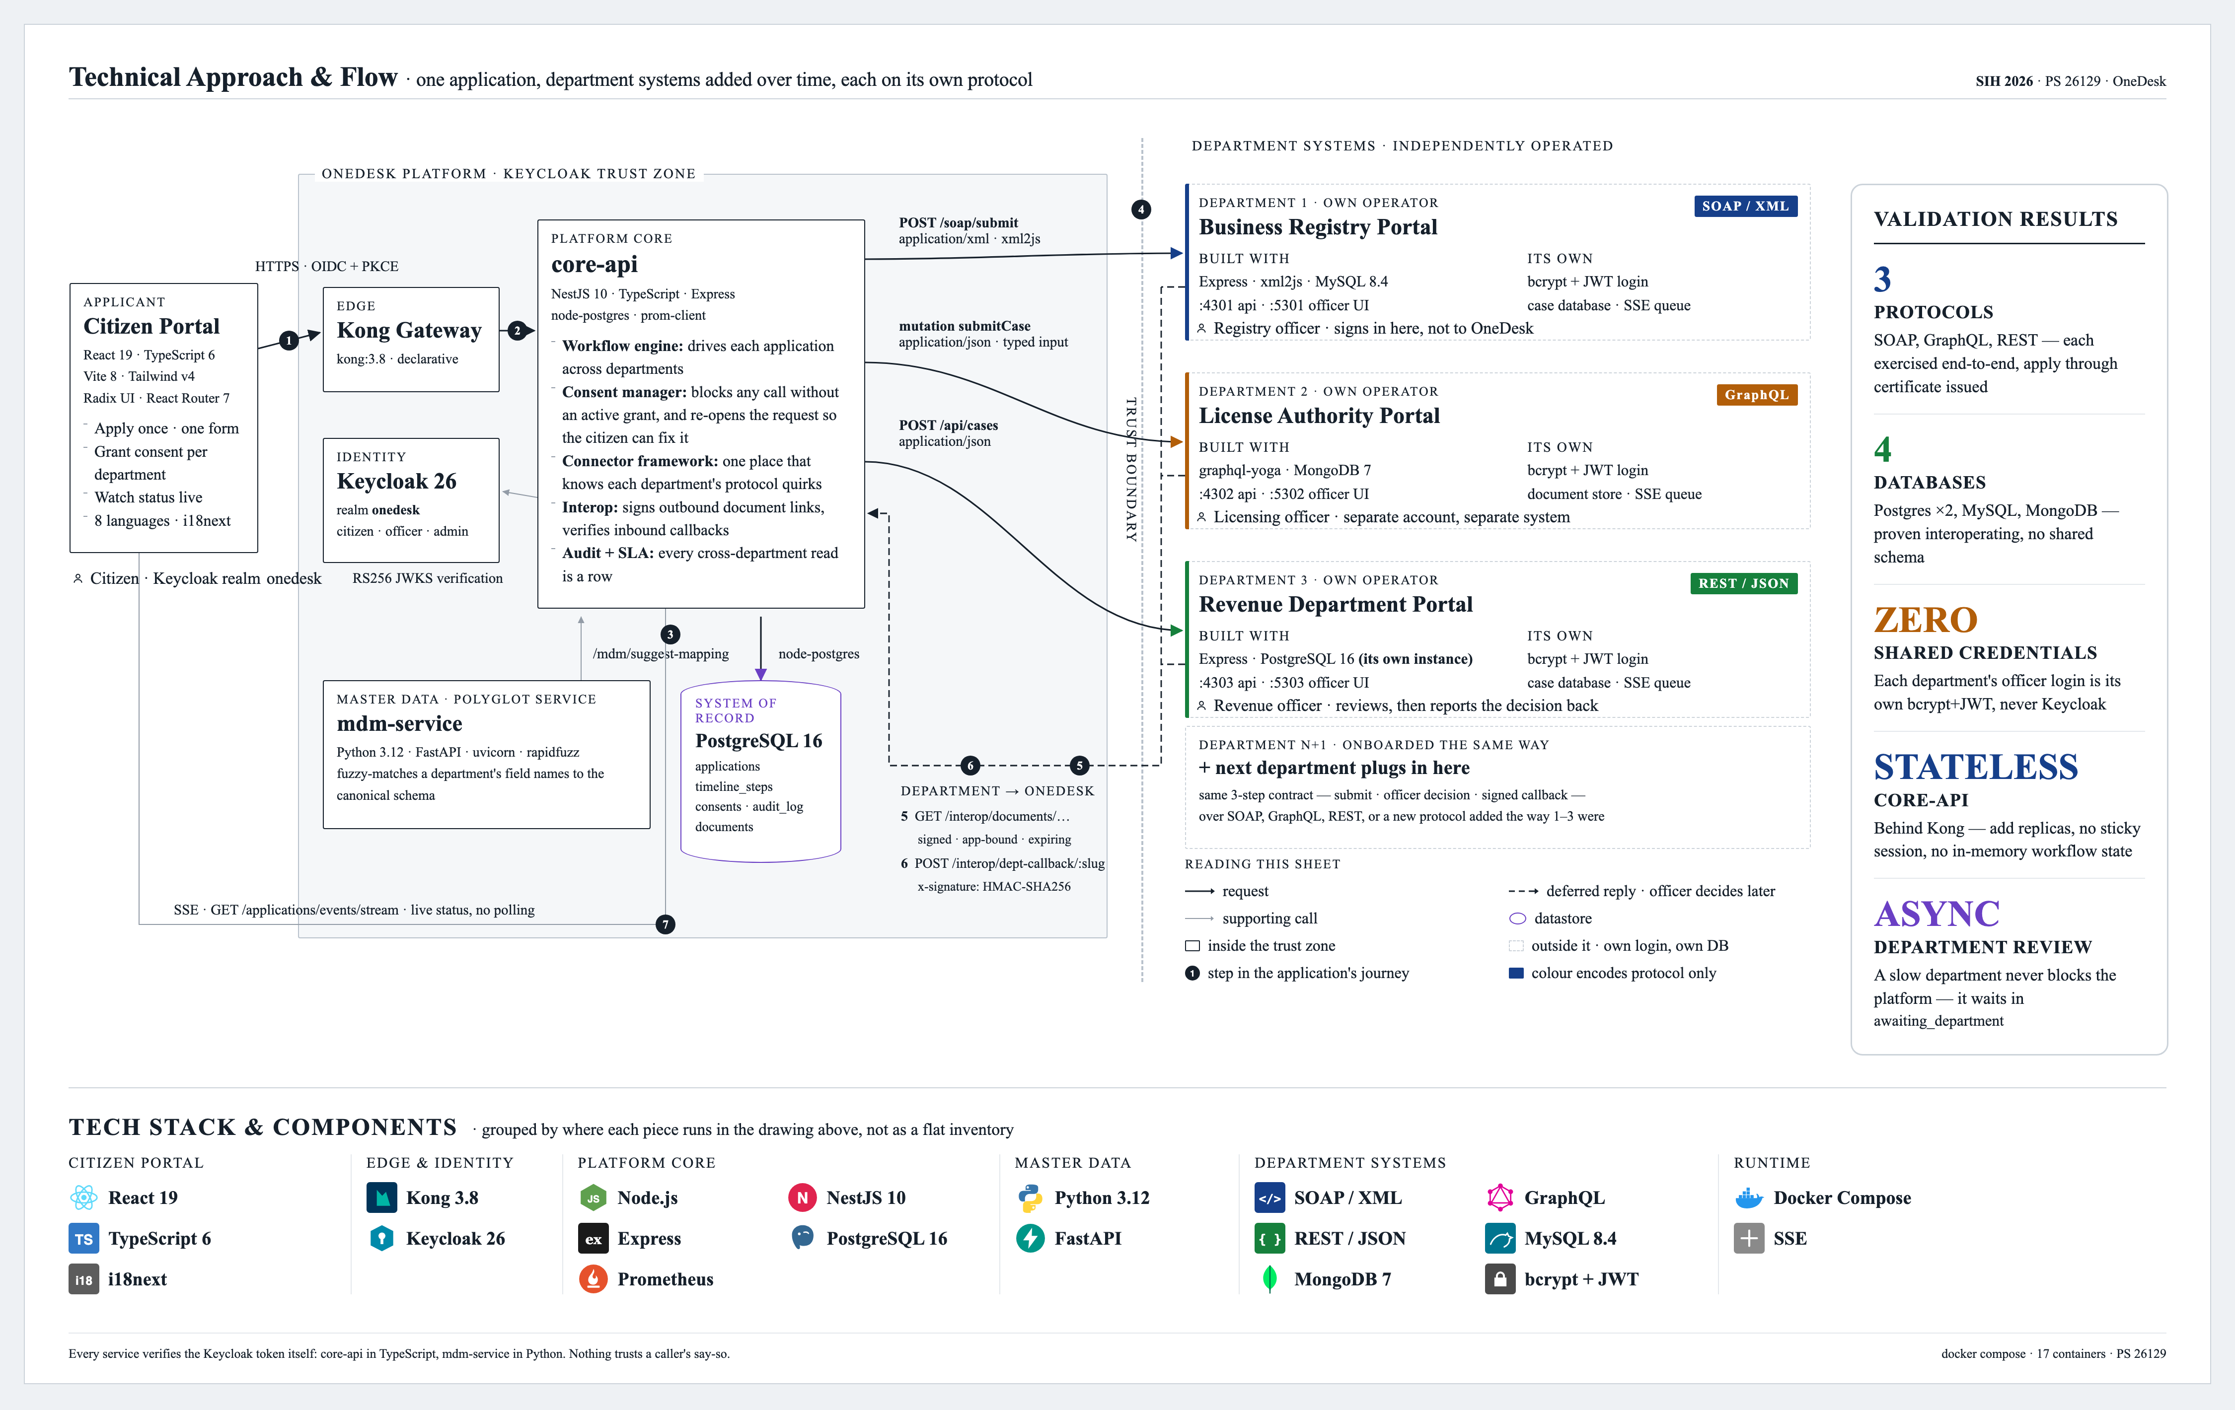
TECHNICAL APPROACH
One Citizen, One Government, One Platform.
Demo Video : link

Slide 4
FEASIBILITY AND VIABILITY ANALYSIS
One Citizen, One Government, One Platform.
POTENTIAL CHALLENGES AND RISKS
Legacy & Scalability: Old systems, inconsistent data, high traffic, and failures make integration difficult.
Trust & Adoption: Departments may hesitate to share data, while citizens need clear consent and control.
Security & Privacy: Requires encryption, access control, consent management, auditing, and secure data sharing.
.
System Replacement
Legacy SOAP or database systems require full replacement to integrate.
Adapter Layer
Modern API gateways and adapters wrap existing systems to lower rebuild costs.
IDEA FEASIBILITY
Schema Fragmentation
Departments maintain disparate database schemas causing data silos.
Canonical Mapping
Common fields map to a canonical schema without forcing database changes.
Bolted-on Security
Security and privacy controls are added as secondary features.
Consent-Based Access
Access is blocked by design without a valid consent token.
STRATEGIES FOR OVERCOMING CHALLENGES
Legacy & Data Quality: Standard adapters, data validation, and identity matching ensure accurate data.
Trust & Adoption: Simple consent controls and small pilot programs build trust.
Security, Privacy & Resilience: Zero-trust security, encryption, audit logs, backups, alerts, and automatic recovery ensure safe and reliable operation.
High Friction
Departments face significant pressure to change internal systems.
Low Friction
Departments retain system ownership by adding thin connectors.
Big-Bang Integration
Large-scale, simultaneous system integration is required.
Pilot-First Approach
Conditional routing allows for incremental, department-by-department deployment.
DEPENDENCIES
Digi Locker – Citizen details and Digital document verification.
Internet – Platform access and notifications.

Slide 5
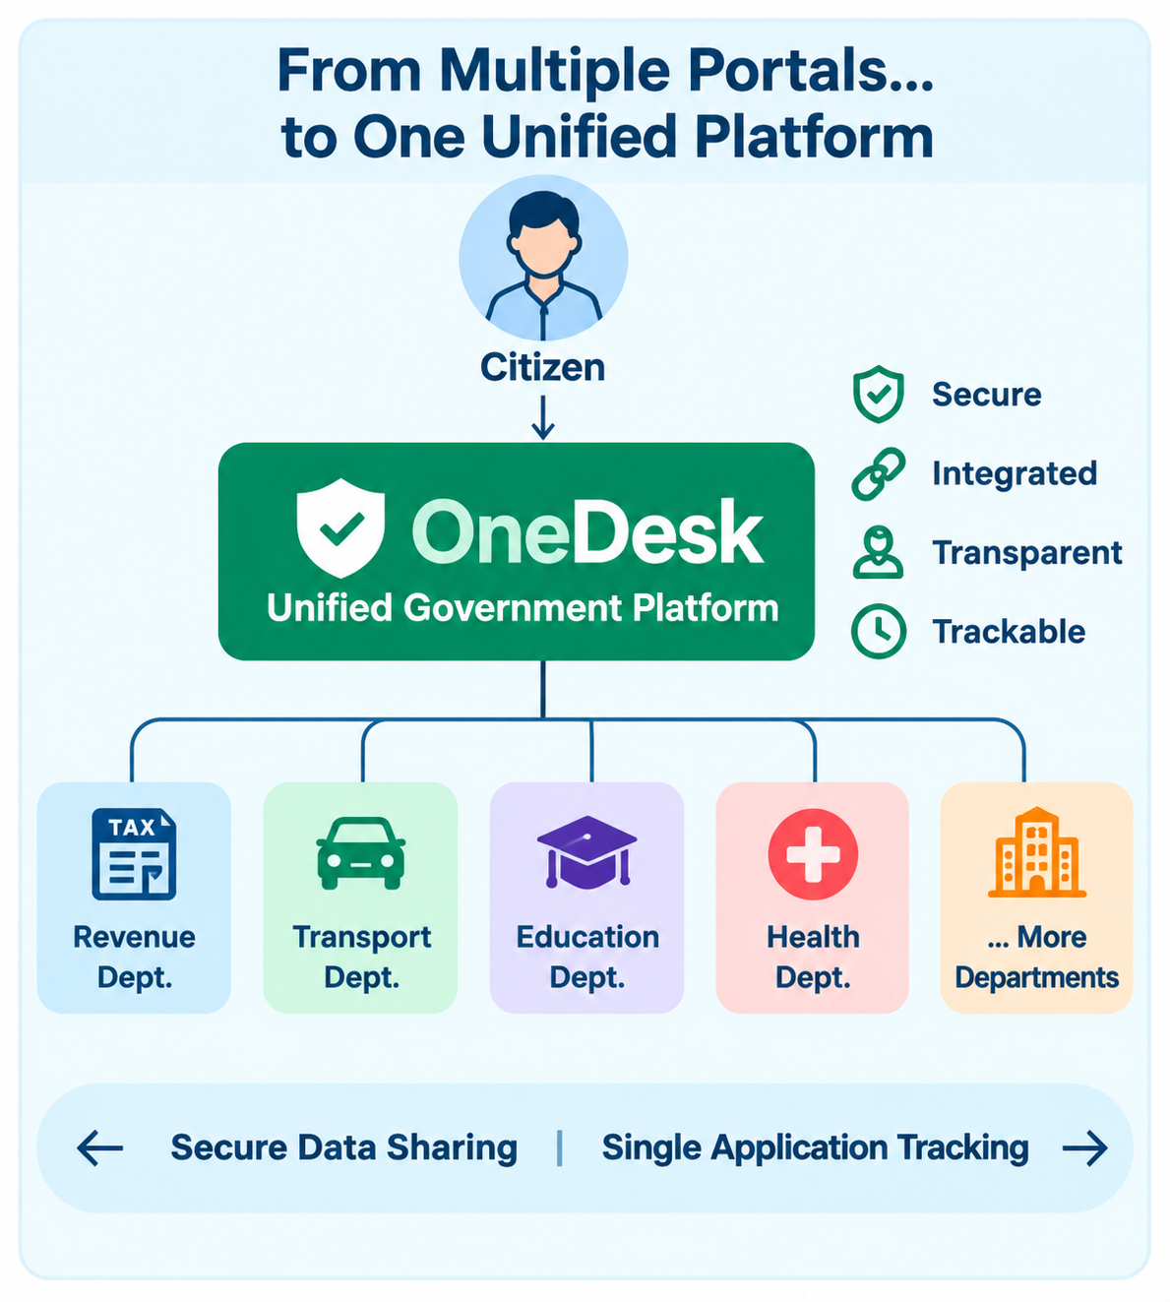
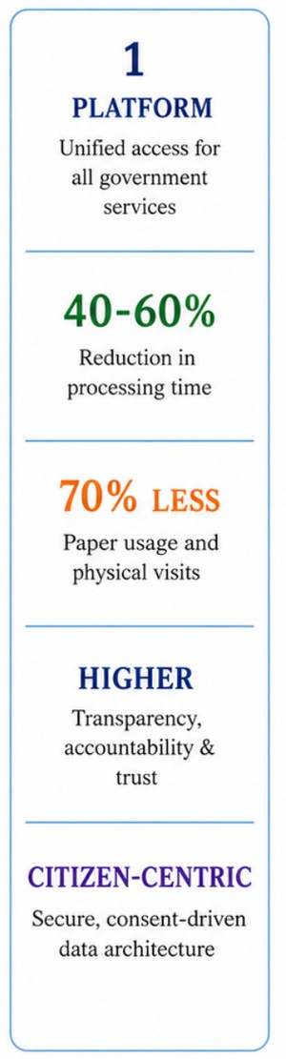












IMPACT AND BENEFITS
One Citizen, One Government, One Platform.
IMPACT
IMPACT
BENEFITS
BENEFITS
Social [SDG 10]
Citizens
Greater transparency, trust and accessibility.
Faster, transparent, hassle-free services.
Rural Citizens
Economic [SDG 8]
Lower processing costs and delays.
Less travel, paperwork no middlemen.
Officers
Governance
Better coordination and accountability.
Less manual verification and faster processing
Environmental
Businesses
Less paper and travel.
Faster approvals and simplified licensing.
Data Privacy
Administrators
Consent-based, secure data sharing.
Better monitoring and data-driven decisions.
Scalability [SDG 9]
Vulnerable Groups
OneDesk adds an integration layer - existing departmental systems remain unchanged
Extendable across departments and services
Reduced time, travel and effort.
STAKEHOLDERS
Citizens / Users
Government Departments
Government Officials
Easy service access & application tracking
Less paperwork & office visits
Secure data sharing & verification
Less manual work & faster service delivery
Efficient application, workflow & management
Better monitoring & transparency

Slide 6
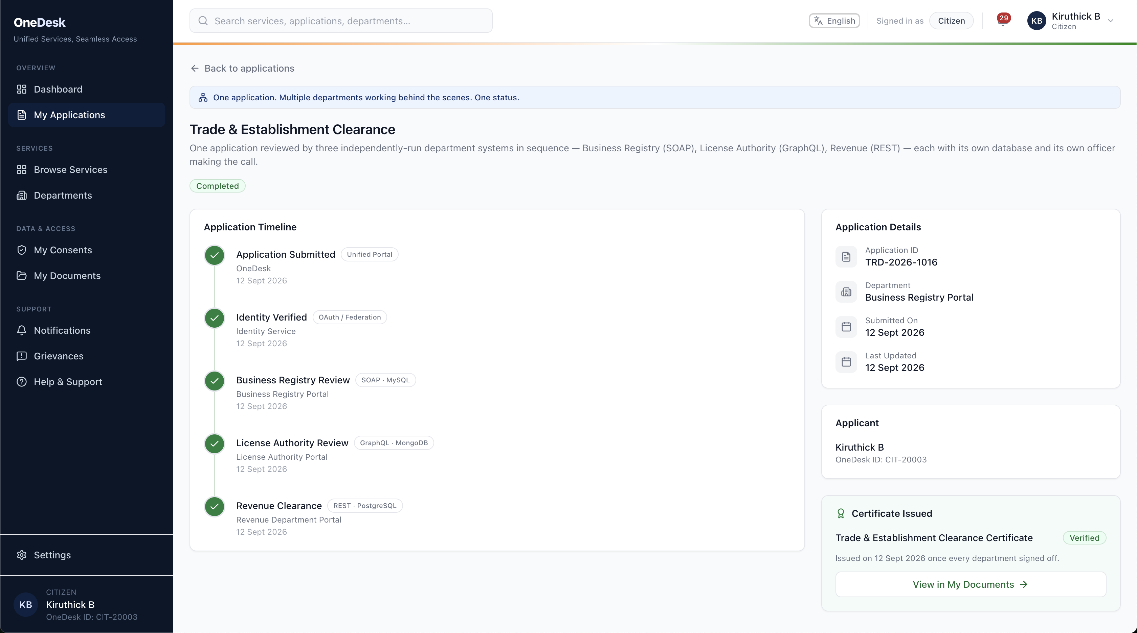
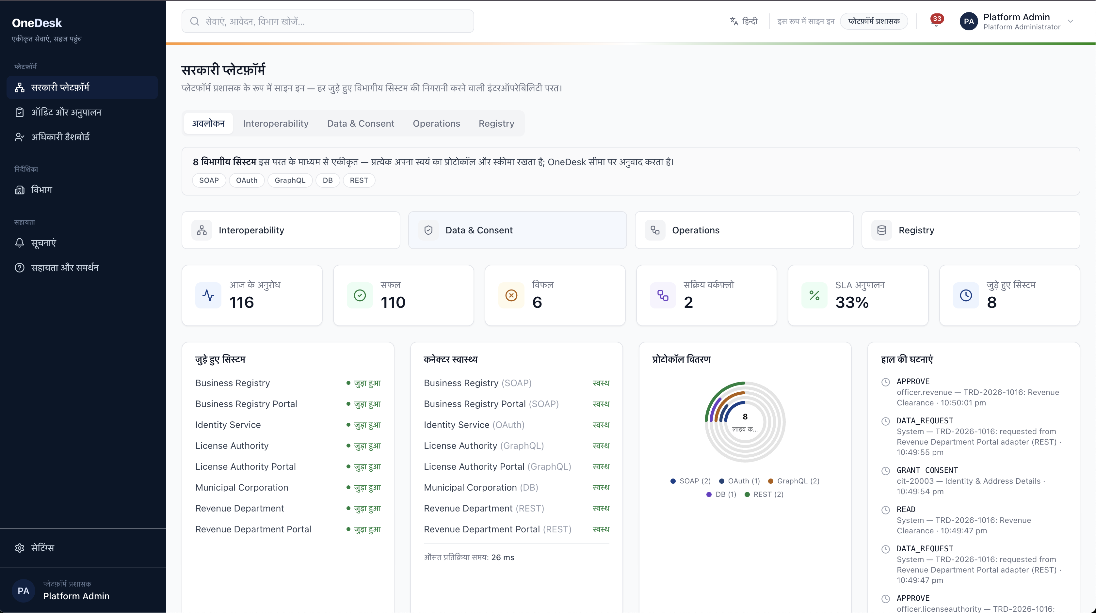
RESEARCH AND REFERENCES
One Citizen, One Government, One Platform.
Government & Interoperability Frameworks
Technical Standards & Integration
Research & Academic Papers
● India API Setu MeitY · National interoperability platform
● India Enterprise Architecture (IndEA) 1.0 Govt. of India enterprise framework
● India Stack UIDAI · NPCI · MeitY - Aadhaar, eKYC, UPI, DigiLocker
● X-Road Data Exchange Layer Estonia · national X-Road backbone
● OAuth 2.0 Authorization Framework RFC 6749 · IETF
● OpenID Connect Core 1.0 Identity layer over OAuth 2.0
● Canonical Data Model Enterprise Integration Patterns
● API Gateway Pattern microservices.io
● Sarantis et al. - Greek EGIF IEEE · one-stop service provision
● E-gov Data Interoperability, Hong Kong IEEE
● One-Stop-Shop e-Government Paradigm IEEE
● Cross-Border Interoperable Identity arXiv, 2023 · developing countries
4 SOURCES
4 SOURCES
4 SOURCES
HOW RESEARCH SHAPED ONEDESK
Government Frameworks
→
Standards
→
Research
→
Architecture
→
OneDesk
API Setu · IndEA
OAuth2 · OIDC · X-Road
IEEE · arXiv papers
Gateway · canonical model
production system
Citizen Experience
Admin & Interoperability
✓ One shared application
✓ Live status timeline
✓ Consent-based sharing
✓ Automatic certificate
✓ Unified system oversight
✓ Per-protocol health
✓ Live SLA metrics
✓ Full audit trail
GitHub : One Desk - System Integrations and Interoperability among Govt Orgs
Documents : OneDesk Research and References

