Slide 1



Fingerprint based ATM Machine
PROJECT PROGRESS REPORT
Kiruthiga Ravindran

Slide 2

PROJECT
MEMBERS INVOLVED
The aim of the project is to ensure utmost security to the ATM’s by using fingerprint authentication.
Fingerprint Sensor is installed in the ATMs for authentication purpose instead of inserting the plastic card.’
Even if the ATM card is stolen / misplaced, the money will still be safe.
The existing ATM system will not be altered in the implementation of this system.
Process Owner: Kiruthiga Ravindran
Champion: Naveen Sadineni
Project Leader: Akshaya Yenugula
Sri Krishna Simhadri

Slide 3

PROJECT TIMELINE & MILESTONES
Initiation & Defining
Scheduled to complete - Mid-February
Planning
Budget Allocation, Resource Planning , Sprint Planning - Mid - March
EXECUTION
Development & Implementation – April End
Testing
Project goes live - June
Security Testing & Installation - Mid - May
Closure

Slide 4
Current Status
Project Initiated and kickstarted as per schedule
Budget Allocated and secured for the project
Development Cost - $100K
Fingerprint sensor installation : $2000k
Development Started on March 1, 2022. 6 Sprints of 2 weeks is planned for execution.
Sprint 1 (March 1 – March 11) – Development of Databases to store Fingerprints, Collection of available fingerprints and storage, Initiation of Image Processing, design of sensors
Sprint 2 (March 14 – March 25) – Precise Image Processing development, Testing of data storage issues, Sensor development to detect fingerprints.
Sprint 3 (March 28 – April 8) – Fixing the issues in Database, Testing of image processing, Production of sensors continued.

Slide 5
WBS
Fingerprint based ATM
Approvals & Scheduling
Design of Sensors
Image Processing
Database
Sensor modelling
Testing & Integration
Implementation of Digital Image Processing
Finalizing optical sensor working well with design
Unit Testing of Fingerprint deduction
Database Creation
Uploading available Fingerprints
Retrieval and storage of fingerprints
Load testing
Integration of Sensors and Image Processing
Connecting the implementation to storage
Testing Overall flow of storing and authenticating fingerprint
Field Testing
Installation
Installation of final product in ATM’s

Slide 6
Network Information
Fingerprint Based ATM upgrade network information
Activity | Description | Preceding Activity | Activity Time
A | Define Requirements & Project Initiation | None | 15
B | Sensor Modelling / Design | A | 10
C | Database Creation, Storage and load test | A | 20
D | Image Processing | A | 25
E | Production of Sensors | B | 25
F | Integration of Sensor, Image Processing and DB | C,D,E | 20
G | Testing Single integrated Unit | F | 5
H | Field Testing & Security Testing | G | 15
I | Installation on ATM machines | H | 10

Slide 7
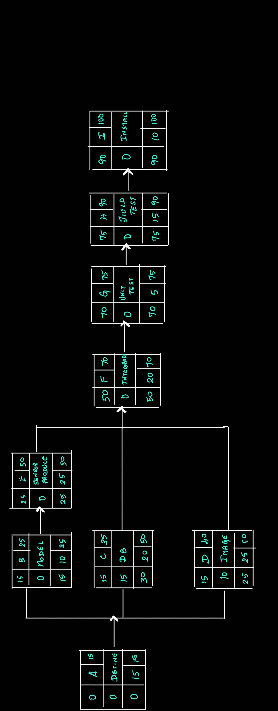
Network Diagram

Slide 8

Issues Faced
Tasks Accomplished
Production of Sensors is expected to complete by April 8, but will likely extend till April 15 – Completion of integration of Sensors will be delayed
Integration will be completed by May 6, but parallel testing can be started to compensate the loss of time.
Sprint 1 – Database creation, Uploading available fingerprints, Sensor Design
Sprint 2 – Finalize Sensor Model, Load testing of database, Image Processing Implementation.
Sprint 3 (Current Sprint) – Ongoing testing of image processing and production of sensors.

Slide 9
Project Timeline
1–11 Mar.
Sprint 1 (March 1 – March 11) – Development of Databases to store Fingerprints, Collection of available fingerprints and storage, Initiation of Image Processing, design of sensors
14–25 Mar.
Sprint 2 (March 14 – March 25) – Precise Image Processing development, Testing of data storage issues, Sensor development to detect fingerprints.
28 Mar. – 8 Apr.
Sprint 3 (March 28 – April 8) – Fixing the issues in Database, Testing of image processing, Production of sensors continued.
11–22 Apr.
Sprint 4 ( April 11 – April 22) – Production of Sensors completion, Start of Integration of sensors and digital image processing.
25 Apr. – 6 May
Sprint 5 (April 25 – May 6) – Connecting implementation to storage, Storage and retrieval of Fingerprints using implemented system.
9–20 May
Sprint 6 (May 9 – May 20) – Testing overall flow and authentication of fingerprints with respect to the already available process and Field testing.
31 May
Installation of Sensors to ATM by May 31

Slide 10
Priorities & Deadlines
11–22 Apr.
Sprint 4 ( April 11 – April 22) – Production of Sensors completion, Start of Integration of sensors and digital image processing.
25 Apr. – 6 May
Sprint 5 (April 25 – May 6) – Connecting implementation to storage, Storage and retrieval of Fingerprints using implemented system.
9–20 May
Sprint 6 (May 9 – May 20) – Testing overall flow and authentication of fingerprints with respect to the already available process and Field testing.
31 May
Installation of Sensors to ATM by May 31

Slide 11
Pending Work - Responsibility Matrix
Task | Kiruthiga | Akshaya | Naveen | Sri Krishna
Sensor production | R |  | S
Integrate sensor and image |  | R |  | S
Database Connection to integrated system |  |  | R | S
Storage and retrieval of Fingerprints using integrated system | S | R
Overall Flow Testing |  | S |  | R
Field Testing & security Testing | R |  |  | S
Installation of Sensors to ATM machine | S |  | R
R = Responsible
S = Support / Assists

Slide 12

Thank You

