Slide 1
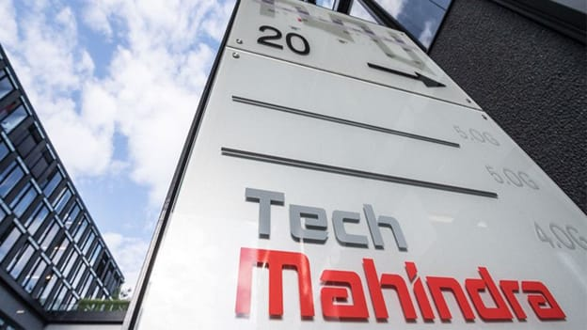


This Photo by Unknown Author is licensed under CC BY-SA

Slide 2

With the past few years dataset of the stock predict the future price of the future price.

Slide 3

BACKGROUND
Imported the dataset
Scale the data
Split the data into Train and Test
Perform LSTM
Plot the graph train,test
Predict the future price of the stock

Slide 4
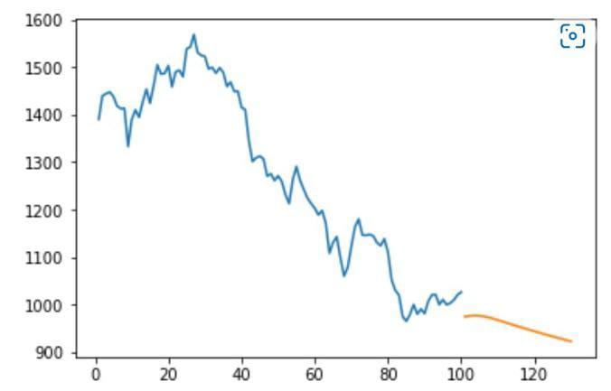
What I did?
Model is build using LSTM
Trained the model with data
Predict the future value of stock

Slide 5

CONCLUSION LSTM Model is build. Future price of the stock is predicted

Slide 6

Dataset-Tech Mahindra Limited (TECHM.NS) Stock Historical Prices & Data - Yahoo Finance
Code-Stock-MArket-Forecasting/Untitled.ipynb at master · krishnaik06/Stock-MArket-Forecasting (github.com)
Code-Stack Overflow - Where Developers Learn, Share, & Build Careers

Slide 7


