Slide 1
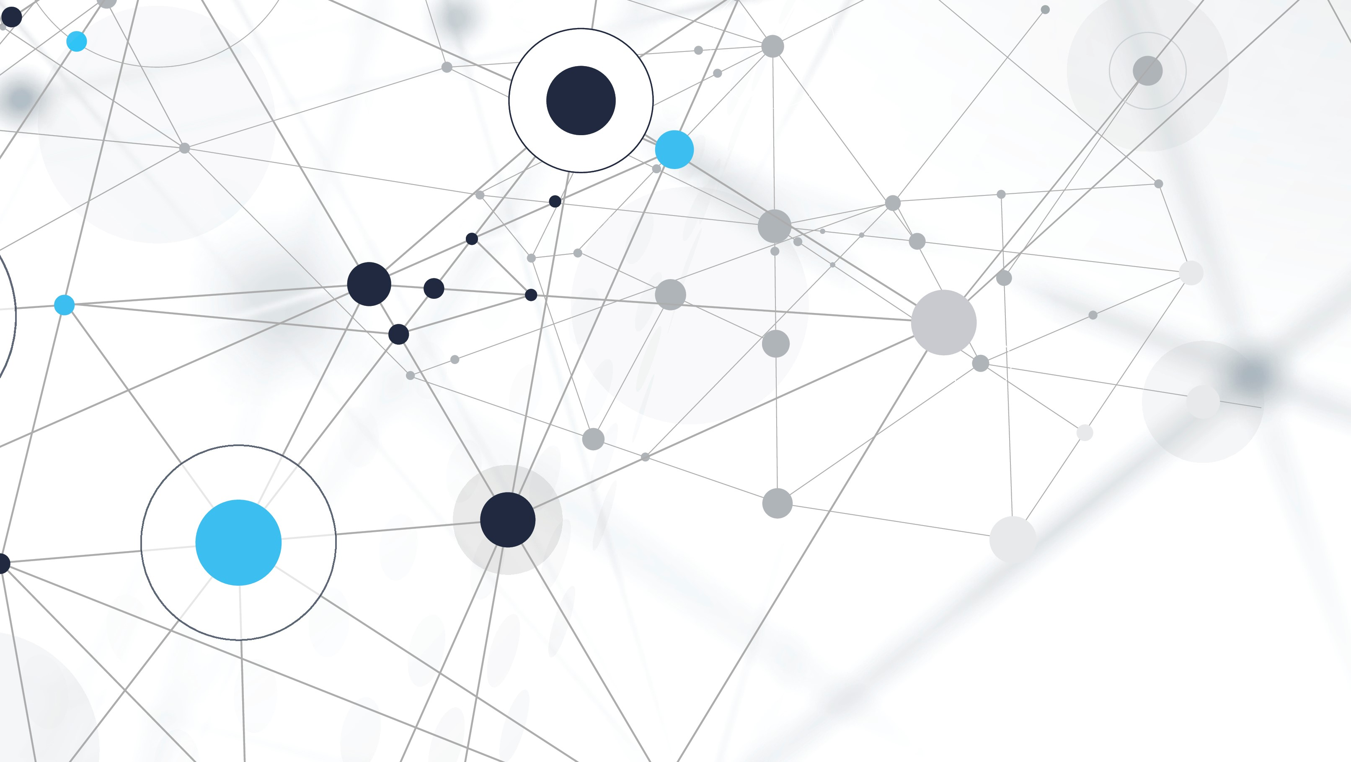
Text Generation from Knowledge Graphs with Graph Transformers
2034025

Slide 2
PROBLEM
The problem addressed in this paper is the generation of coherent multi-sentence texts from the output of an information extraction system SciLE, specifically from a knowledge graph generated by it.
This task necessitates a structured representation of content to effectively express complex ideas across multiple sentences. However, manually creating such representations is costly.
The challenge lies in effectively handling knowledge graphs, which lack hierarchy, long-distance dependencies, and demonstrate structural diversity.

Slide 3
INTRODUCTION
Introduction of a novel graph transforming encoder, GraphWriter which can leverage the relational structure of such knowledge graphs without imposing linearization or hierarchical constraints.
GraphWriter incorporates a new attention model for graph encoding, allowing for a more structured representation of content compared to traditional methods.
The paper also introduces the AGENDA dataset, providing a valuable resource for the text generation community to further develop and evaluate their models.
Human and automatic evaluations demonstrate the utility of GraphWriter compared to strong baselines, highlighting its effectiveness in generating coherent multi-sentence texts.
While GraphWriter shows promising results, challenges such as repetition and entity coverage still need to be addressed. Nevertheless, the work emphasizes the importance of incorporating knowledge graphs into text generation systems to enhance performance across various domains.
The key contributions include proposing a graph transformer encoder, demonstrating the use of IE output as a graph for attention-based encoders, and providing a dataset of knowledge graphs paired with scientific texts.

Slide 4
Previous works
It highlights the shift from table-based data to graph-based representations and discusses the challenges and improvements in encoding and utilizing graph structures for text generation tasks.
Early works focused on generating text from structured data like tables, with recent advancements moving towards more complex data structures like graphs.
Previous research has tackled tasks such as generating Wikipedia entry introductions and sports game summaries, often relying on template-based methods or sequence encoding.
Previous approaches, like those by Konstas et al. (2017), have utilized neural models for this task but relied on linearization and sequence encoding instead of directly modeling the graph structure.
Recent works, such as Marcheggiani and Perez-Beltrachini (2018), have introduced more sophisticated graph encoding techniques, like graph convolutional encoders.
by Song et al. (2018) and Beck et al. (2018), utilize gated graph neural networks for information propagation. These models heavily rely on label information, can be computationally expensive, especially when dealing with large graphs or when multiple layers of gating mechanisms are used.
paper distinguishes itself from related works by emphasizing the use of extracted information as input, Flexibility in Representing Relationships, Handling of Multi-relational Data, Capture of Higher-order Relationships, Adaptability to Varied Data Structures

Slide 5
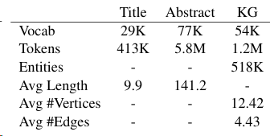
DATASET
The dataset comprises pairs of scientific paper titles and their corresponding abstracts. These titles and abstracts are taken from the proceedings of 12 top AI conferences.
Data Split:
The AGENDA dataset is split into training, validation, and test sets, comprising 38,720 training data points, 1000 validation data points, and 1000 test data points.

Slide 6
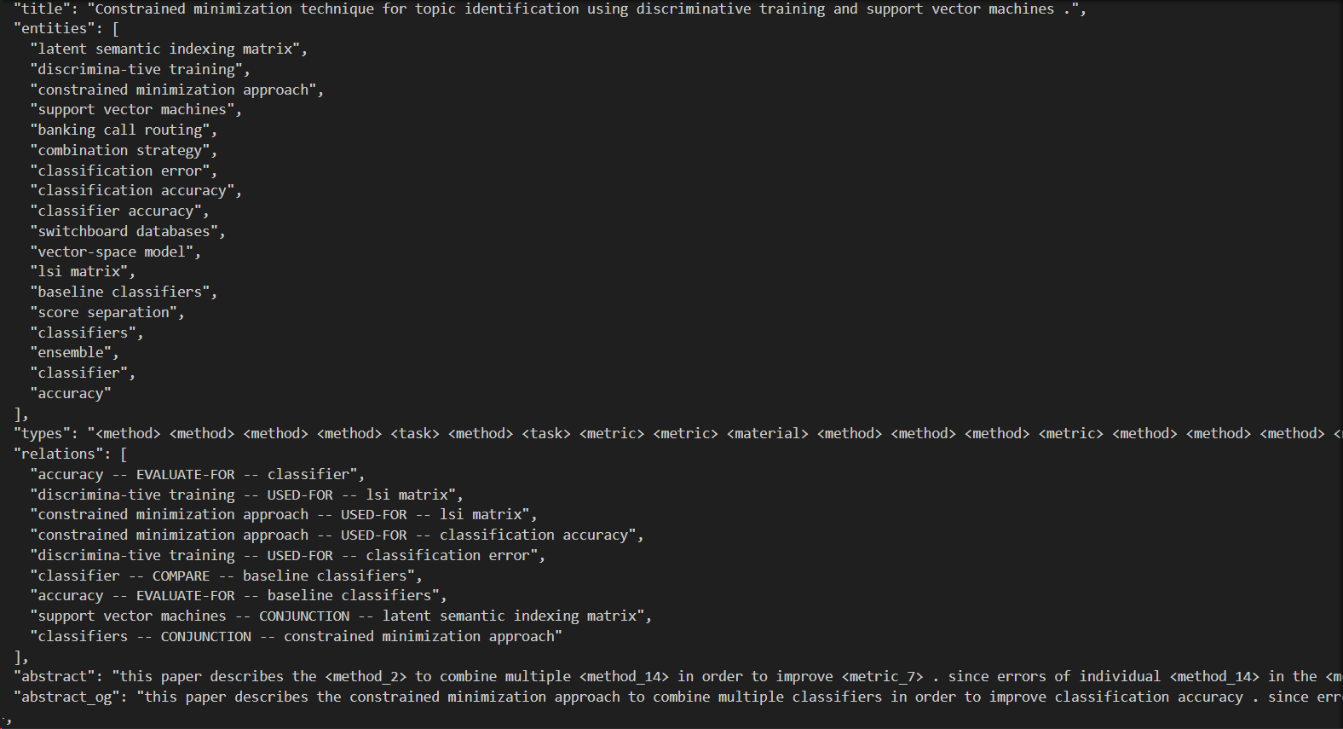
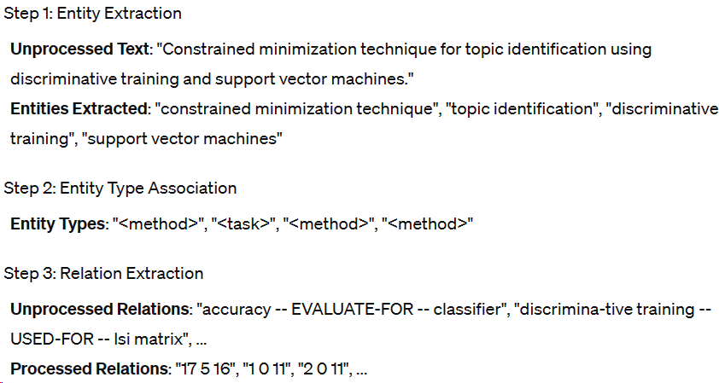
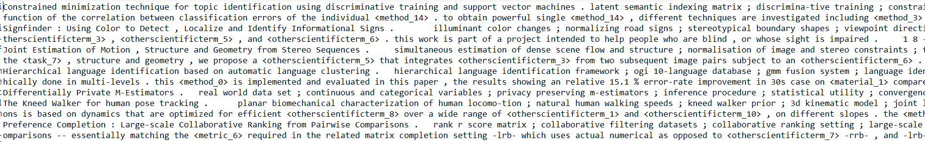

Slide 7
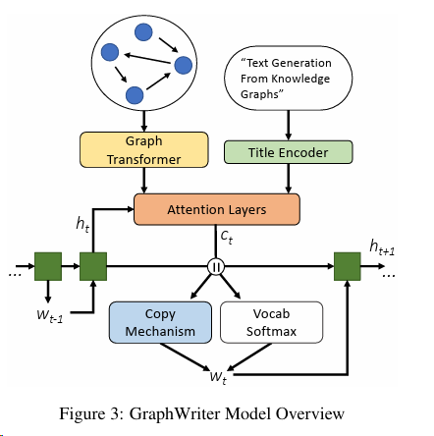
MODEL
Title Encoder: This component encodes the input title using a bidirectional recurrent neural network (Bi-RNN), capturing contextual information from both directions.
Graph Transformer: A novel architecture used to encode the knowledge graph. This Graph Transformer architecture is designed to process the graph structure and capture relationships between entities and relations.
Attention Layers: These layers are used to attend to the encodings of the knowledge graph and document title at each decoding time step. This allows the model to focus on relevant information during the generation process.
Copy Mechanism: This mechanism enables the model to copy input directly from the knowledge graph when appropriate, instead of generating new text from the vocabulary. It helps to ensure that important information from the graph is retained in the generated text.
Vocab Softmax: This softmax layer generates the output probability distribution over the vocabulary for the next word in the sequence.

Slide 8
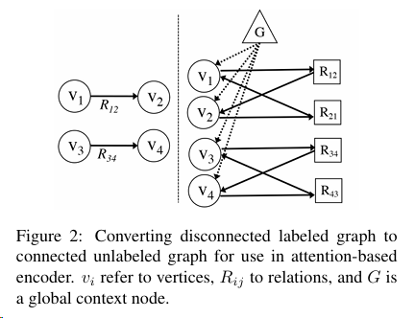
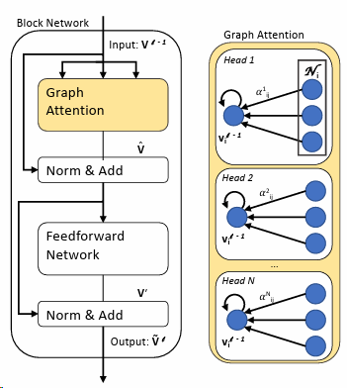
METHODOLOGY: Encoder
Graph Preparation: Knowledge graph is converted into an unlabeled connected graph. This restructuring involves replacing labeled edges with two vertices representing the forward and reverse directions of the relation. Additionally, a global vertex is added to connect all entity vertices, facilitating information flow across the graph.
Graph Transformer encoder contextualizes each vertex representation by attending over its neighbors in the graph. This allows for a more global contextualization of each vertex.
Input: The input to the Graph Transformer is the initial vertex encodings, denoted as v^-1 . These encodings represent entities, relations, and the global node in the graph.
Graph Attention: The input encodings are passed through multiple layers of graph attention. Each layer computes attention scores between vertices, allowing the model to focus on relevant information while aggregating information from neighboring vertices.
Norm & Add: After attention computation, normalization and addition operations are applied to the attention scores. These operations help stabilize the learning process and prevent the model from diverging during training.
Feedforward Network: Following the attention mechanism, the output is passed through a feedforward network. This network applies non-linear transformations to the vertex encodings, allowing the model to capture complex relationships and patterns in the graph structure.
Output: The final output of the Graph Transformer, denoted as V(cap) , represents the updated vertex encodings after passing through multiple layers of graph attention and feedforward networks.

Slide 9
decoder
Decoder in the GraphWriter model employs an attention-based mechanism with a copy mechanism for incorporating information from both the knowledge graph and the title.
At each decoding timestep t, the decoder hidden state ht​ is used to compute context vectors cg​ and cs​ for the graph and title sequence respectively. cg​ is computed using multi-headed attention over the graph contextualized encodings VL​, while cs​ is computed similarly over the title encoding T.
The computed context vectors cg​ and cs​ are concatenated to form the final context vector ct​=[cg, ​cs​]
An input-feeding decoder is utilized, where both the decoder hidden state ht​ and the context vector ct​ are passed as input to the next recurrent neural network (RNN) timestep.
Copy Mechanism Probability: The probability p of copying from the input is computed using ht​ and ct​ Vocab probability: The probability distribution over entities and input tokens (copy) is computed using attention, while the remaining probability is assigned to the vocabulary and calculated using a softmax function.
Implementation details
Training models end to end
SGD optimization with momentum
Learning rate scheduling (0.25 to 0.05 over the course of 5 epochs, then re sets for the following epoch)
Models utilize single-layer LSTMs for recurrent networks, dropout in self-attention layers, and fixed dimensions for hidden states and embeddings.

Slide 10
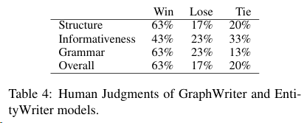
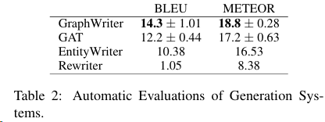
Evaluation metrics and results
Human
automatic
Baselines
Best-Worst Scaling (BWS) methodology is employed, where participants are presented with pairs or triads of abstracts and asked to rank them based on criteria such as grammar and fluency, coherence, and informativeness.
well-formed English, coherence in structuring (introduction, problem/task statement, solution description, evaluation/results discussion), and relevance to the provided title with appropriate scientific terminology usage.
Automatic metrics such as BLEU (bilingual evaluation understudy) and METEOR (metric for evaluation of translation with explicit ordering) are employed.
BLEU measures n-gram overlap between generated abstracts and reference abstracts, providing an indication of linguistic similarity.
METEOR considers paraphrase and language-specific factors in addition to n-gram overlap, offering a more comprehensive evaluation of text quality.
Graph Attention Network (GAT): A model utilizing a Graph Attention Network encoder.
Entity-Writer: A model using only entities and the document title.
Rewriter: A gated rewriter model using only the document title to iteratively revise drafts of its output.

Slide 11
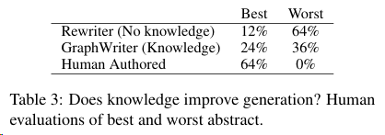

Evaluation metrics and results
Expert annotators compare abstracts generated by GraphWriter, Rewriter, and the gold standard abstracts.
Comparison with EntityWriter:
Detailed comparison between GraphWriter and EntityWriter using 30 additional test data points indicates that structured knowledge from a graph improves abstract generation, particularly in document structure and grammar.
Comparison with Rewriter:
InferEntityWriter, a variant of GraphWriter, is developed to generate abstracts solely from titles by predicting relevant entities.
InferEntityWriter achieves better results than Rewriter, suggesting that the intermediate entity prediction step enhances abstract generation.

Slide 12
analysis
GraphWriter vs. GAT vs. EntityWriter vs. Rewriter
GraphWriter demonstrates superior performance compared to GAT, EntityWriter, and Rewriter. It effectively incorporates more entities from the input, arranges them with clearer textual context, and exhibits less repetition. GAT also performs well in terms of coherence but lacks the nuanced articulation seen in GraphWriter.
Coherence and Context
Both GraphWriter and GAT excel in coherence, providing abstracts that are more contextually relevant compared to EntityWriter and Rewriter, which tend to copy entities without fitting them into the context logically.
Future work
An analysis of GraphWriter outputs reveals that 40% of entities in the knowledge graphs do not appear in the generated text. This indicates a coverage problem that needs to be addressed in future work.
Repetition
Approximately 18% of sentences generated by GraphWriter exhibit repetition, prompting the need for post-processing pruning to enhance the quality of outputs.

Slide 13
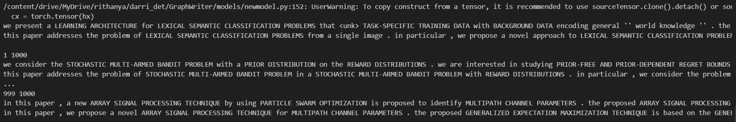
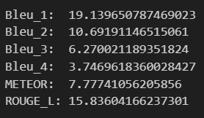
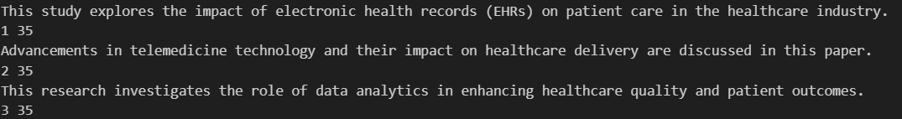
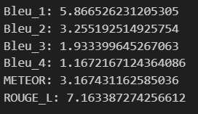
INFERENCE AND RESULTS
AGENDA DATASET RESULTS
CUSTOM DATASET RESULTS

Slide 14
Metrics table
Dataset | Model | BLEU-1 | BLEU-2 | BLEU-3 | BLEU-4 | METEOR | ROUGE-L
Custom | Custom Graph Transformer | 19.56 | 10.79 | 7.28 | 3.75 | 7.99 | 16.68
Custom | Original Model | 5.87 | 3.26 | 1.93 | 1.17 | 3.17 | 7.16
Original | Original Model | 19.14 | 10.69 | 6.27 | 3.75 | 7.78 | 15.84

Slide 15
conclusion
In conclusion, the integration of knowledge graphs into language processing systems present good benefits, particularly in handling structured data:
By leveraging the rich interconnectedness encoded within knowledge graphs, language models can effectively reduce repetition, enhance coherence in text generation, and seamlessly present information in a contextually relevant manner.
the structured nature of knowledge graphs empowers language processing systems to not only understand individual entities but also grasp the intricate relationships between them, thus facilitating deeper comprehension and more informed decision-making.

