Slide 1
SQL

Slide 2
Sql
SQL is a standard language for storing, manipulating and retrieving data in databases.
MySQL, SQL Server, MS Access, Oracle, Sybase, Informix, Postgres, and other database systems.

Slide 3
What is RDBMS?
RDBMS stands for Relational Database Management System. RDBMS is the basis for SQL, and for all modern database systems like MS SQL Server, IBM DB2, Oracle, MySQL, and Microsoft Access.
A Relational database management system (RDBMS) is a database management system (DBMS) that is based on the relational model as introduced by E. F. Codd in 1970.

Slide 4
Features:
High Performance.
High Availability.
Scalability and Flexibility Run anything.
Robust Transactional Support.
Web and Data Warehouse Strengths.
Strong Data Protection.
Comprehensive Application Development.
Management Ease.
Open Source Freedom and 24 x 7 Support.
Lowest Total Cost of Ownership

Slide 5
What is a Table?
The data in an RDBMS is stored in database objects known as tables. This table is basically a collection of related data entries and it consists of numerous columns and rows.
Every table is broken up into smaller entities called fields. A field is a column in a table that is designed to maintain specific information about every record in the table.
A record is also called as a row of data is each individual entry that exists in a table.
A NULL value in a table is a value in a field that appears to be blank, which means a field with a NULL value is a field with no value.

Slide 6
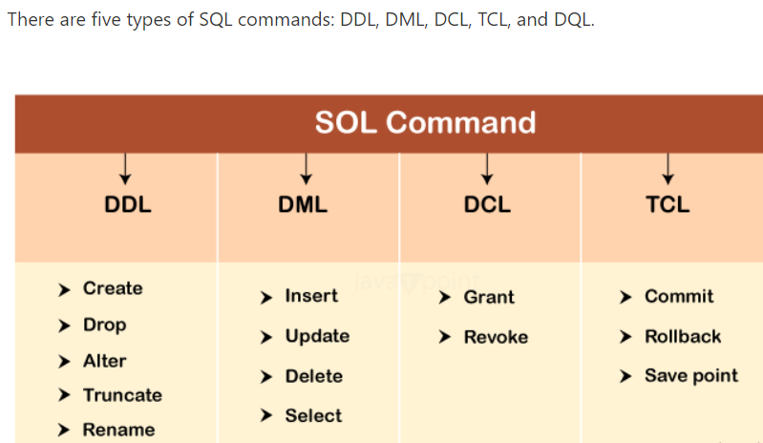
Types of SQL Commands

Slide 7
Data Definition Language (DDL)
DDL changes the structure of the table like creating a table, deleting a table, altering a table, etc.
All the command of DDL are auto-committed that means it permanently save all the changes in the database.
Here are some commands that come under DDL:
CREATE
ALTER
DROP
TRUNCATE

Slide 8
Data Manipulation Language
DML commands are used to modify the database. It is responsible for all form of changes in the database.
The command of DML is not auto-committed that means it can't permanently save all the changes in the database. They can be rollback.
Here are some commands that come under DML:
INSERT
UPDATE
DELETE

Slide 9
Data Control Language
DCL commands are used to grant and take back authority from any database user.
Here are some commands that come under DCL:
Grant
Revoke
Grant: It is used to give user access privileges to a database.
Revoke: It is used to take back permissions from the user.

Slide 10
Transaction Control Language
TCL commands can only use with DML commands like INSERT, DELETE and UPDATE only.
These operations are automatically committed in the database that's why they cannot be used while creating tables or dropping them.
COMMIT
ROLLBACK
SAVEPOINT
Commit: Commit command is used to save all the transactions to the database.
Rollback: Rollback command is used to undo transactions that have not already been saved to the database.
SAVEPOINT: It is used to roll the transaction back to a certain point without rolling back the entire transaction.

Slide 11
Data Query Language
DQL is used to fetch the data from the database.
It uses only one command:
SELECT
SELECT: This is the same as the projection operation of relational algebra. It is used to select the attribute based on the condition described by WHERE clause.

