Slide 1
Employee Data Analysis using Excel
STUDENT NAME: KIRUTHIKA N
REGISTER NO: 312216969( 78540C1BF4E17F88FDC401908FA88FE6)
DEPARTMENT: B.COM(G)
COLLEGE: SHRI KRISHNASWAMY COLLEGE FOR WOMEN

Slide 2
PROJECT TITLE
USING PIVOT TABLES FOR EMPLOYEE TURNOVER ANALYSIS

Slide 3


AGENDA
Problem Statement
Project Overview
End Users
Our Solution and Proposition
Dataset Description
Modelling Approach
Results and Discussion
Conclusion
3/21/2024 Annual Review

Slide 4

PROBLEM STATEMENT
•Employee turnover is a critical issue for organizations as it can lead to increased recruitment and training costs, loss of productivity, and decreased employee morale.
•Understanding the patterns and reasons behind employee turnover is essential for implementing effective retention strategies.

Slide 5

PROJECT OVERVIEW
1.This project focuses on analyzing employee turnover using pivot tables.
2. Pivot tables allow for the quick summarization and exploration of large datasets, making it easier to identify trends and correlations.
3. The goal is to provide insights into the factors contributing to employee turnover and to help the organization develop strategies to reduce it.

Slide 6

WHO ARE THE END USERS?
•HR Managers: To identify trends in turnover and design targeted retention programs.-
•Executives: To understand the impact of turnover on overall business performance.-
•Department Heads: To gain insights into turnover within their specific departments.-
•Analysts: To conduct in-depth analysis and report findings to stakeholders.

Slide 7

OUR SOLUTION AND ITS VALUE PROPOSITION
❗Our solution involves creating a comprehensive analysis of employee turnover using pivot tables. We will analyze various factors such as department, tenure, job role, and performance ratings to identify key drivers of turnover.
❗The proposition is that by using pivot tables, the organization can quickly and effectively identify actionable insights to reduce turnover rates.

Slide 8
Dataset Description
Employee ID: Unique identifier for each employee.
Employee name: Name of the employee
Department: Department where the employee work
Job Role: Specific role of the employee within the organization.
Tenure: Duration of employment.
Employees status: Active/Future Active
Gender: Employee’s gender.
Education Level: Highest level of education attained. Performance Rating: Performance evaluation score
Exit Date: Date of termination
Start Date: Date of joining

Slide 9

THE "WOW" IN OUR SOLUTION
1.Innovative Approach – Highlights the unique aspects of data analysis
2.User experience- Discuss how the Pivot table solution enhance the user experience
3. Impactful insights – Share any surprising or particularly valuable insights uncovered by the analysis that might not have been evident with standard approaches.
3/21/2024 Annual Review
9

Slide 10
MODELLING
1.Summarize-data across different dimensions (e.g., department, job role)
2.Filter- data to focus on specific groups (e.g., employees with high turnover)
3.Cross-tabulate-data to compare turnover rates across different variables (e.g., turnover by department and tenure)
4.Calculate- turnover rates and other key metrics (e.g., average tenure of employees who left)
10

Slide 11
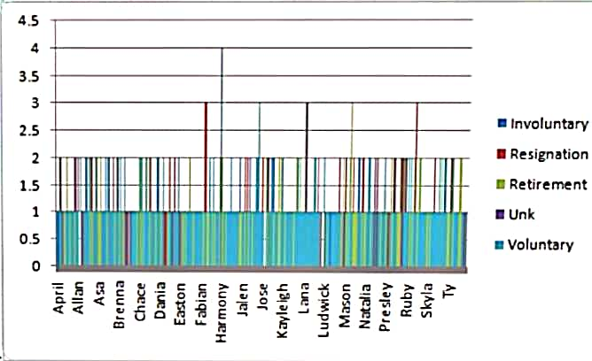
RESULTS
11

Slide 12
conclusion
•The use of pivot tables for employee turnover analysis provides a powerful tool for HR professionals and management to quickly identify key factors driving turnover.
• By focusing on the insights gained from this analysis, the organization can develop targeted strategies to improve employee retention, ultimately leading to a more stable and productive workforce.

