Slide 1
QUIC
Quick UDP Internet Connections"

Slide 2
It is a transport layer network protocol designed to improve the performance of connection-oriented web applications by reducing latency and providing better congestion control

Slide 3
Key Features and Benefits:
Reduced Latency:
Improved Congestion Control:
Built-in Security:
Connection Migration:
QUIC allows connections to migrate between different networks (e.g., from Wi-Fi to cellular)
Fast Handshake (Connection Establishment)
Built-in Encryption (TLS)

Slide 4
Fast Handshake (Connection Establishment)
QUIC merges transport and cryptographic handshakes:
  Client → Server: Initial packet with TLS 1.3 handshake
  Server → Client: Response with handshake + encryption keys
  Connection established: Ready to send data!

Slide 5
Applications of the QUIC Protocol
1) HTTP/3
  Provides: Faster web page loads, Lower latency
  Better performance under poor network conditions
  2) Browsers supporting HTTP/3 over QUIC:
  Google Chrome
  Mozilla Firefox
  Microsoft Edge
  Apple Safari
  3) Video Streaming 4) Online Gaming 5)Cloud Service

Slide 6
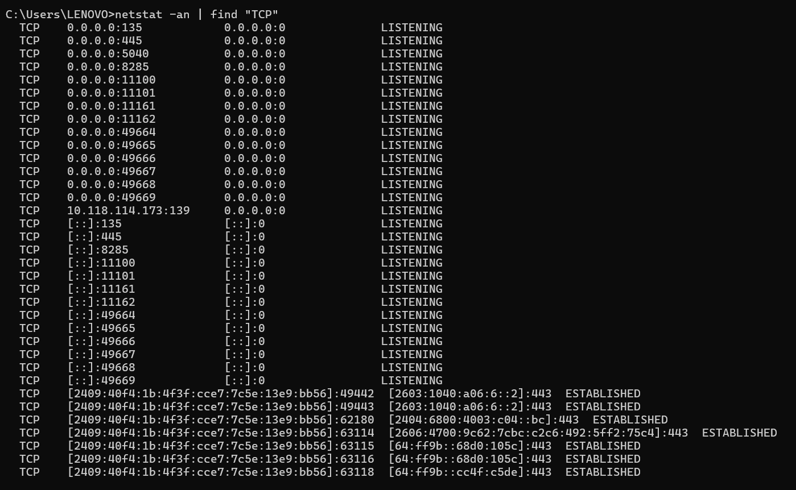
View Active TCP Connections
Open Command Prompt
(Win + R, type cmd, press Enter)
netstat -an | find "TCP“

Slide 7
Guide to Check QUIC Usage
Open Chrome
Type in the address bar:
  chrome://flags
Search using QUIC
Make sure the "Experimental QUIC protocol" flag is set to Enabled

