Slide 1
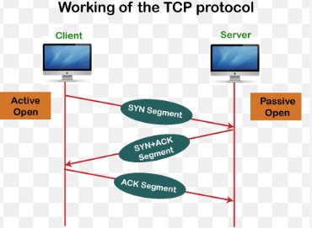
23-3 TCP
It is a connection-oriented protocol, meaning it establishes a dedicated connection between two endpoints before data transfer begins
In addition, TCP uses flow and error control mechanisms at the transport level.
23.<number>

Slide 2
How TCP works
TCP operates through a series of steps to ensure reliable data transfer:
Connection Establishment: Before data transfer, TCP uses a three-way handshake (SYN, SYN-ACK, ACK) to set up a reliable connection.
Data Transfer: Data is broken into segments, each with a sequence number for correct ordering.
Reliable Data Delivery: Sequence numbers and acknowledgements (ACKs) ensure data integrity and order. If a segment's ACK isn't received, it's retransmitted.
  sequence number is a 32-bit field used to track the order of bytes sent from sender to receiver.

Slide 3
Flow control : It is a mechanism that ensures a sender does not overload the receiver by sending too much data too quickly.
Congestion Control: Algorithms prevent network congestion by adjusting data flow based on network conditions.
Connection Termination: A four-way handshake gracefully ends the connection.
TCP offers full-duplex service, in which data can flow in both directions at the same time. Each TCP then has a sending and receiving buffer, and segments move in both directions.

Slide 4
TCP provides process-to-process communication using port numbers
A port number is used to identify specific processes or services running on a device in a network
Example: http://192.168.1.10:8080
  The request goes to the device at 192.168.1.10, and the operating system routes the data to the application listening on port 8080

Slide 5

Table 23.2 Well-known ports used by TCP
23.<number>

Slide 6

Figure 23.13 Stream delivery
TCP is a stream-oriented protocol.
TCP allows the sending process to deliver data as a stream of bytes and allows the receiving process to obtain data as a stream of bytes.
23.<number>

Slide 7
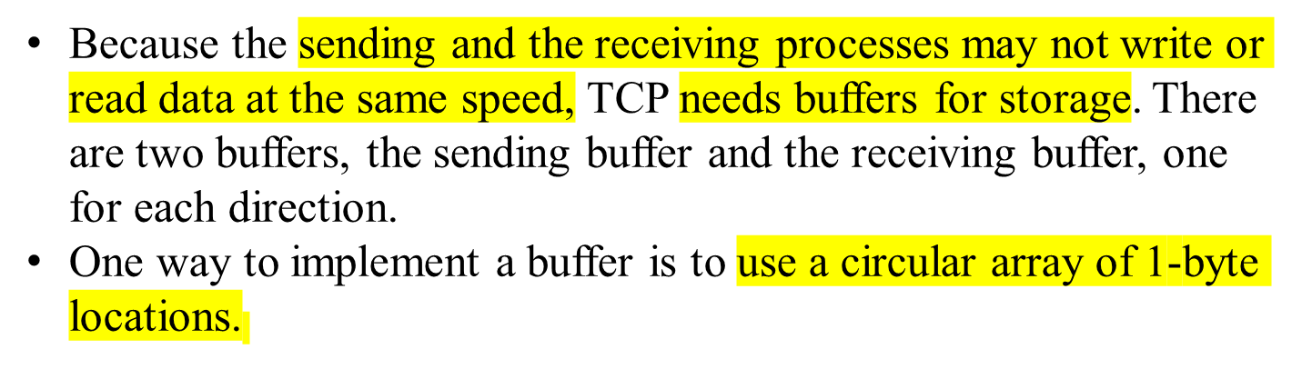

Figure Sending and receiving buffers
23.<number>

Slide 8
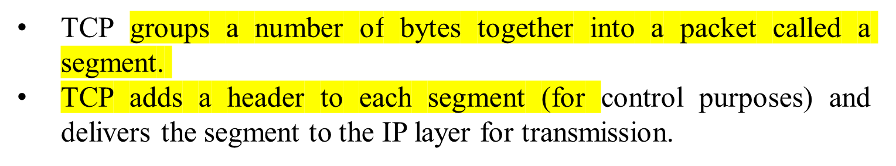

Figure TCP segments
23.<number>

Slide 9
1. Suppose a TCP connection is transferring a file of 5000 bytes. The first byte is numbered 10,001. What are the sequence numbers for each segment if data are sent in five segments, each carrying 1000 bytes?
Solution
Segment 1 - | Sequence Number: 10,001 (range: 10,001 to 11,000)
Segment 2 - | Sequence Number: 11,001 (range: 11,001 to 12,000)
Segment 3 - | Sequence Number: 12,001 (range: 12,001 to 13,000)
Segment 4 - | Sequence Number: 13,001 (range: 13,001 to 14,000)
Segment 5 - | Sequence Number: 14,001 (range: 14,001 to 15,000)

Slide 10

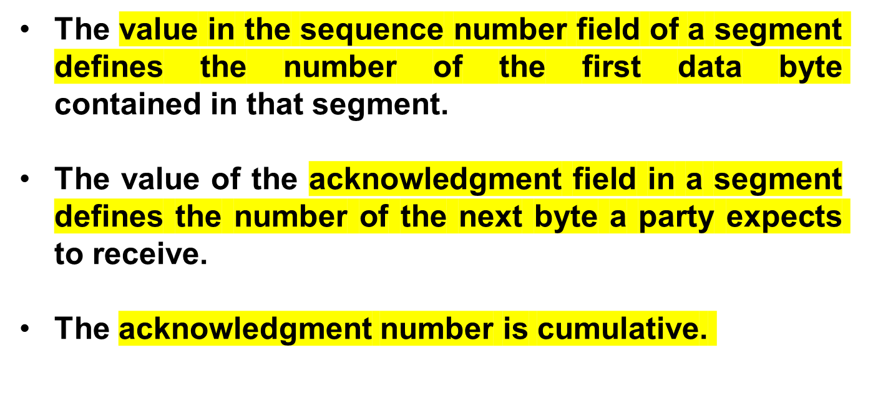
Note
23.<number>

Slide 11

Figure 23.16 TCP segment format
23.<number>

Slide 12

Figure 23.17 Control field
23.<number>

Slide 13
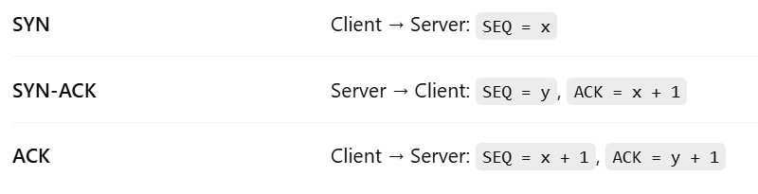

Figure Connection establishment using three-way handshaking
23.<number>

Slide 14
Note
A SYN segment cannot carry data, but it consumes one sequence number.
A SYN + ACK segment cannot
carry data, but does consume one
sequence number.
An ACK segment, if carrying no data, consumes no sequence number.
23.<number>

Slide 15

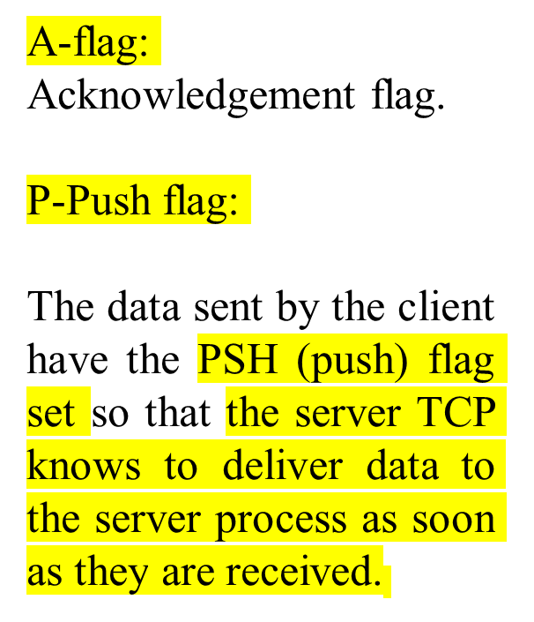
Figure 23.19 Data transfer
23.<number>

Slide 16
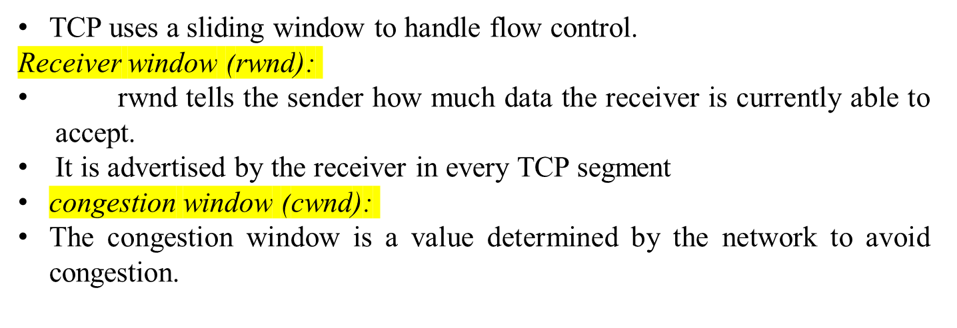

Figure Sliding window
23.<number>

Slide 17
Note
A sliding window is used to make transmission more efficient as well as
to control the flow of data.
TCP sliding windows are byte-oriented.
23.<number>

Slide 18
Example 23.4
What is the value of the receiver window (rwnd) for host A if the receiver, host B, has a buffer size of 5000 bytes and 1000 bytes of received and unprocessed data?
Solution
The value of rwnd = 5000 − 1000 = 4000.
Host B can receive only 4000 bytes of data before overflowing its buffer.
Host B advertises this value in its next segment to A.
Refer Page No : 766 for more problems
23.<number>

Slide 19

Example 23.5
What is the size of the window for host A if the value of rwnd is 3000 bytes and the value of cwnd is 3500 bytes?
Solution
The size of the window is the smaller of rwnd and cwnd, which is 3000 bytes.
23.<number>

Slide 20
Note
ACK segments do not consume sequence numbers and are not acknowledged.
23.<number>

Slide 21
Note
In modern implementations, a retransmission occurs if the retransmission timer expires or three duplicate ACK segments have arrived.
23.<number>

Slide 22
Note
No retransmission timer is set for an ACK segment.
In TCP, the time it waits before retransmitting a segment is called the Retransmission Timeout (RTO).
23.<number>

Slide 23

TCP calculates RTO using:
SRTT -Smoothed Round-Trip Time (average RTT)
RTTVAR-Round-trip time variation
G - Clock granularity (usually 0.1 sec or 100 ms)
Example
Measured RTT = 200 ms
RTTVAR = 25 ms
G = 100 ms
23.<number>

Slide 24

Figure Normal operation
23.<number>

Slide 25
Note
The receiver TCP delivers only ordered data to the process.
23.<number>

Slide 26

Figure 23.26 Fast retransmission
23.<number>

Slide 27
A TCP sender sends a segment with Sequence Number = 1000 and payload = 500 bytes. What will be the Acknowledgment Number if all data is received correctly?
ACK number = Last byte received + 1
= 1000 + 500 = 1500 + 1
= 1501

Slide 28
In TCP's 3-way handshake, which of the following is the correct sequence?
Options:
A) ACK → SYN → SYN-ACK
B) SYN → ACK → SYN-ACK
C) SYN → SYN-ACK → ACK
D) SYN-ACK → SYN → ACK
SYN → SYN-ACK → ACK

Slide 29
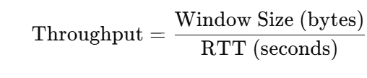
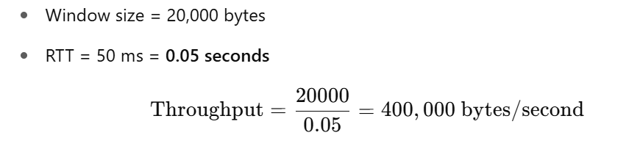
If the Maximum Segment Size (MSS) is 1000 bytes, and the round-trip time (RTT) is 50 ms, what is the maximum theoretical throughput of TCP in bytes/second if the window size is 20,000 bytes?

Slide 30
2)A TCP sender is using a window size of 10,000 bytes. Each segment carries 1000 bytes of data. The receiver has acknowledged up to sequence number 3000. What is the highest sequence number the sender can send next?
Window size = 10,000
Bytes sent = from 3001 to 13,000
→ Highest SEQ = 13,000
23.<number>

Slide 31
The following is a dump of a TCP header in hexadecimal format 053200217 000000001 00000000 500207FF 00000000
1) What is the source port number?
2) What is the destination port number?
3) What is sequence number?
4) What is the acknowledgement number?
5) What is the length of the header?
6) What is the type of the segment?
7) What is the window size
23.<number>

Slide 32
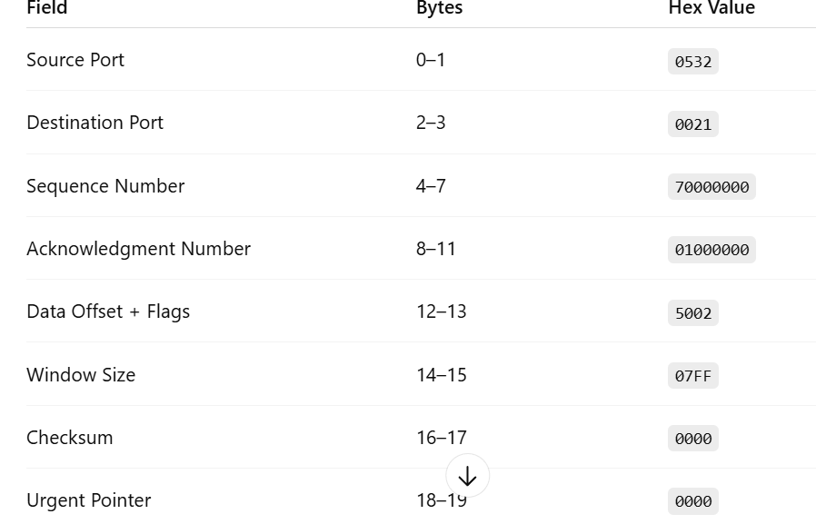
053200217 000000001 00000000 500207FF 00000000
23.<number>

Slide 33
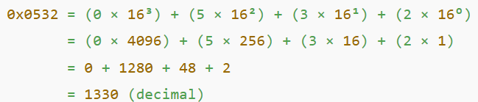
What is the source port number?
0532 (hex) = 1330 (decimal)
23.<number>

Slide 34
What is the length of the header?
Data Offset field = First 4 bits of 50 (hex) = 0101 = 5
Header length = 5 × 4 bytes = 20 bytes
What is the type of the segment?
Flags field = 02 → This corresponds to SYN
23.<number>

