Slide 1
H&M FASHION BUSINESS ANALYTICS
RETAIL ANALYTICS
ANALYSIS: Category Performance, Seasonality, Customer Segments & Retention
EXECUTIVE SUMMARY — FOUR NUMBERS THAT TELL THE STORY
79%
81%
32%
14%
of revenue from just 3 of 18 categories
of revenue comes from repeat customers
of customers are “At Risk” of churn
of shopping baskets span multiple categories
Upper / Lower / Full body garments
who are only 51% of the customer base
the single largest RFM segment
cross-sell is largely untapped
Taken together: retention and category focus matter far more to H&M's revenue than acquisition or catalogue breadth.
1
Notes:
OPENING (30-40 sec): Introduce yourself and the project scope: an end-to-end Power BI analysis of H&M transaction data covering category performance, seasonality, RFM customer segmentation, market basket, and retention. Read the four headline numbers as a preview, not a deep dive - '79% of revenue from just 3 categories, 81% from repeat customers, 32% at risk of churn, only 14% cross-category baskets.' Say: 'Over the next five slides I'll unpack each of these and end with what H&M should do about them.' Keep this slide under 1 minute - it's a trailer, not the movie.

Slide 2
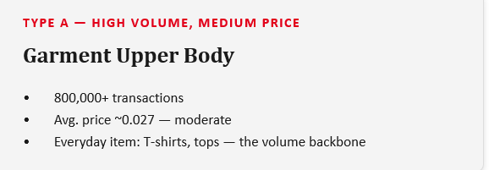
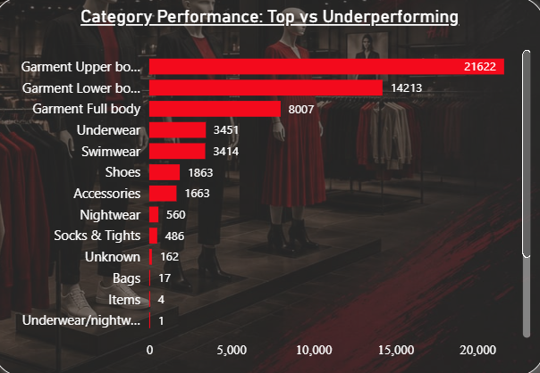
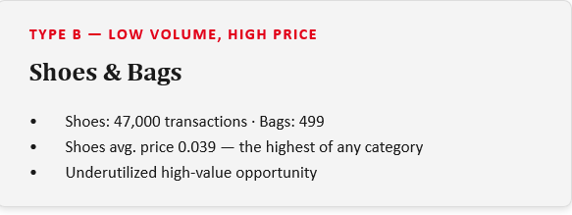
Category Performance: Top vs. Underperforming
DEAD-WEIGHT CATEGORIES — NEAR-ZERO REVENUE
Cosmetic
Furniture
Stationery
Interior Textile
~0.00% revenue
33 transactions
18 transactions
~0.00% revenue
Action: concentrate stock, design, and marketing on the top 3 categories; invest in Shoes design/marketing; discontinue or shrink dead-weight categories to limited collections.
4

Slide 3
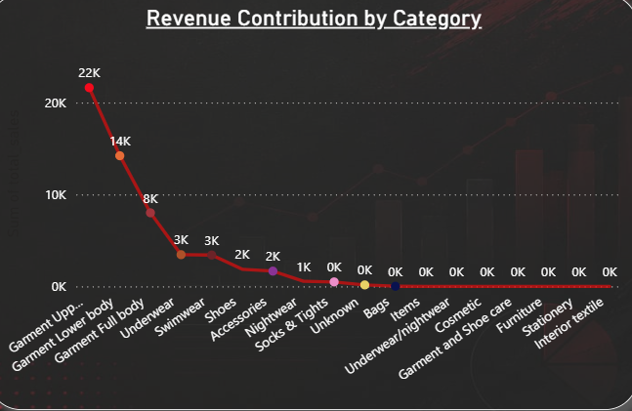
Revenue Contribution by Category
79%
of total revenue from just 3 of 18 categories — Upper body, Lower body, and Full body garments.
6.15%
from Swimwear alone — low unit price, but very high volume drives it above most other categories.
14.85%
spread across the remaining 14 categories — a long tail, not a core business driver.
5

Slide 4
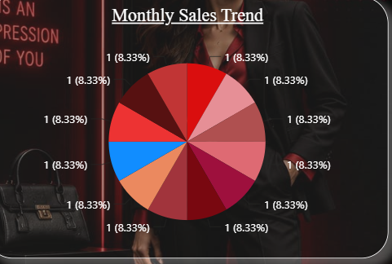
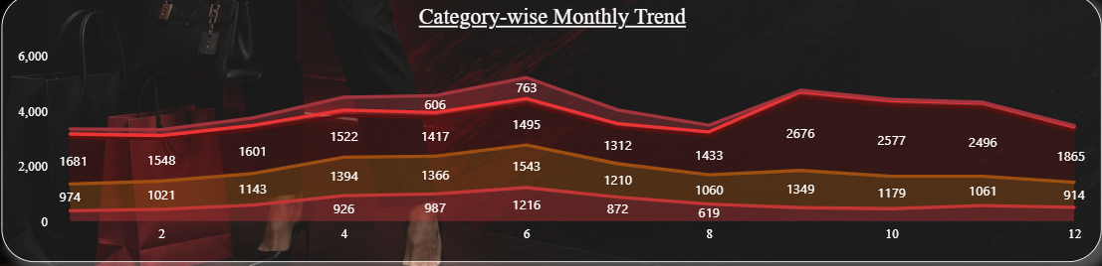
Monthly Sales Trend
Two seasonal spikes, one clear trough
June — peak month: 5,765 sales / 231,906 transactions
September — second peak: 5,290 sales
February — lowest: 3,783 sales
Summer start (May–Jun) and early autumn (Sep) drive spikes; winter's end (Jan–Feb) is consistently soft.
Action
Plan promotions and staffing around June/September; use Jan–Feb for clearance and cost control.
6

Slide 5
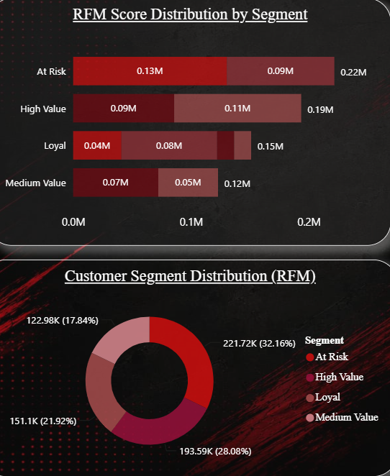
Customer Segment Distribution (RFM)
At Risk
221,720 · 32%
Haven't purchased in a long time — highest churn risk, the largest segment
High Value
193,592 · 28%
Recent, frequent, high spend — the revenue backbone
Loyal
151,102 · 22%
Frequent, but lower spend per visit — an upsell opportunity
Medium Value
122,975 · 18%
Average customers — lower priority for special attention
10

Slide 6
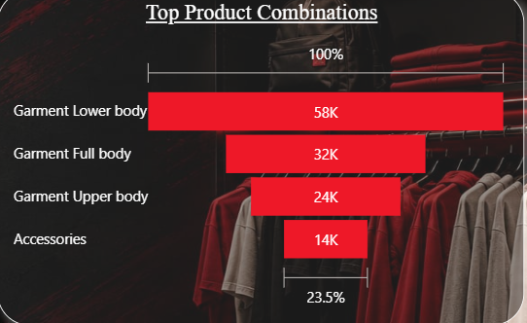
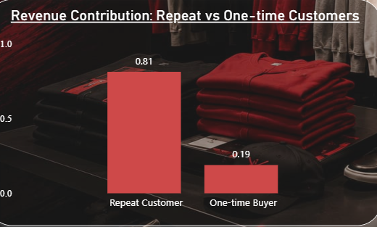
Customers Buy Outfits — Repeat Buyers Fund the Business
Only 14% of 1,709,966 total baskets span multiple categories — but “complete the outfit” (Upper+Lower) dominates at 45,809.
A textbook Pareto pattern: 51% of customers (repeat buyers) generate 81% of revenue. This links to the 32% At-Risk segment on the previous slide.
Opportunity: bundle Upper+Lower body at checkout and in displays; push accessory attachment; prioritize retention over acquisition — it is H&M's highest-leverage lever.
5
Notes:
Left chart: of 1.7 million baskets, only 14% cross categories, but when they do, Upper+Lower body (45,809) dwarfs every other pairing - customers naturally shop for a complete outfit. Accessories are under-attached (8,914 and 4,606) - call this a bundling opportunity. Right chart: the project's #1 insight. Repeat customers are 51% of the base but drive 81% of revenue; one-time buyers are basically the mirror image (49% of customers, only 19% of revenue). Mention repeat customers buy 3.9 times on average, and even nudging someone from 1 to 2-3 purchases has an outsized revenue effect. Explicitly connect back to slide 4: 'the 32% At-Risk segment are repeat buyers slipping away before they churn completely - protecting them protects this 81%.' End on the opportunity line - this is the pivot into your final recommendations slide.

Slide 7
Where H&M Should Focus Next
1
Protect the At-Risk segment
2
Invest in the top 3 categories
Launch a win-back campaign — personalized discounts and re-engagement — targeting the 32% of customers going quiet.
Double down on Upper/Lower/Full body garments with stock, design and marketing; unlock Shoes as a high-value growth category.
3
Bundle the complete outfit
4
Plan stock by seasonal type
Promote Upper + Lower body pairings at checkout and in displays; push accessory attachment, currently far behind garment pairings.
Build Swimwear/Full body stock Feb-Mar and clear by Sep; build Upper body stock ahead of September; treat Lower body/Shoes as steady.
Created By:
Kiruthika.V
Thank You — Questions & Discussion
6
Notes:
Present the four cards as a single cohesive plan, not four unrelated ideas: 'Retain the At-Risk 32%, double down on the categories that already earn 79% of revenue, bundle the outfit pairings customers already buy, and time stock to the seasonal patterns we saw.' If asked which one matters most: lead with retention (card 1) - it's the highest-leverage lever because repeat customers already drive 81% of revenue. Close by inviting questions. Have the underlying numbers (79/81/32/14 from slide 1) ready to restate if asked to summarize in one sentence: 'H&M's revenue is concentrated in a few categories and a loyal minority of customers - protecting and growing both matters more than broad acquisition.'

