Slide 1
Employee Data Analysis using Excel
STUDENT NAME: KIRUTHIKA H
REGISTER NO:312209839
NM ID:5517CE175D675C4ACC74B810BB2B1E0D
DEPARTMENT:B.COM (ACCOUNTING AND FINANCE))
COLLEGE: VALLIAMMAL COLLEGE FOR WOMEN

Slide 2
PROJECT TITLE
Employee Performance Analysis using Excel

Slide 3


AGENDA
Problem Statement
Project Overview
End Users
Our Solution and Proposition
Dataset Description
Modelling Approach
Results and Discussion
Conclusion
3/21/2024 Annual Review

Slide 4

PROBLEM STATEMENT
Asking for help with formulating a problem statement.
Could provide more context or details about the specific issue or topic you'd like to address? This will help me craft a clear and concise problem statement for you

Slide 5

PROJECT OVERVIEW
.
To help you create a project overview, I need more details about your project. Could you provide some context or key information, such as:- The main objective of the problem or need it addresses- The target audience or stakeholders- The key deliverables or outcomes- Any constraints or challenges this information, I can help you draft a comprehensive project overview.

Slide 6

WHO ARE THE END USERS?
To identify the end users for your project, it’s important to consider the nature of the product or service you're developing. Here’s a general guide based on different types of projects Software Applications (e.g., mobile apps, websites)

Slide 7

OUR SOLUTION AND ITS VALUE PROPOSITION
To craft a strong value proposition for your solution, it’s
important to clearly articulate what your solution offers and
how it benefits the end users. Here’s a framework to help you
define this:
Solution Description What is your solution
describe the product, service, or technology you're offering
What problem does it solve? the specific issue or pain
point your solution add

Slide 8
Dataset Description
create a comprehensive dataset description, it's important to
cover several key aspects that provide context and clarity.
structure you can use:
1. Dataset Overview Name: Provide a clear
and concise name for the dataset
Source: Mention where the data was collected from (e.g., public databases, surveys, experiments, APIs).

Slide 9

THE "WOW" IN OUR SOLUTION
Interactive dashboards and heat maps reveal top performers, areas for improvement, and hidden trends in real-time, enabling data-driven decision with conference.
3/21/2024 Annual Review
9

Slide 10
MODELLING
Pivot tables
Charts (e.g., column, line, scatter)
Conditional formatting- Formulas
Data validation
Trend analysis tools (e.g., moving averages, regression).
10

Slide 11
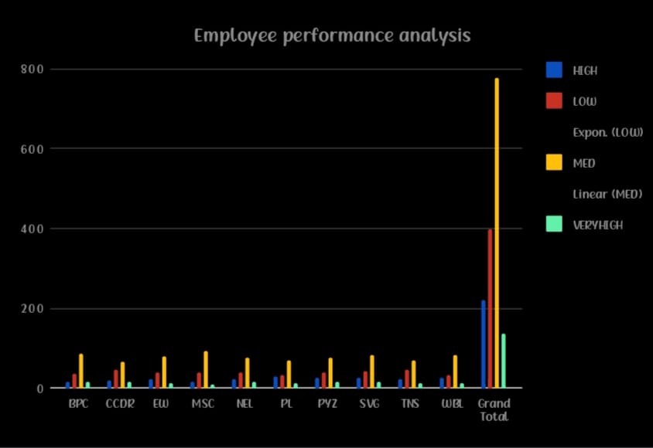
RESULTS
11

Slide 12
conclusion
Unlock the full potential of your workforce with data-driven
insights from our Employee Performance Analysis Excel
solution, empowering informed decisions and strategic growth.
Transform performance data into actionable intelligence to
drive business success and employee development.

