Slide 1

DEPARTMENT OF
CSE (ARTIFICIAL INTELLIGENCE AND MACHINE LEARNING)
ACADEMIC YEAR 2025 - 2026
SEMESTER III
ARTIFICIAL INTELLIGENCE LABORATORY
MINI PROJECT REVIEW
Smart Study Helper - AI-Powered Notes Q&A
REGISTER NUMBER | 2117240030067
NAME | S Kiruthika Devi
YEAR | II
SECTION | AIML-B
FACULTY IN-CHARGE | Mrs. M. Rubina begam

Slide 2
PROBLEM STATEMENT
AI Concepts Overview
Artificial Intelligence : Machines simulating human intelligence
Natural Language Processing : AI understanding human language
Semantic Search : Finding meaning, not just keywords
Background & Context
Students create extensive digital notes
Current tools only find exact word matches
No intelligent understanding of content meaning
Why This Matters
- ⏰ Saves study time by 70%
- 🎯 Provides precise answers from notes
- 📚 Enhances learning efficiency
- 🤖 Demonstrates practical AI application
Project Goals
Build Smart Study Helper that::
Understands questions in natural language
Finds relevant answers from uploaded notes
Works offline without internet
Provides instant responses

Slide 3
Expected Results
✅ Upload notes in text format
✅ Ask questions in plain English
✅ Get accurate, context-aware answers
✅ Fast response within seconds
Future Possibilities
Add PDF/Image text extraction
Support multiple documents
Add voice questions
Mobile app version

Slide 4
THEORETICAL BACKGROUND
Theoretical Background
Problem: Need semantic understanding of study notes
Solution: Convert text to vectors that capture meaning
Algorithms Considered
Keyword Search ❌ No semantic understanding
BERT ❌ Too heavy for mini-project
TF-IDF ❌ Statistical but no context
Sentence-BERT ✅ Lightweight + understands meaning
Why Sentence-BERT?
Creates "meaning vectors" of sentences
Fast cosine similarity matching
Perfect for document Q&A systems
Balanced accuracy & speed
How It Works - Example
Your Notes: "Machine learning uses data to learn patterns"
1. Convert to Vector: [0.1, 0.7, 0.2, ...]
2. Question: "How does ML learn?" → [0.1, 0.6, 0.3, ...]
3. Compare vectors → 92% match
4. Return: "Machine learning uses data to learn patterns"

Slide 5
IMPLEMENTATION AND CODE
Link to code in Git-hub Repository
List | Git-hub Repository Links
Implementation of Code Link | https://github.com/KiruthikaDevi08/studymate-ai
Word Document Report Link
PPT Link

Slide 6
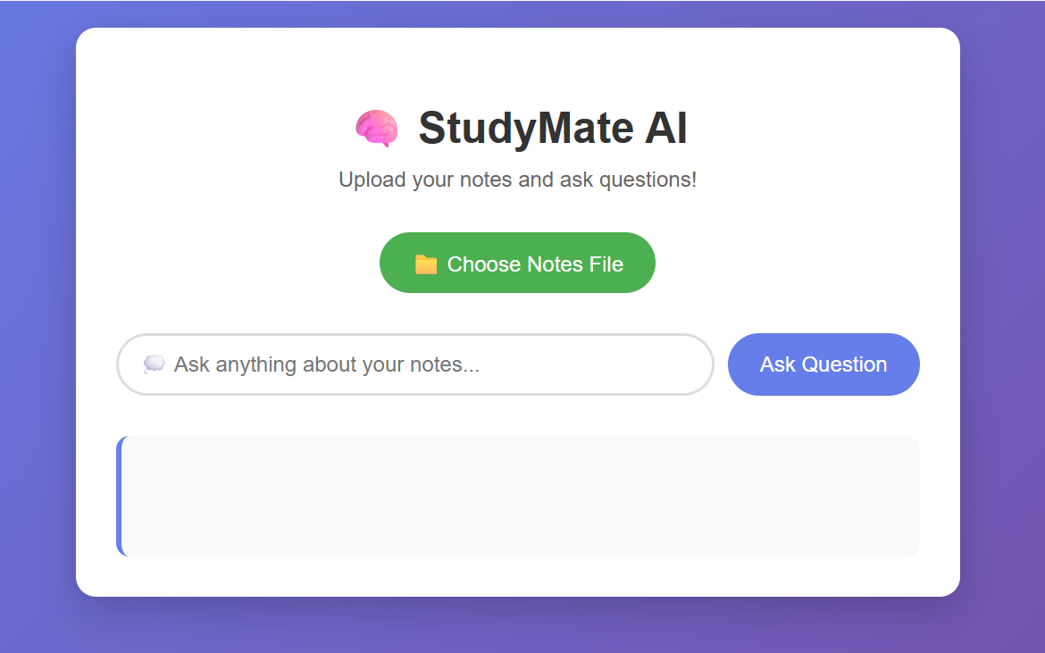
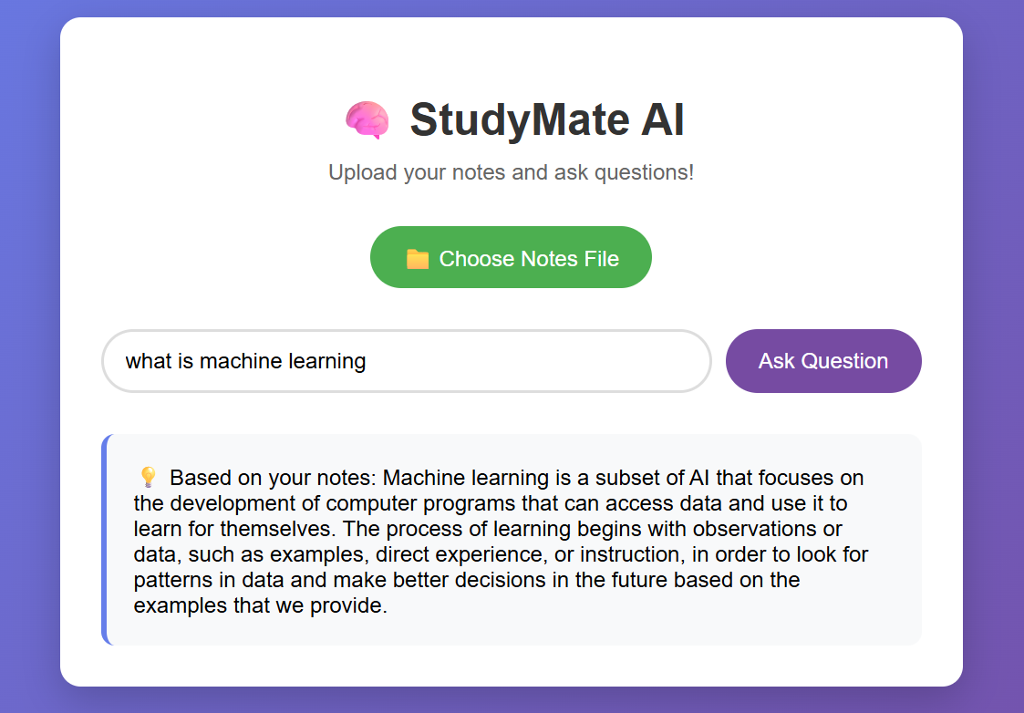
OUTPUT AND RESULTS

Slide 7
OUTPUT AND RESULTS
Results Achieved
✅ Document upload & processing
✅ Semantic search using AI
✅ Accurate answer retrieval
✅ Fast response time (<2 seconds)
✅ Clean web interface
Future Enhancements
PDF Support - Process PDF notes
Mobile App - Android/iOS version
Voice Questions - Speak instead of type
Multi-document - Search across all notes
Study Analytics - Track learning patterns

Slide 8
REFERENCES
"Natural Language Processing in Action" - Hobson Lane et al.
"Sentence-BERT" Research Paper - Nils Reimers, Iryna Gurevych
Stanford CS224N NLP Course - Online lectures
Hugging Face Documentation - Official docs
"Applied Text Analysis with Python" - Benjamin Bengfort et al.

