Slide 1
B.A.R.F Blind Abled Reading Frame
Kshitij Sharma – 2nd Year CSE 185001080
Kiruthika J – 2nd Year CSE 185001078
Raghav.R – 2nd Year CSE 185001119

Slide 2
Definition of Problem:
The main problem is the development of an algorithm which automatically “reads” every kind of printed book or written material (e.g. magazines) and turns it into speech, under certain circumstances.
Also, the above described problem encounters the following difficulties:
Hardware limitations (CPU, RAM, camera resolution).
Noise in the data (light conditions, reflections, blurring, shadows, finger existence etc.)
Data variations according to different font styles, font sizes and language.
The system is constituted by a pair of glasses equipped with an HD camera, Bluetooth headset and LED light. The aim of the hardware is to help VI people to have the experience in a natural way, without many wires or big cameras.

Slide 3
What is B.A.R.F?
A cognitive frame
Helps blind people read
Camera attachment takes picture
Detects text and coverts to audio

Slide 4
Why B.A.R.F?
Makes life easier for blind
Removes use of fingers to read(Braille)
Achieve self-sufficiency and independence
Light weight
Portable
Wireless

Slide 5
Components
Glasses: To attach the camera
Pi Camera: Takes a high quality picture of material to be read
Raspberry Pi: To run python code to detect text from image and convert to audio
Earphones
Power bank

Slide 6
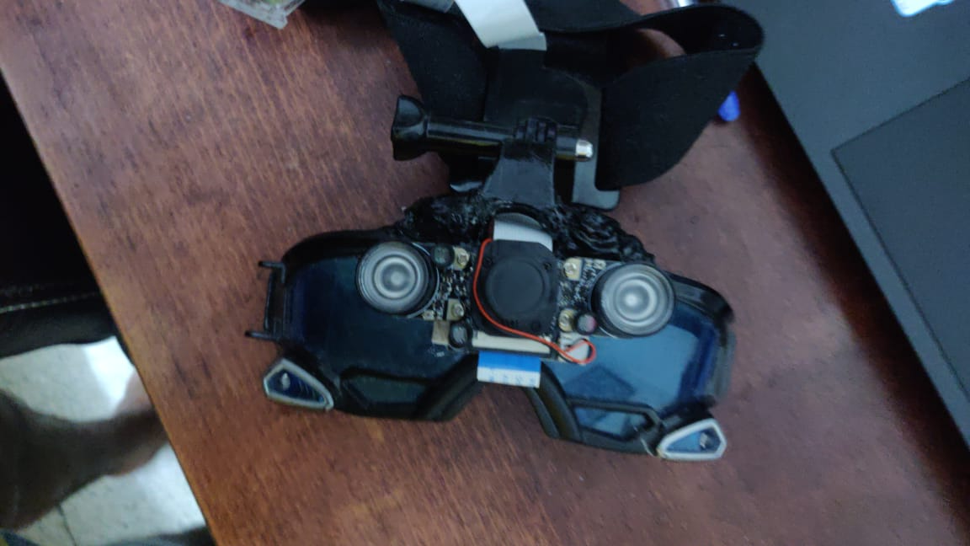
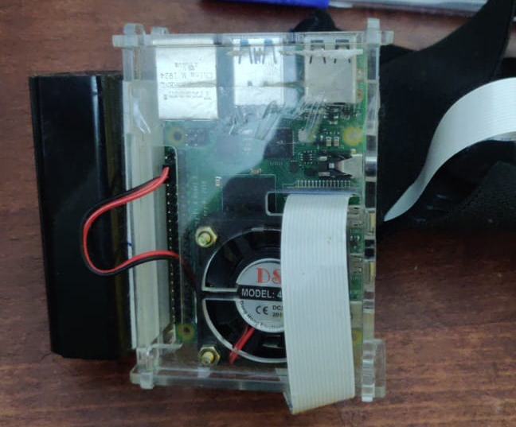
a) Glasses and pi camera
b) Raspberry pi with case

Slide 7
Working
Raspberry Pi Camera captures image
Google cloud vision detects text from image or the object from image
GTTS used to convert text data to speech
Audio delivered through earphones

Slide 8
Future Uses
Object Description
Reading newspaper content columnwise
Currency Detection
Face Recognition
Time Detection
Images from mobile

Slide 9
Budget Estimation
S.No | Item | Price in Rs
1 | Raspberry Pi Camera | 2000
2 | Raspberry Pi 4 | 4099
3 | Flex Cable | 445
4 | Raspberry Pi case | 399
5 | Micro SD Card | 799
6 | Pole mount for Go Pro | 229
7 | Go Pro Head Strap | 249
8 | Miscellaneous | 780
 | TOTAL | 9000

