Slide 1
Online Survey system
By,
KIRUTHIKA S

Slide 2
Content
Introduction
Objective
Requirements
Modules Output Conclusion

Slide 3
Introduction
Online Survey System Project is developed in Java programming language to facilitate online survey.
The main aim of the project is to form a platform to collect the viewpoints of related people about a particular survey topic.
It can also be implemented in any organizations or college for carrying out survey of any kind.
This project helps in lots of fields for taking surveys about a topics what people thinking about or if they have an issues they can express through the surveys.

Slide 4
Objective
Online Survey System is easy and comfortable to use.
In this application, the answers of the participants are collected and organise in a database.
The system is designed in such a way that it automatically adds the votes to each alternative and after the deadline of survey it displays the result.
All the activities in the project are controlled by admin of the survey.
The implementation of project avoids the programs such as meetings, conferences etc. to take any decision or research.
With the help of this online system, one can easily forward his/her ideas and viewpoints to the officials.

Slide 5
System requirements
SYSTEM REQUIREMENTS
Operating System - Windows
Platform - Eclipse IDE
Language - Core Java 8
Database - MS SQL server, MySQL
HARDWARE REQUIREMENTS
SERVER-: Processor - Intel Core Family,
RAM - 8 GB
Disk Space - 500 MB or more

Slide 6
Modules
REGISTER Survey CREATE Survey
TAKE Survey DISPLAY All Survey DELETE Survey

Slide 7
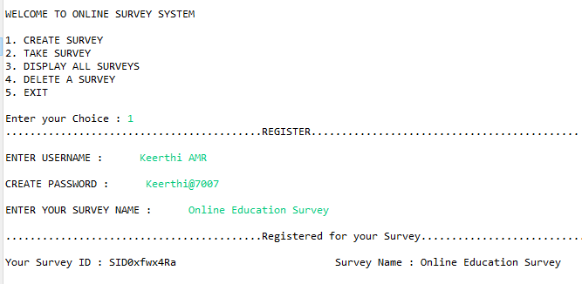
Register module

Slide 8
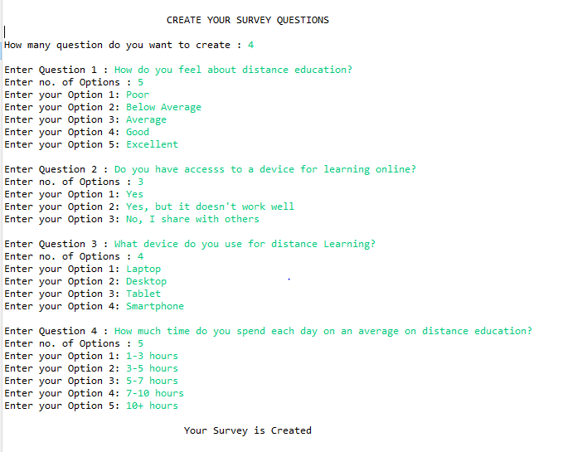
Create survey module

Slide 9
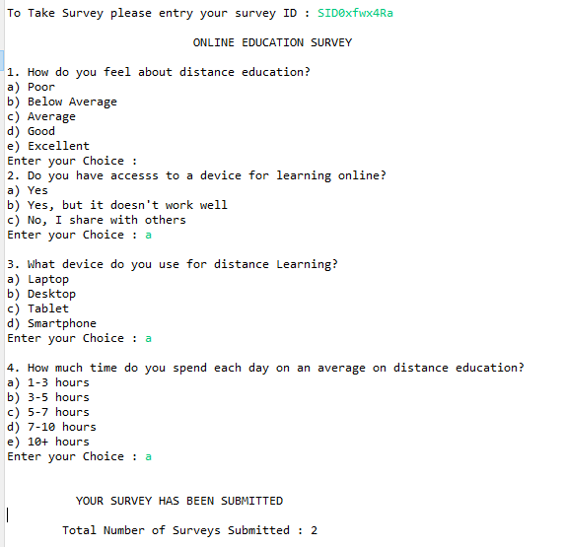
Take Survey module

Slide 10
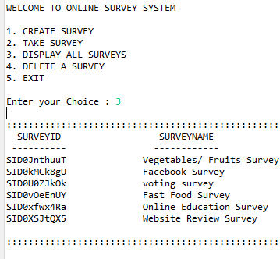
Display survey module

Slide 11
Conclusion
Online Survey System Project in Java is an excellent software to conduct online survey with minimized economy.
The result of this project will be accurate and totally error free.
With this system, the whole survey process can be conducted secretly by hiding the identities of the people surveyed.
The growing use of internet and computers confirms the good scopes of project.
This project helps in lots of fields for taking surveys about a topics what people thinking about or if they have an issues they can express through the surveys.

Slide 12
Thank you

