Slide 1
PROJECT TITLE
AD4V71 – DATA SCIENCE
Scholarship Eligibility Prediction
Presenting By
Team Member 1 Name :Kirutick Siddhesh V
Team Member 1 Regd No. :210425243120
Team Member 1 Section :C
Team Member 2 Name :Krishna H
Team Member 2 Regd No. :210425243124
Team Member 2 Section :C

Slide 2
Problem Identification and Title Justification
Relevance of the Problem
Scholarship screening in higher education traditionally requires checking multiple academic, financial, and demographic criteria across student applications. An automated prediction system can assist institutional review committees in screening applications efficiently based on objective criteria.
Problem Statement
Determining scholarship eligibility involves evaluating multiple criteria. This project develops a machine-learning classification pipeline that predicts whether a student application is predicted as Eligible or Not Eligible based on available student attributes.
Title Justification and Scope
The title "Scholarship Eligibility Prediction" accurately represents the machine-learning classification task using academic and financial attributes. The project scope includes data preprocessing, exploratory data analysis, feature engineering, classification model benchmarking, evaluation, and decision-support prediction, while explicitly excluding official scholarship approval, fund allocation, and document verification.

Slide 3
Basic Concepts Related to the Project
Machine Learning: Enables computer systems to learn patterns from historical student data to make predictions without being explicitly hardcoded.
Classification: A supervised learning task that categorizes student applications into discrete classes (Eligible or Not Eligible).
Dataset: A structured collection of academic, financial, and demographic student attributes used for model training and evaluation.
Data Preprocessing: Cleaning, handling categorical encodings, and scaling numerical features into standardized formats for algorithms.
Feature Selection / Engineering: Identifying and transforming key predictor attributes (e.g., family income, board marks) that contribute to predictions.
Model Training: Fitting classification algorithms on training data using supervised learning to minimize prediction error.
Prediction System: Evaluating new student attribute inputs through the trained pipeline to output predicted eligibility with confidence scores.

Slide 4
Literature Survey & Research Gap
Related Systems Survey:
1. Scholarship Recommender: Suggests scholarships | Limitation: No eligibility prediction
2. Financial Aid Predictor: Uses income data | Limitation: Limited academic factors considered
3. AI Screening System: Faster evaluation | Limitation: Requires very large enterprise datasets
4. Student Support System: Assists decisions | Limitation: Less personalized to individual criteria
5. ML Eligibility Model: Good initial accuracy | Limitation: Restricted feature scope
Research Gap Addressed:
• Multidimensional Feature Integration: Combines academic, financial, and demographic attributes in a unified pipeline rather than isolated evaluations.
• Multi-Algorithm Benchmarking: Systematically compares four distinct classification paradigms (linear, tree, ensemble, probabilistic).
• Zero-Leakage Pipeline: Implements strict ColumnTransformer preprocessing fitted exclusively on training data.
Reference Context Note:
• Government scholarship guidelines and AISHE statistics provide conceptual domain context; the dataset is a synthetic reference benchmark created for academic experimentation.

Slide 5
Objectives of the Project
1. Develop a machine learning classification model for scholarship eligibility prediction.
2. Analyze academic, financial, and demographic student attributes affecting eligibility.
3. Perform structured data preprocessing and exploratory data analysis (EDA).
4. Train and benchmark multiple classification algorithms (Logistic Regression, Decision Tree, Random Forest, Naïve Bayes).
5. Evaluate model performance using standard evaluation metrics (Accuracy, Precision, Recall, F1-Score) to predict students labeled as eligible in the dataset.
6. Provide a decision-support prediction interface with probability estimation.

Slide 6
Project Planning and Time Schedule
  PROJECT PLANNING
  TASK ALLOCATION MILESTONES
  Kirutick Siddhesh M1: Problem Definition
  Literature Survey M2: Literature Survey
  Data Collection M3: Dataset Prepared
  Documentation M4: Model Developmen
  Krishna H M5: Testing & Evaluation
  Model Development M6: Final Submission
  Testing
  Presentation
Timeline:
W1-W2 → Literature Survey
W3-W4 → Data Collection & Pre-processing
W5-W6 → Model Development
W7 → Testing & Evaluation
W8 → Documentation & Presentation

Slide 7
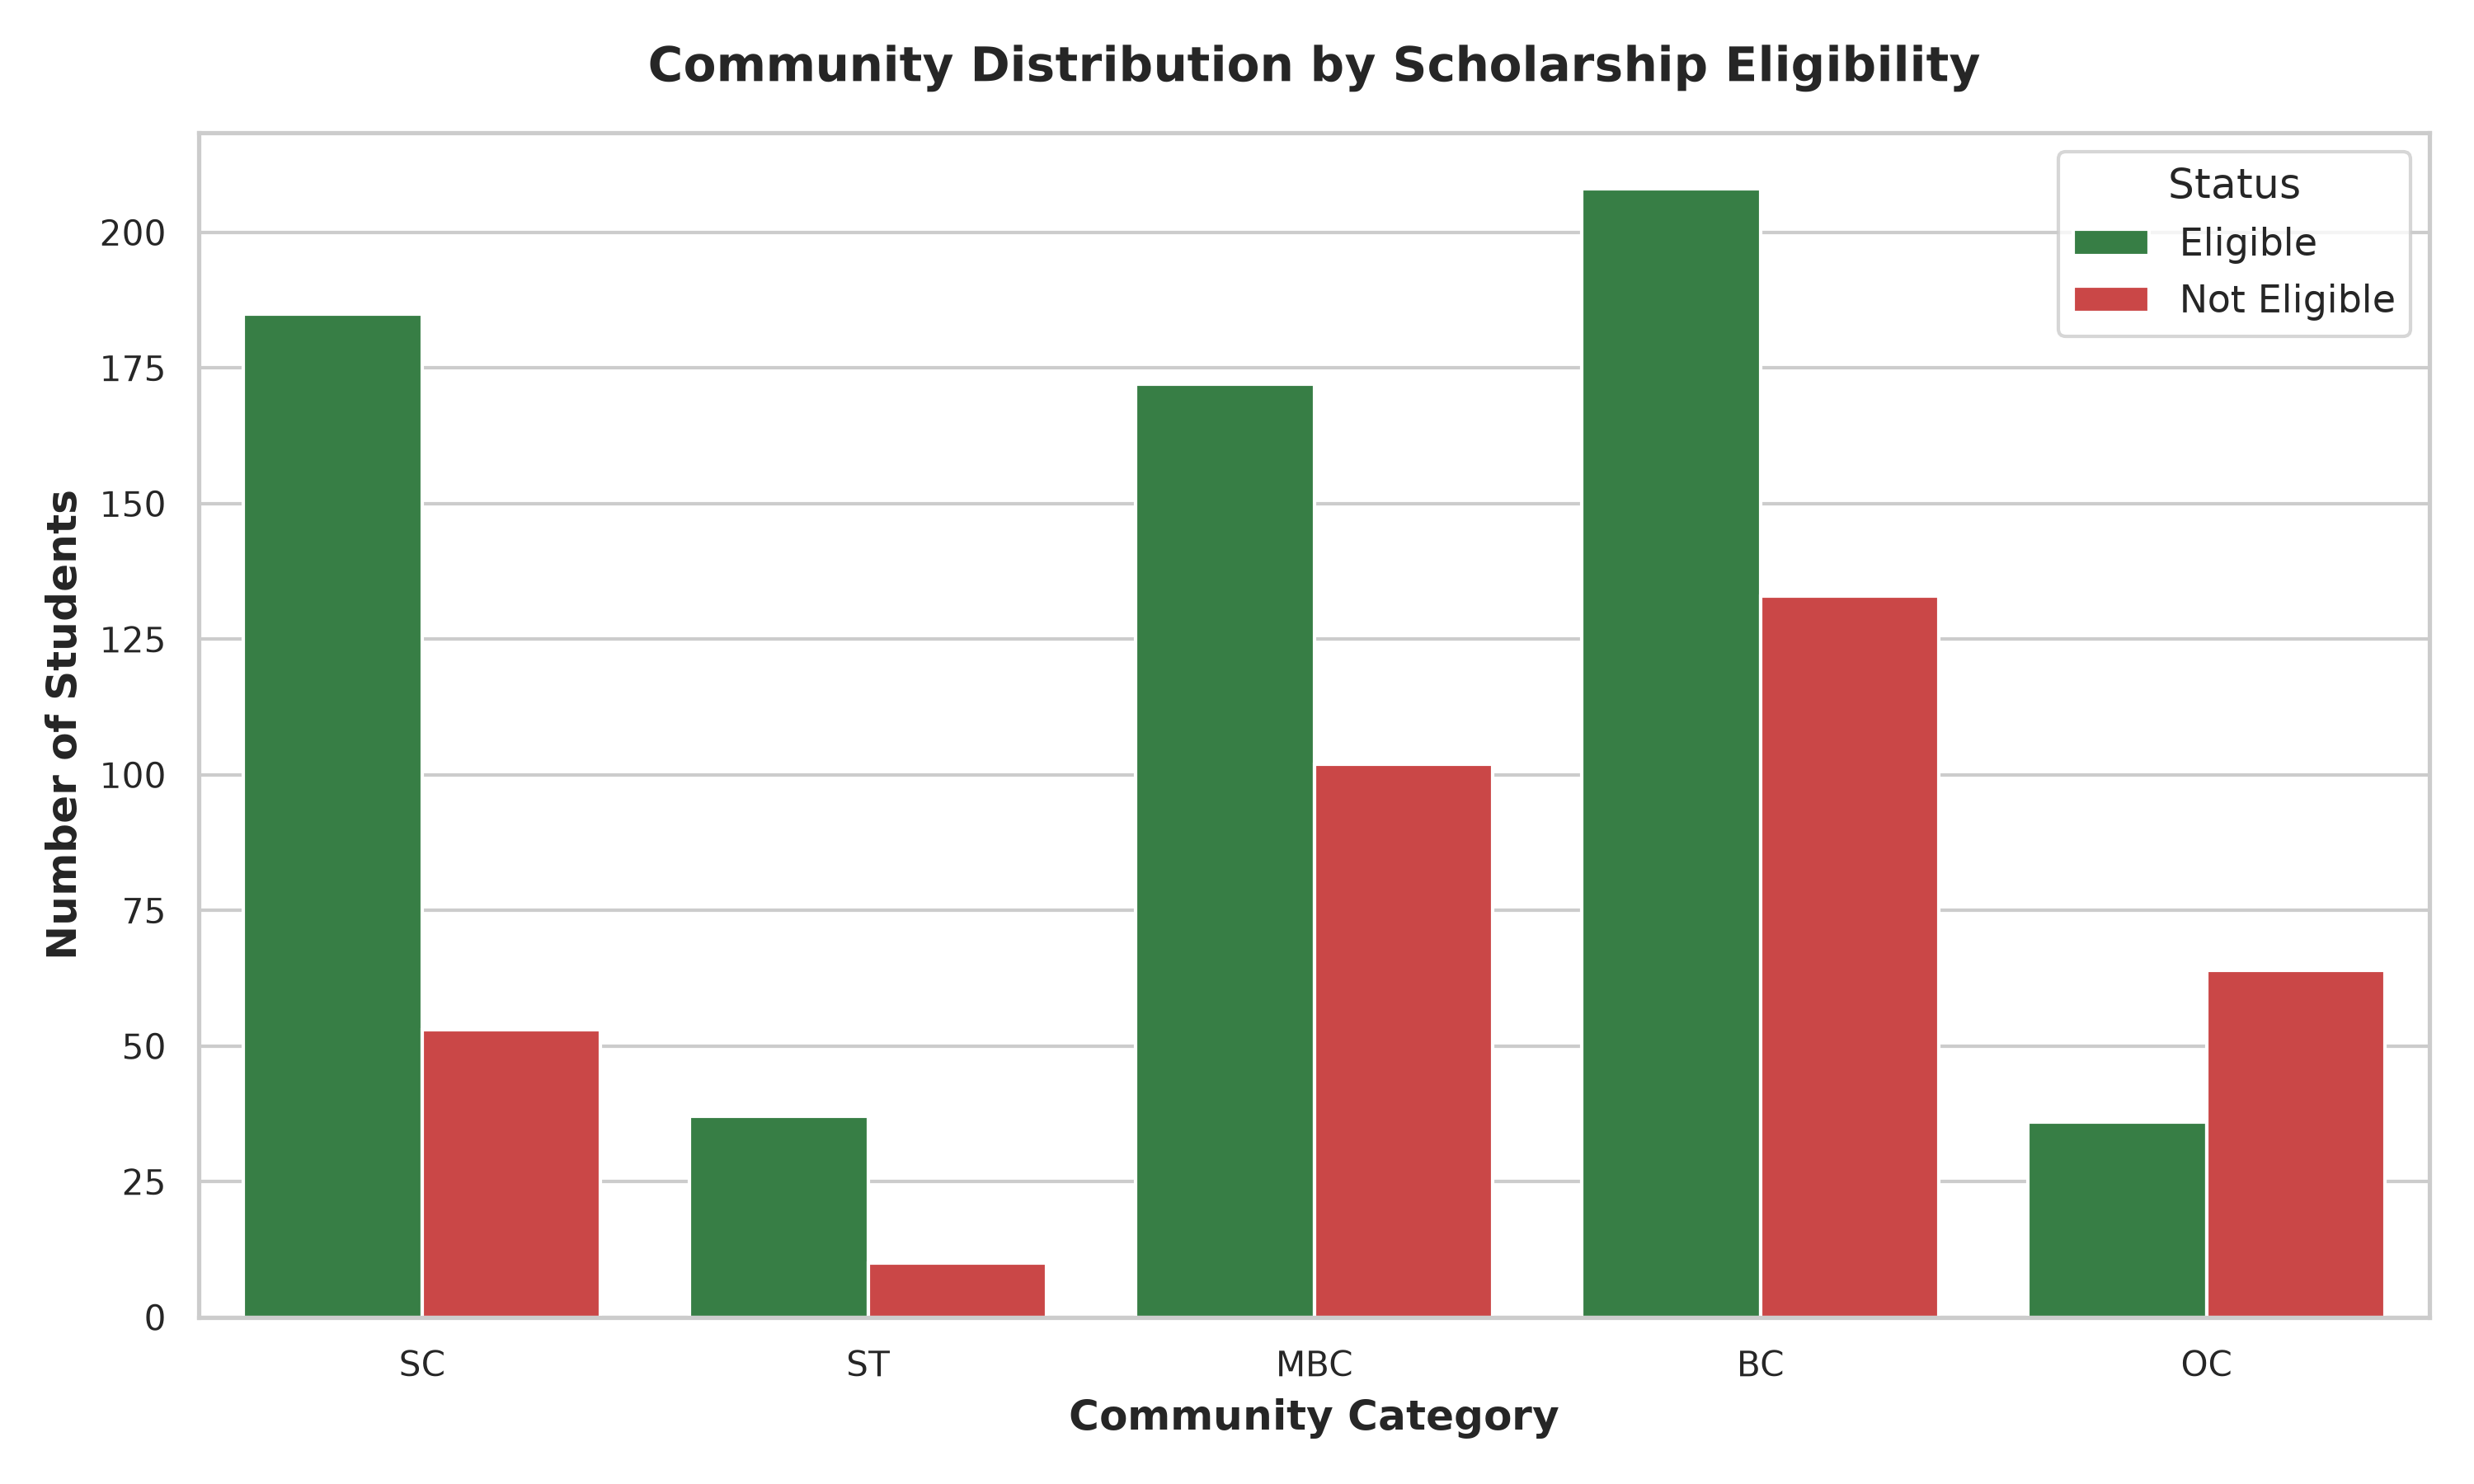
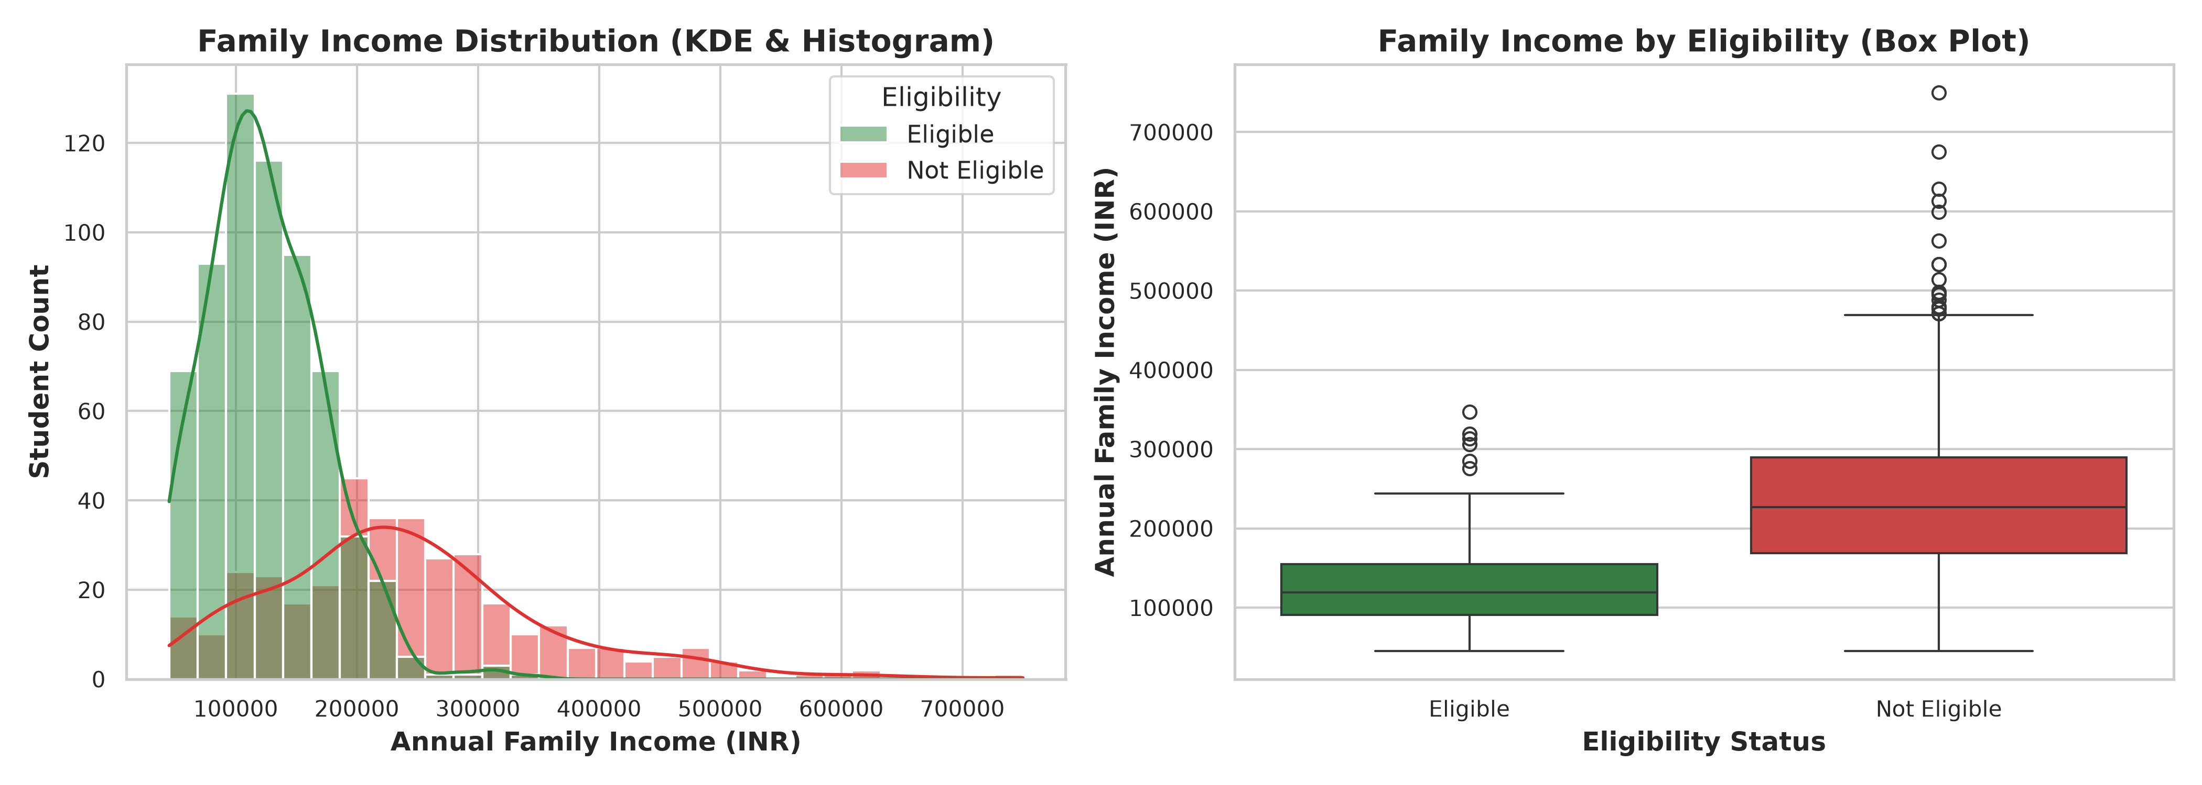
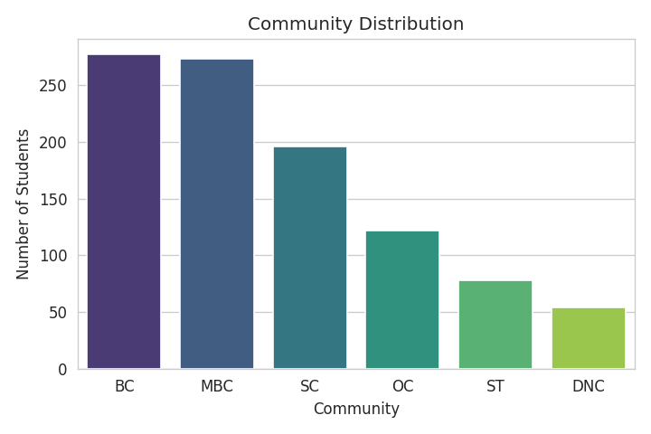
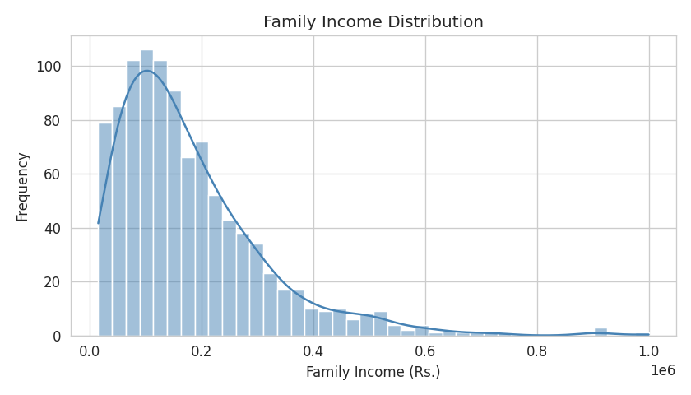
Exploratory Data Analysis (EDA)
Dataset: 1,000 synthetic student records (Community, FamilyIncome, 12thMarks, FirstGraduate, District, CollegeType, Course).
Target Distribution: 63.8% Eligible (638) vs 36.2% Not Eligible (362) — moderately imbalanced classification target.
FamilyIncome Correlation: r ≈ -0.57 (Calculated r = -0.5739) — shows the strongest negative linear association with eligibility.
12thMarks Correlation: r ≈ +0.22 (Calculated r = +0.2226) — shows a moderate positive linear association with eligibility.
Causality Note: Correlation indicates linear statistical association within the dataset, not causation (income/marks do not independently cause eligibility).

Slide 8
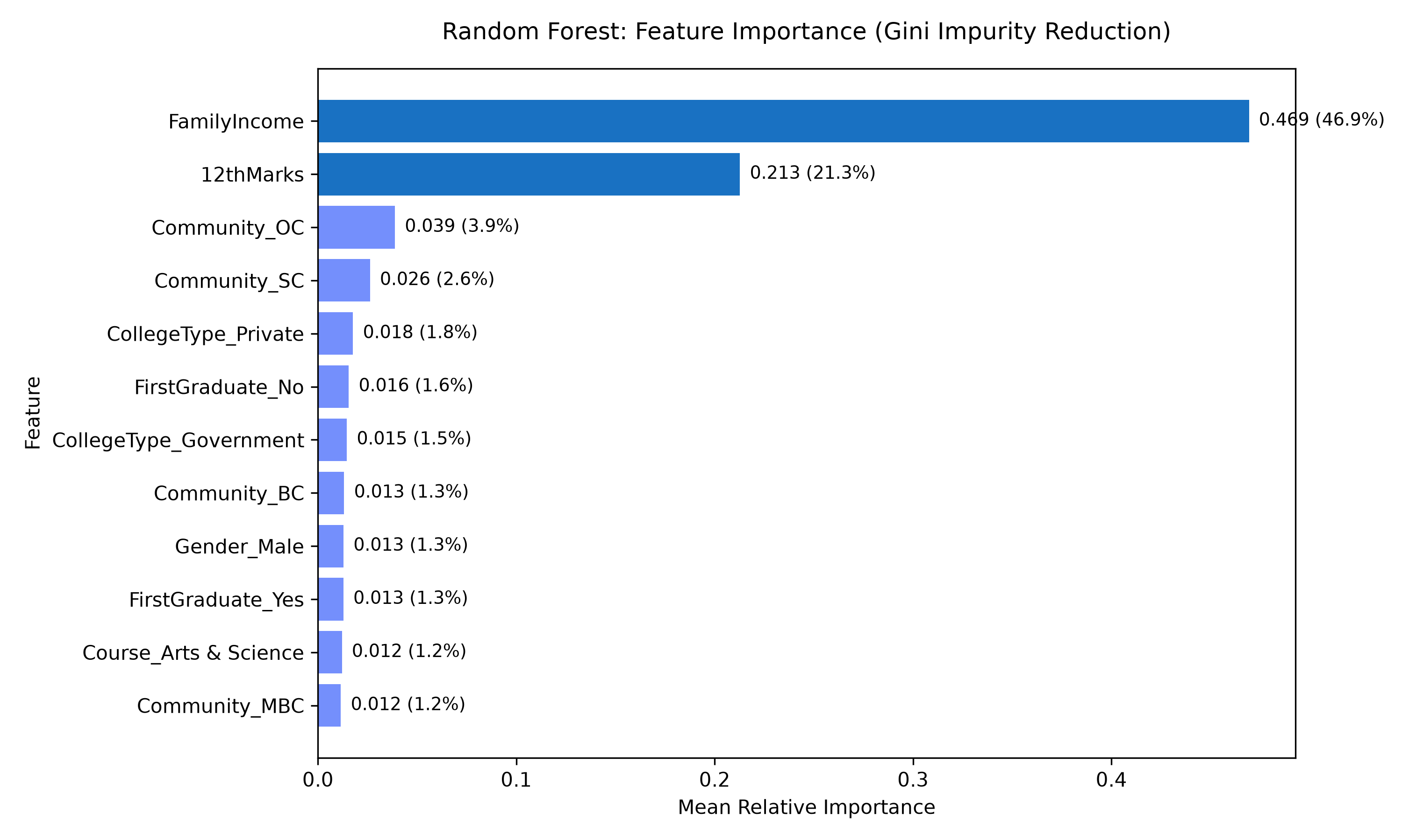
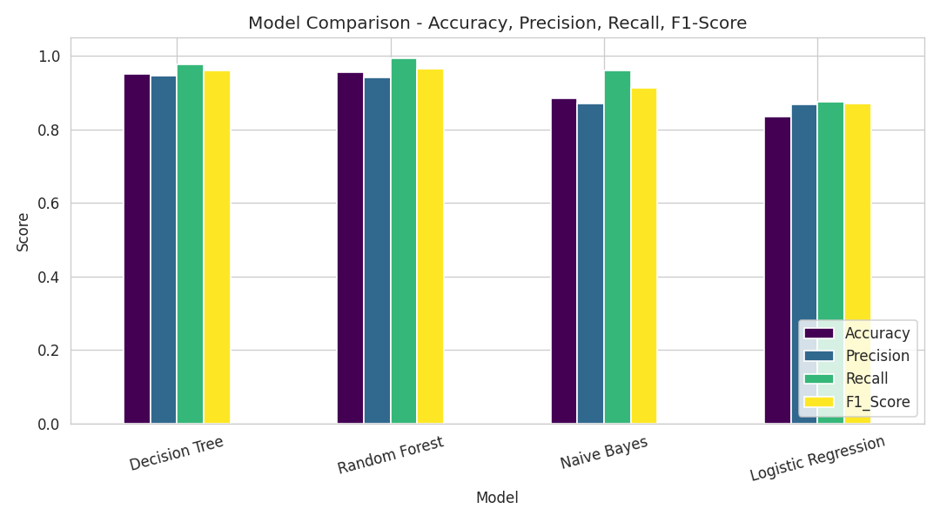
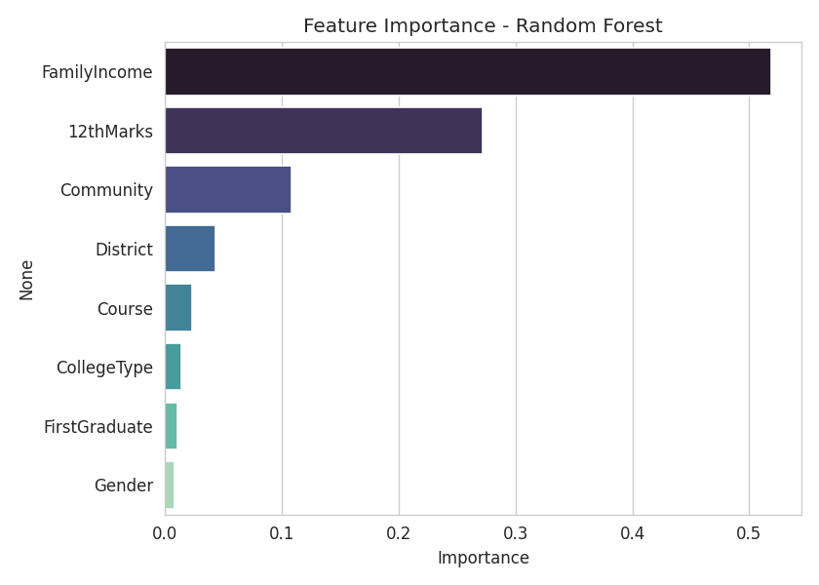
Model Comparison & Results
• Four classification algorithms were trained on 800 samples and evaluated on 200 held-out test samples (stratified 80/20 split).
• Random Forest achieved 93.0% accuracy and 0.944 F1-score on the held-out test set, performing best in the experiment.
• Random Forest Feature Importance: FamilyIncome (46.94%) and 12thMarks (21.28%) are the top predictors in the model.
Model | Accuracy | Precision | Recall | F1-Score
Logistic Regression | 86.0% | 0.8906 | 0.8906 | 0.8906
Decision Tree | 90.5% | 0.9504 | 0.8984 | 0.9237
Random Forest (Best) | 93.0% | 0.9672 | 0.9219 | 0.9440
Naïve Bayes | 84.0% | 0.8810 | 0.8672 | 0.8740

Slide 9
References
Pedregosa, F., et al. (2011). Scikit-learn: Machine Learning in Python. Journal of Machine Learning Research, 12, 2825-2830.
Breiman, L. (2001). Random Forests. Machine Learning, 45(1), 5-32.
Quinlan, J. R. (1986). Induction of Decision Trees. Machine Learning, 1(1), 81-106.
McKinney, W. (2010). Data Structures for Statistical Computing in Python (pandas). Proceedings of the 9th Python in Science Conference.
Government of Tamil Nadu: Post-Matric Scholarship Scheme Guidelines (Adi Dravidar & Tribal Welfare / Backward Classes Welfare Department) – Used as conceptual reference context for eligibility criteria.
Ministry of Education, Government of India: All India Survey on Higher Education (AISHE) Reports – Used as reference context for higher education enrolment demographics.
Note: References provide algorithmic background and conceptual domain context; the project dataset is a synthetic reference dataset generated for academic machine-learning experimentation.

Slide 10
Thank You!
Academic Machine Learning Classification Demonstration
Course: AD4V71 – Data Science
Team: Kirutick Siddhesh V (210425243120) & Krishna H (210425243124)

