Slide 1
Statistical Approach for Recognition and Detection of Phonetic Borrowings in Chinese (Case Study of the Russian Proper Names)
Kirill Semenov
HSE – Moscow
eReL: May 11th , 2019

Slide 2
Object: Is It Important?..
There are other more popular spheres in modern Chinese lexicography:
Semantic borrowings: Superman > 超人 (chāorén = “exceed”+ “man”)
Loanword blending: ballet > 芭蕾舞 (bālěiwǔ = phonetic loan + “dance”)
“Lettered words”: 卡拉OK (kǎlā ou kei – “karaoke”);
三G手机 (sān Gē shǒujī – “three” + “Generation [English]” + “mobile phone”)
Modern Internet neologisms
同志 (tóngzhì) – “comrade” > “homosexual”
1314 (yī sān yī sì) ≈ yī sheng yī shì = “forever”

Slide 3
Object: It Is Important!
For the fundamental research:
phonetic adaptation in a language of different phonetic inventory
For the natural language processing (NLP) purposes:
PoS-tagger
NER (Named Entity Recognition)
MT (Machine translation)
etc

Slide 4
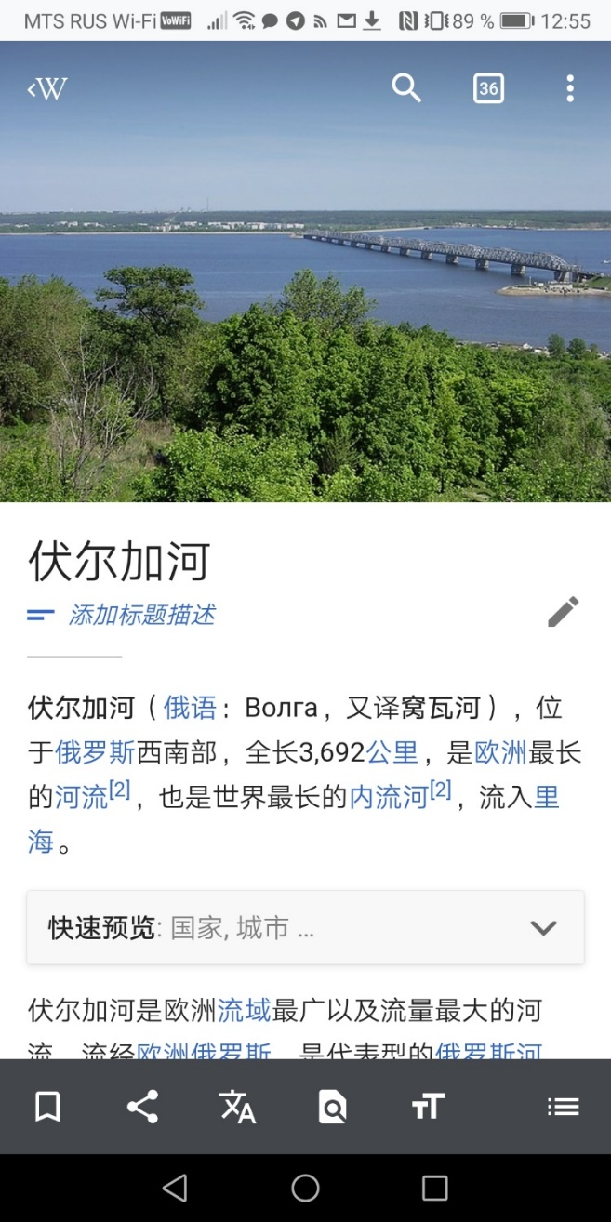
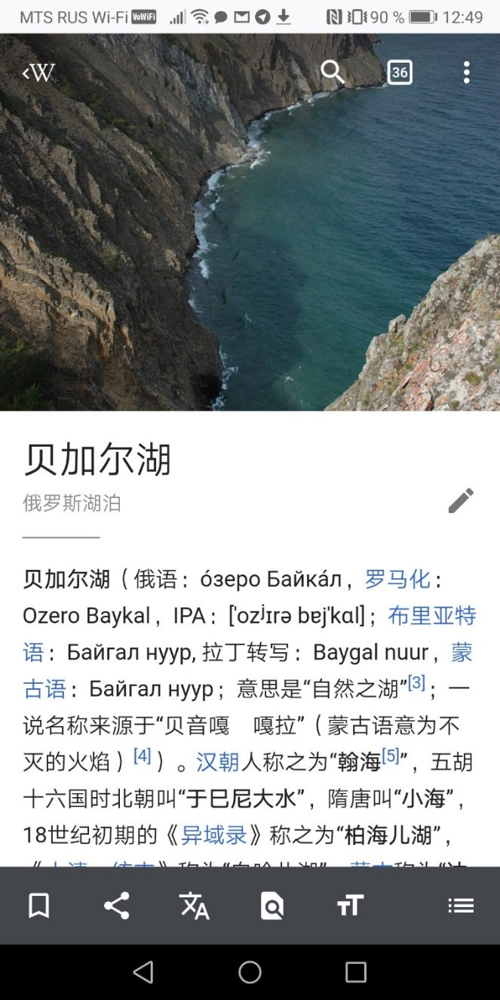
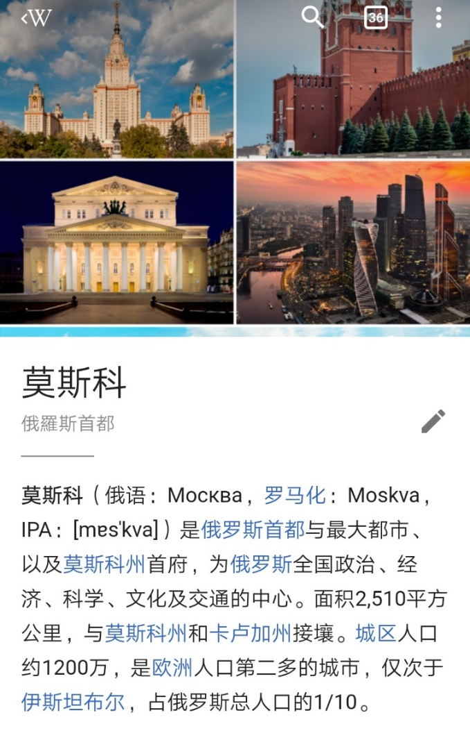
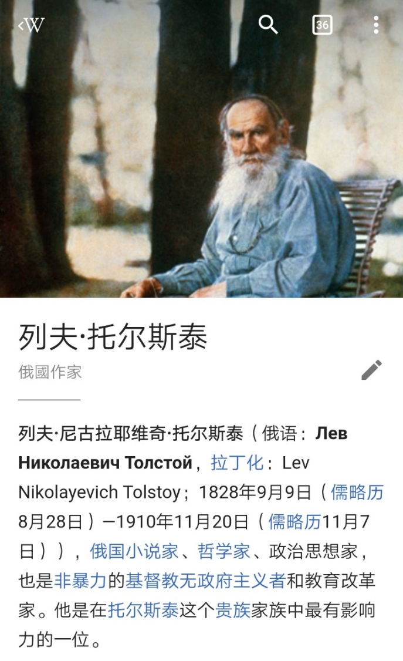
Object

Slide 5
Problems: Phonetic Aspect
A big difference in phonetic inventories of the SAE languages and the Chinese
A big level of homonymy in Chinese
shí: 时 (a while), 十 (ten), 石 (stone)…
shì: 是 (to be), 市 (town), 事 (case), 试 (to try), 世 (generation), 示 (to demonstrate)…
SAE | Chinese
Voiced VS Voiceless consonants | Aspirated VS Unaspirated consonants
Stress | Tone

Slide 6
Problems: Graphical Aspect
Absence of spaces between words
本宪章不得认为授权联合国干涉在本质上属于任何国家国内管辖之事件，且并不要求会员国将该项事件依本宪章提请解决；但此项原则不妨碍第七章内执行办法之适用。
No set of symbols used specifically for the phonetic loanwords
马里 (mǎlǐ) = “Horse mile/Inside horse” > Mali (African country) / Mary (city in Turkmenistan)
Ambiguity of the characters
乐 (yuè) = “music” / (lè) “happy”
了 (le) = PERF / (liǎo) = “to understand”

Slide 7
Our Hypothesis:
There is a particular pattern of transliteration for the Russian words in Chinese.
Our Aim:
To find it!

Slide 8
Our Tasks
1. To check whether the transliteration trends of English and German are applicable to the Russian loanwords
Case study: to check whether there is influence of a Chinese-Russian pidgin on the current Russian loanwords’ adaptation
2. To compare the prescribed transliteration rules (Xinhua) to the real data (Wikidata, dictionaries)
3. To analyze the cases of the partial semantic translation of the Named Entities (Wikidata, dictionaries)
4. To compare the most frequent N-grams in the Russian NE, Chinese NE and the reference corpus (Wikidata)

Slide 9
1. Phonetic Adaptation of the Russian Words in Chinese: the OT Approach

Slide 10
Phonetic Adaptation of the Russian Words in Chinese: the OT Approach
Based on the study of the English, German and Italian loanword adaptation in Chinese (Miao 2005)
Alternation of consonant phonemes
Transformation of consonant clusters
Made in the Optimality Theory paradigm

Slide 11
The main principles are confirmed on the Russian data:
The crucial consonant feature is MANNER:
s => s (75%) >> ʂ (20%) >> ɕ (5%); *ʤ
t => tʰ (70%) >> t (20%) >> *! ʦʲ (10%); *n
The C deletion rate (Coda position):
Liquids >> plosives >> fricatives >> /m, n/
Phonetic Adaptation of the Russian Words in Chinese: Results

Slide 12
Hard VS Soft feature of Russian consonants
In general – does not affect the transformation
Soft velars – c, ɟ, ç:
In Russian – palatal place and a fricative-like release
In Chinese – substituted by affricates ʤʲ ʦʲ ɕʲ
detected in English as well, but more consistent in Russian
Soft dentals - dʲ , tʲ:
In Russian - almost affricates ʤʲ ʦʲ
In Chinese - substituted by the corresponding affricates
Phonetic Adaptation of the Russian Words in Chinese: Results

Slide 13
Case Study: Chinese-Russian Pidgin

Slide 14
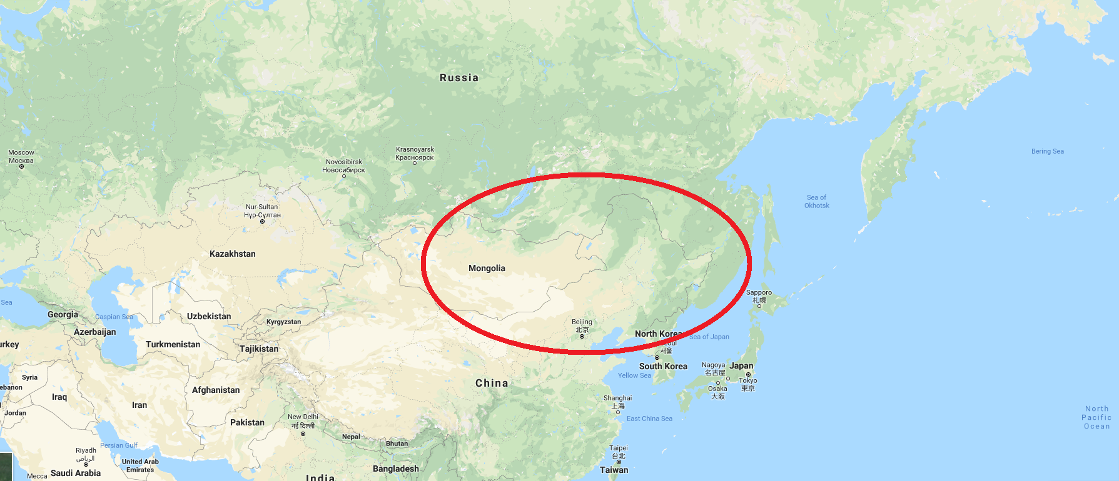
Case Study: Chinese-Russian Pidgin
Russian has a different history of contact with Chinese
Pidgin has existed since the end of XVIII cent.

Slide 15
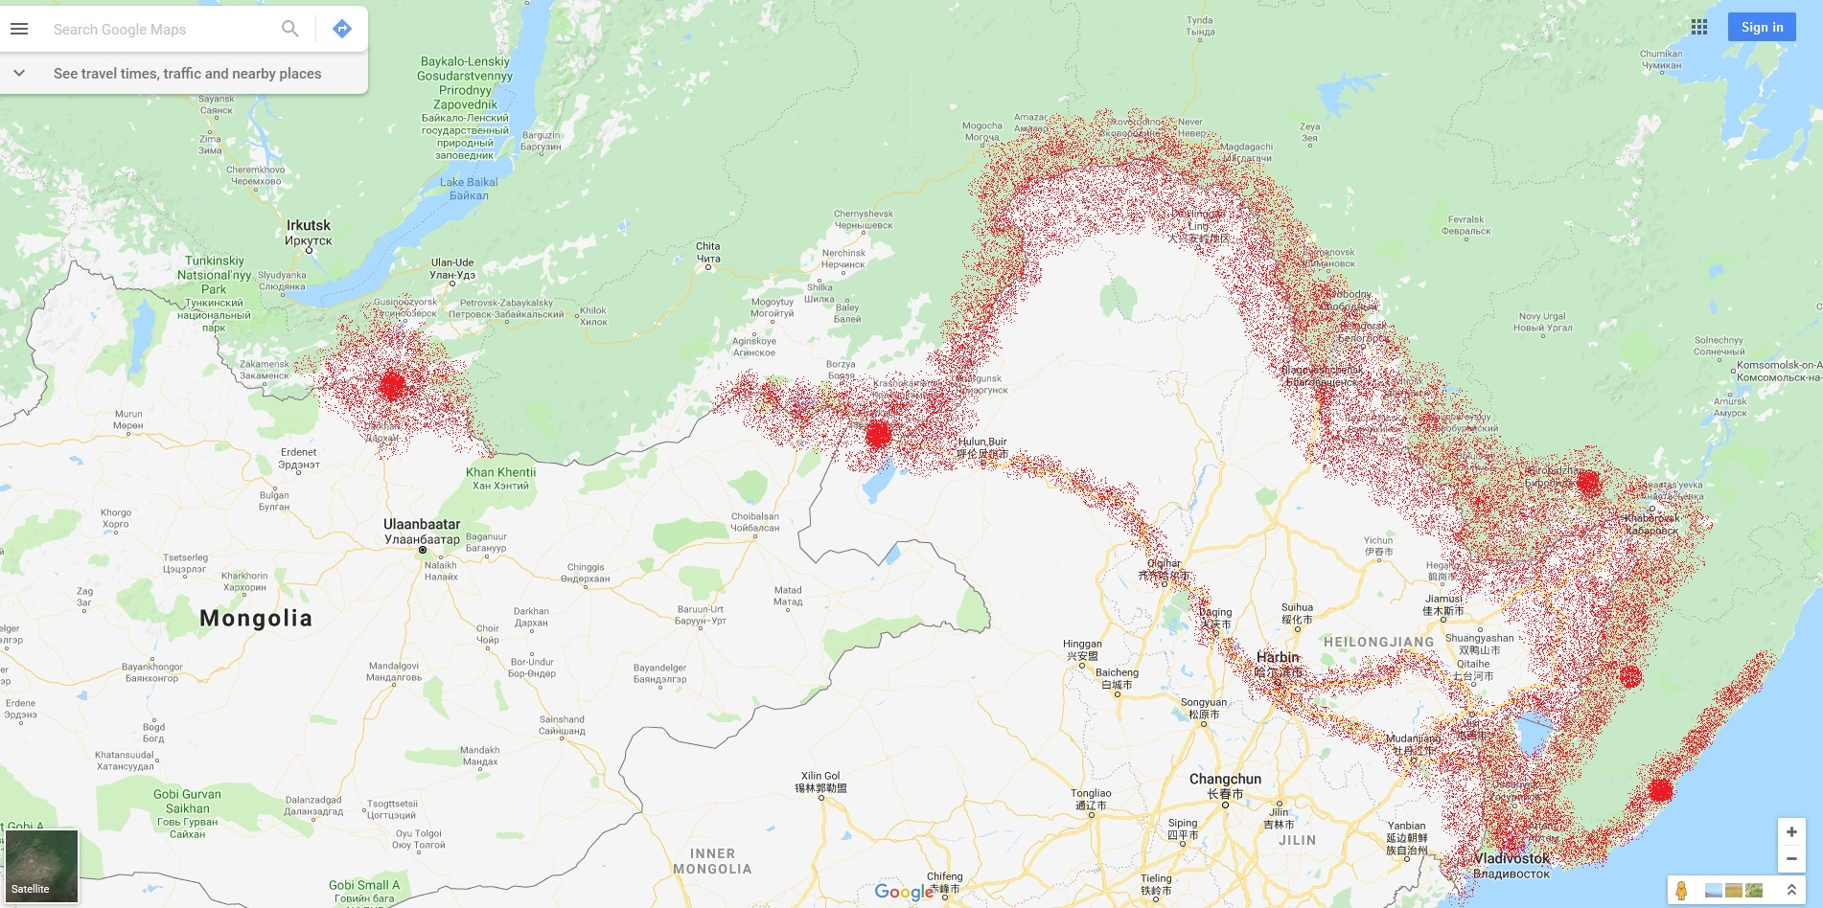
Case Study: Chinese-Russian Pidgin

Slide 16
Case Study: Hypothesis
The Chinese-Russian pidgin can influence:
The phonetic appearance of the exact “old” loanwords
The phonetic adaptation strategy for the new Russian loanwords
We can state it if:
The phonetic adaptation differs from the usual Chinese one
The phonetic adaptation is made according to the dialect phonology

Slide 17
Case Study: Results
The majority of the dialectal features from the standard Chinese is not observed in the loanwords
If it is, it can be usually explained by the OT assumptions:
哈拉嗦 hālāsuó instead of halaʂuo – predicted by the variation within one MANNER type

Slide 18
Case Study: Results
Two aspects likely to be transferred from pidgin:
“ʣa-adaptation” of nouns – a very “pigdinish” feature
The adaptation of a sound [z] is an affricate [ʣ] or [ʤ], which differs from the predicted by OT adaptation (same for pidgin and for contemporary Russian loans)
Russian | Pidgin | Northern Dialects | Modern Chinese
Купец | kupе-ʣa | 谷瘪-子 gǔbiě-zi* | 谷瘪-子 gǔbiě-zi*
Халат | Hala-ʣa | 哈拉-子 hālā-zi* | 哈拉-呢 hālā-nǐ
 | Russian | Pidgin | Modern Chinese
XX cent. Borrowing | колхоз | kaxóʣə | 科尔火支 kē'ěrhuǒzhī*
New Borrowing (NE) | Рязань | --- | 梁赞 liángzàn*
*by official “pinyin” transcription, “z” = [ʣ], “zh” = [ʤ]

Slide 19
2. Prescriptions and Use

Slide 20
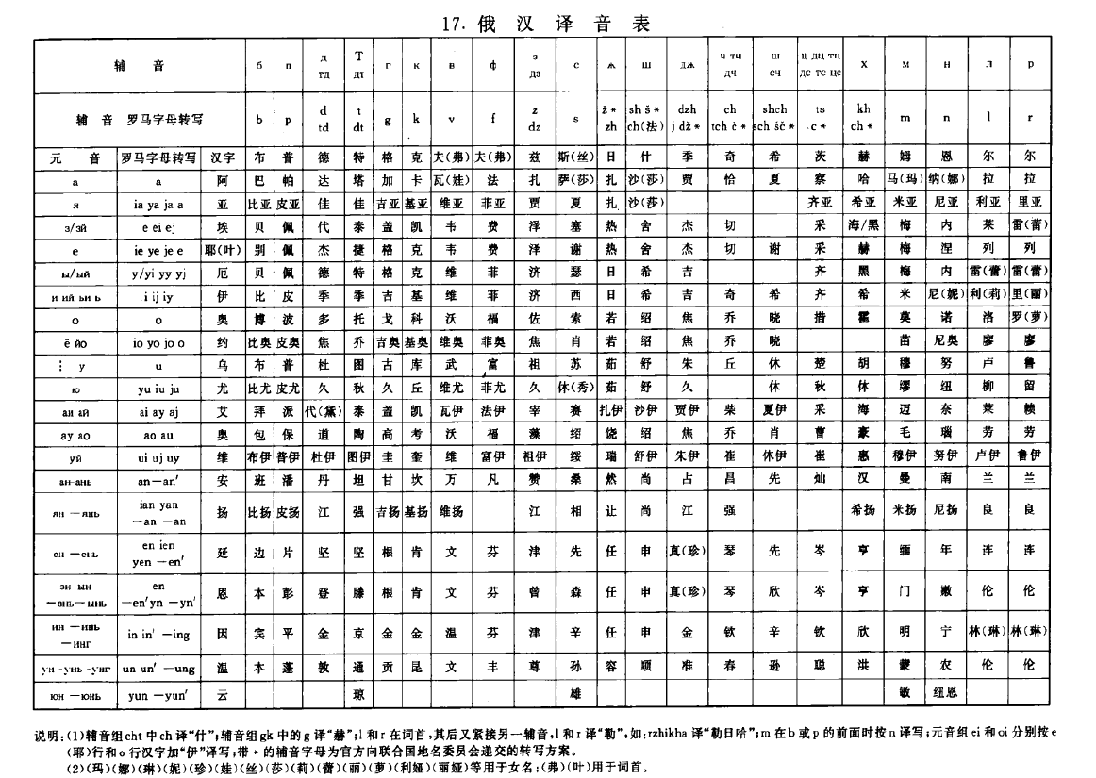
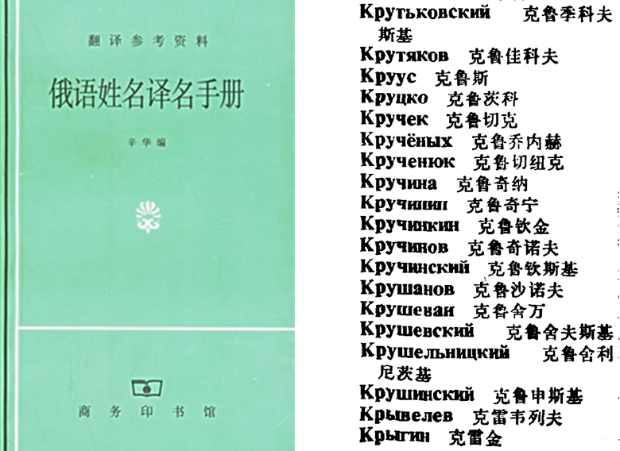
Xinhua prescriptions
Xinhua (新华社) is the biggest official news agency in PRC
Russian-Chinese translation dictionary (1982)
Russian-Chinese transliteration table (1993)
But are they really valid?..

Slide 21
Xinhua Algorithm
Python code
Regular expressions
“if”- “else” constructions
Pandas library
.csv table with prescriptions

Slide 22
Algorithm Application
Wikidata

Slide 23
Data: Wikipedia Objects

Slide 24
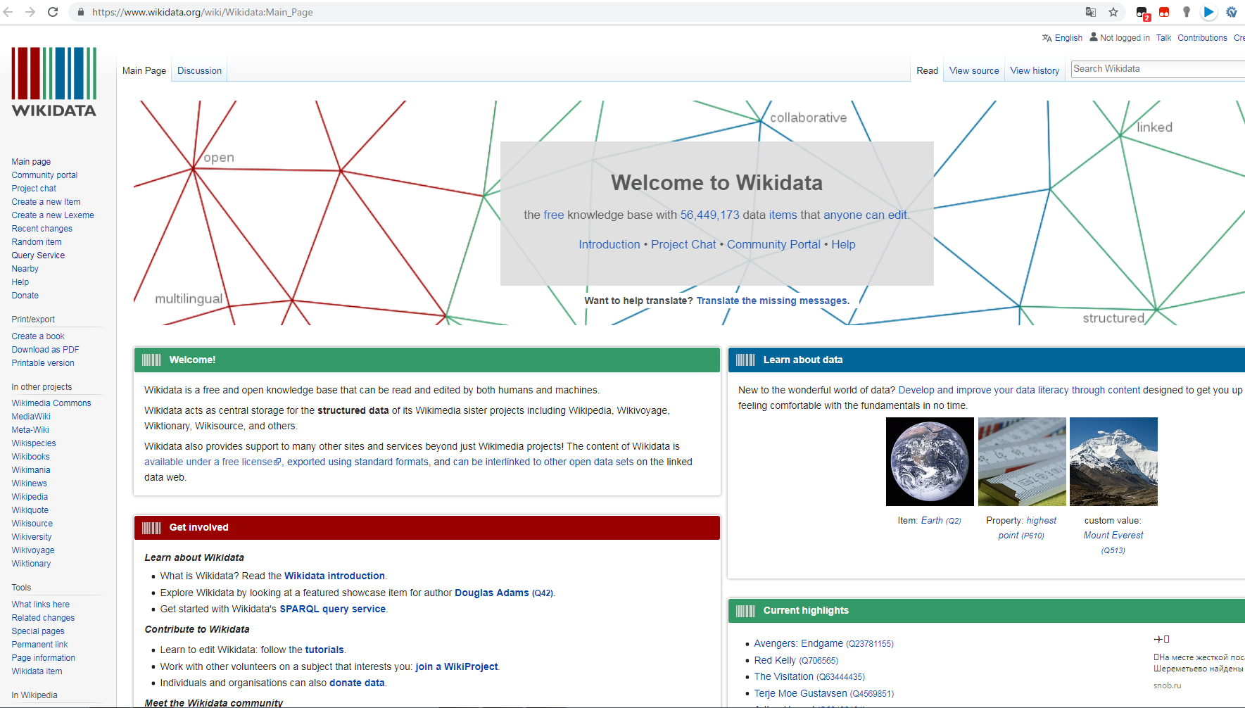
Source: Wikidata

Slide 25
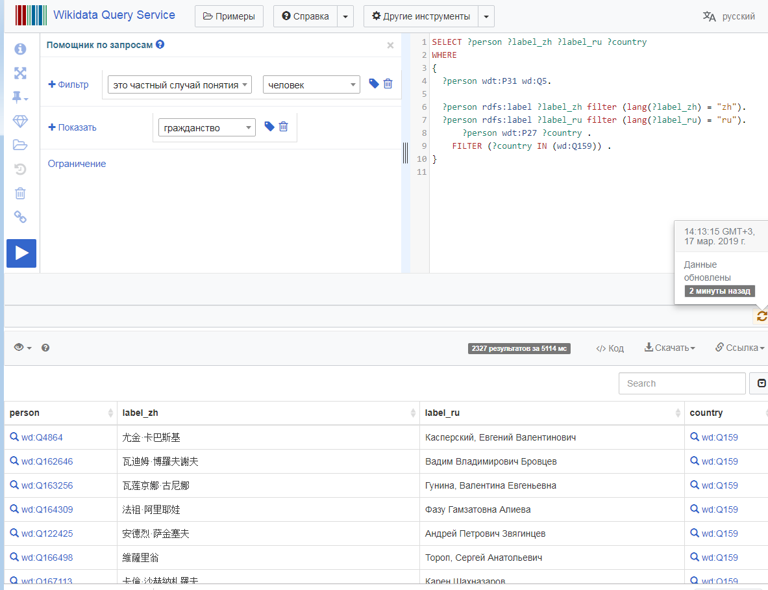

Slide 26
Dataset
Parameters:
Categories:
Country
Type of an object
Words:
Russian proper names
Wikidata transliteration
Xinhua-based transliteration
Metrics:
Absolute Levenstein distance
Normalized Levenstein distance
Jaccard index
Country sample:
Russian Federation
Transnistria (Приднестровье)
The USSR
The Russian Empire
Belarus
Ukraine – pilot study
Type sample:
Lakes
Rivers
Islands
Mountains
Settlements
Person names

Slide 27
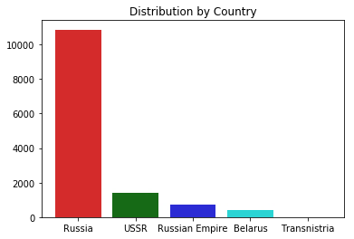
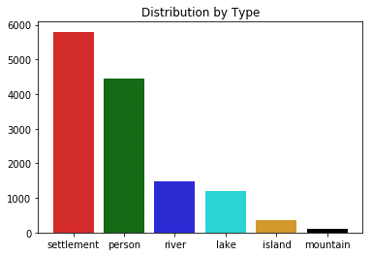
Dataset: Overview
13410 objects
Countries: 81% - Russia, 10% - USSR
Types: 43% - settlements, 33% - names of persons, 11% - rivers

Slide 28
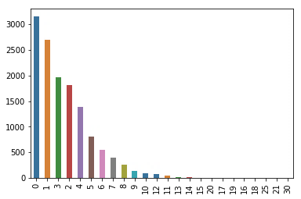
Dataset: Study
Levenstein distance:
Absolute: [0, ∞]; 0 – identical strings,
1-∞ - number of symbols to change

Slide 29
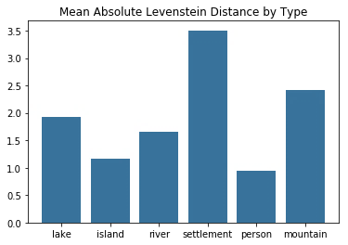
Dataset: Study
Classifiers?..

Slide 30
Dataset: Results
Xinhua rules are not so bad for personal names…
…but are hardly applicable to other types of objects
There might be some semantic elements which are translated to Chinese…

Slide 31
3. Semantic Elements in Transliteration

Slide 32
Classifiers: Overview
One syllable
In the end of the word
No classifiers for personal names
伏尔加河 fú’ěrjiā hé
奥涅加湖 àonièjiā hú
萨哈林岛 sàhālín dǎo
弗拉基米尔市 fúlājīmǐ’ěr shì

Slide 33
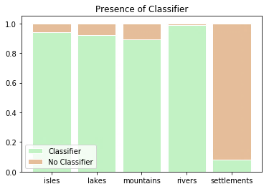
Classifiers: Frequency

Slide 34
Irresistible Compulsion to Semantic Elements
Novi Zeland VS New York
Новая Зеландия VS Нью-Йорк
How strong is it in Chinese?

Slide 35
Partial Semantic Translation
Based on the rough data overview, we split the possible variants into 3 groups:
“Spatial” Adjectives (“Higher”, “Southern”, “Central” etc.)
Other Adgectives (“Greater”, “New”, “Red” etc.)
Affixes (“Trans-”, “-upon-” etc.)

Slide 36
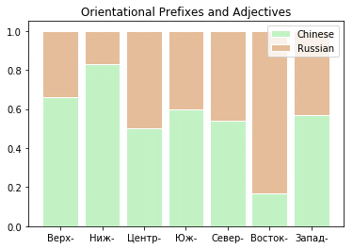
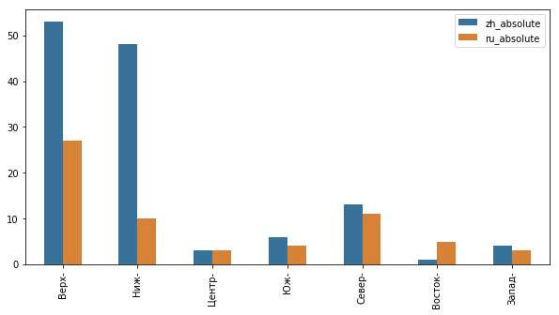
Partial Semantic Translation: “Spatial” Adjectives

Slide 37
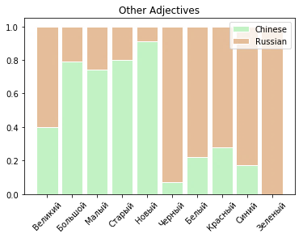
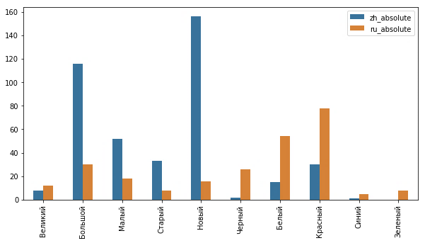
Partial Semantic Translation: Other Adjectives

Slide 38
Partial Semantic Translation: Affixes
The least likely to be semantically transformed
Two occurrences:
Забайкальск > 后-贝加尔斯克 > hòu (behind) -bèijiā’ěrsīkè
Ростов-на-Дону > 顿河畔罗斯托夫 > dùnhé pàn luósītuōfū

Slide 39
4. N-gram Frequency

Slide 40
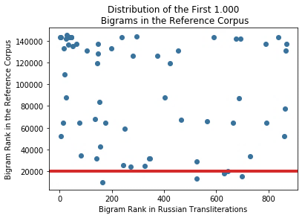
Bigrams
936 of Bigrams are not met in the reference corpus at all

Slide 41
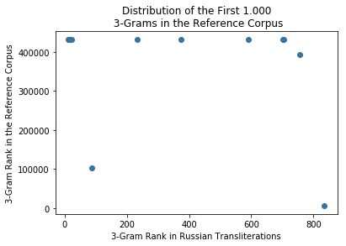
3-Grams
988 of 3-Grams are not met in the reference corpus at all

Slide 42
Results
Generally the trends of Russian loanwords’ phonetic adaptation are similar to those of other European languages
But the official (Xinhua) prescriptions do not cover them
The Chinese meaningful characters can be an efficient hint in limiting the loanwords
Adjective-like affixes – from the left
Classifiers (except personal names) – from the right
The majority of N-grams in transliterations are rare in the usual Chinese texts

Slide 43
Future Perspectives
Implementation of the statistics in Chinese NLP algorithms
Hidden Markov models
Seq2Seq Neural networks
Analysis of a bigger dataset
BaiduPedia (百度百科) – bigger than Wikipedia in 5 European languages altogether
More oriented on PRC
conduct the same research on other European languages
Experts in these language are needed – we invite you to take part!

Slide 44
Thank you for your attention!
Hvala na pažnji!
非常感谢！
Kirill Semenov,
HSE – Moscow
kir.semenow@yandex.ru

Slide 45
Additional Materials

Slide 46
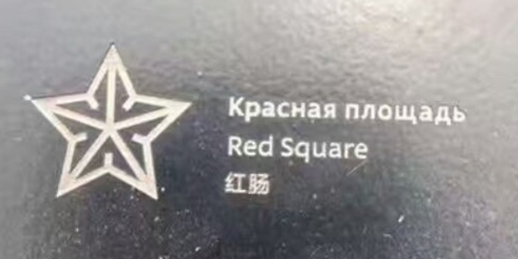
Problems: all over Russia
* 红场 - hóng chǎng – Red Square
红肠 - hóng cháng – Red Guts

Slide 47
Phonetic Adaptation of the Russian Words in Chinese: the OT Approach
Sources:
汉语外来词词典 (Chinese Loanword Dictionary), 1984 – 387 words
БКРС-Online (Big Chinese-Russian Dictionary Online) – 1494 items

Slide 48
Case Study: Material
Dictionaries and grammar of Russian-Chinese pidgin (Perekhval’skaya 2008)
Grammar of the Northern Chinese dialects (Zavyalova 1996)
Dictionaries of the Northern Chinese dialects and of the modern Chinese

Slide 49
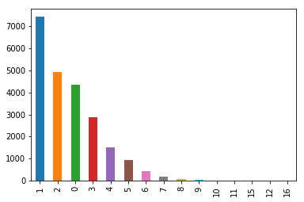
Levenstein Distance for Ukrainian Settlements

Slide 50
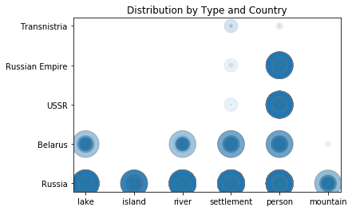
Dataset: Overview

Slide 51
Dataset: Study
Character diversity in Wikidata items | 877
Character diversity of Xinhua-based transliterations | 260

Slide 52
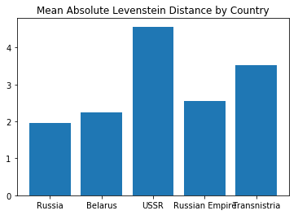
Dataset: Distribution by Type
Communist names?..

Slide 53
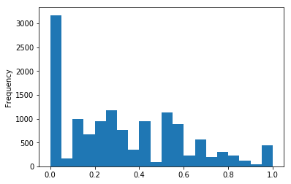
Dataset: Study
Normalized Levenstein distance:
[0, 1]; 0 – identical strings, 1 – totally different strings

Slide 54
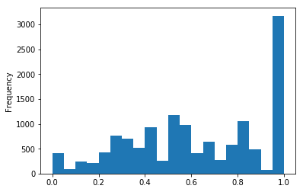
Dataset: Study
Jaccard Index: [0, 1]; 0 – the same set of symbols, 1 – no overlap

Slide 55
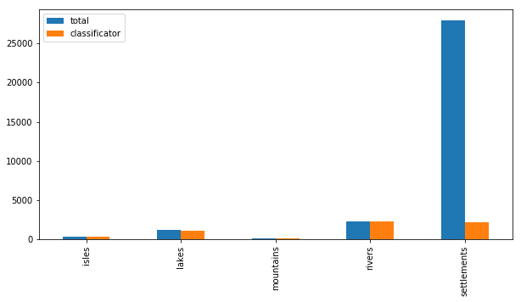
Classifiers: Absolute Numbers

Slide 56
Total Semantic Translations
East Asian Toponyms
Especially former Japanese territories – Kuril islads, Sakhalin, etc.
On-border settlements:
海参崴 hǎishēnwǎi (Sea cucumber river bend) = Владивосток
Communist Toponyms
Октябрьское, Первомайское, etc.
Other literal translations:
Белая (деревня)
Старое (село)
Аэропорт (район)
Чистые пруды

Slide 57
N-grams: Chinese Wikidata 3-grams
维奇· 739
夫卡$ 491
斯基$ 466
夫斯$ 434
科耶$ 410
斯克$ 396
亚历山 355
斯科耶 350
$亚历 280
科夫$ 273
历山大 253
诺夫$ 251
耶维奇 242
山大· 231
夫斯基 215
尼古拉 210
米哈伊 200
耶夫$ 189
谢尔盖 185
$谢尔 182
诺耶$ 164
$弗拉 160
洛夫$ 157
诺维奇 154
$尼古 148
拉基米 146
尔盖· 146
弗拉基 145
罗维奇 142
米尔· 137

Slide 58
N-grams: Russian Wikidata 4-grams
кий$ 2550
ский 2508
кое$ 2204
ское 2100
овск 1385
вско 937
инск 904
вски 864
нски 834
вич 753
нско 655
ович 583
андр 536
лекс 525
алек 521
$але 421
евск 408
ксан 390
санд 379
нико 379
екса 376
енск 344
ий$к 339
евич 330
анов 319
ова$ 318
ков$ 300
новс 295
ковс 285
ое$к 279

Slide 59
Algorithm Application: Part 1
Chinese Loanwords’ Dictionary (汉语外来词词典), Shanghai, 1984
378 words of Russian origin
Or borrowed into Chinese via Russian

Slide 60
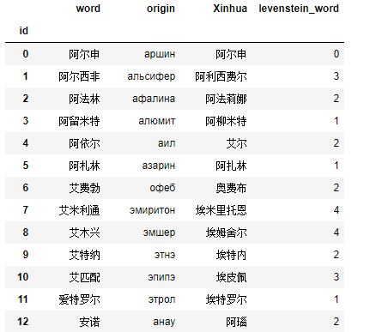
Algorithm Application: Part 1
Dataset:
Chinese dictionary occurrence
Russian analogue
Xinhua-generated transliteration of the Russian word
Levenstein distance between the dictionary and Xinhua words

Slide 61
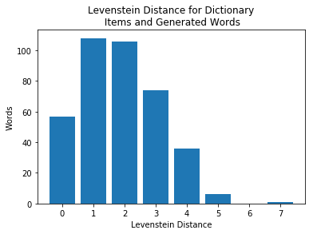
Algorithm Application: Part II
Character diversity in dictionary items | 319
Character diversity of Xinhua-based transliterations | 168
Explanation: there is a bigger variance of the Chinese characters in the dictionary, and the problem is in multiple choice of a character based on one phonetic reading:
“li”: 利 (Xinhua) 利, 里, 理, 立, 列 (dictionary)

