Slide 1
ICT 1101: Basic Computing
Lecture 04
Basic Concepts of I.T
Mr.Miiro Joseph
(BSc,CCNA)
Department of Computing & Technology
Faculty of Engineering, Design & Technology
January 2024

Slide 2
Lecture Overview
Subtopic 1: Computer Generations
Subtopic 2: Emerging Technologies
Subtopic 3: Security
Subtopic 4: Health and safety precautions
Subtopic 5:

Slide 3
Computer Generations
The change in technology that a computer has gone through from when it was first invented to date.

Slide 4
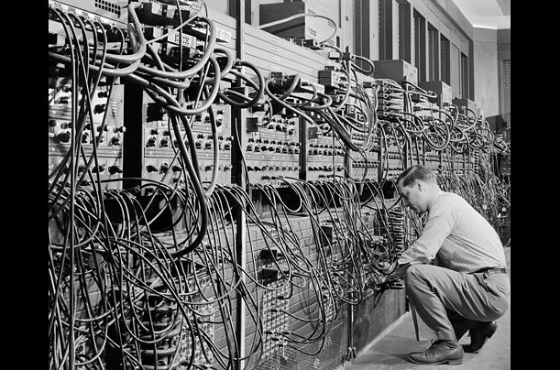
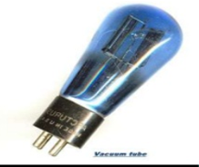
Computer Generations
First Generation
Used vacuum tube technology.
Used punch cards
Examples include ENIAC

Slide 5
Computer Generations
Characteristics
Huge in size- occupied entire room
Supported machine language only
Generated a lot of heat
Very expensive, unreliable etc..

Slide 6
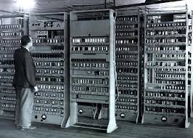
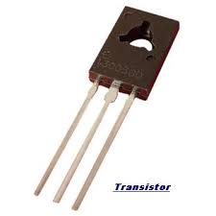
Computer Generations
Second Generation
Main technology was transistors.
smaller in size than first generation
Computers.

Slide 7
Computer Generations
Characteristics of second generation
Faster than first generation computers.
Consumed less electricity than first generation computers.
More reliable than first Generation computers.
Still very costly.

Slide 8
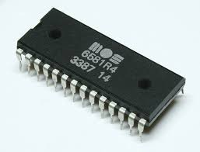
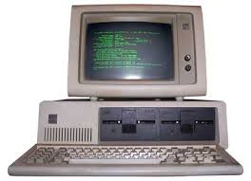
Computer Generations
Third Generation
Integrated circuits technology.
More reliable
Smaller in size

Slide 9
Computer Generations
Third Generation characteristics
Produced less heat.
Consumed less electricity
Still costly. Etc..

Slide 10
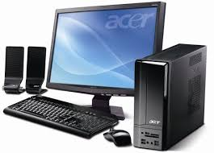
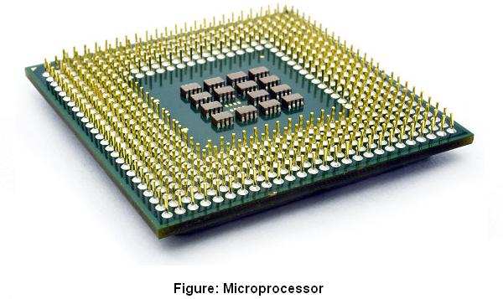
Computer Generations
Fourth Generation
Used Very Large Scale Integrated Circuits(VLSI).
PC revolution
Networks and Internet

Slide 11
Computer Generations
Fourth Generation characteristics
Portable.
Cheap.
Small in size
Available to general population

Slide 12
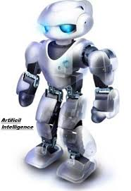
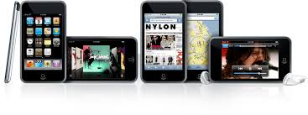
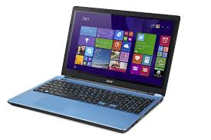
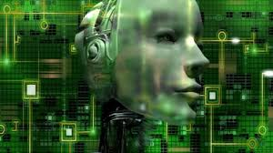
Computer Generations
Fifth Generation
Ultra Large Scale Integrated Circuits (ULSI).

Slide 13
Computer Generations
Fifth Generation characteristics
Support artificial intelligence- Ability to perform tasks that normally require human intelligence, e.g. visual perception, speech recognition, decision-making, and translation between languages.

Slide 14
Computer Generations
Fifth Generation characteristics
Recognise images and graphs.
Can work with natural language.
Will support parallel processing- more than 1 CPU
Aimed at solving highly complex problems, e.g decision making etc..

Slide 15
The Next Class
Emerging technologies in your field of study
Threats to data security and measures to counter them.
Health and safety precautions when using the computer.

Slide 16
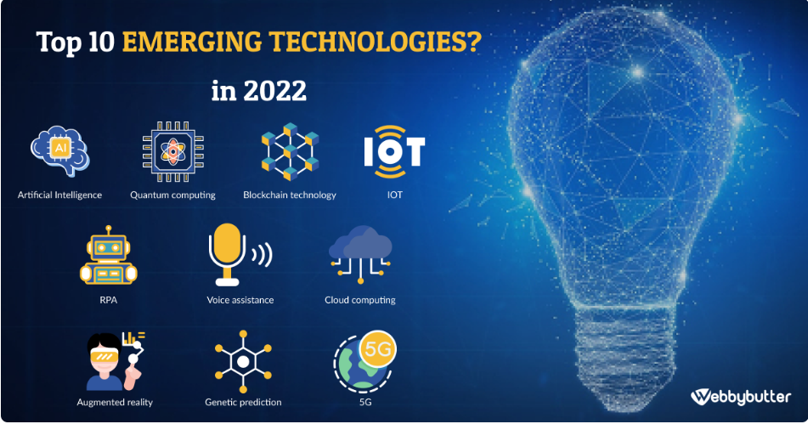
Emerging Technologies

Slide 17
Security
Security involves
Prevention of theft or damage to the hardware.
Prevention theft of or damage to the data/ information.
To prevent disruption of service.
Physical security, Password management, Access control

Slide 18
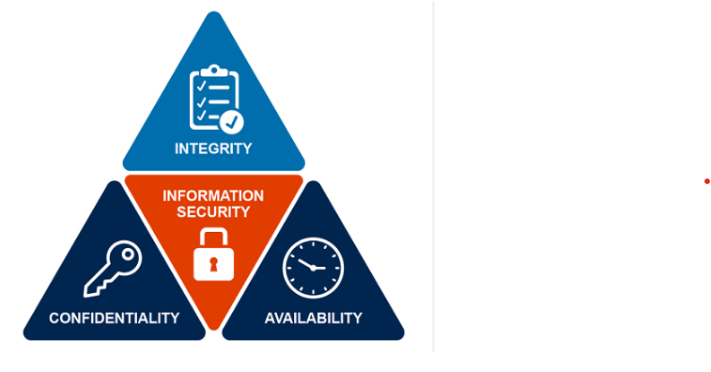
Security
CIA Triad

Slide 19
Threats to data security
Threat
Anything that can has potential to cause harm or loss. It can be an object, person, or other entity that posses / represents constant danger to your assets.

Slide 20
Threats to data security
Threats
Solutions
Malware (virus, Adware, spyware, ransomware, Trojan horses, etc…)
Unauthorized users
Install and update anti-malware e.g. anti-virus, use port locker software.
Strong passwords, encrypt documents.

Slide 21
Threats to data security
Threat
Solution
Hackers
Thieves
Firewall, Intrusion prevention and detection systems.
Burglar proof, alarms, security guards etc..

Slide 22
Threats to data security
Threat
Solution
Power issues
Natural disasters ( fire outbreak, earth quakes, floods etc.)
Save your work always, UPS.
Smoke detectors, fire extinguishers, etc…

Slide 23

Threats to data security
Threat
Ultimate Solution
The threats are increasing each day and hard to keep track of.
What do we
do then???
The ultimate solution for any threat is to have a BACKUP of the data offsite/remotely.

Slide 24
Reading Assignment for Next Class
Health and safety precautions for the user and computer.
Graphical user Interface
Computer Networks

