Slide 1
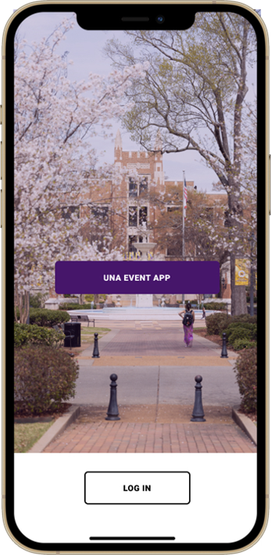
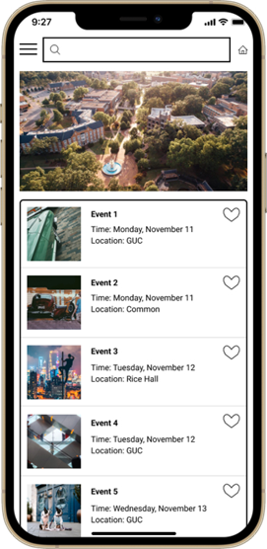
UNA Events App Prototype
Thuan Nguyen
Nhu Tran
Tuyet Nguyen
Professor Ronald Davis
April 18, 2025

Slide 2
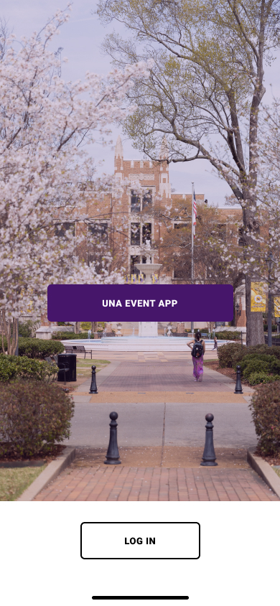
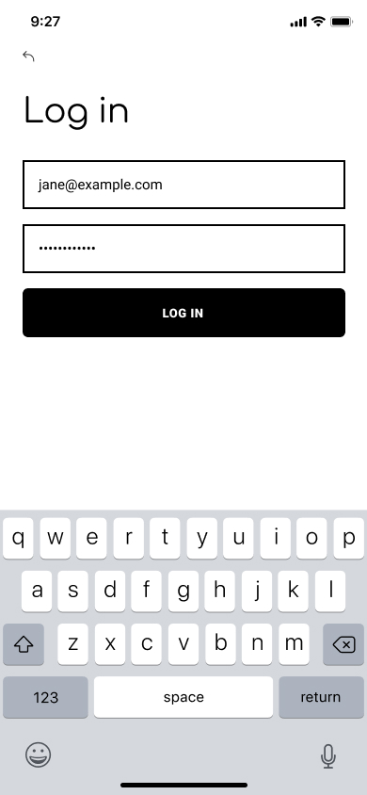
Login Screen
The mobile app connects to the UNA website, enabling UNA students to log in with their credentials and view upcoming campus events. Access is restricted to authorized users only, ensuring a secure experience.

Slide 3
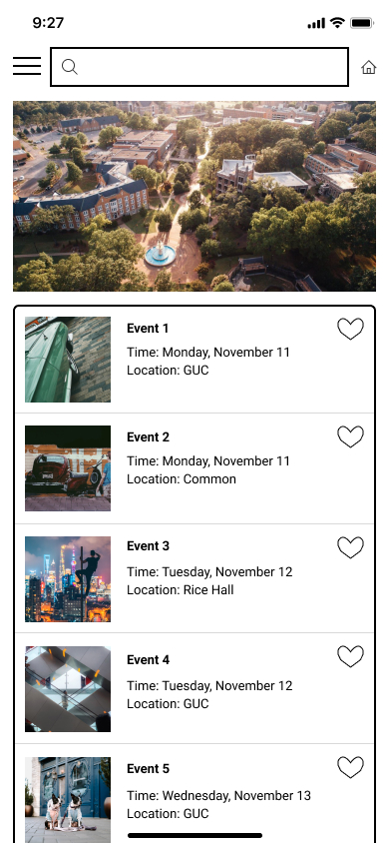
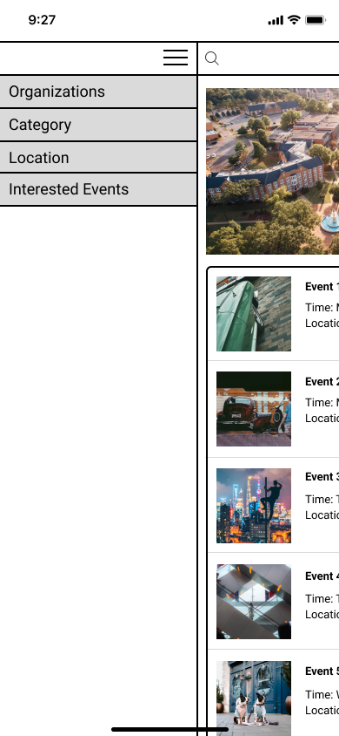
Main Menu Screen
The main menu serves as the central hub for all app users, offering navigation to various screens. The home screen displays all upcoming events, while a drop-down button in the top left enables further exploration, including options to filter by organizations and locations.

Slide 4
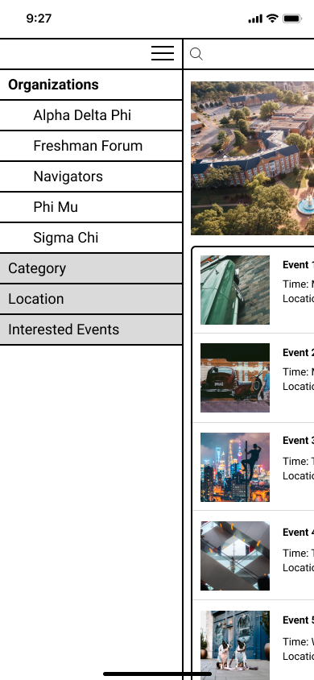
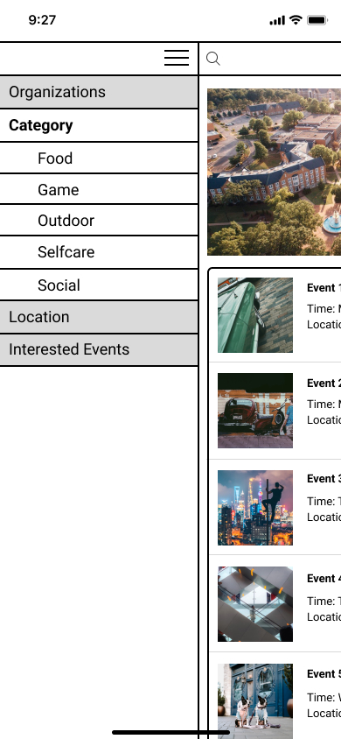
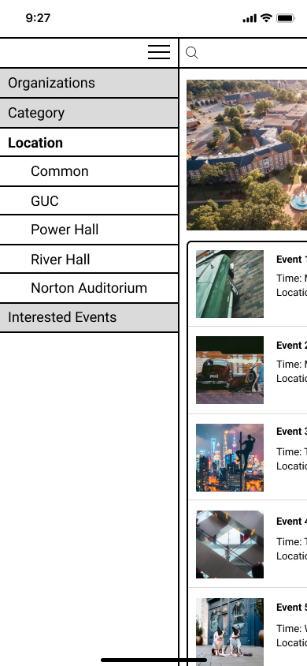
The Drop-Down Button Screen
On the home screen, a drop-down button in the top left corner triggers a side menu when tapped. This menu displays four clickable buttons: Organizations, Category, Location, and Interested Events. Selecting either the Organizations or Category buttons reveals additional sub-options for further navigation.
.

Slide 5
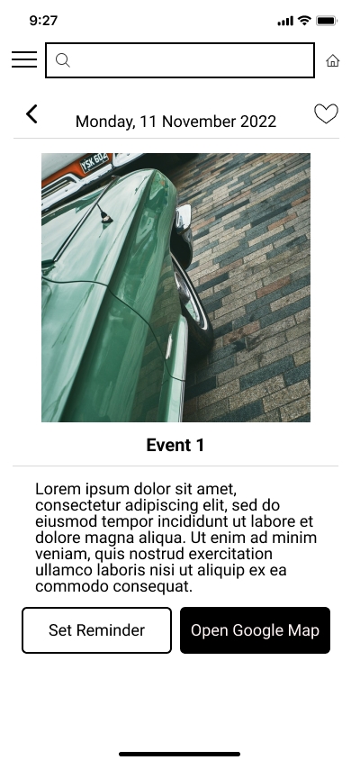
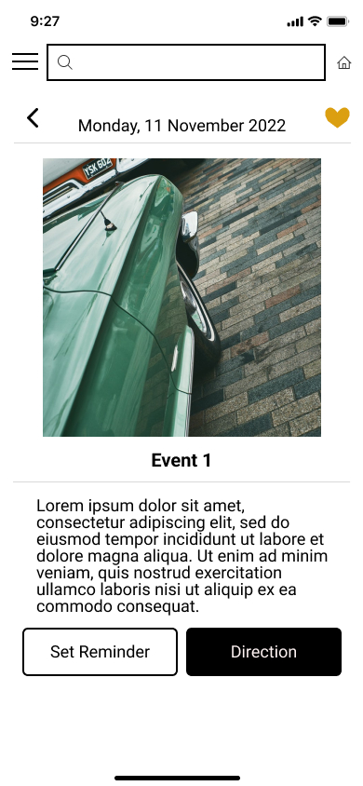
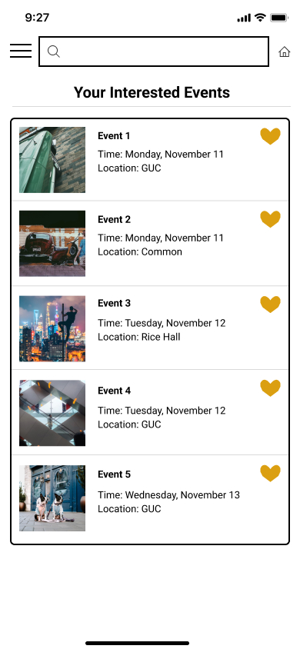
Interested Event
Users can set event reminders that automatically sync with their phone calendar to keep track of upcoming event dates. Additionally, they can use the "map" feature to get directions and navigate to event venues.

Slide 6
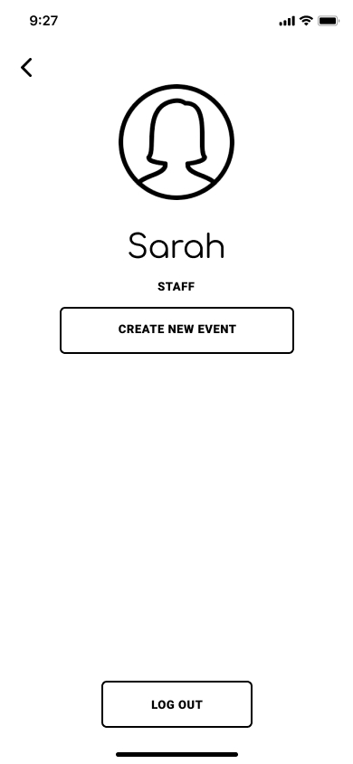
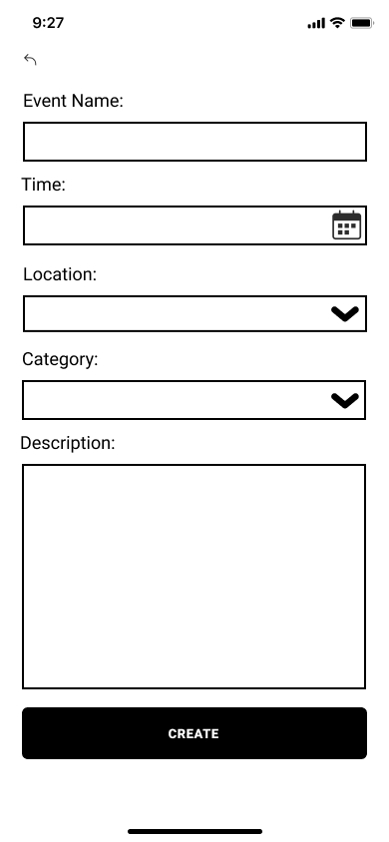
Create Event
Users can create new events in the app, including details like a description, location, and time for each event. An admin must then approve or reject the event request before it is published on the app.

Slide 7
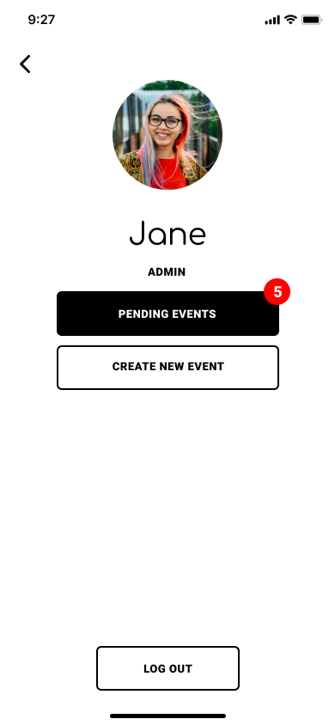
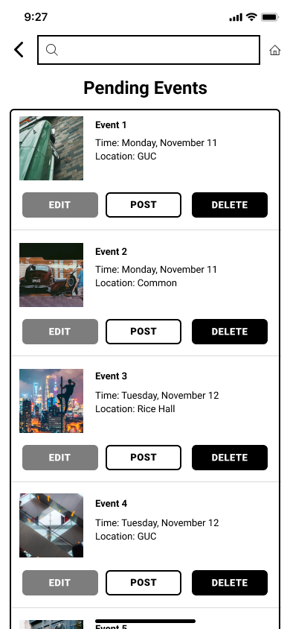
Admin
This page is exclusively for staff with permission to approve proposed events. To handle errors, it includes two buttons: one for canceling duplicate events and another for approving or denying upcoming events.

Slide 8
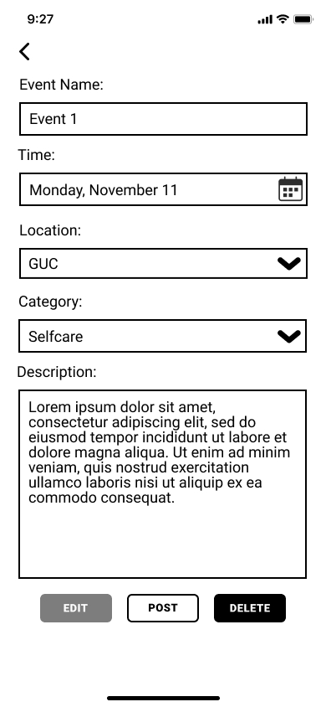
Admin Event Edit
Select users with admin privileges can access the edit event function, which enables them to modify specific details of an event, such as updating the date, location, and other information as needed.

Slide 9
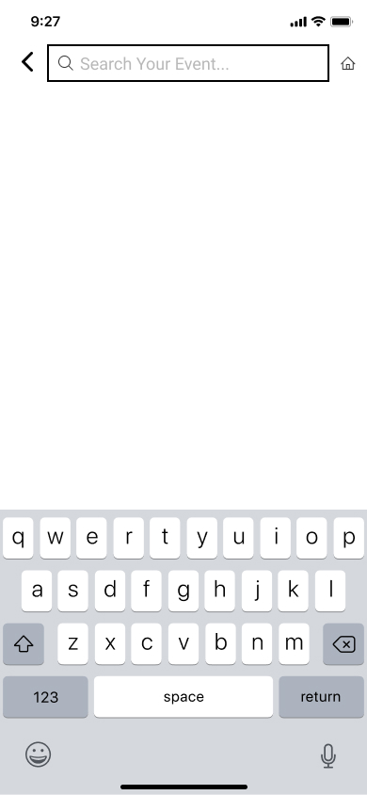
Event Search
The event search allows for the user to search specific events. Events can be filtered by date or location. It also gives users the ability to save events of interest; saved events can easily be viewed or added to event reminders.

Slide 10
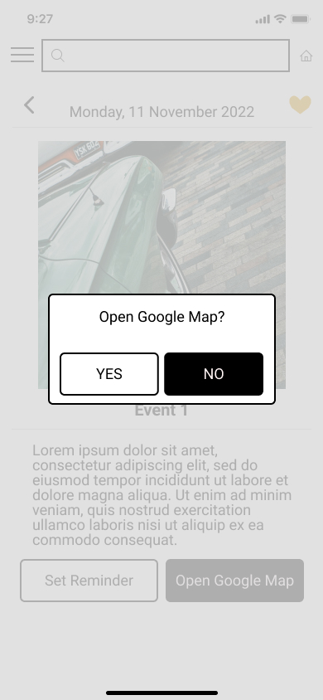

Reminders and Map Function
The user can set event reminders that auto save to their phone calendar to save the date of upcoming events. The user also can utilize the "map" function to access directions and navigate to event locations.

